Slide 1
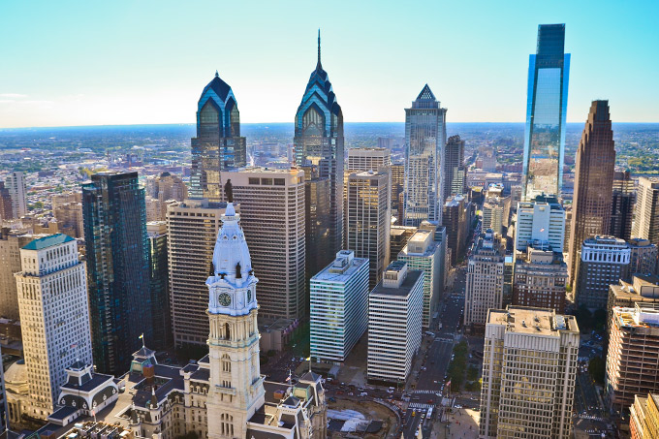

The City of Philadelphia
2026 Investors Conference
General Obligation and Other Tax Backed Credits
May 13, 2026

Slide 2
Disclaimer
This Presentation is provided as of May 13, 2026, in connection with the City of Philadelphia (the “City”) Investors Conference. If you are viewing this presentation after May 13, 2026, there may have been events that occurred subsequent to such date that could have a material adverse effect on the information, financial or otherwise, that is presented herein. The City has not undertaken any obligation to update this Presentation beyond the aforementioned date thereof. Financial data, including revenues, expenditures, demographic statistics, debt service and other information provided herein are not warranted as to completeness or accuracy and are subject to change without notice.
This Presentation is provided for your information and convenience only. If and to the extent the City issues bonds after the date of this Presentation, any investment decisions regarding such bonds should only be made after a careful review of the complete Preliminary Official Statement prepared in connection therewith. You agree not to duplicate, copy, download, screen capture, electronically store or record this Presentation, nor to produce, publish or distribute this Presentation in any form whatsoever.
This Presentation does not constitute a recommendation or an offer or solicitation for the purchase or sale of any security or other financial instrument, including any planned issuance of bonds by the City, or to adopt any investment strategy as it relates to any planned issuance of bonds by the City or any outstanding debt of the City. Any offer or solicitation with respect to future bonds will be made solely by means of the Preliminary Official Statement, which shall describe the actual terms of such bonds.
In no event shall the City be liable for any use by any party of, for any decision made or action taken by any party in reliance upon, or for any inaccuracies or errors in, or omissions from, the information contained herein and such information may not be relied upon by you in evaluating the merits of participating in any transaction relating to bonds issued by, or on behalf of, the City. The City makes no representations as to the legal, tax, credit or accounting treatment of any transactions relating to bonds issued by, or on behalf of, the City, or any other effects such transactions may have on you and your affiliates or any other parties to such transactions and their respective affiliates.
You should consult with your own advisors as to such matters and the consequences of the purchase and ownership of any bonds. To the extent any underwriter or financial advisor has participated in the preparation of this Presentation, they shall not be liable for any misinformation or misstatements contained herein, unless the information is explicitly sourced to such entity. Furthermore, no underwriter or financial advisor that has participated in the preparation of this Presentation has undertaken any obligation to update this Presentation beyond the aforementioned date thereof nor have, or will, they take any steps to verify the completeness or accuracy of the information contained herein.
Past performance is not indicative of future results, which will vary. This Presentation contains information on proposed budgets and financial plans as well as estimated financial results for current fiscal year. Information that is shown as “Estimated” or “Proposed” is subject to change in its entirety and subsequent proposals or final versions may deviate materially from the proposed information contained herein. There is no assurance that estimated financial results will be realized and actual financial results may differ, perhaps materially, from the estimates contained herein. By providing such information in this Presentation, the City has not undertaken any obligation to update such information or to update any changes in the events, circumstances or conditions on which such information is based.

Slide 3
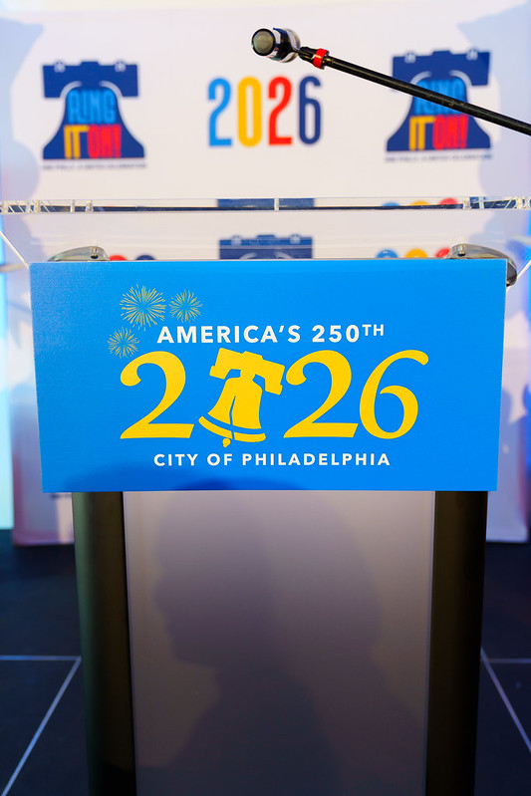
Presenters:
Rob Dubow
Director of Finance
Sabrina Maynard
Budget Director
Jackie Dunn
City Treasurer

Slide 4
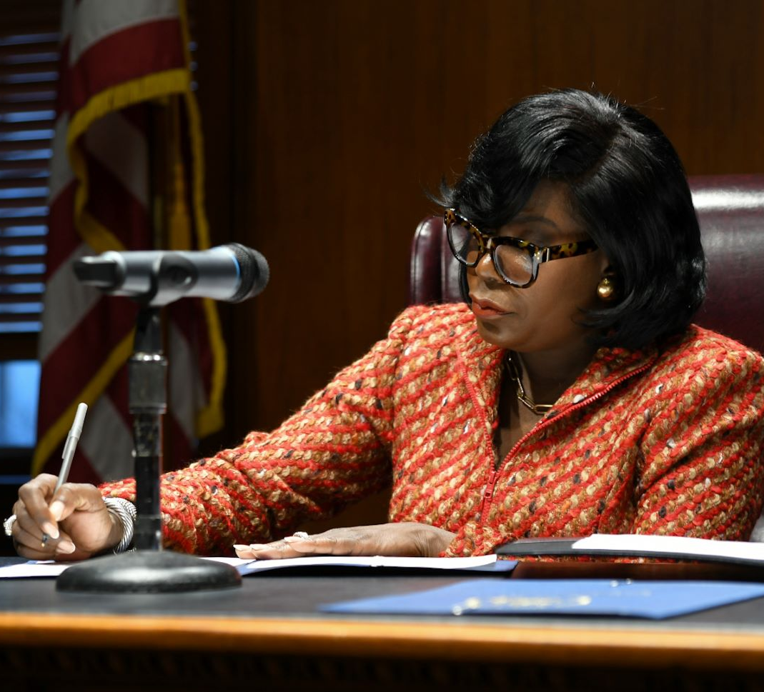
The Parker Administration
Make Philadelphia the Safest, Cleanest, Greenest big city in America with access to Economic Opportunity for all.
Build mutual trust and safety in our neighborhoods through model of community policing
Improve quality of life across city by making all neighborhoods cleaner, greener, and more vibrant
Unlock access to economic opportunity for all and position Philadelphia as a more attractive and equitable place to do business
Increase access to housing for both renters and homeowners to ensure vibrant and equitable communities and help build intergenerational wealth
Innovate to provide world-class education for Philadelphia students of all ages and socioeconomic backgrounds
Continued focus on the City’s long-term fiscal health through strong financial management and planning, building reserves, and investments in reducing pension liability

Slide 5
Philadelphia Credit Highlights

Slide 6
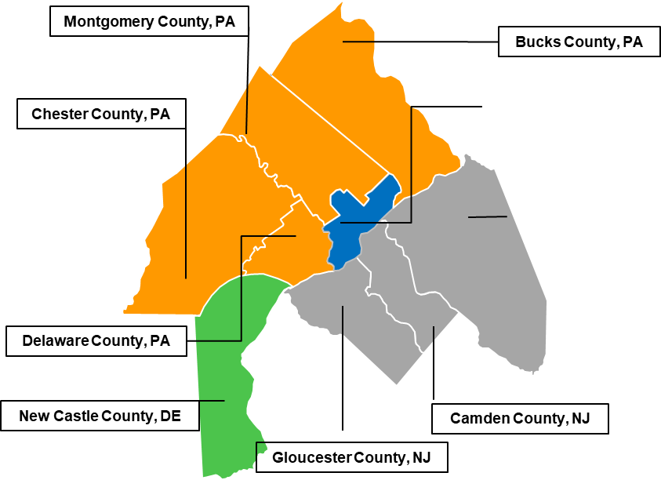
The City is the Center of a Major Regional Economy
The Philadelphia Metropolitan Statistical Area is the eleven-county area, representing an area of over 5,100 square miles with approximately 6.3 million residents
Strategically located within a day’s drive of 50% of the U.S. population, Philadelphia offers direct access to key regional and international markets
Non-residents from all over the region work in Philadelphia
Non-resident workers are subject to the City’s Wage Tax
The non-resident portion of the Wage Tax comprised approximately 13.5% of all General Fund revenue in FY25

Slide 7
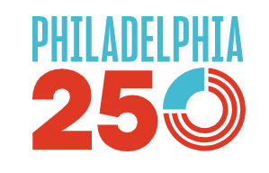
Growing Economy & Strategic Location
Several Fortune 500 companies have a major presence in the city such as Comcast, Aramark, and Crown Holdings
Hosting major events such as America’s 250th birthday Semi Quincentennial, FIFA World Cup 2026 games, and the MLB Allstar Game
Diverse, knowledge-based economy with virtually all classes of industrial and commercial business represented
6 higher education institutions, more than 30 hospitals, 5 medical schools, 2 dental schools, and 2 pharmacy schools
Nation’s largest concentration of healthcare resources within a 100-mile radius
6th largest city in US by population
4th largest MSA - East Coast
3rd lowest cost of living in NE ¹
From 2015 to 2024, Philadelphia gained 101,800 private sector jobs, representing a growth of 17.5%
Philadelphia’s key wealth metrics continue to improve, with growth of median household income growing by 50.4% between 2015 and 2024, exceeding the nationwide average
Wage, Property, Business Income and Receipts, and Real Property Transfer taxes provide diversity to the City’s tax revenues
Philadelphia is experiencing a revival of construction, with over $9.6bn in real estate investments made or expected to occur between 2025 and 2031.
7
¹ Only includes cities with populations over 250,000 in the northeast region which includes D.C. and Maryland
Sources: U.S. Census Bureau, American Community Survey, Bureau of Labor Statistics, Center City District & Central Philadelphia Development Corporation, Philadelphia Department of Planning and Development, and Numbeo.com 2025

Slide 8
City Growth and Resiliency
Population: City, MSA, Pennsylvania & Nation (000s)¹
Private Sector Job Growth, 2015-2024 (000s)²
 | 2000 | 2010 | 2020 | 2024 | % Change 2000-2010 | % Change 2010-2024
Philadelphia | 1,518 | 1,505 | 1,582 | 1,580 | -0.86% | 4.98%
Region | 5,687 | 5,912 | 6,092 | 6,272 | 3.96% | 6.09%
Pennsylvania | 12,281 | 12,613 | 12,795 | 13,019 | 2.70% | 3.22%
United States | 281,422 | 303,965 | 326,569 | 334,922 | 8.01% | 10.18%
Total employment in the City continues to grow, with private sector job growth of 17.5% since 2015
Median Household Income: 2015-2024 ($000s)³
Between 2015 and 2024, Philadelphia’s median household income rose 63.2%, exceeding the national growth rate of 50.0% Median household income as percentage of national median household income has grown to approximately 77% in 2024, up from approximately 70% in 2015
U.S. Census Bureau. "ACS Demographic and Housing Estimates." American Community Survey, ACS 5-Year Estimates
Bureau of Labor Statistics, 2024 (annual average totals may not sum due to rounding)
U.S. Census Bureau, “Income in the Past 12 Months”, American Community Survey, ACS 5-Year Estimates (includes unrelated people living together)

Slide 9
Financial Management and Budget Updates

Slide 10
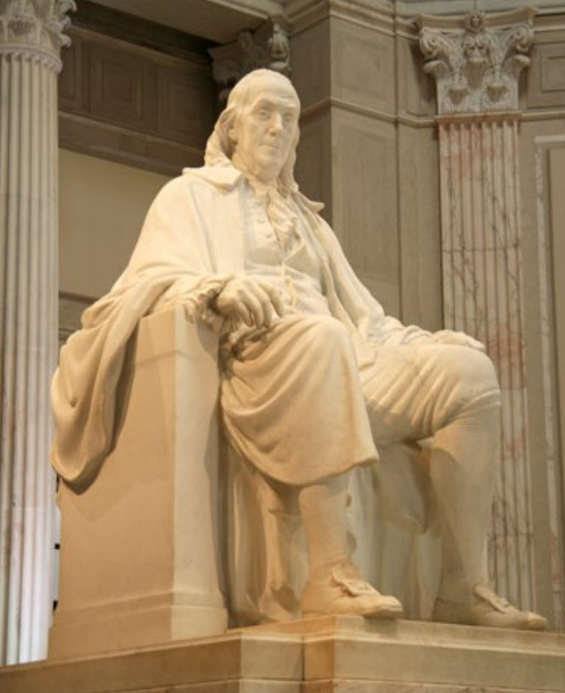
Consistent and Conservative Financial Management
The City’s financial management has been rooted in adhering to best practices, responsible budgeting and long-term planning, efficient operation and a focus on building reserves
Conservative forecasting - actual results consistently outperform budget projections
  In addition to statutory Budget Stabilization Reserve, the City has multiple discretionary reserve line items including Labor and Federal Funding Reserves
Managing pension liability to gradually reduce the risk profile of the plan
  Annual pension contributions in excess of statutorily required amounts since 2014
  Legislatively dedicating a portion of sales tax revenue to the pension fund
  Development of the Revenue Recognition Policy (RRP)
  Projected by actuary to be fully funded by 2033
City provides 5 years of post-retirement health coverage for retirees and budgets for those OPEB costs in the Five-Year Plan on pay-go basis
Pennsylvania Intergovernmental Cooperation Authority (PICA) oversight and reporting requirements extended through at least 2047

Slide 11
FY 25 Audited General Fund Balance: $1.179B
The City’s FY25 audited General Fund balance is $1.179 billion (18.1% of General Fund revenues).
  FY25 audited fund balance is $265 million higher than the estimate in the PICA-approved FY26-30 Five Year Plan
  Including the Budget Stabilization Reserve balance, the City had $1.358 billion in FY25 reserves
Reasons for Fund Balance Improvement:
$91 million of the overall $95 million internal Federal Funding Reserve remains unspent
Underspends due to hiring challenges or delays: $169 million
Tax Revenue Outperformance: $88 million in higher collections in Business Income and Receipts Tax (BIRT), Net Profits Tax (NPT), and Realty Transfer Tax (RTT) relative to projections
Areas for Monitoring:
Uncertainty related to federal policy and potential threats to federal grant dollars
Impacts of macroeconomic uncertainty on our City’s tax base
Negotiation/arbitration process with three labor unions with open contracts (Fire, Correctional Officers, Deputy Sheriffs)
FY26 is the first full fiscal year without American Rescue Plan Act (ARPA) support

Slide 12
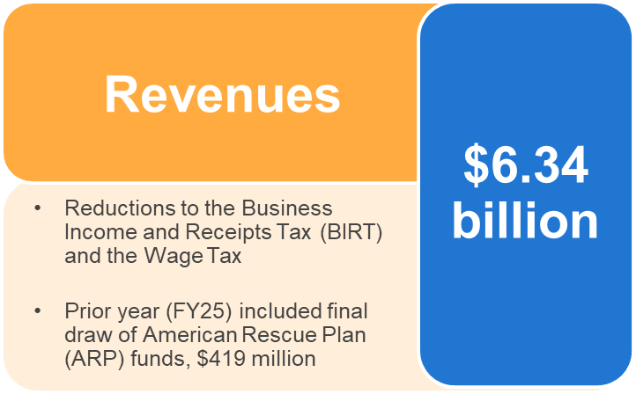
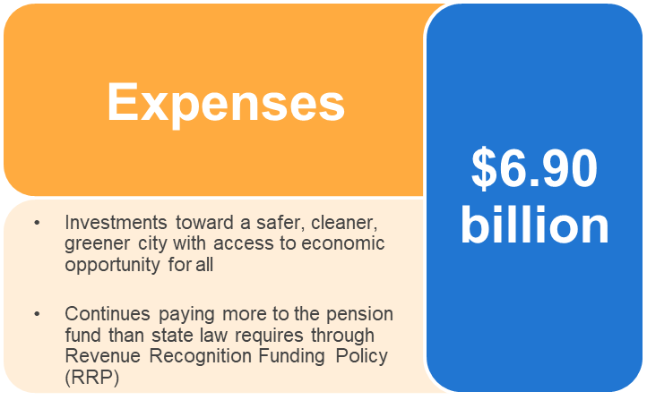
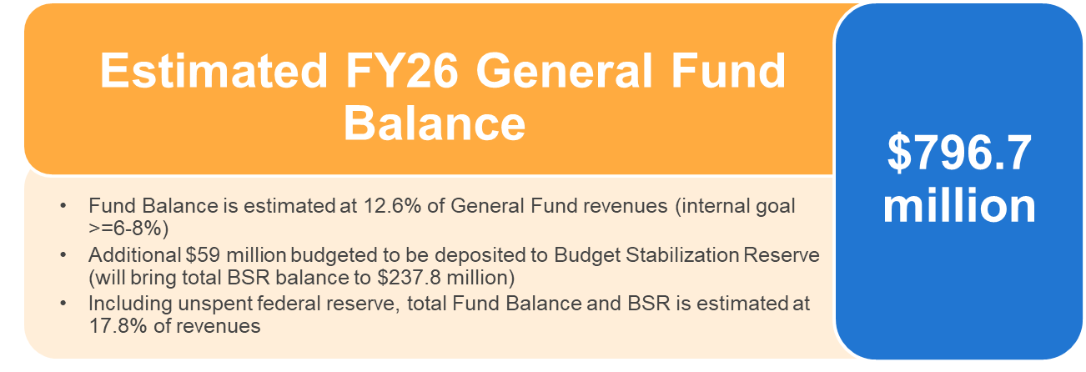
FY 26 – Estimated General Fund Balance
Source: City of Philadelphia FY27-FY31 Proposed Five Year Plan.

Slide 13
General Fund Revenues – FY25 Actual, FY26 Estimate, FY27 Proposed
FY26 revenues are estimated to have decreased by 2.7% relative to the FY25 actual, primarily due to the end of the American Rescue Plan Act funds in 2024.
FY27 revenues are projected to increase by 3.0% relative to FY26 estimates, primarily due to growth in the Wage, Sales, and Realty Transfer Taxes.
Revenues (Millions) | FY25 Actual | FY26 Estimate | FY27 Budget | FY26 Estimate vs. FY25 Actual | % Change | FY27 Budget vs. FY26 Estimate | % Change
Wage, Earnings, & Net Profits Tax | $1,994.5 | $2,086.9 | $2,178.8 | $92.4 | 4.6% | $91.9 | 4.4%
Real Property Taxes | $903.2 | $936.1 | $981.7 | $32.9 | 3.6% | $45.6 | 4.9%
Business Income & Receipts Tax (“BIRT”) | $752.0 | $779.3 | $806.4 | $27.3 | 3.6% | $27.1 | 3.5%
Real Property Transfer Tax | $331.5 | $334.1 | $353.6 | $2.6 | 0.8% | $19.5 | 5.8%
Sales Tax | $311.3 | $323.2 | $342.0 | $11.9 | 3.8% | $18.8 | 5.8%
Beverage | $68.2 | $71.0 | $69.4 | $2.8 | 4.1% | ($1.6) | -2.3%
Other Taxes | $51.9 | $54.0 | $55.5 | $2.1 | 4.0% | $1.5 | 2.8%
Total Taxes | $4,412.6 | $4,584.6 | $4,787.4 | $172.0 | 3.9% | $202.8 | 4.4%
Locally Generated Non-Tax Revenue | $466.5 | $473.3 | $394.9 | $6.8 | 1.5% | ($78.4) | -16.6%
Revenue from Other Governments | $389.3 | $438.3 | $480.9 | $49.0 | 12.6% | $42.6 | 9.7%
PICA City Account | $761.1 | $762.7 | $796.9 | $1.6 | 0.2% | $34.2 | 4.5%
Revenue from Other Funds of City* | $488.0 | $79.8 | $66.2 | ($408.2) | -83.6% | ($13.6) | -17.0%
Total Revenue | $6,517.5 | $6,338.7 | $6,526.2 | ($178.8) | -2.7% | $187.6 | 3.0%
*The American Rescue Plan funds are included in Revenue from Other Funds of City. Original ARP funds were fully expended in FY25 as required.
Source: City of Philadelphia FY27-FY31 Proposed Five Year Plan. Totals may not add due to rounding.

Slide 14
Key Tax Revenue Trends
Wage and Earnings Tax
Business Income and Receipts Tax
Sales and Use Tax
Wage and Earnings Tax collections for FY23, FY24, and FY25*, exceed the amounts collected in FY22
BIRT projected to generate approximately 17.0% of the City’s local tax revenue in FY26*
The City’s Sales and Use Tax collections in FY25* increased 12% over FY22
Real Property Tax
Real Property Transfer Tax
Philadelphia Beverage Tax
While the tax rate has remained constant and total collections have increased due to increased assessed values of taxable property, the City has allocated more revenue to the School District, resulting in reduced revenue to the City
While collections have decreased since FY22, FY25 revenues were $332 million*, 25% above FY24's amount
The Philadelphia Beverage Tax taxes the distribution of certain beverages at 1.5 cents per ounce and is deposited into the General Fund
*Sources: For Fiscal Years 2022-2025, the City’s ACFRs for such Fiscal Years. For Fiscal Year 2026, the Fiscal Year 2026 Adopted Budget and the FY 2026 Second Quarter QCMR, as applicable

Slide 15
Key Tax Revenue Trends (000s)
Wage Tax
Real Estate Tax
Business, Income & Receipts Tax
Realty Transfer Tax

Slide 16
City of Philadelphia
New Revenue Proposals to Support Investments
Investment(s) | Tax/Fee | Proposed Change(s)
Support the addition of 1,000 new permanent shelter beds with wrap around services to the City's shelter system | Hotel Tax | A 2% increase to the Hotel Tax starting August 2026, generating an additional ~$20M annually. This change requires both State and local authorization. Provides revenue to the Hotel Tax Fund.
Improvements to road conditions across the city | Retail Delivery Tax | The creation of a Retail Delivery Tax of $0.25 per order on the delivery of certain goods within Philadelphia, charged to the retailer, starting July 1, 2027. It excludes food, baby products, drugs & medical devices, and wholesale goods. Revenue from the tax, estimated to be $15M annually, would be directed to the Transportation Fund and requires local authorization. Provides revenue to the Transportation Fund.
Leveling the playing field for local businesses | Sales & Use Tax | Closing a loophole in the Sales & Use Tax by requiring that out-of-city sellers that collect the 6% State Sales Tax also collect the 2% Philadelphia Sales Tax, starting July 1, 2026. This change, which is contingent on State authorization and does not require local legislation, is estimated generate an additional $1.5M annually for the City and the Pension Fund.
Sustaining critical City services funded by fees as the costs of providing those services increases | Various Fees | Increases to certain Zoning Board of Adjustment filing fees and certain air management and asbestos fees, as well as to attorney fees on property tax matters, the commercial trash fee, and the accelerated plan review fee through L+I. Creation of a Certified Mail fee. Requires local legislation.

Slide 17
School District of Philadelphia
New Revenue Proposals to Support Investments
Combined, the proposed changes below would generate an additional $50.4M annually for the School District. These proposals require local authorization.
Investment(s) | Tax/Fee | Proposed Change(s)
School District of Philadelphia | Transportation Network Company Tax | A $1.00 per ride tax on rideshare rides originating in Philadelphia beginning January 1, 2027. This tax is estimated to generate $48M annually, with all revenue dedicated to the School District.
School District of Philadelphia | Use & Occupancy Tax | Modifying the Use & Occupancy Tax for cell towers to calculate liability based on the assessed value of the tower rather than square footage. This change would better align tax liability with the business value generated by cell towers and is estimated to generate an additional $2.4M annually for the School District.

Slide 18
General Fund Expenditures – FY25 Actual, FY26 Estimate, FY27 Proposed
FY27 budgeted obligations are projected to increase by 1.0% relative to the FY26 estimate, primarily due to targeted investments in each of Mayor Parker’s top priority areas, including housing, economic mobility, the City workforce, tax reform, wellness, and significant contributions to the labor reserve
FY26 estimated fund balance is $796.7 million (12.6% of revenues), a decrease of 32.4% relative to the FY25 actual fund balance of $1.2 billion (18.1% of revenues).
The projected FY27 fund balance is approximately $391.6 million (6.0% revenues).
Obligations (Thousands) | FY23 Audited | FY25 Actual | FY26 Estimate | FY27 Budget | FY26 Estimate vs. FY25 Actual | % Change | FY27 Budget vs. FY26 Estimate | % Change
Personal Services | $ 1,975,601 | $ 2,223,350 | $ 2,412,989 | $ 2,462,264 | $ 189,639 | 8.5% | $ 49,275 | 2.0%
Personal Services: Pensions | $ 837,541 | $ 783,897 | $ 734,423 | $ 727,474 | $ (49,474) | -6.3% | $ (6,949) | -0.9%
Personal Services: Pensions (Sales Tax) | $ 92,143 | $ 95,634 | $ 101,585 | $ 110,255 | $ 5,951 | 6.2% | $ 8,670 | 8.5%
Personal Services: Other Employee Benefits | $ 696,257 | $ 746,155 | $ 886,858 | $ 983,439 | $ 140,703 | 18.9% | $ 96,581 | 10.9%
Sub-total: Employee Compensation | $ 3,601,542 | $ 3,849,036 | $ 4,135,855 | $ 4,283,432 | $ 286,819 | 7.5% | $ 147,577 | 3.6%
Purchase of Services | $ 1,207,299 | $ 1,451,834 | $ 1,578,071 | $ 1,647,923 | $ 126,237 | 8.7% | $ 69,852 | 4.4%
Materials, Supplies & Equipment | $ 167,720 | $ 165,463 | $ 170,901 | $ 175,238 | $ 5,438 | 3.3% | $ 4,337 | 2.5%
Contributions, Indemnities, Taxes | $ 480,792 | $ 474,999 | $ 476,983 | $ 432,794 | $ 1,984 | 0.4% | $ (44,189) | -9.3%
Debt Service | $ 190,496 | $ 195,090 | $ 222,495 | $ 241,195 | $ 27,405 | 14.0% | $ 18,700 | 8.4%
Payments to Other Funds | $ 205,404 | $ 123,166 | $ 151,235 | $ 95,436 | $ 28,069 | 22.8% | $ (55,799) | -36.9%
Advances/Misc.: Labor Reserve | $ - | $ - | $ 15,508 | $ 39,309 | $ 15,508 | 0.0% | $ 23,801 | 100.0%
Advances/Misc.: Federal Uncertainty Reserve | $ - | $ - | $ 91,000 | $ - | $ 91,000 | 0.0% | $ (91,000) | -100.0%
Payment to Budget Stabilization Reserve Fund | $ 65,128 | $ 58,291 | $ 58,860 | $ 52,484 | $ 569 | 1.0% | $ (6,376) | -10.8%
Total: Obligations | $ 5,918,381 | $ 6,317,879 | $ 6,900,908 | $ 6,967,811 | $ 583,029 | 9.2% | $ 66,903 | 1.0%
Operating Surplus (Deficit) for the Year | $ (4,821,800) | $ 199,609 | $ (562,194) | $ (441,594) | $ (761,803) | -381.6% | $ 120,600 | -21.5%
Prior Year Fund Balance Available for Appropriation | $ 779,144 | $ 942,900 | $ 1,179,095 | $ 796,703 | $ 236,195 | 25.0% | $ (382,392) | -32.4%
Net Adjustments - Prior Year | $ 73,795 | 36,586 | $ 179,802 | $ 36,500 | $ 143,216 | 391.5% | $ (143,302) | -79.7%
Fund Balance | $ (3,968,861) | $ 1,179,095 | $ 796,703 | $ 391,609 | $ (382,392) | -32.4% | $ (405,094) | -50.8%
Source: City of Philadelphia FY27-FY31 Proposed Five Year Plan. Totals may not add due to rounding.

Slide 19
The City’s Commitment to Building Reserves
The City has built reserves to help withstand economic volatility and uncertainty at the federal level
Combined fund balance plus reserves exceed the City’s minimum target of 6% of revenues in all years of the Proposed FY27-31 Five-Year Plan
Notes: Balance estimates assume the Federal Funding Reserve goes unspent in FY26. Balances do not include unspent funds allocated to the Labor Reserve for future labor costs over the proposed FY27-FY31 Five-Year Plan (those are already reflected as an expenditure).
Source: City of Philadelphia FY27-FY31 Proposed Five Year Plan. BSR balance also reflects interest earnings through June 30, 2025.

Slide 20
Historical General Fund Balances & Reserves Consistently Meet City Targets
The City has consistently maintained combined Fund Balances within or above its 6-8% policy.
Even in the ultimate “stress-test” years of 2020 and 2021, combined Fund Balances and reserves remained within the City’s target due to conservative management.
Notes: Post FY21, fund balances do not include ARP funds remaining in Grants Fund and only reflect ARP funds once drawn.
Sources: City of Philadelphia Annual Comprehensive Financial Reports FY19-FY25

Slide 21
Update on Current Matters

Slide 22
Status of Labor Agreements
As of February 2026, the City had approximately 24,700 unionized employees representing approximately 81% of the City’s workforce
In July 2025, the City reached new three-year contracts with DC33 and DC47. Combined, the cost of those agreements is $195 million across the FY 26-30 Five Year Plan
In August 2025, the FOP received an arbitration award for a two-year term with a total cost of $343 million over the FY 26-30 Five Year Plan
The City’s FY 27-31 Five-Year Plan has approximately $615.7 million in labor reserves, its largest labor reserve ever, set aside through FY31 to offset costs of future labor agreements, including contracts and awards. The combined $537 million cost for the FOP award and DC33 and DC47 agreements was funded by this reserve.
Previous agreements included significant reforms to improve the health of the City’s Pension Fund which remain in place.
Employee Breakdown
Employee Group | Count | Contract Term
Fraternal Order of Police (FOP Lodge 5) | 5,469 | 7/1/25-6/30/27
Deputy Sheriffs and Register of Wills (Lodge 5) | 322 | 7/1/24-6/30/25*
International Association of Fire Fighters (IAFF Local 22) | 2,831 | 7/1/24-6/30/25*
AFSCME District Council 33 | 9,068 | 7/1/25-6/30/28
Correctional Officers (Local 159 | 1,741 | 7/1/24-6/30/25*
AFSCME District Council 47 | 4,198 | 7/1/25-6/30/28
Local 810 (District Council 47 Court Employees) | 410 | 7/1/25-6/30/28
Steelworkers Local 286 | 697 | 7/1/25-6/30/28
Non-Represented | 1,294 | -
Exempt | 4,921 | -
Total Employees | 30,951
* Contract term has ended. The parties are engaging in the interest arbitration process to arrive at new contracts.

Slide 23
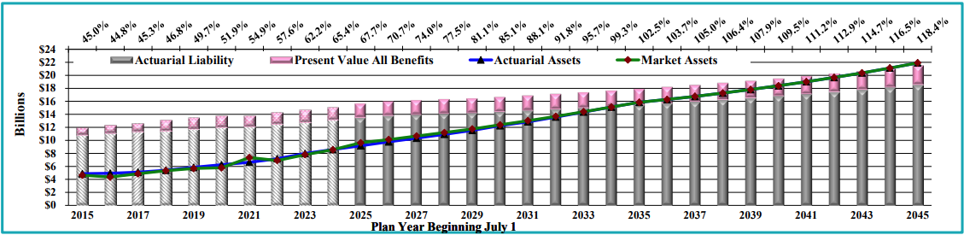
Continued Pension Funding Progress
The City’s municipal Pension Fund is 67.7% funded on an actuarial basis (July 1, 2025 valuation), the highest in more than two decades. The plan was 44.8% funded in 2016 (+22.9%).
The Municipal Pension Board voted to reduce the assumed rate of return from 7.25% to 7.20% effective July 1, 2026 to continue gradually reducing the plan’s risk profile.
The City’s adopted budget for FY26 and the proposed FY 27-31 Five-Year Plan continue to budget the amount dictated by the RRP, which means the City pays more than the statutorily required contribution to pay down the unfunded liability faster.
The City has made annual pension contributions in excess of statutorily required amounts each year since 2014.
Source: July 1, 2025 Actuarial Valuation

Slide 24
Maintaining a Conservative Debt Profile
The City has a conservative debt profile with approximately 67% of principal amortizing within 10-years and limited exposure to variable rate debt
City General Obligation and General Fund Supported Debt Service (as of 4/30/2026)
Note: FY26 debt service includes full year totals.

Slide 25
Philadelphia’s Positive Credit Momentum
Demonstrated track record of conservative financial management
Revenues rebounded to above pre-pandemic levels
Conservative debt portfolio
Continued progress on improving the long-term health of the pension fund to a 100% funded level within a decade
Investments in job growth through long-term reform of tax structure and introduction of PHLPRIME to ease doing business in Philadelphia
Continued investments in energy efficiency and increased investments in affordable housing
Adept and experienced management, with continued PICA oversight through at least 2047

Slide 26
Upcoming Transactions*
Timing* | Borrowing | Estimated Size*
June 2026 | Philadelphia Redevelopment Authority – City Service Agreement (Neighborhood Preservation Initiative, Social) | $50 million
June 2026 | Philadelphia Energy Authority – City Service Agreement (Quadplex Guaranteed Energy Savings Agreement, Green) | $30 million
Summer 2026 | Philadelphia Municipal Authority - City Service Agreement (400 N Broad) | $200 million
Fall 2026 | Gas Works Revenue Refunding Bonds | $135 million
Fall 2026 | Water and Wastewater Revenue Bonds | $400 million
*Preliminary and subject to change

Slide 27
Visit the City’s Investor Website at www.phila.gov/investor

Slide 28
City of Philadelphia
2026 Investors Conference

