Slide 1
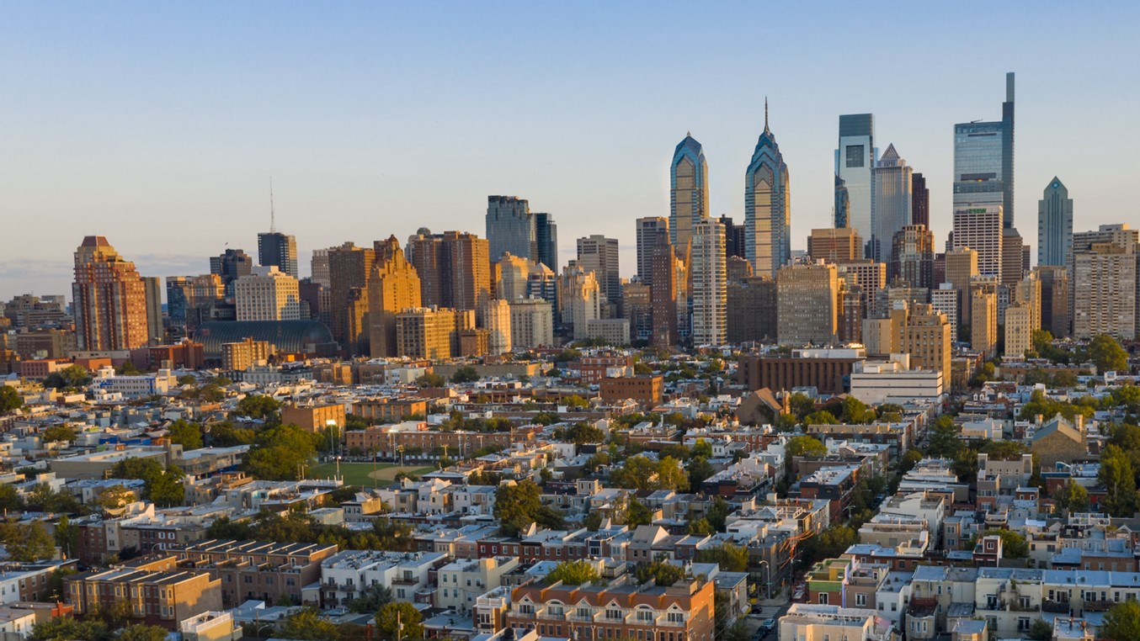

City of Philadelphia Water and Wastewater System
2026 City of Philadelphia
Investors Conference
May 13, 2026
Presented by:
Benjamin Jewell, Commissioner - Philadelphia Water Department
Lawrence Yangalay, Deputy Commissioner Finance – Philadelphia Water Department

Slide 2
Disclaimer
This Presentation is provided as of May 13, 2026, in connection with the Investor Conference of The City of Philadelphia (the “City”). If you are viewing this Presentation after May 13, 2026, there may have been events that occurred subsequent to such date that could have a material effect on the information, financial or otherwise, that is presented herein. Neither the City nor any related department has undertaken any obligation to update this Presentation beyond the aforementioned date thereof. Financial data, including revenues, expenditures, demographic statistics, debt service and other information provided herein are not warranted as to completeness or accuracy and are subject to change without notice.
This Presentation is provided for your information and convenience only. If and to the extent the City issues bonds or incurs other debt obligations after the date of this Presentation, any investment decisions regarding such bonds or other securities should only be made after a careful review of the complete Preliminary Official Statement prepared in connection therewith. By viewing this Presentation, you agree not to duplicate, copy, download, screen capture, electronically store or record this Presentation, nor to produce, publish or distribute this Presentation in any form whatsoever.
This Presentation is not intended to and should not be used as the basis for making any investment decisions in obligations issued by or for the City.
This Presentation does not constitute a recommendation or an offer or solicitation for the purchase or sale of any security or other financial instrument, including any planned issuance of bonds by, or on behalf of, the City, or to adopt any investment strategy as it relates to any planned issuance of bonds by the City or any related issuer or any outstanding debt thereof. Any offer or solicitation with respect to future bonds will be made solely by means of the Preliminary Official Statement, which shall describe the actual terms of such bonds.
No representation or warranty, express or implied, is provided in relation to the fairness, accuracy, correctness, completeness, or reliability of the information, opinions or conclusions expressed herein. The information contained in this Presentation is provided in summary form and does not purport to be complete.
This Presentation may contain forecasts, projections and estimates that are based on current expectations but are not intended as representations of fact or guarantees of results. If and when included in this Presentations, the words “expects,” “forecasts,” “projects,” “intends,” “anticipates,” “estimates,” and analogous expressions are intended to identify “forward‐looking statements” as defined in the Securities Act of 1933, as amended, and the Securities Exchange Act of 1934, as amended, and any such statements inherently are subject to a variety of risks and uncertainties, which could cause actual results to differ materially from those contemplated in such forward‐looking statements. These forward‐looking statements speak only as of the date set forth above. Nothing in this Presentation should be considered as an express or implied commitment to do or take, or refrain from taking, any action by the City or an admission of any fact or future event. Nothing in this Presentation shall be considered a solicitation, offer to sell, recommendation or advice to any person to participate, pursue or support a particular course of action or transaction, to purchase or sell any security, or to make any investment decision.
In no event shall the City or any related issuer be liable for any use by any party of, for any decision made or action taken by any party in reliance upon, or for any inaccuracies or errors in, or omissions from, the information contained herein and such information may not be relied upon by you in evaluating the merits of participating in any transaction relating to bonds issued by, or on behalf of, the City. The City does not have any representations as to the legal, tax, credit or accounting treatment of any transactions relating to bonds issued by, or on behalf of, the City, or any other effects such transactions may have on you and your affiliates or any other parties to such transactions and their respective affiliates. You should consult with your own advisors as to such matters and the consequences of the purchase and ownership of any bonds.
To the extent any investment bank or financial advisor has participated in the preparation of this Presentation, they will not be liable for any misinformation or misstatements contained herein, unless the information is explicitly sourced to such entity. Furthermore, no investment bank or financial advisor that has participated in the preparation of this Presentation has undertaken any obligation to update this Presentation beyond the aforementioned date thereof nor have, or will, they take any steps to verify the completeness or accuracy of the information contained herein.
Past performance is not indicative of future results, which will vary. This Presentation contains information on proposed budgets and financial plans, as well as estimated financial results for the current fiscal year. Information that is shown as “Estimated” or “Proposed” is subject to change in its entirety and subsequent proposals or final versions may deviate materially from the proposed information contained herein. There is no assurance that estimated financial results will be realized and actual financial results may differ, perhaps materially, from the estimates contained herein. By providing such information in this Presentation, neither the City nor any related department has undertaken any obligation to update such information or to provide updates due to changes in the events, circumstances or conditions on which such information is based.
THIS PRESENTATION IS EXPECTED TO BE MADE AVAILABLE ON THE CITY’S INVESTOR WEBSITE FOLLOWING THE CONFERENCE.
Disclaimer

Slide 3


Water and Wastewater System

Slide 4










Stable and Diverse Customer Base
TOP 10 CUSTOMERS
SYSTEM OVERVIEW
1,550,542
individuals served
505,000 active water accounts
542,000 wastewater accounts
46,000
stormwater only accounts
10 wholesale contracts for wastewater treatment
10 largest customers = 10.4% of total revenue
Source: Philadelphia Water Department

Slide 5
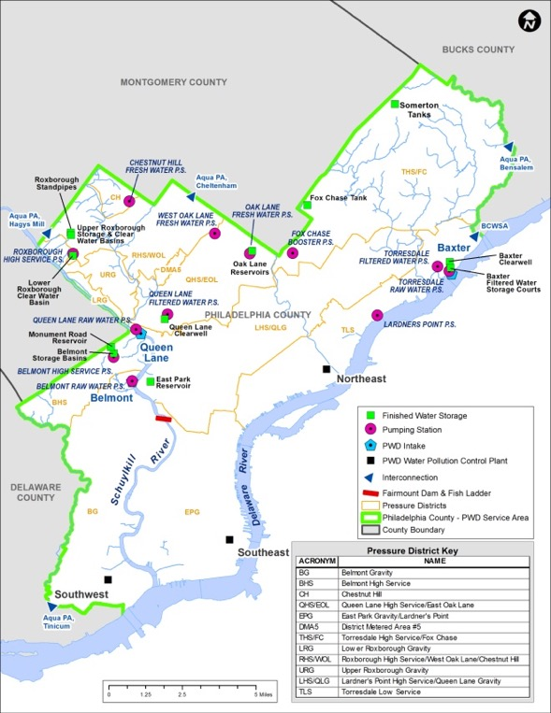
High Quality Capacity for the Service Area
SYSTEM OVERVIEW
WATER SYSTEM
Receives 57% of its water from the Delaware River and the balance from the Schuylkill River
Water treatment is provided by three water treatment plants
  The storage capacity for treated and untreated water in the combined plant and distribution system totals 1,010 million gallons (“MG”)
Serves the City and has one wholesale contract to deliver water to Aqua Pennsylvania
WASTEWATER SYSTEM
Consists of wastewater collection and treatment facilities, including contracted biosolids treatment and disposal
  Three water pollution control plants (“WPCPs”) with a combined dry weather flow design capacity of 522 million gallons daily (“MGD”) and a peak capacity of 1,059 MGD
Serves the City and has 10 wholesale contracts for wastewater treatment
Source: Philadelphia Water Department

Slide 6
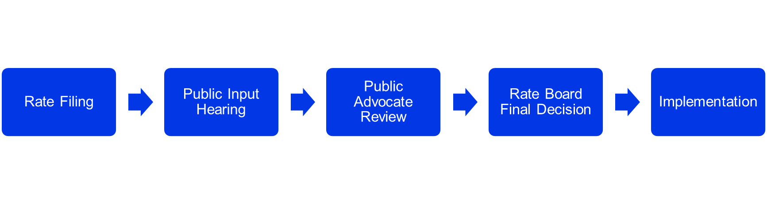
Rate Setting Process
THE RATE BOARD
TIMING
MANAGEMENT
The Department routinely files for revenue adjustments:
        Base Rates: filing every year or every other year, next filing is expected in Q1 2027
  Tiered Assistance Program Surcharge Reconciliation Process: annual filing
  The typical rate process is completed within 6 months
An independent rate-making body known as the Philadelphia Water, Sewer and Stormwater Rate Board is solely responsible for fixing and regulating rates and charges.
        Rate Setting Standards
  Charter Standards
  Rate Ordinance Requirements
  Additional Board supported financial targets
THE PROCESS

Slide 7
Demonstrated Support from the Rate Board
MANAGEMENT
A | B | C | D | E | F | G
Rate Proceeding (Filed in Jan.) | Fiscal Year (Ending 6/30) | Base Rate Revenue Increase Requested by PWD | Projected DSCR at Time of Rate Filing | Final Adopted Base Rate Revenue Increase | Adopted Rate as % of Requested | Actual DSCR¹
2016 | 2017 | 5.42% | 1.25x | 4.52% | 83% | 1.31x
2016 | 2018 | 5.42% | 1.26x | 4.52% | 83% | 1.38x
2018 | 2019 | 1.60% | 1.28x | 1.33% | 83% | 1.33x
2018 | 2020 | 4.50% | 1.30x | 1.20% | 27% | 1.28x
2020 | 2021 | 6.20% | 1.30x | N/A | N/A | 1.27x
2021 | 2022 | 8.61% | 1.20x | 1.85% | N/A | 1.29x
2022 | 2023 | 5.89% | 1.20x | 5.37% | 91% | 1.22x
2023 | 2024 | 11.02% | 1.25x | 9.64% | 87% | 1.22x
2023 | 2025 | 8.77% | 1.25x | 8.16% | 93% | 1.30x
2025 | 2026 | 10.74% | 1.27x | 8.53% | 79%
 | 2027 | 6.95% | 1.30x | 6.51% | 94%
Due to COVID-19, PWD requested to withdraw its rate request in 2020
after the original filing in January
In 2021, PWD’s pension obligations were reduced as part of a revision to the City’s allocations, and as a result, the rate increase request was reduced and renegotiated after the original filing
The temporary reduction of the DSCR targets was due to the effects of COVID-19, and both the Rate Board and PWD expect to return to the long-term financial target of 1.30x by FY 2027¹
¹ In the 2025 Rate Determination, the Rate Board affirmatively maintained the financial metric recommendations from the 2018 Rate Determination (i.e. 1.30x DSCR, $150mm Residual Fund and RSF combined balance, and 20% Pay-Go funding targets)
Sources: Rate proceeding filings and Rate Board decisions; City of Philadelphia and Philadelphia Water Department Annual Financial Statements

Slide 8

Water Service & Customer Assistance
MANAGEMENT
The City and PWD offer a variety of payment assistance options including:
Tiered Assistance Program
  Assists 68,413 customers¹
Senior citizen discounts and special hardships
Standard and extended payment agreements
Charitable organization discounts upon approval of each application
Utility Emergency Services Fund
¹ TAP eligible customers as of March 31, 2026

Slide 9
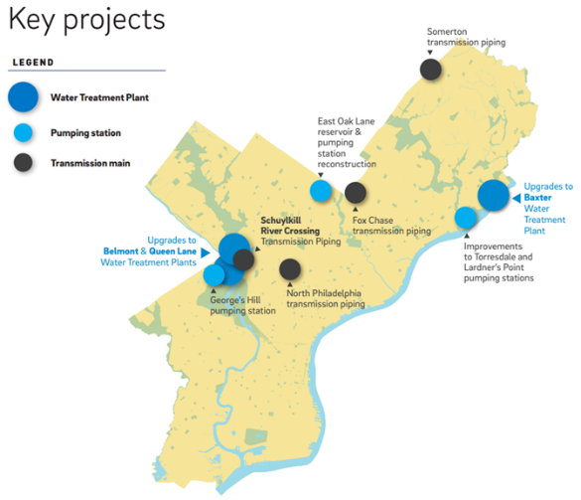
Overview of the CIP
PWD’s FY 2027-32 CIP is approximately $5.14 billion and is focused on system reinvestment
PLANNING
Drinking Water Revitalization Plan (“WRP”)
PWD’s 2019 WRP, updated in December 2022, outlined a multi‑decade, comprehensive program to upgrade the City’s drinking water treatment and supply facilities. The initial program estimate in 2019 was $2.5 billion, but such estimates are being revisited. PWD has recently initiated a new update to the WRP to ensure continued alignment with current system goals, with completion anticipated in 2027.
Green City, Clean Waters
The City achieved the 10-year Performance Standard required by the COA in 2022 and is projected to meet the 15- year milestone of 3,812 Greened acres. Between July 1, 2011 to June 30, 2024, $970 million ($436 million capital, $534 million operating) has been spent on the COA.
Replacement of Aging Infrastructure
In FY 2026, the PWD budget is $208 million for water main replacements, with a goal of replacing a total of 32 miles of water mains in FY 2026.

Slide 10
FY 2027-32 Capital Budget Summary
($ millions)
FY 2027-32 Capital Budget
PLANNING
 | FY 2027-32
Collector System | $1,627M
Treatment Facilities | $2,119M
Conveyance System | $1,292M
General (Engineering & Administrative) | $102M
Total | $5,140M

Slide 11
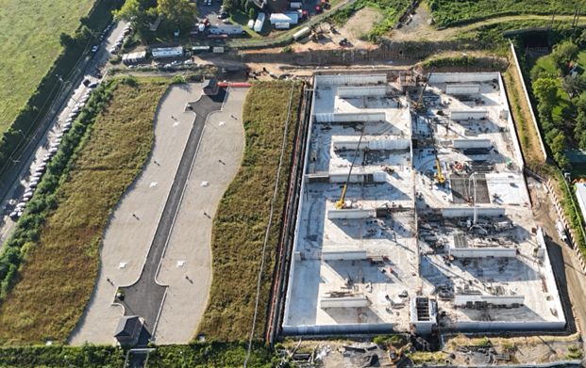
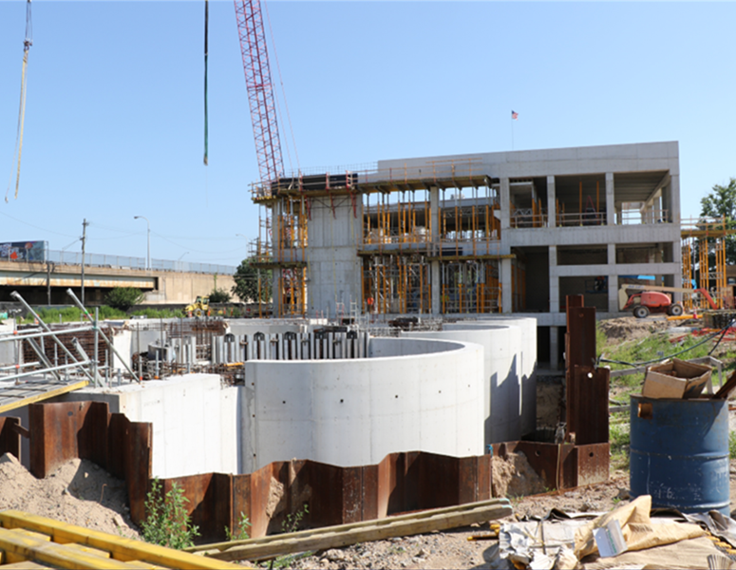
CIP Funding: FY 2027-32
PWD updates its CIP annually to help inform its future critical strategic planning efforts. Approximately 80% of CIP costs are expected to be funded with debt.
PLANNING
Anticipated Future Public Revenue Bond Offerings ($ millions)¹
Average debt issuance: $603 million/year
¹ Future public revenue bond issues are all modelled assuming level annual debt service with no deferral of principal

Slide 12
Debt Service Coverage
  PWD DEBT SERVICE COVERAGE, FY 2019-FY 2025
FINANCIALS
Notes:
“Senior Debt Service Coverage”: calculated as net revenues over outstanding revenue bond debt service. Must be ≥ 1.2x
“Total Payments Coverage”: calculated as net revenues over the sum of revenue bond debt service and any transfers to the Capital Fund. Must be ≥ 1.0x
“Source: City of Philadelphia and the Philadelphia Water Department Financial Statements

Slide 13
Debt Service Coverage & Additional Bonds Test Requirements
FINANCIALS
Additional Bonds Test
Debt Service Coverage
Net Revenues that will equal at least, for such Fiscal Year:
  1.20 times Debt Service Requirements paid on senior Bonds; and
  1.00 times the sum of:
    Debt Service Requirements paid on all Bonds (including subordinated bonds);
    Amounts deposited into the Debt Reserve Account of the Sinking Fund;
    Principal or redemption price of an interest on GO Bonds paid in respect of the System;
    Debt service requirements paid on Interim Debt; and
    The Capital Account Deposit Amount net of any transfer from the Residual Fund to the Capital Account; and
Net Revenues (excluding transfers from the Rate Stabilization Fund to the Revenue Fund) that will equal at least 90% of Debt Service Requirements paid on senior revenue bonds for such Fiscal Year.
The Director of Finance must certify all to the following:
During the immediately preceding Fiscal Year, the City met the Rate Covenant.
Based on the report and the opinion of the Consulting Engineer, Net Revenues are currently sufficient to comply with the Rate Covenant and are projected to be sufficient to comply with the Rate Covenant for each of the two Fiscal Years following the Fiscal Year in which the Additional Bonds are being issued; provided, that if interest on the Additional Bonds or a portion thereof has been capitalized, the projection shall extend to 2 years following the Fiscal Year up to which interest has been capitalized on such Additional Bonds.
Based on the report and the opinion of the Consulting Engineer rendered on the basis of actual, if appropriate, and estimated future annual financial operations of the System, the System will generate Project Revenues over the amortization period of the Additional Bonds to be issued sufficient to:
  Pay the O&M and repair and replacement expenses of the System;
  Fund all required reserves;
  Pay the principal or redemption price of and interest on all revenue Bonds (which includes the Additional Bonds) as the same becomes due and payable for which Project Revenues are pledged; and
  Pay any state taxes assumed by the City to be paid on the revenue Bonds

Slide 14
Current Debt Portfolio Provides Capacity to Fund CIP
$3.5 billion of par outstanding (as of June 30, 2025) with a final maturity in November 2054 (FY 2055)
  100% of PWD’s outstanding debt is in fixed rate mode
  No outstanding subordinate debt, variable-rate debt or swap exposure
  PWD continues to work closely with the Commonwealth of Pennsylvania in securing low-cost fixed rate loans under the Pennvest Loan Program (secured on a parity basis with other outstanding bonds)
  PWD has borrowed from the WIFIA program in the past and is able to use WIFIA funds when appropriate in the market rate environment
  Current ratings: A1/A+/A+ (M/S/F)
FINANCIALS
PWD OUTSTANDING ANNUAL DEBT SERVICE (FYE 6/30)

Slide 15
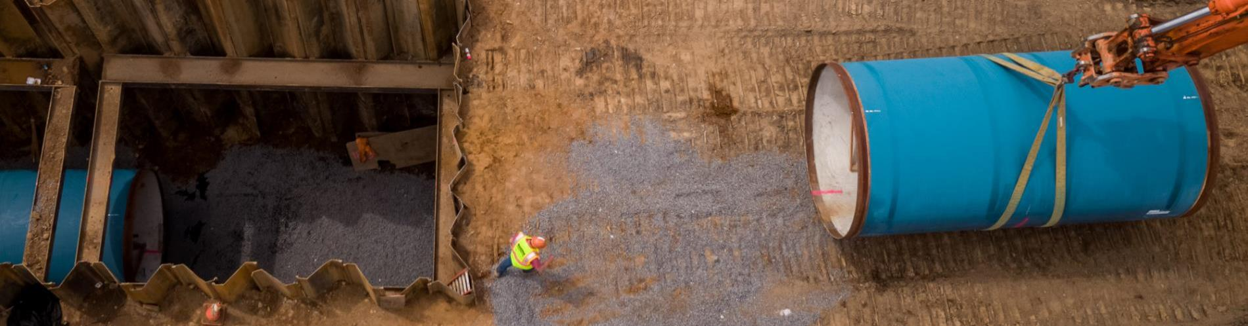
2026 Financing Opportunities With the City
Upcoming Transaction
Projected Date | Projected Transaction
Fall 2026 | Water and Wastewater Revenue Bonds, estimated $400 million, New Money
The City of Philadelphia makes financial information publicly available for interested investors. Please visit the City’s Investor Information website: https://www.phila.gov/programs/investor-information/

Slide 16
City of Philadelphia
2026 Investors Conference

