Slide 1
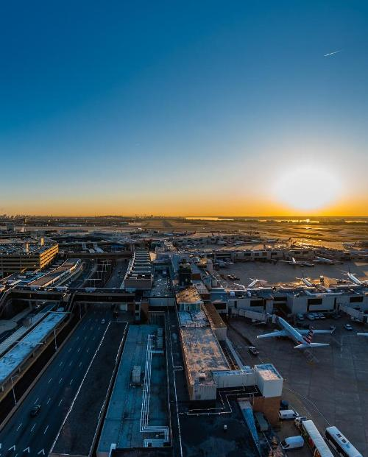

City of Philadelphia Investor Conference 2026
City of Philadelphia, Department of Aviation
May 13, 2026

Slide 2
Disclaimer
This Presentation is provided as of May 13, 2026, in connection with The City of Philadelphia (the “City”). If you are viewing this Presentation after May 13, 2026, there may have been events that occurred subsequent to such date of the Investor Conference that could have a material effect on the information, financial or otherwise, that is presented herein. Neither the City nor any related department has undertaken any obligation to update this Presentation beyond the aforementioned date thereof. Financial data, including revenues, expenditures, demographic statistics, debt service and other information provided herein are not warranted as to completeness or accuracy and are subject to change without notice. This Presentation speaks only as of its date.
This Presentation is provided for your information and convenience only. If and to the extent the City issues bonds or incurs other debt obligations after the date of this Presentation, any investment decisions regarding such bonds or other entities should only be made after a careful review of the complete Preliminary Official Statement prepared in connection therewith. By viewing this presentation, you agree not to duplicate, copy, download, screen capture, electronically store or record this Presentation, nor to produce, publish or distribute this Presentation in any form whatsoever.
This Presentation is not intended to and should not be used as the basis for making any investment decisions in obligations issued by the City. This Presentation does not constitute a recommendation or an offer or solicitation for the purchase or sale of any security or other financial instrument, including any planned issuance of bonds by, or on behalf of, the City, or to adopt any investment strategy as it relates to any planned issuance of bonds by the City or any related issuer or any outstanding debt thereof. Any offer or solicitation with respect to future bonds will be made solely by means of the Preliminary Official Statement, which shall describe the actual terms of such bonds.
No representation or warranty, express or implied, is provided in relation to the fairness, accuracy, correctness, completeness, or reliability of the information, opinions or conclusions expressed herein. The information contained in this Presentation is provided in summary form and does not purport to be complete.
This Presentation may contain forecasts, projections, and estimates that are based on current expectations but are not intended as representations of fact or guarantees of results. If and when included in this Presentations, the words “expects,” “forecasts,” “projects,” “intends,” “anticipates,” “estimates,” and analogous expressions are intended to identify “forward‐looking statements” as defined in the Securities Act of 1933, as amended, and the Securities Exchange Act of 1934, as amended, and any such statements inherently are subject to a variety of risks and uncertainties, which could cause actual results to differ materially from those contemplated in such forward‐looking statements. These forward‐looking statements speak only as of the date set forth above. Nothing in this Presentation should be considered as an express or implied commitment to do or take, or refrain from taking, any action by the City or an admission of any fact or future event. Nothing in this Presentation shall be considered a solicitation, offer to sell, recommendation or advice to any person to participate, pursue or support a particular course of action or transaction, to purchase or sell any security, or to make any investment decision.
In no event shall the City be liable for any use by any party of, for any decision made or action taken by any party in reliance upon, or for any inaccuracies or errors in, or omissions from, the information contained herein and such information may not be relied upon by you in evaluating the merits of participating in any transaction relating to bonds issued by, or on behalf of, the City. The City does not make any representations as to the legal, tax, credit or accounting treatment of any transactions relating to bonds issued by, or on behalf of, the City, or any other effects such transactions may have on you and your affiliates or any other parties to such transactions and their respective affiliates. You should consult with your own advisors as to such matters and the consequences of the purchase and ownership of any bonds.
To the extent any investment bank or financial advisor has participated in the preparation of this Presentation, they shall not be liable for any misinformation or misstatements contained herein, unless the information is explicitly sourced to such entity. Furthermore, no investment bank or financial advisor that has participated in the preparation of this Presentation has undertaken any obligation to update this Presentation beyond the aforementioned date thereof nor have, or will, they take any steps to verify the completeness or accuracy of the information contained herein.
Past performance is not indicative of future results, which will vary. This Presentation contains information on proposed budgets and financial plans, as well as estimated financial results for the current fiscal year. Information that is shown as “Estimated” or “Proposed” is subject to change in its entirety and subsequent proposals or final versions may deviate materially from the proposed information contained herein. There is no assurance that estimated financial results will be realized and actual financial results may differ, perhaps materially, from the estimates contained herein. By providing such information in this Presentation, neither the City nor any related department has undertaken any obligation to update such information or to provide updates due to changes in the events, circumstances or conditions on which such information is based.
This report will be available on the City’s investor website at: https://www.phila.gov/programs/investor-information/

Slide 3
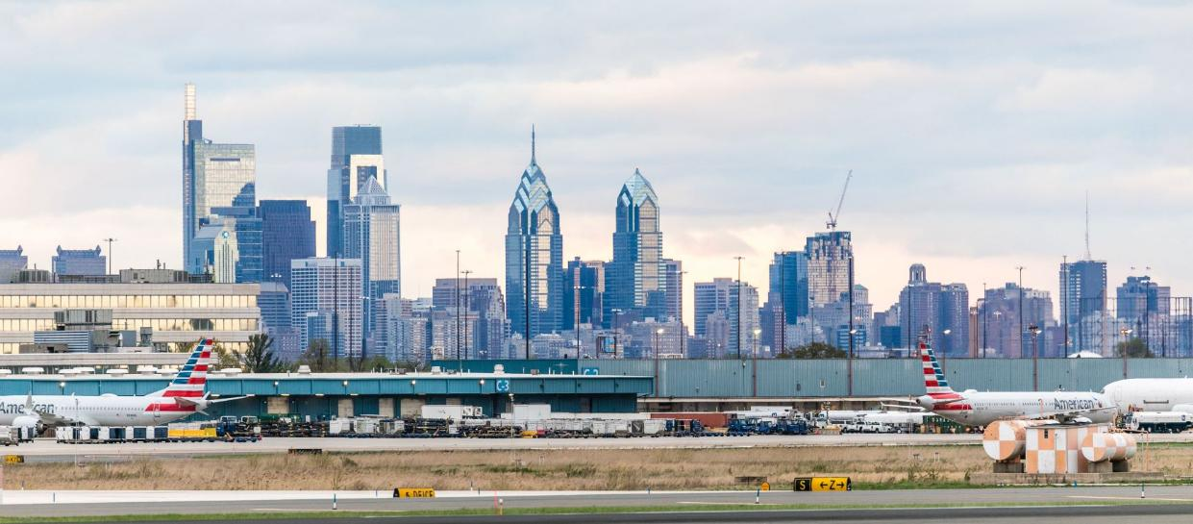
PHL Overview
Overview of the Airport
The Airport System, owned by the City and operated by the Department of Aviation, consists of the Philadelphia International Airport (“PHL”) and the Northeast Philadelphia Airport (“PNE”)
PHL has benefitted from growing origin and destination (“O&D”) traffic – 75% of PHL’s traffic was O&D in FY2025, up from 58% in FY2015
PHL serves as the primary transatlantic gateway for American Airlines, offering service to 19 transatlantic destinations, the leader among American’s other gateways as of FY2025
PHL has diverse air carrier service with American’s market share at 67.3%, Frontier at 10.2% Delta at 6.2%, and Southwest at 4.5% (as of CY2025)
United Parcel Service (UPS) operates its second-largest North American hub at PHL with a 700,000-square-foot sorting facility, ramp space for 32 parked aircraft and is UPS’s East Coast regional hub, with additional future cargo capacity
Additionally, Cargo City accommodates nearly 600,000 square feet of cargo space for other cargo carriers
21st
20th
30.1M
67.3%
19
5
2*
Busiest Airport in the U.S by total passengers in CY2024
Busiest in the nation for cargo tonnage in CY2024
Total passengers served in CY2025
of all enplaned passengers were serviced by American Airlines in CY2025
U.S.-flag airlines provided scheduled passenger service
Airlines flagged in a foreign country
All-cargo airlines
*Based on available data as of 4/24/2026

Slide 4


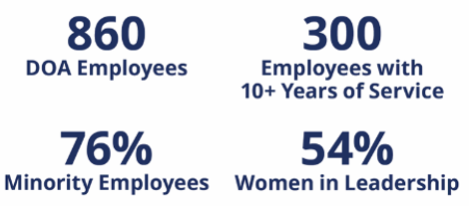
By The Numbers
PHL KEY STATS
*
**
*
ECONOMIC IMPACT OF PHL & PNE
EMPLOYMENT AT PHL & PNE
*Based on available data as of 4/24/2026
**Based on Regional Economic Impact of Philadelphia’s Airport System, published September 2024

Slide 5
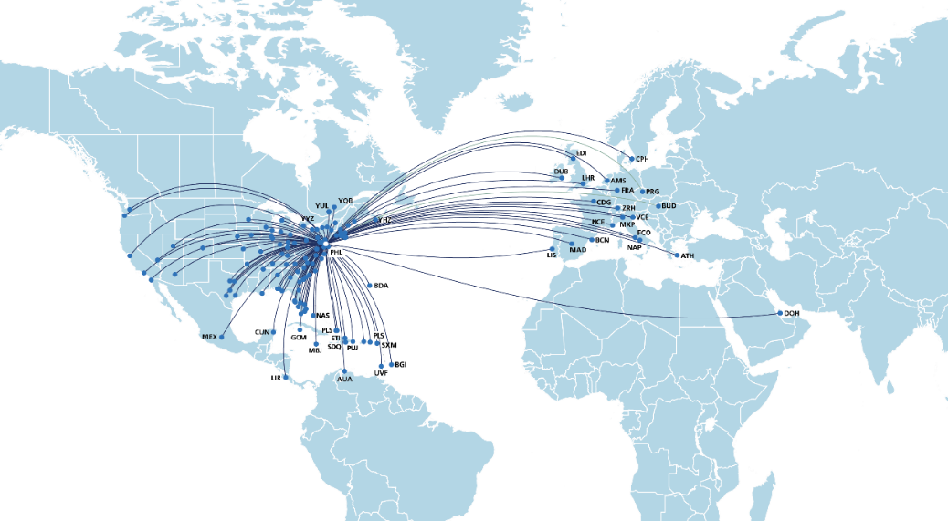



AA Routes To New European Destinations
PHL Air Service Overview
PHL offers service to 135 unique destinations, including 39 unique international destinations.*
Prague (PRG) – May to October 2026
PHL is the only US airport to offer service to Prague
Budapest (BUD) – May to October 2026
Porto (OPO) – Summer 2027
PHL Welcomes Allegiant Airlines
Starting in May 2026, Allegiant Airlines will offer new routes from PHL to:
Grand Rapids
Knoxville
Des Moines
*Note: Destination count excludes markets that have been discontinued (LGA & PBG ) or run as special event service (ABQ, AGS, SJC) or announced and not yet selling (OPO), however, includes markets announced and selling (BUD, PRG)
Source: Cirium schedule data as of 4/23/26; Includes Landline

Slide 6
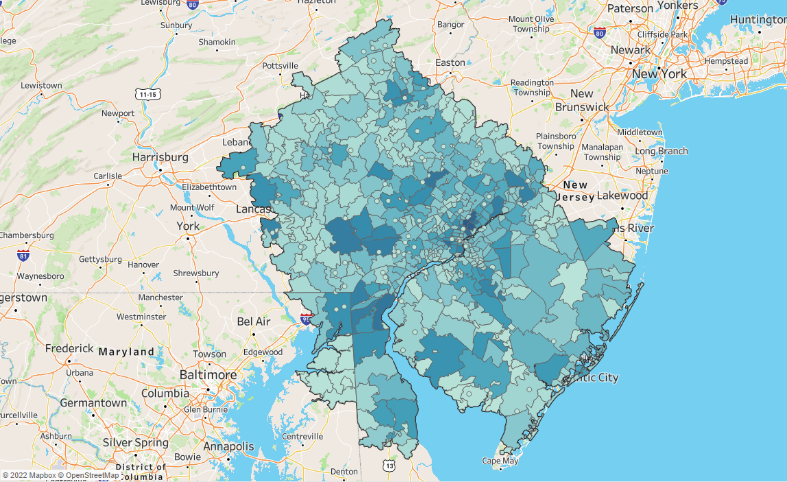
PHL’s Primary Catchment Area Population is More than 8.6M
Population: 8,618,748
ABE
EWR
JFK
MDT
PHL
Population | 8,618,748
Households | 3,370,598
Household Income (mil. $) | $408,531
Mean Household Income | $121,204
BWI
IAD
Note: PHL’s Primary Catchment Area includes all locations where PHL is the closest major airport based on driving time
Source: U.S. Bureau of the Census, 2024 American Community Survey (5-Year)

Slide 7
Summary of PHL Air Service
Historical Enplanements (FY2016 – FY2025) (Millions)¹
Origin & Destination vs. Connecting Traffic (FY2016-FY2025) (Millions)²
In FY2025, enplaned passenger traffic increased 4.8% year over year. From FY2020 through FY2025, total enplanement increased by a CAGR of 4.5%.
 | 2016 | 2017 | 2018 | 2019 | 2020 | 2021 | 2022 | 2023 | 2024 | 2025
O&D % | 65% | 69% | 68% | 68% | 70% | 77% | 77% | 76% | 76% | 75%
Connecting % | 35% | 31% | 32% | 32% | 30% | 23% | 23% | 24% | 24% | 25%
Airline* Market Share by Enplanements (CY2025)³
Domestic vs. International Traffic (CY2025)⁴
(1) Source: City of Philadelphia Department of Aviation Municipal Securities Disclosure Annual Financial Report Fiscal Year Ending June 30,2025 Exhibit S-8 (2) City of Philadelphia Airport Revenue & Refunding Bonds, Series 2025 Official Statement, Report of the Airport Consultant Table 4-4. (3) Internal Department of Aviation CY25 Enplaned Passengers by Market Share Report, prepared January 2026 (4) PHL Aviation Activity Report – December 2025 *includes regional affiliated airlines, as applicable; **Other includes British Airways, Air Canada, JetBlue Airways, Lufthansa German Airlines, Aer Lingus, Qatar Airways and Sun Country Airlines, and other airlines with minimal market share.

Slide 8
Projected Enplanements, Airline CPE & Debt Coverage
Historical and Forecasted Enplaned Passengers FY2015-FY2031¹
1.2% CAGR from 2015-2019
2.35% CAGR from 2024-2031
Projected Airline Cost Per Enplanement (FY)²
Projected Debt Service Coverage³
(1) Source: Interim enplanement projection prepared for the Airport by Ricondo, February 2026 (2) Interim CPE projection from AVK Consulting based on interim enplanement projection, prepared February 2026 (3) Interim debt service coverage projection from AVK Consulting based on interim enplanement projection, prepared February 2026

Slide 9
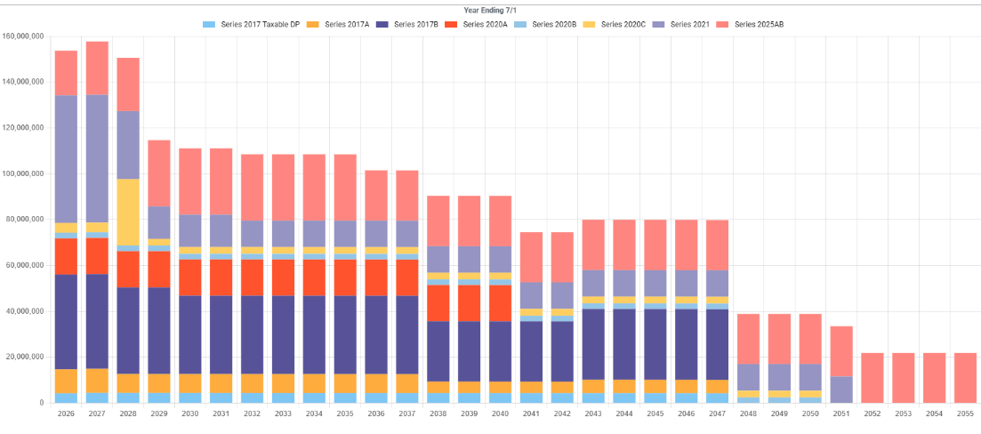
Modest Debt Levels
Year Ending 6/30

Slide 10
Capital Development Program
PHL’s Capital Development Program currently includes approximately $2 billion of projects approved by the Signatory Airlines, of which approximately $875 million has been spent to date¹.
(Dollars in millions)​ | ​
PROJECTS​ | TOTAL COST​
Airfield and Aprons​ | $758.3
Terminal and Landside​ | 1,098.5​
Security and Technology​ | 115.6​
PNE Airfield and Taxiways​ | 75.5​
TOTAL CAPITAL PROJECTS | $2,047.9​
FUNDING SOURCES​ | TOTAL FUNDING SOURCES​
PFC / Grants​ | $627.9
Operating Funds​ | 1.3
Existing Debt​ | 385.6​
2025 Bonds​ | 261.4​
Future Debt​ | 771.7​
TOTAL FUNDING ​SOURCES​ | $2,047.9
(1) As of April 3, 2026.

Slide 11
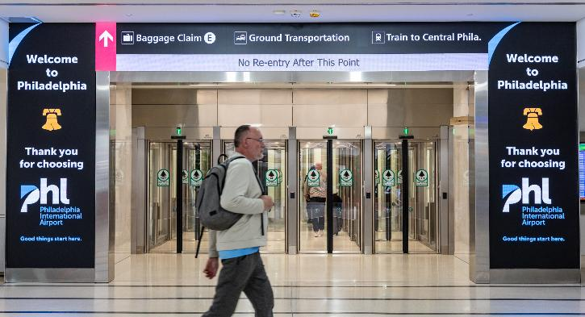
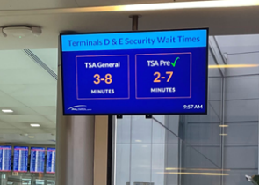
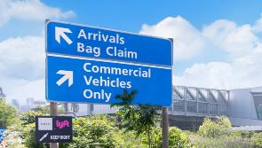
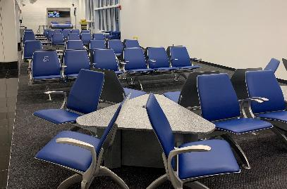
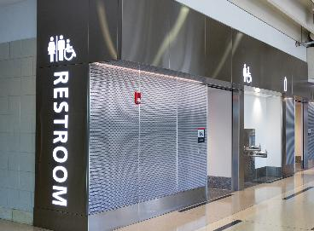

Refreshed Terminals for 2026

Slide 12
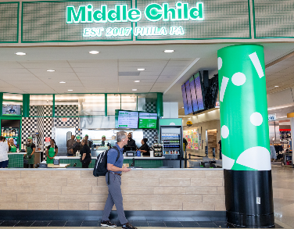





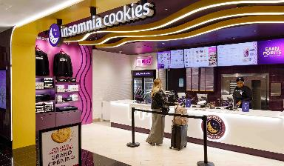


Elevated Airport Experience

Slide 13



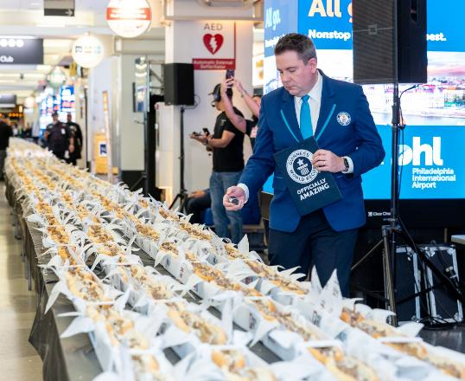
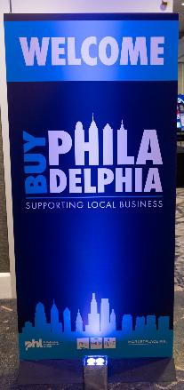
Good Things Start Here

Slide 14
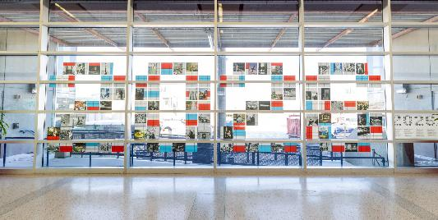





Revitalized Art Exhibits

Slide 15
PHL Credit Strengths
Strong Air Service Market |  | PHL serves a large population and diverse economy and was the 21st busiest airport in the US in CY2024 by total passengers according the Airports Council International Origin and destination (“O&D”) passenger traffic accounted for 75% of PHL’s passenger demand in FY2025 Population in PHL’s catchment area reached over 8.5 million in 2024 and per capita personal income exceeded that of both the Commonwealth and United States Philadelphia MSA’s diverse economy is driven by healthcare, education, financial services and telecom
Commitment from American Airlines |  | Demonstrating its strong commitment, American Airlines provided service to 89 domestic and 34 international destinations in FY2025 American Airlines has established PHL as its primary transatlantic gateway with 19 destinations served, nearly double its next closest gateway airport American Airlines has 10,000 employees in the Philadelphia area and ranks as the 9th largest non-governmental employer by number of employees as of October 2024
Financial Performance |  | PHL’s residual airline agreement provides a strong cost recovery model with significantly increased liquidity requirements resulting in strong levels of days cash on hand Days cash on hand of 686 days in FY2025 and projected growth through FY2031 Strong historical debt service coverage and projected coverage levels that exceed the minimum requirements of 1.5x and 1.0x for Rate Covenant Test #1 (bond debt service coverage) and Test #2 (total debt service coverage) through 2031
Conservative Debt Profile |  | PHL’s declining debt service structure provides future debt capacity without significant increases to annual debt service requirements and near-term airline costs per enplaned passenger PHL has an experienced and seasoned management team

Slide 16
Future Bond Issuances
Estimated Future Bond Issuances¹
Future Bond Issuances | Estimated Project Funding ($Millions)
FY2028 Bonds (Anticipated Summer/Fall 2027) | $484.1 million
FY2030 Bonds | $287.6 million
Estimated Debt Service Requirements – FY2028 Bonds²
Fiscal Year | Estimated Debt Service Requirement ($Millions)
FY2030 | $22.4 million
FY2031 | $44.8 million
(1) Source: City of Philadelphia Airport Revenue & Refunding Bonds, Series 2025 Official Statement, Report of the Airport Consultant Table 5-4 (2) City of Philadelphia Airport Revenue & Refunding Bonds, Series 2025 Official Statement, Report of the Airport Consultant 5.5.1 General Airport Revenue Bond Debt Service

Slide 17
Thank you!
Tracy Borda
Interim Chief Executive Officer, Chief Financial Officer
Christina Saggiomo
Senior Director of Capital Finance

Slide 18
City of Philadelphia
2026 Investors Conference

