Slide 1


TIERED ASSISTANCE
PROGRAM (TAP)
Proposed TAP-R
Reconciliation
May 2026

Slide 2
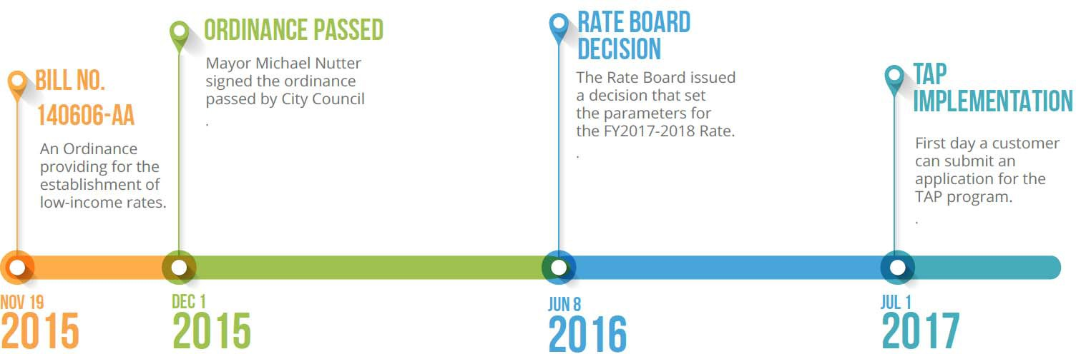
What is the Tiered Assistance Program (TAP)?
Ordinance passed and approved by the Mayor.
The Rate Board issued a decision that set the parameters for the TAP-R Rate Rider.
The Rate Board issued a decision that set the parameters for the TAP program.
140607-AA
In 2015, City Council passed an ordinance requiring the establishment of an assistance program that would allow low‐income customers to pay reduced bills based upon a percentage of their household income. In 2018, the Water, Sewer and Storm Water Rate Board (the Board) established the Tiered Assistance Program Rate Rider (TAP-R).

Slide 3
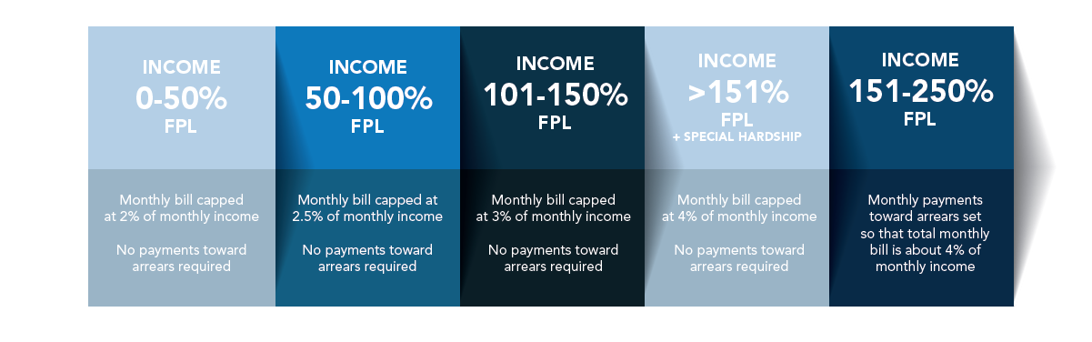
How does TAP work?
The Tiered Assistance Program (TAP) allows low-income customers to pay reduced bills based upon a percentage of their household income.
FPL = Federal Poverty Level
Eligible customers pay a percentage of their bills based on their income.
Bills do not go up based on usage. Enrolled customers pay a fixed amount. Bills are capped as a percentage of income and are constant each month. TAP Participants in the lowest income bracket pay a bill equivalent to 2% of their monthly income or a minimum of $12/month.

Slide 4
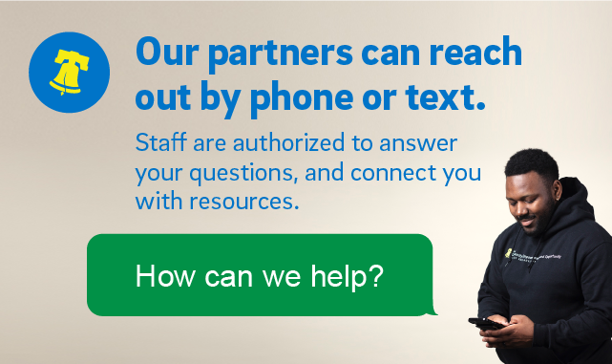
Reaching Our Customers in Need
The City has made TAP more accessible for all qualifying customers through the following methods:
Expedited Enrollment - The City expedites customer enrollment without separate application for:
Customers identified in the City’s IDEA¹ database.
Coordinated Citywide approach: PWD continues to work with other utilities and state agencies to make program improvements.
1. IDEA - The City’s Office of Integrated Data for Evidence and Action (IDEA) database.

Slide 5
What is the “TAP Rate Rider”?
Implemented through Rate Board authorization in 2018, the TAP Rate Rider helps PWD recover (or reimburse) TAP program costs through rates. PWD reviews and adjusts the TAP Rate Rider on an annual basis to account for changes in TAP costs.
The cost of TAP may change over time due to:
the number of PWD customers enrolled in the program
Level of usage of TAP customers; and/or
the level of discounts needed to provide affordable bills to TAP customers
The cost of providing discounts to TAP customers is borne by all other rate payers within the City.

Slide 6
Primary Impacts on the TAP Rider
In the current TAP-R filing, 70,318 TAP participants are projected to be enrolled. This is a result of the City’s continued efforts to enroll vulnerable households in TAP.
In December 2025, there were approximately 67,815 TAP participants. There are currently 68,413 participants as of March 2026. The City anticipates a continued growth in TAP enrollment throughout FY 2027.
 | Previous FY 2026 Estimate | Projection FY 2027 | Difference
Monthly TAP Participants | 60,634 | 70,318 | +9,684
Monthly Discount | $48.95 | $62.82 | +$13.87
Annual Discount | $35.6 M | $53.0 M | +$17.4 M

Slide 7
FY 2026 TAP-R Rate Adjustments
Based upon reconciliation results, the Water Department is proposing to increase the TAP-R rates effective September 1, 2026.
TAP-R Rates | Current | Proposed | Difference
Water ($/Mcf) | $3.59 | $5.65 | +$2.06
Sewer ($/Mcf) | $5.07 | $7.90 | +$2.83

Slide 8
Overall Typical Bill Impacts
This year, the Department has an approved base rate adjustment as of September 1, 2026. The table below shows the combined impact of approved base rate adjustment and the proposed TAP-R rates:
 | Current | Proposed⁴ | Base Rate Increase | TAP-R Increase⁵ | Total Bill Impact
Residential¹ | $89.42 | $96.41 | $4.89 | $2.10 | $6.99
Senior Citizen² | $54.73 | $59.02 | $3.20 | $1.09 | $4.29
Small Business³ | $147.60 | $159.94 | $9.65 | $2.69 | $12.34
¹ Reflects a 5/8" meter with 4.3 ccf of water consumption.
² Reflects a 5/8" meter with 3 ccf of water consumption. Includes Senior Citizen discount of 25%.
³ Reflects a 5/8" meter with 5.5 ccf water consumption, and Parcel gross area of 5,500 sq. ft. and impervious area of 4,000 sq. ft.
⁴ Based upon the combination of proposed TAP-R and base rates that will become effective September 1, 2026.
⁵ Subject to approval by the Rate Board in the 2026 Annual TAP-R Adjustment proceeding.

Slide 9


