Slide 1
Real Estate Development Entitlement Process

Slide 2
Agenda
Process Overview
Zoning
Plan Review & Permitting
Inspections, Licensing & Enforcement
Other Resources

Slide 3
Real Estate Development Process
1. Project Feasibility
2.
Design
3.
Financing
4. Construction
5. Marketing & Leasing
6. Property Management
Zoning
Plan Review & Permitting
Inspections
Licensing & Enforcement

Slide 4
ZONING

Slide 5
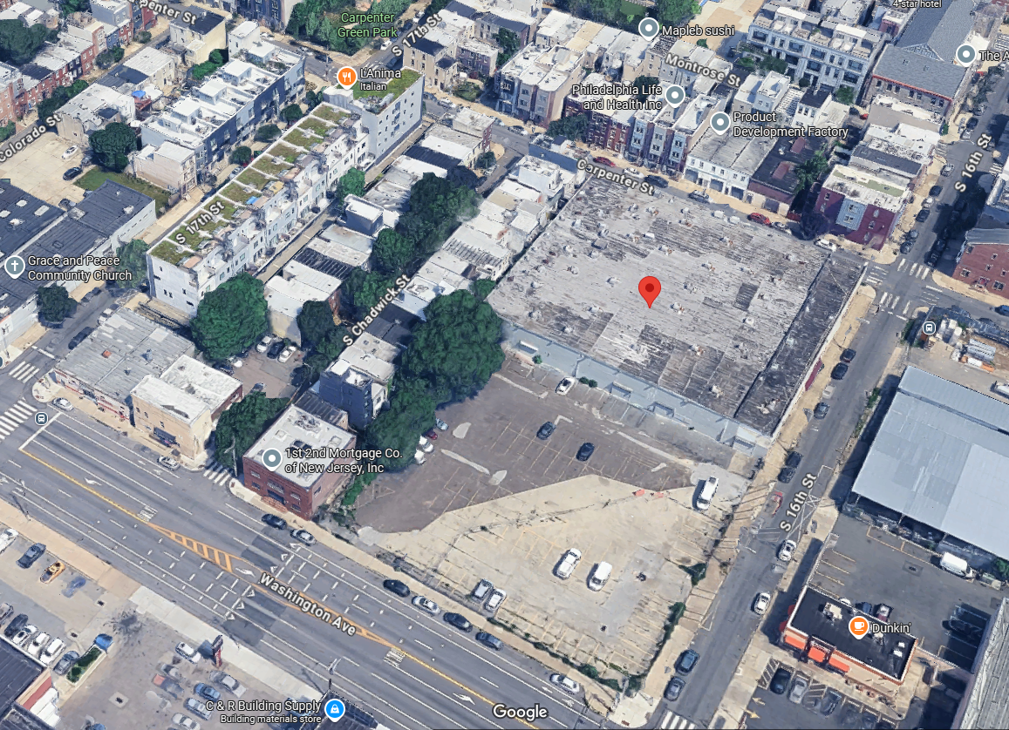
Project Feasibility, Design, and Financing
Neighborhood Context
Market Analysis
Traffic Analysis
Demographics
Needs
Assets
Trends
Stakeholder Review
RCOs
Near Neighbors
Elected Officials
City Departments
Funders
Site Context & Design
Site Control
Title Report
Financial Analysis
Environmental Study
Soil Study
Architecture
Engineering
Zoning
Zoning, Plan Review, & Permitting

Slide 6

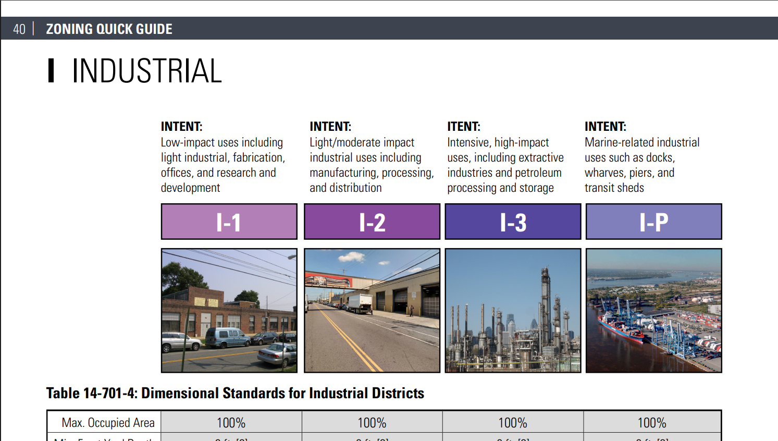
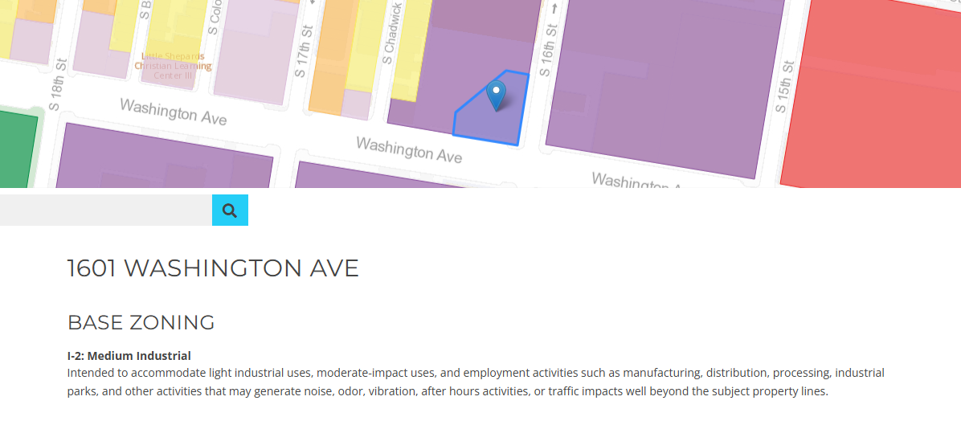
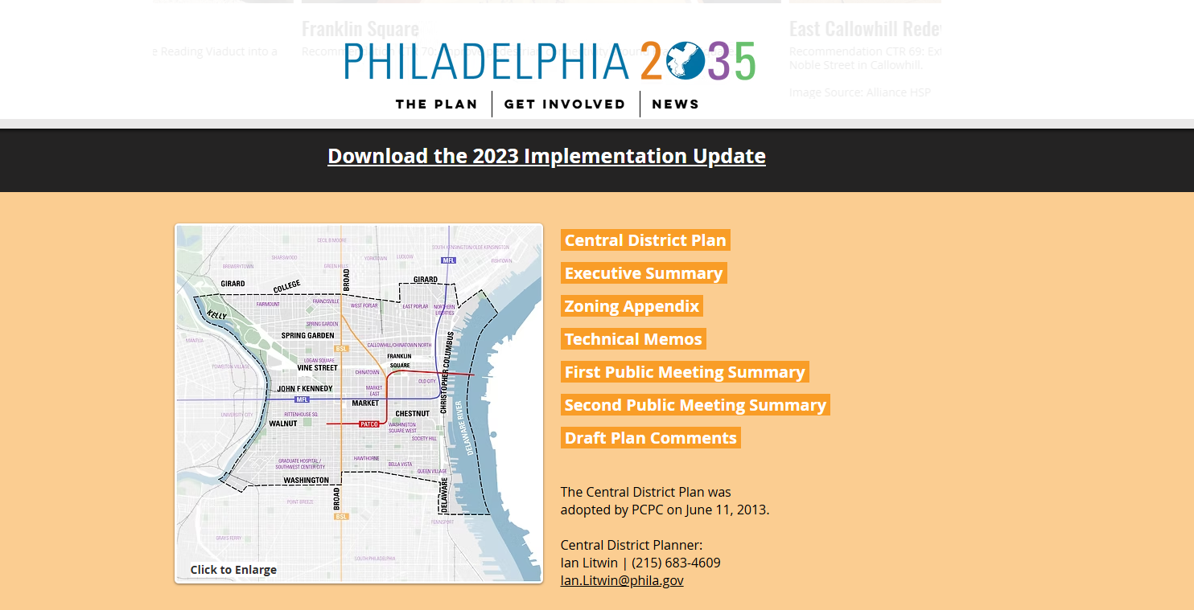
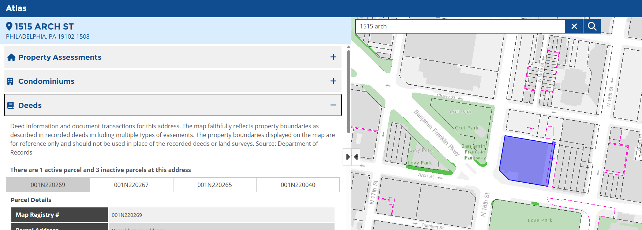
Resources
Zoning
Plan Review & Permitting
Inspections
Licensing & Enforcement
Zoning Quick Guide
Zoning Summary Generator
Neighborhood & Citywide Plans
Atlas

Slide 7
Use Types
Zoning
Plan Review & Permitting
Inspections
Licensing & Enforcement
Residential dwellings: single-family, two-family, multi-family
Hotels: Motels, hostels, bed-and-breakfasts, and short-term (less than 30 days) rentals of properties that are not occupied by a primary resident. These are typically defined as “Visitor Accommodations” in the Zoning Code.
Rooming or boarding house: Shared living spaces (and typically kitchens and bathrooms) between four or more unrelated people.
Assisted living: Provide living space for individuals that need assistance or supervision with getting dressed, bathing, diet, financial management, evacuation from the residence in the event of an emergency, or medication prescribed for self-administration.
Dormitories: Living quarters typically marketed to students that usually provide shared facilities such as kitchens and/or bathrooms.

Slide 8
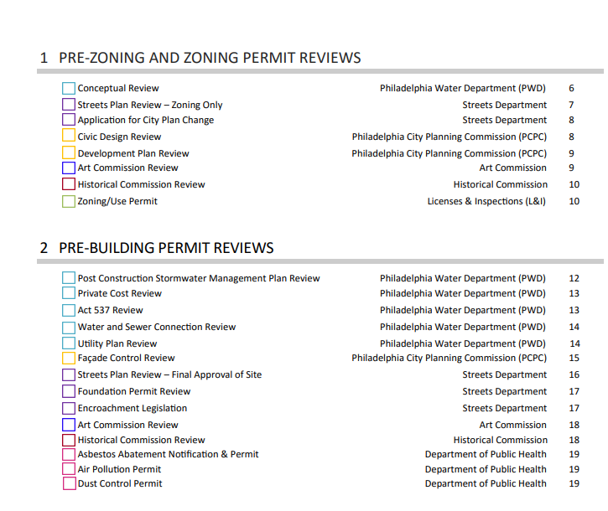
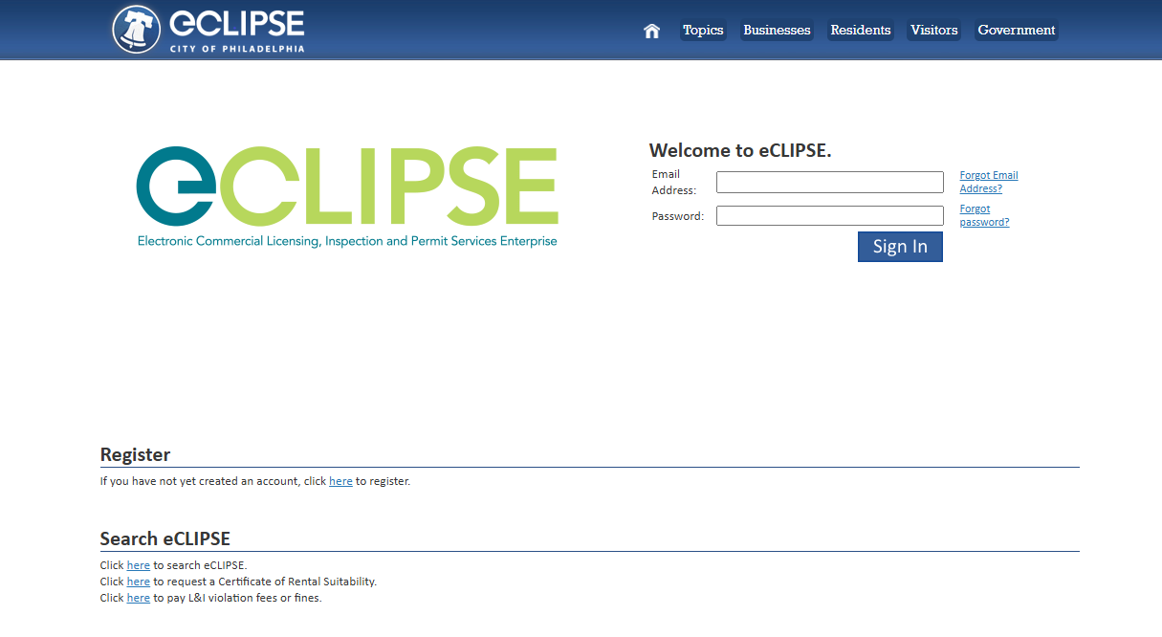
Resources
Zoning
Plan Review & Permitting
Inspections
Licensing & Enforcement
Development Checklist
eCLIPSE

Slide 9
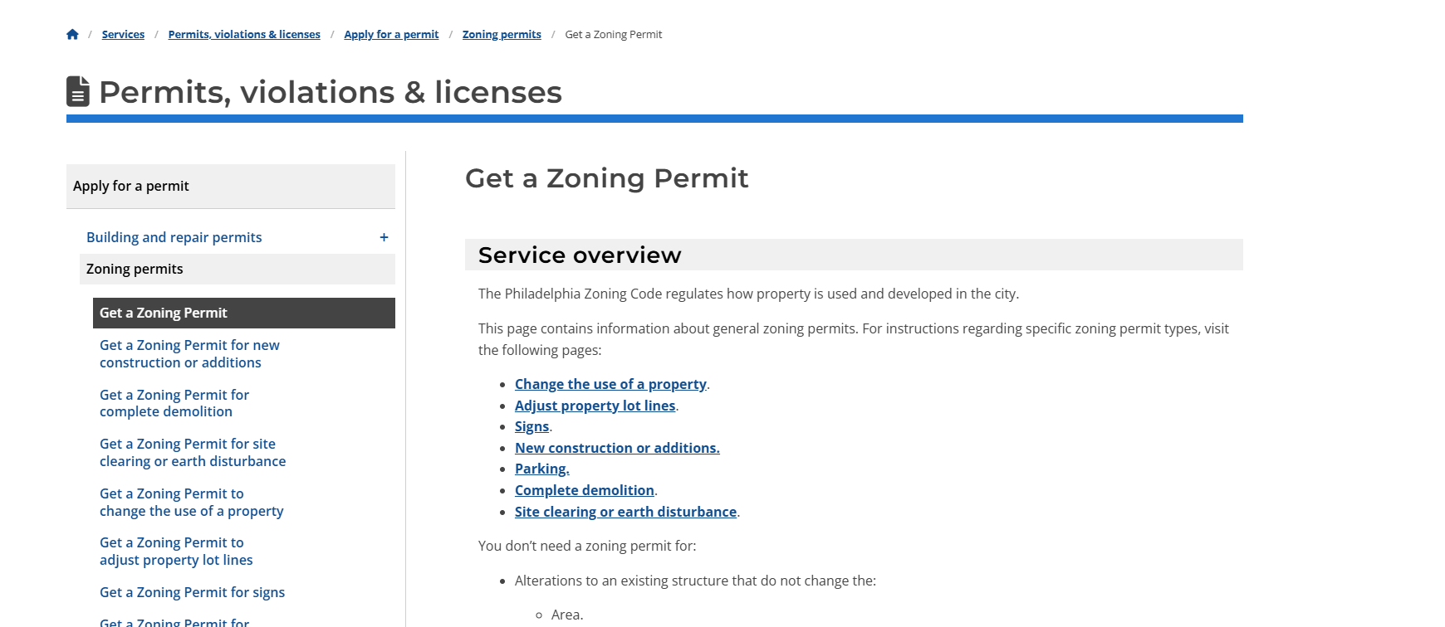
Resources
Zoning
Plan Review & Permitting
Inspections
Licensing & Enforcement
L&I Service Pages

Slide 10
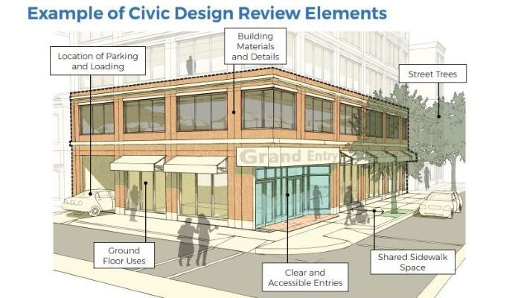
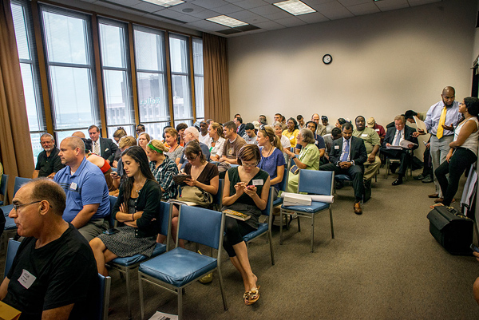
RCO Meetings
Zoning
Plan Review & Permitting
Inspections
Licensing & Enforcement
Zoning Board of Adjustment (ZBA)
Special Exception
Variances
Use
Area
Civic Design Review (CDR)
Most projects exceeding 50,000 sq. ft. or more than 50 units

Slide 11
PLAN REVIEW & PERMITTING

Slide 12
Requirements
Zoning
Plan Review & Permitting
Inspections
Licensing & Enforcement
Health: Asbestos Abatement, Dust Control Permit
Water: Utility Plan Review, Post Construction Stormwater Management Plan Review, Sewer Connection Permit, Meter Installation Permit
Planning Commission: Landscape Review
Park & Recreation: Tree Review
Streets Building Permit Review
Fire Department Approval
Licenses & Inspection (L&I): Building Permit
& other stakeholders (State, PECO, PGW, Verizon, SEPTA, etc.)

Slide 13
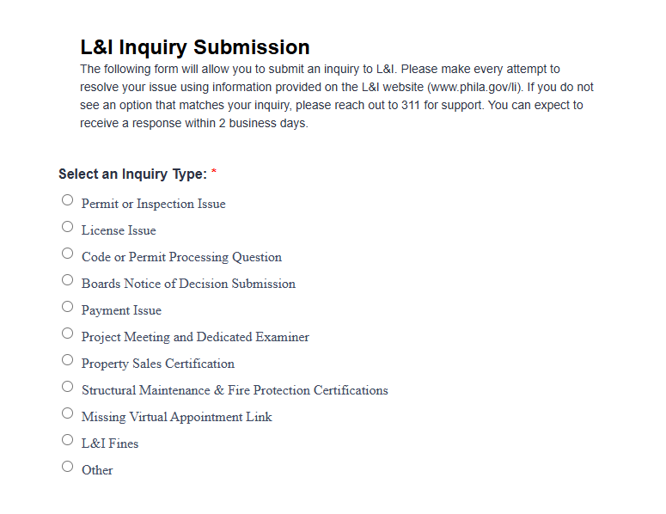
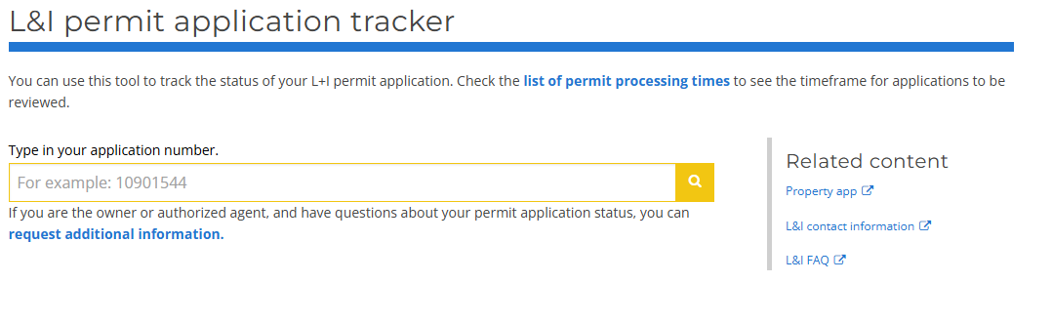
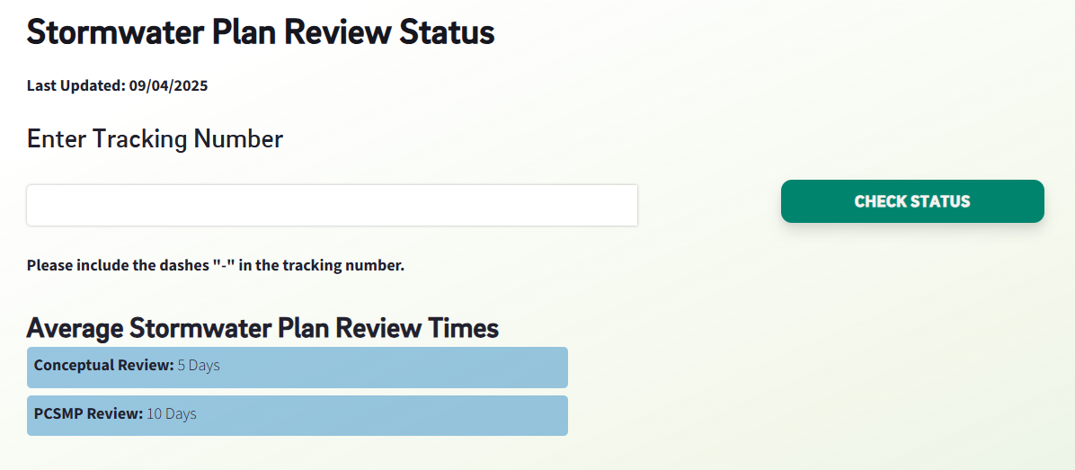
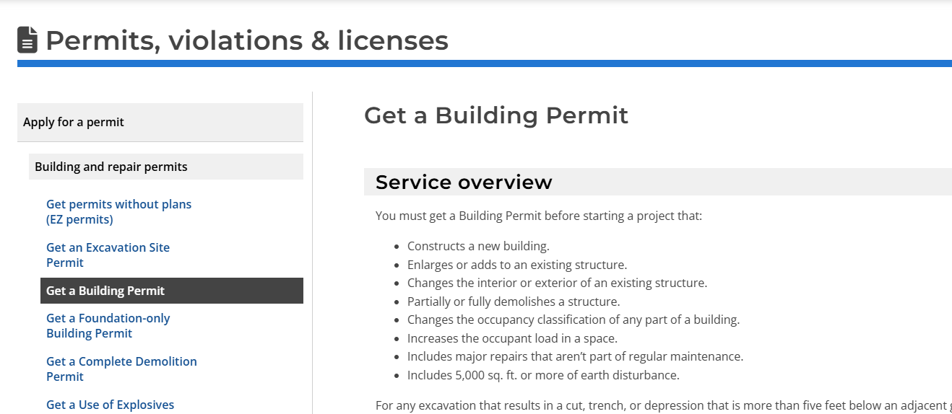
Resources, cont.
Zoning
Plan Review & Permitting
Inspections
Licensing & Enforcement
L&I Jotform
Application Trackers for non-applicants (L&I, PWD)
Service Pages

Slide 14

Permit Triggers
Zoning
Plan Review & Permitting
Inspections
Licensing & Enforcement
Changing the number of units
Changing a use (like changing from commercial to residential, or vice versa)
Changing from a long-term rental to a short-term rental
Most construction (excluding some repairs, cabinetry, and finishing work)
Resource
L&I’s Start Right Guide

Slide 15
INSPECTIONS, LICENSING & ENFORCEMENT

Slide 16
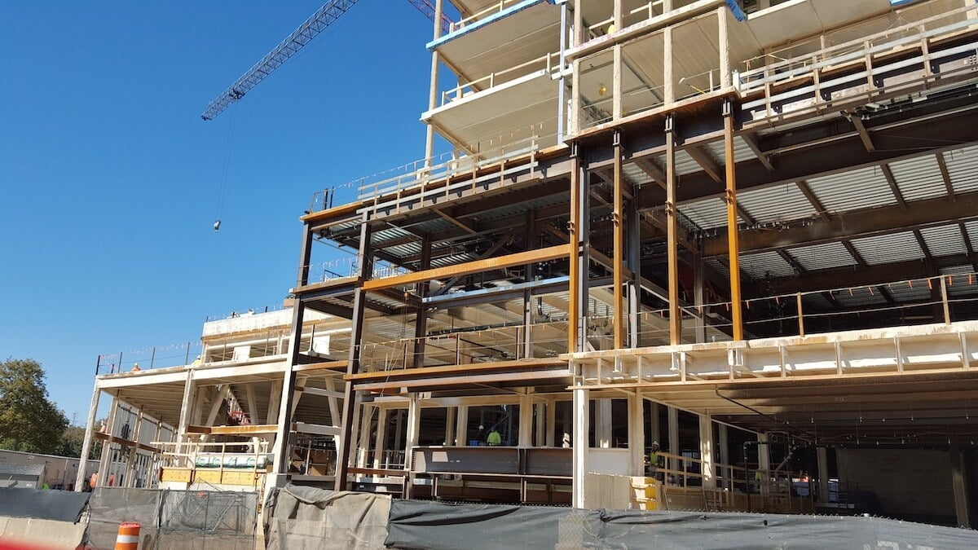
Construction
Licensing & Enforcement
Zoning
Plan Review & Permitting
Inspections
Developer Tasks
Hire a General Contractor
Hire and Manage Subcontractors
Purchase Insurance
Manage the Schedule and Budget
Comply with Building Codes
Secure Final Approvals
Zoning, Plan Review, & Permitting

Slide 17
Property Management
Zoning
Plan Review & Permitting
Inspections
Licensing & Enforcement
Developer Tasks
Get necessary licenses to operate business, including Rental License
Marketing & Leasing
Public Relations
Comply with Federal Fair Housing Act of 1968
Ongoing repairs & maintenance

Slide 18
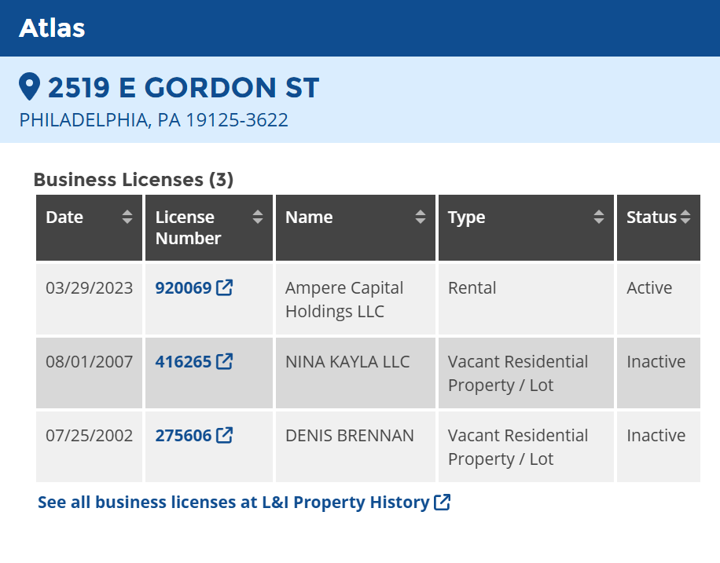
Rental Licenses
Zoning
Plan Review & Permitting
Inspections
Licensing & Enforcement
All rental properties must have an active rental license, renewed annually
Renting out a property is a business –
You’ll need an Activity License Number or Commercial Activity License
AND business tax account
You must follow all lead safety laws
Must be tax & code compliant

Slide 19
OTHER RESOURCES

Slide 20
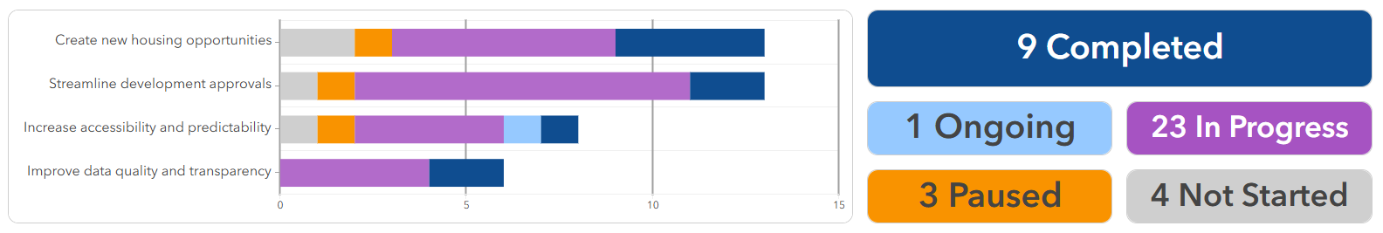
H.O.M.E. Initiative & Development Support
Process Optimization: 38 recommendations to reduce the time, cost, and uncertainty of preserving and developing housing
Rental Improvement Fund (RIF): Landlords who own no more than 15 rental units across no more than 5 rental properties are eligible for a construction loan of up to $100,000.

