Slide 1
Please open this presentation on your desktop before presenting. The fonts and images will not be displayed correctly when you present it directly from the browser.

Slide 2
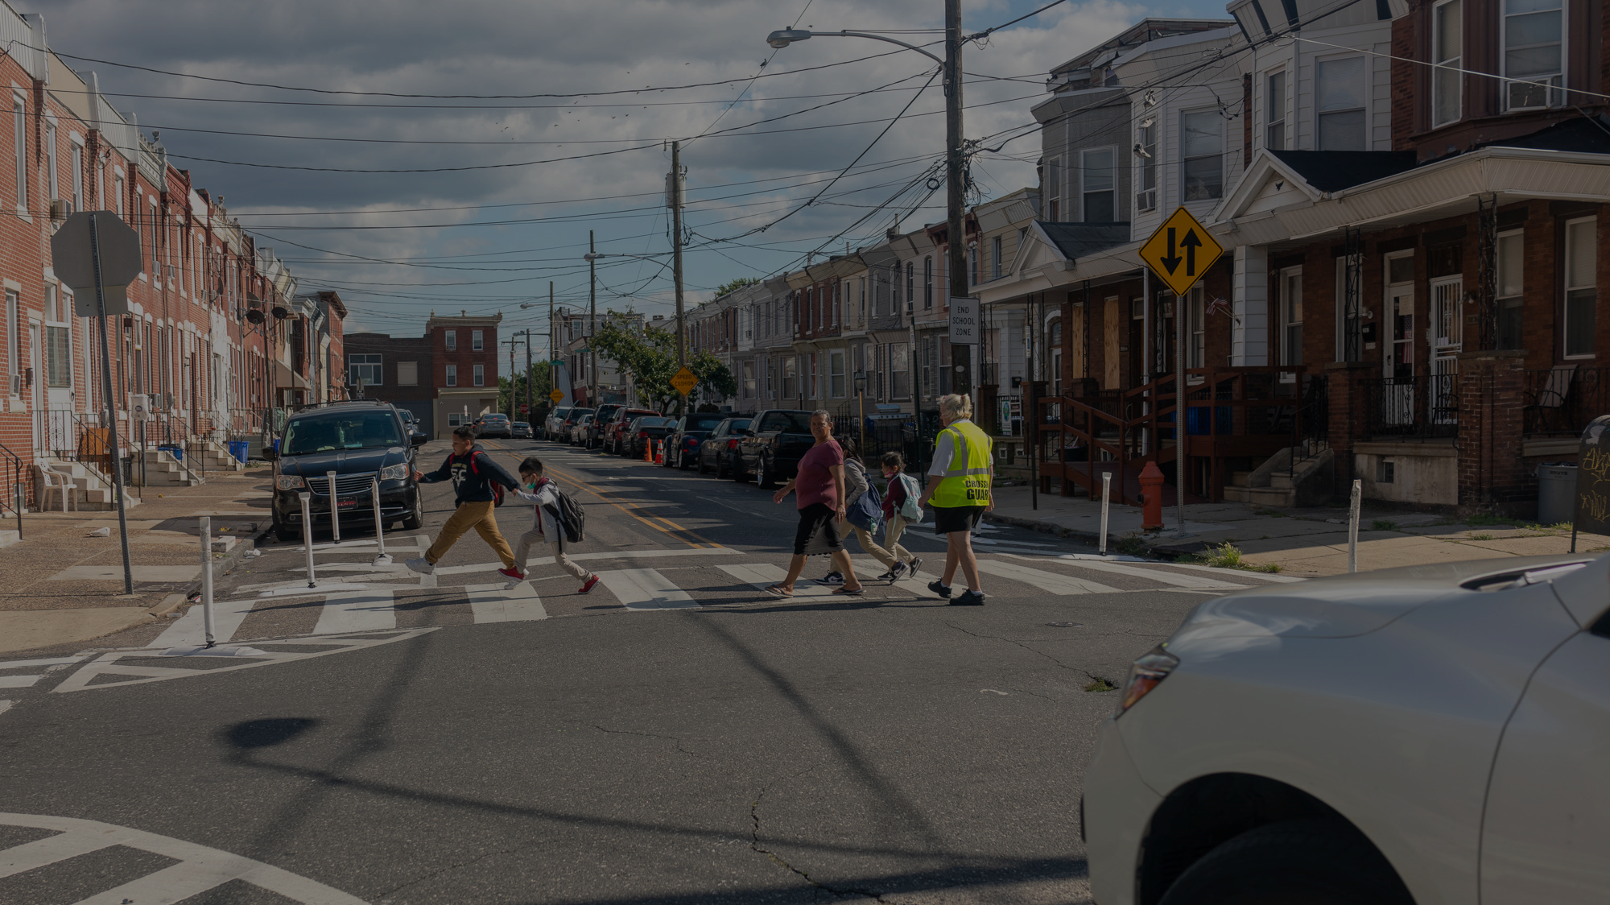


North Philadelphia School Slow Zones

Slide 3
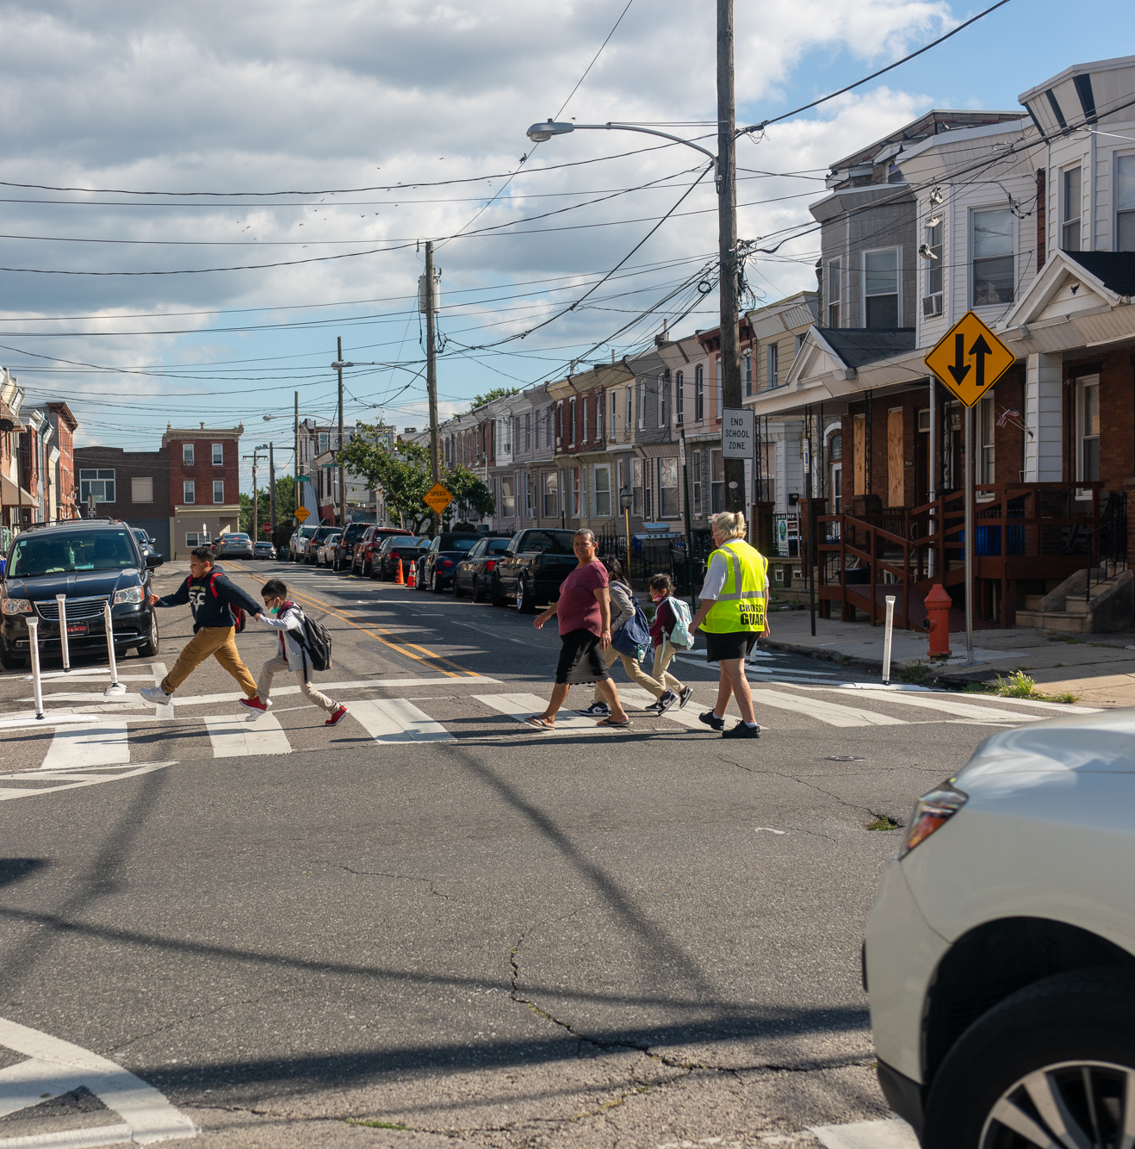
Agenda
Introduction
About Vision Zero
About Safe Routes Philly
About School Slow Zones
Your Involvement
Willard Neighborhood Slow Zone

Slide 4
Summary
Traffic Safety improvements are going to be constructed around Potter-Thomas
We need your help with connecting us to the community so we can gather community feedback

Slide 5
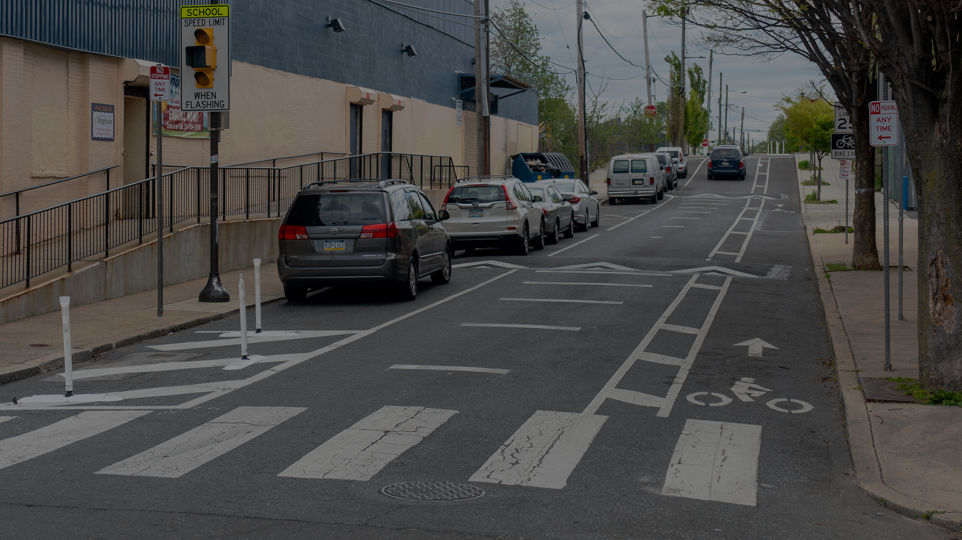

Introduction

Slide 6
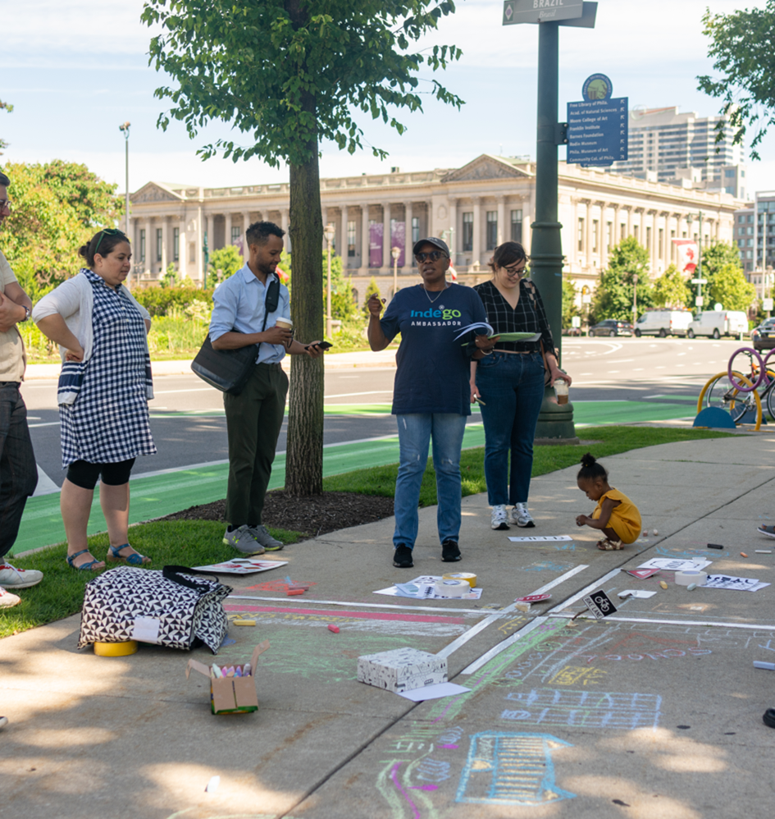
Who are We?
Office of Multimodal Planning
A Division of the Office of Transportation and Infrastructure Systems (OTIS)
Mission Statement
Whether by bus, by bike, on foot, or by car, the Office of Multimodal Planning is leading innovation and engagement to ensure Philadelphians of all ages and abilities can travel safely.

Slide 7
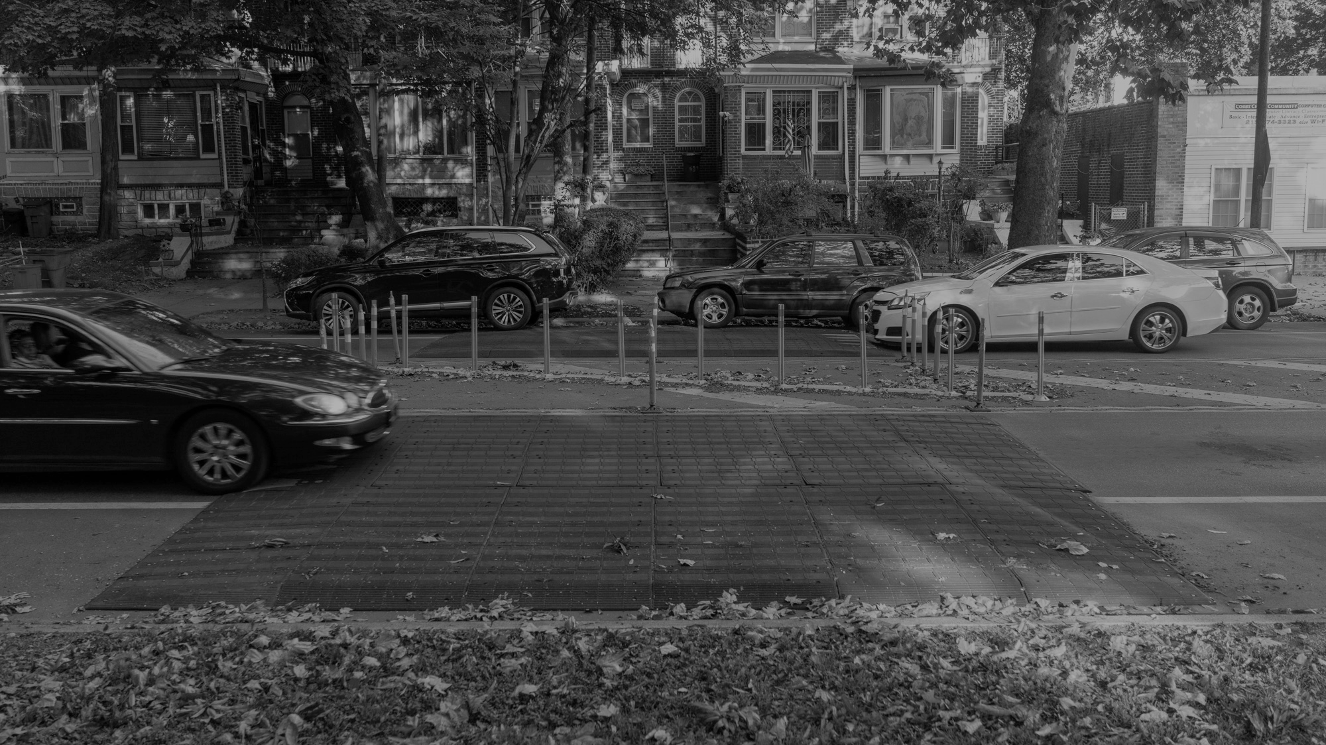
About Vision Zero

Slide 8
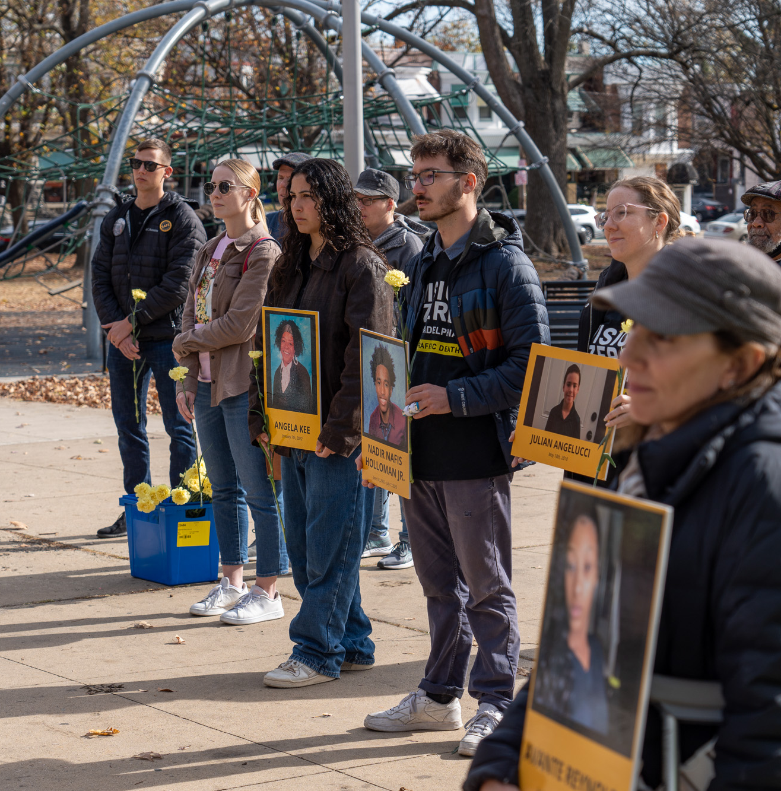
What is
Vision Zero?
A policy that states clearly that traffic deaths are preventable and unacceptable.​
World Day of Remembrance, 2024

Slide 9
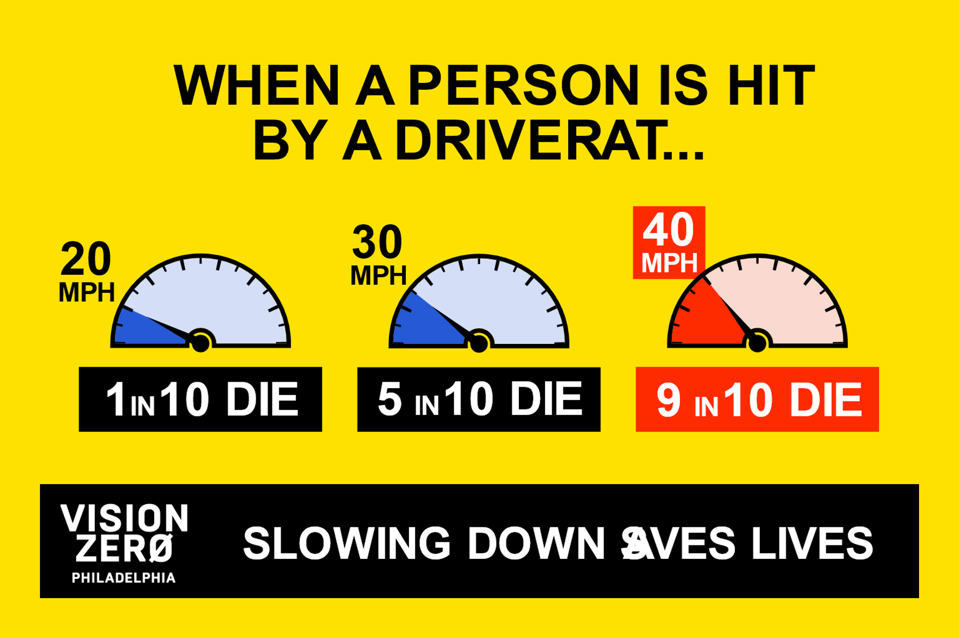

Slide 10
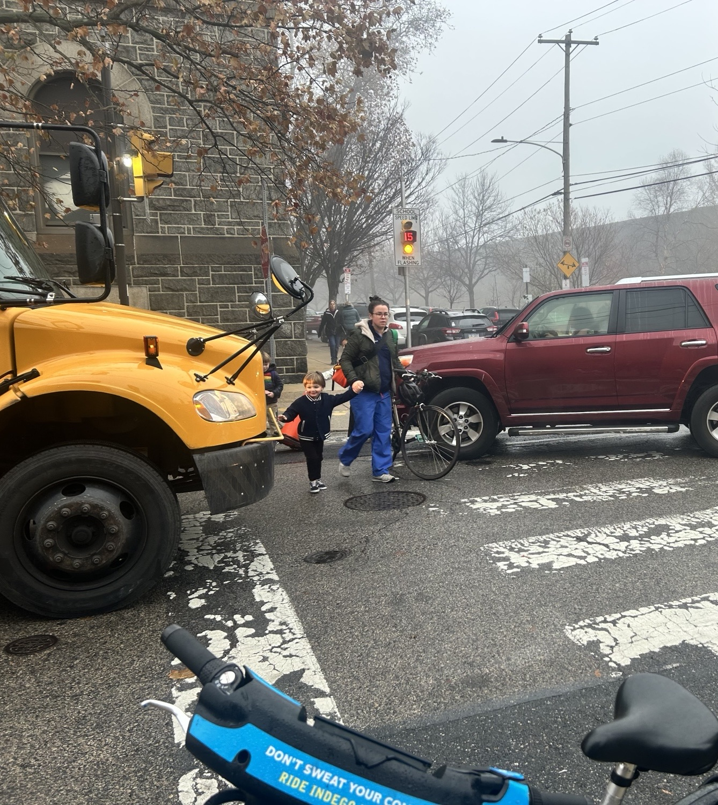
Children are at risk.
Every week in Philadelphia, 4 children aged 17 and under are hit by a driver while walking.

Slide 11
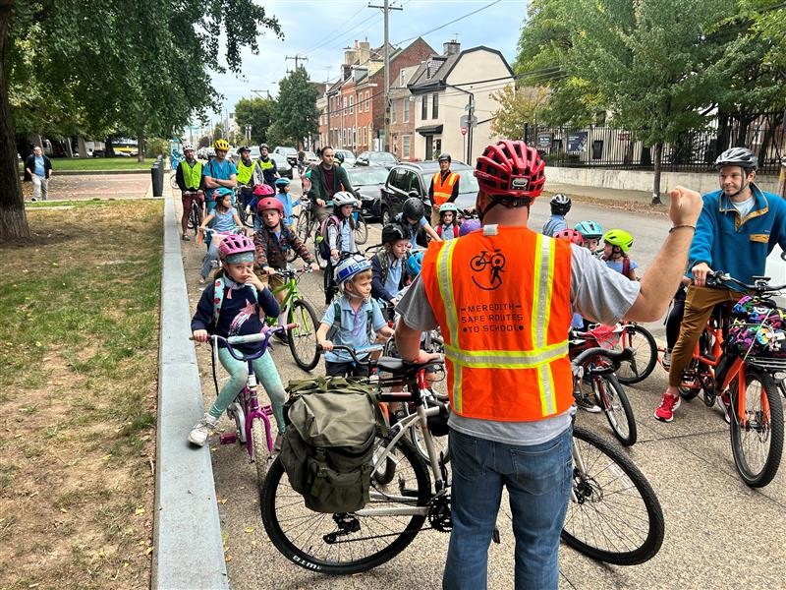

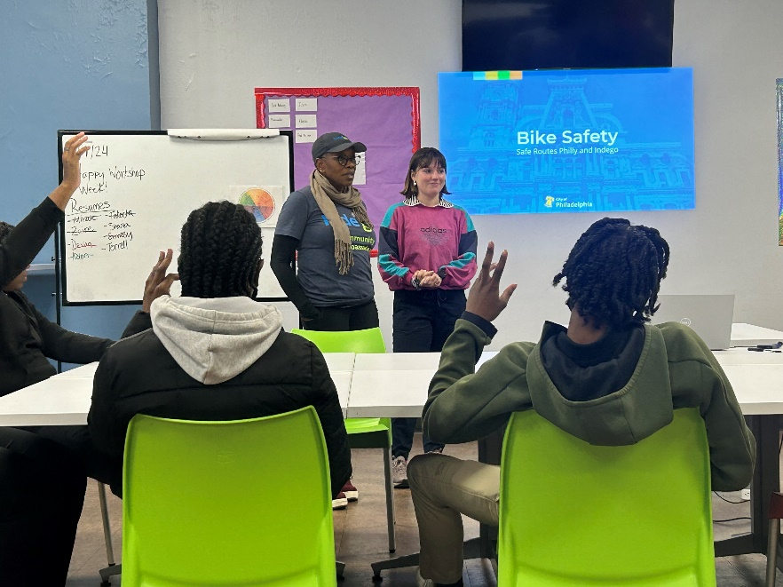
Safe Routes Philly
City’s Youth Pedestrian and Bicycle Safety Program
Lesson plans
Walking and Biking School Buses
Pick-up and Drop-off Support
Ready to go programing that pairs with infrastructure projects

Slide 12
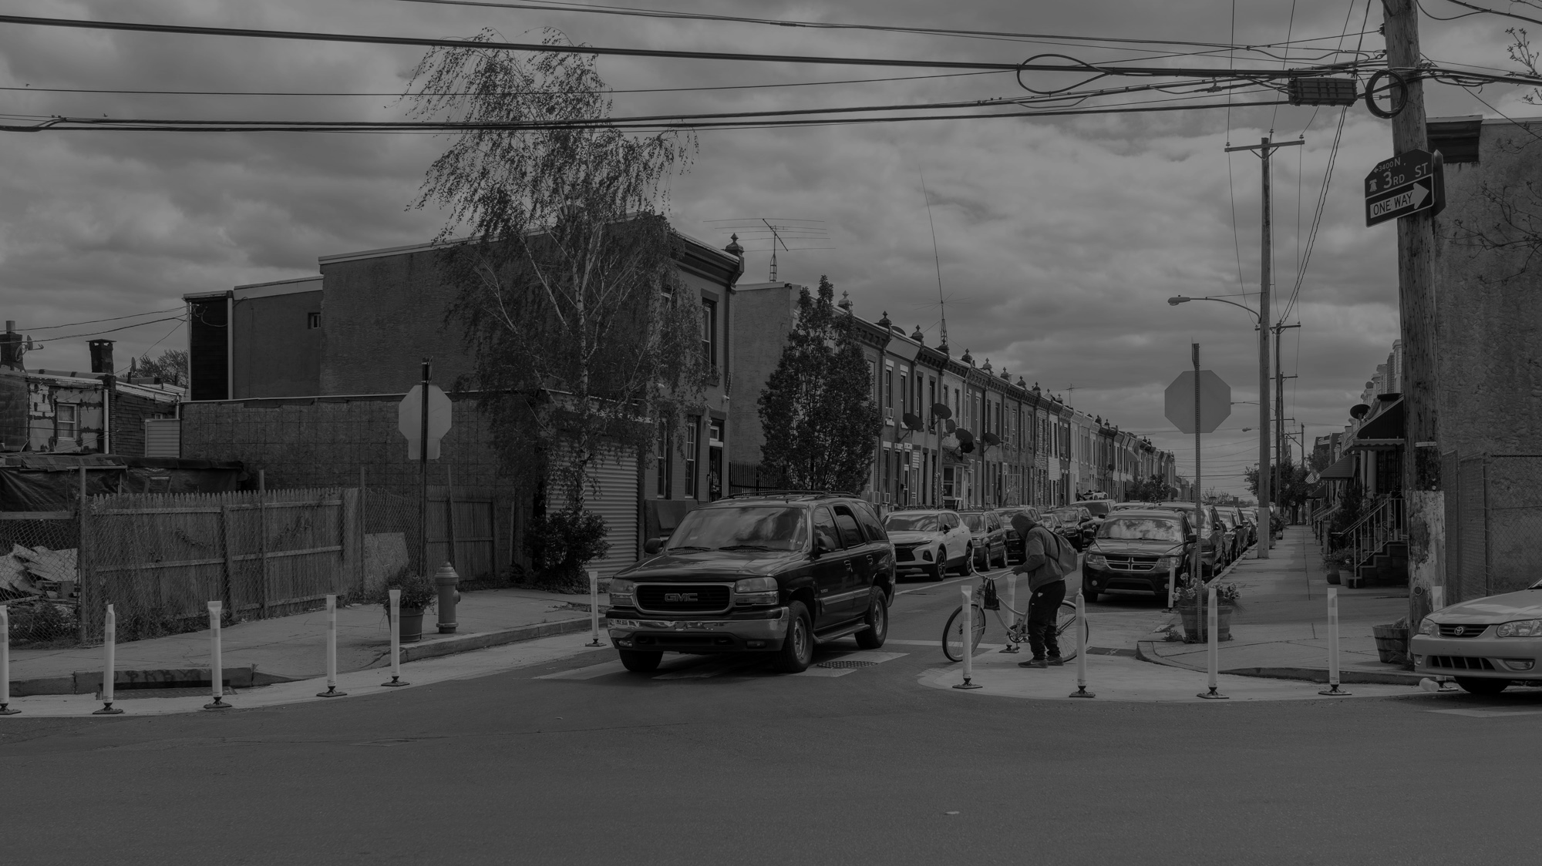
About Slow Zones

Slide 13
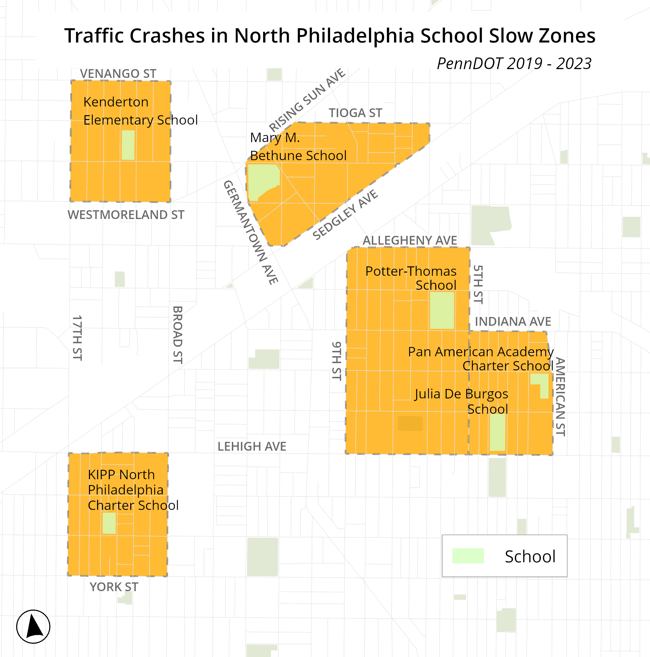
School Slow Zones in North Philadelphia
Six schools in five zones
Kenderton Elementary School
Mary M. Bethune School
Potter-Thomas School
Pan American Academy Charter School / Julia De Burgos School
Kipp North Philadelphia Charter School

Slide 14
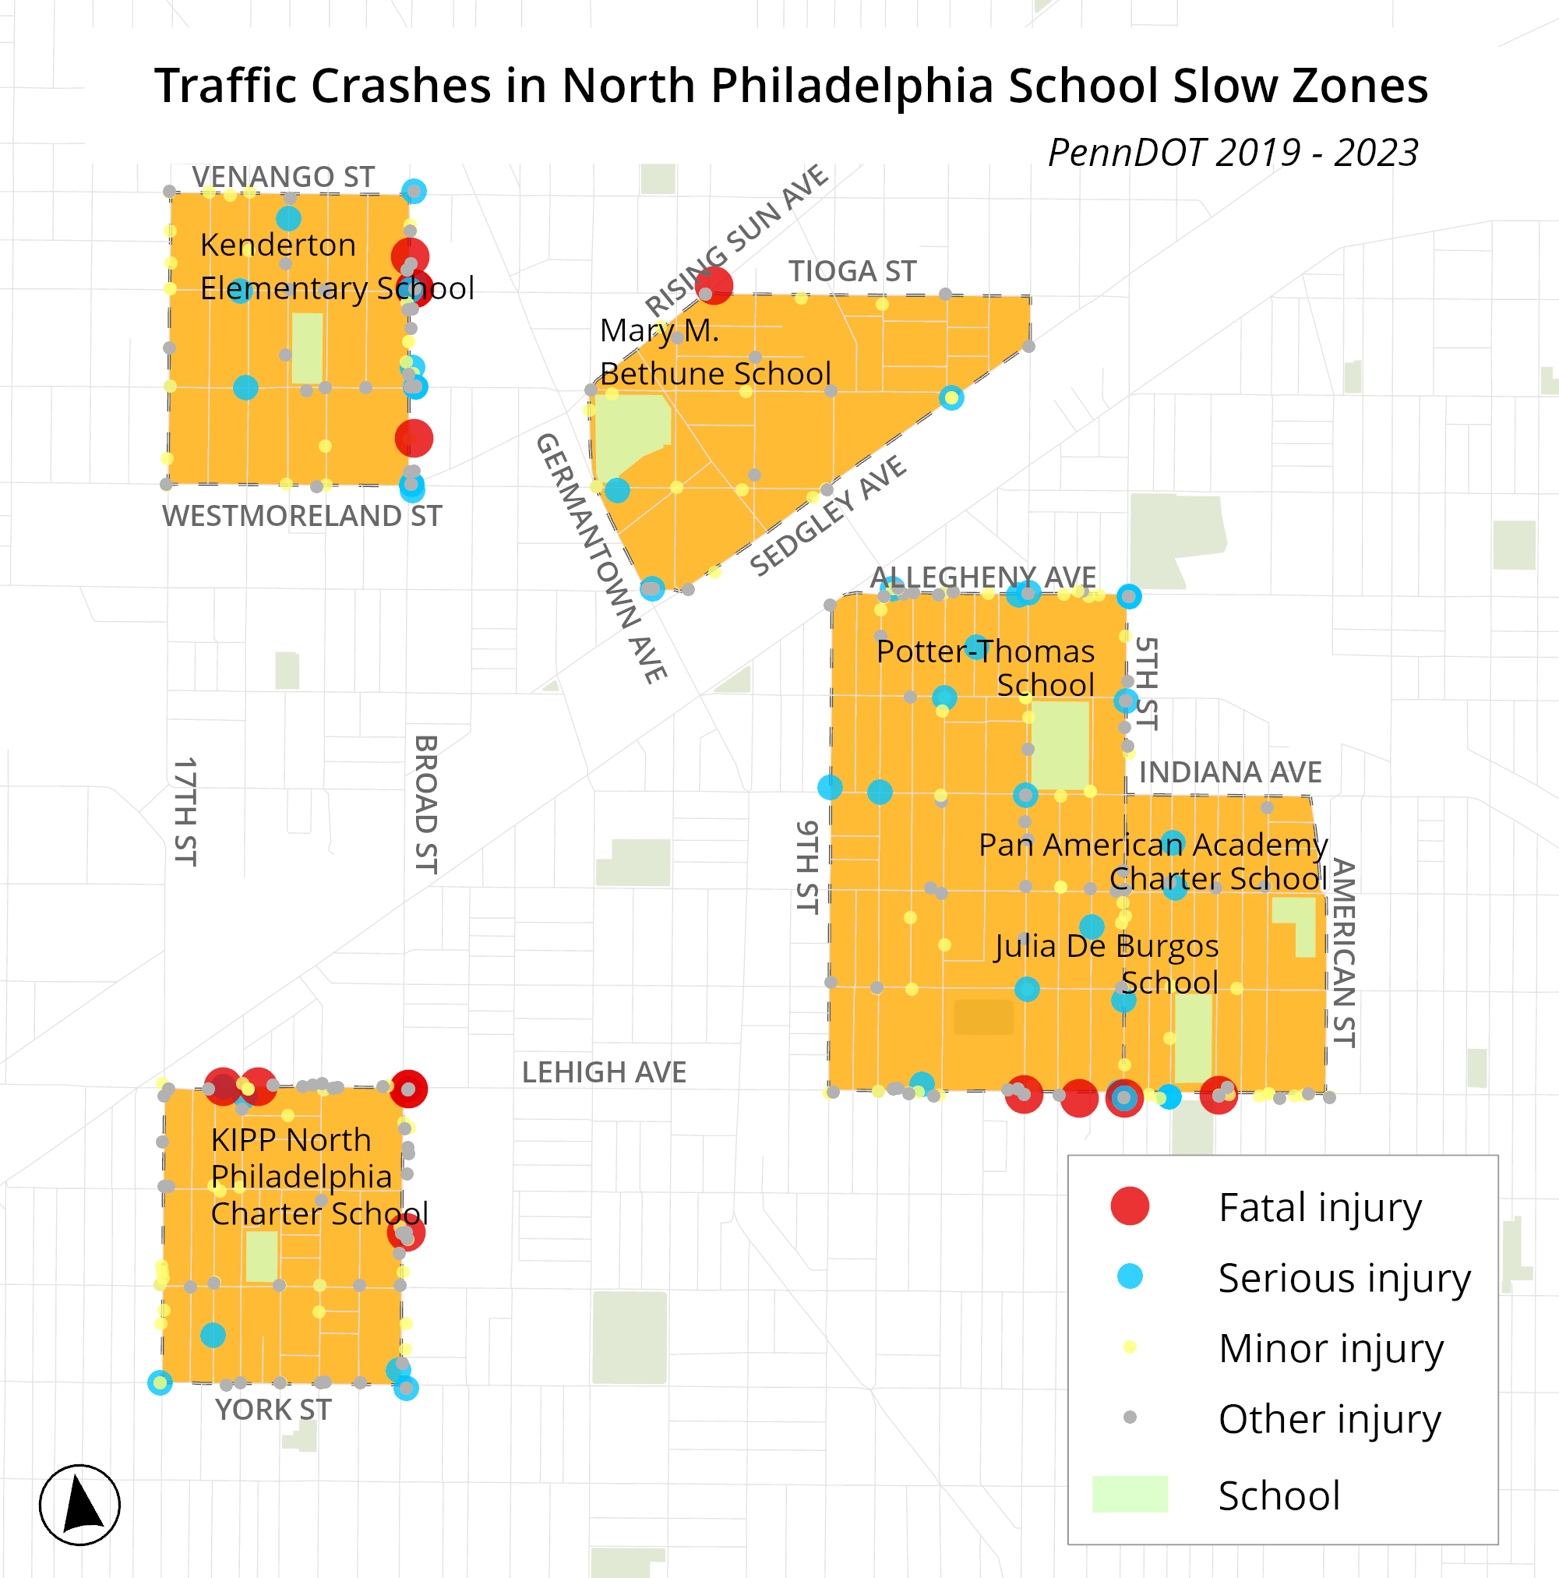
School Slow Zones in North Philadelphia
In the past five years,14 people died and 51 were seriously injured in traffic crashes, including 17 children under 18.
PennDOT Crash Data 2019 - 2023

Slide 15
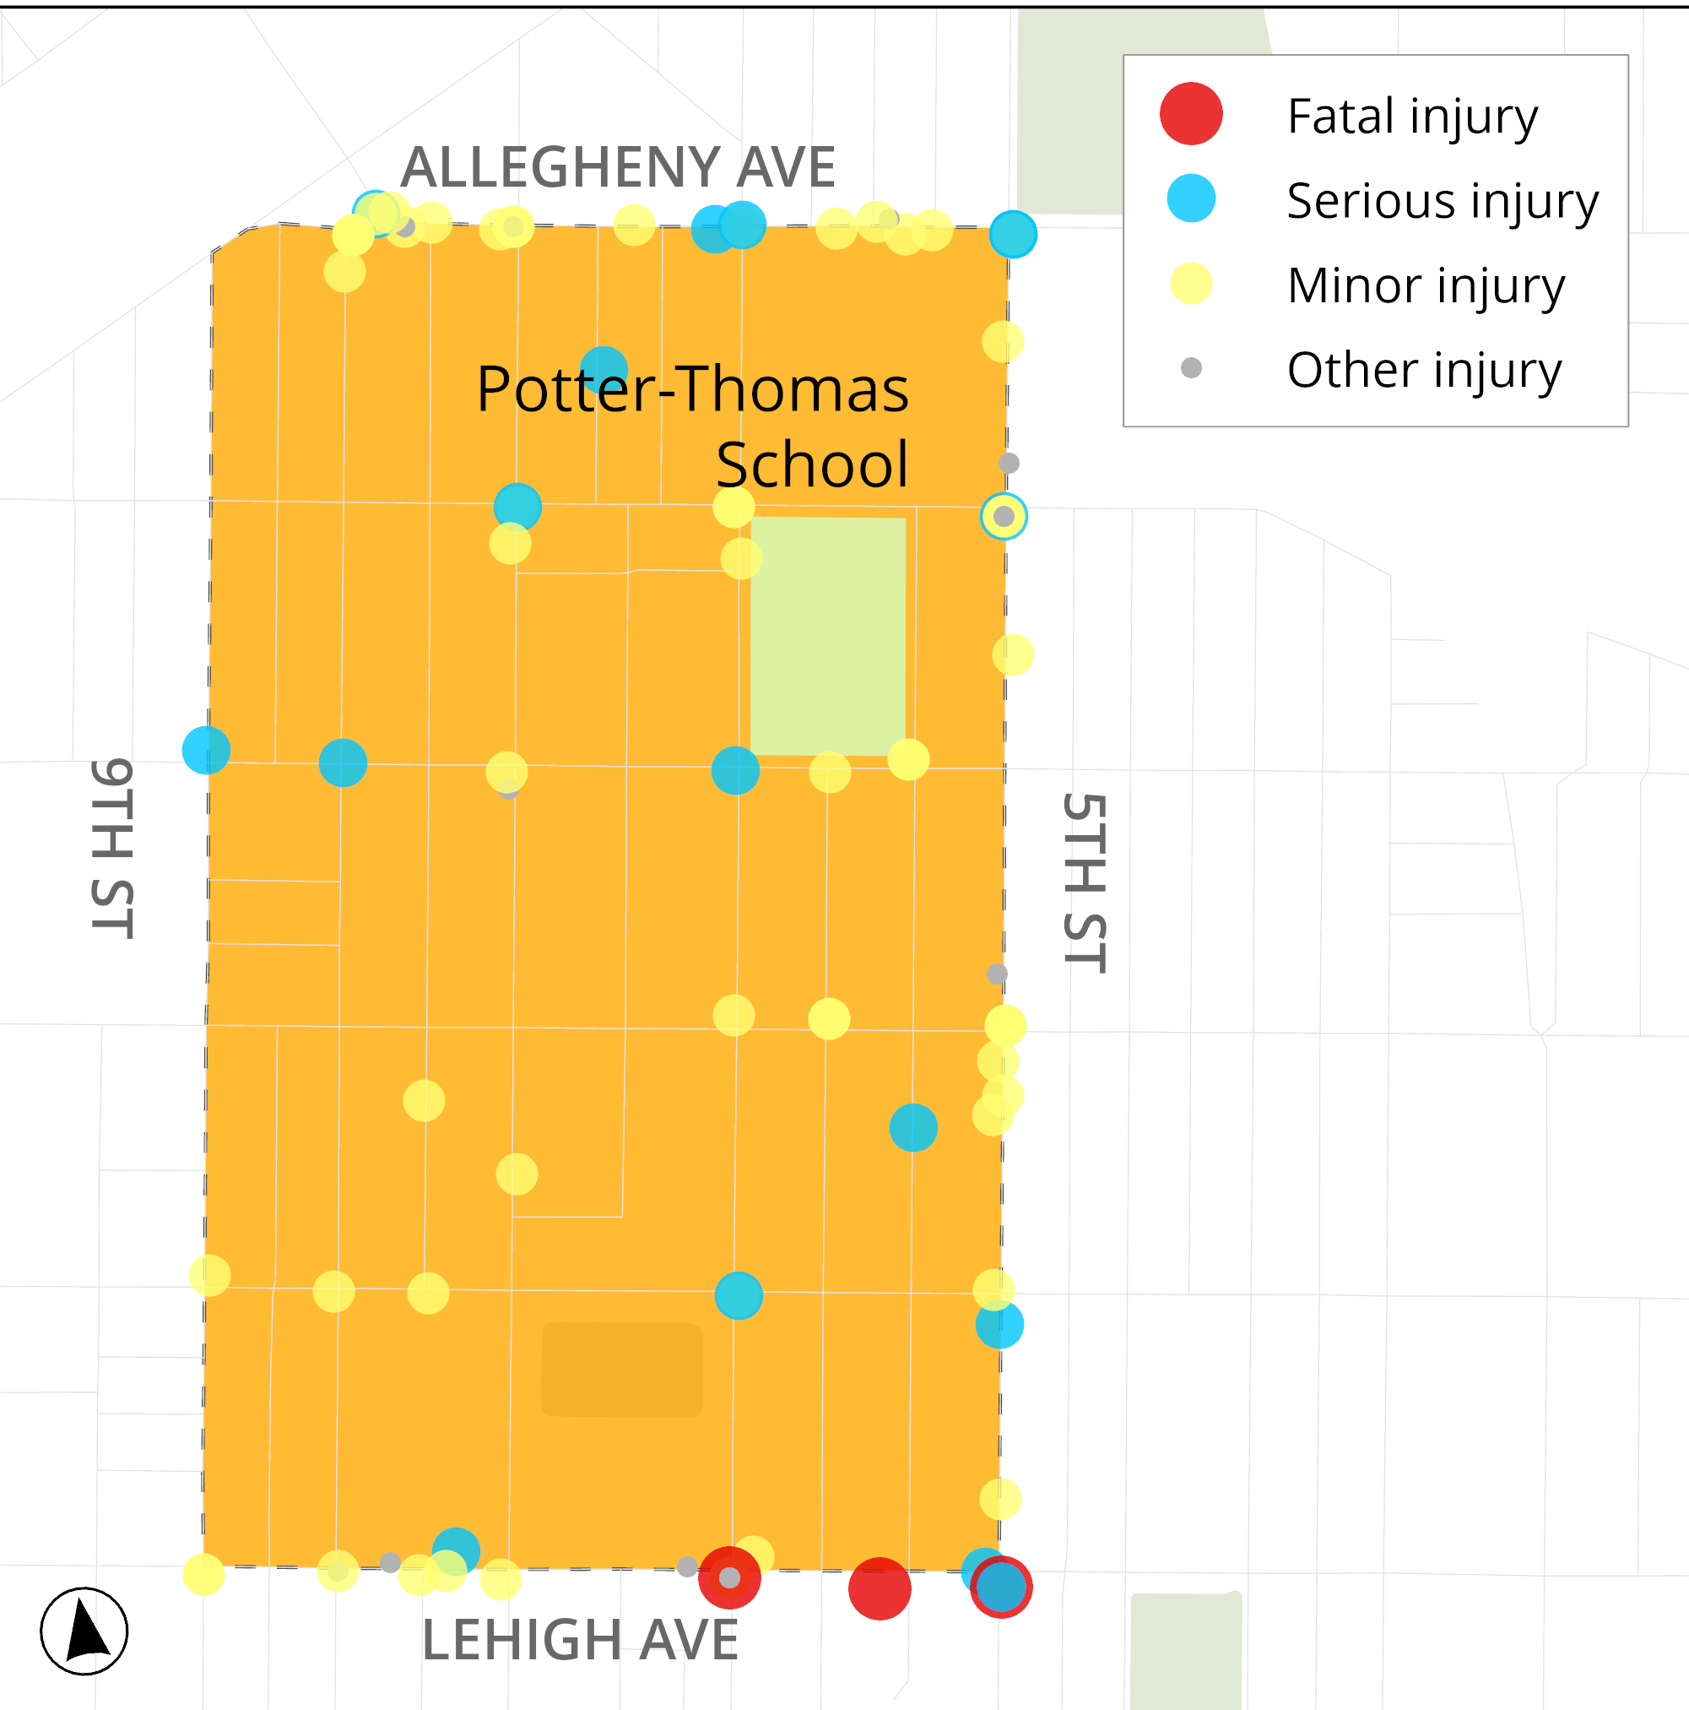
Potter Thomas School Slow Zone
From 2019 to 2023, there were…
193 Crashes
196 people injured
3 people died and 22 seriously injured
PennDOT Crash Data 2019 - 2023

Slide 16
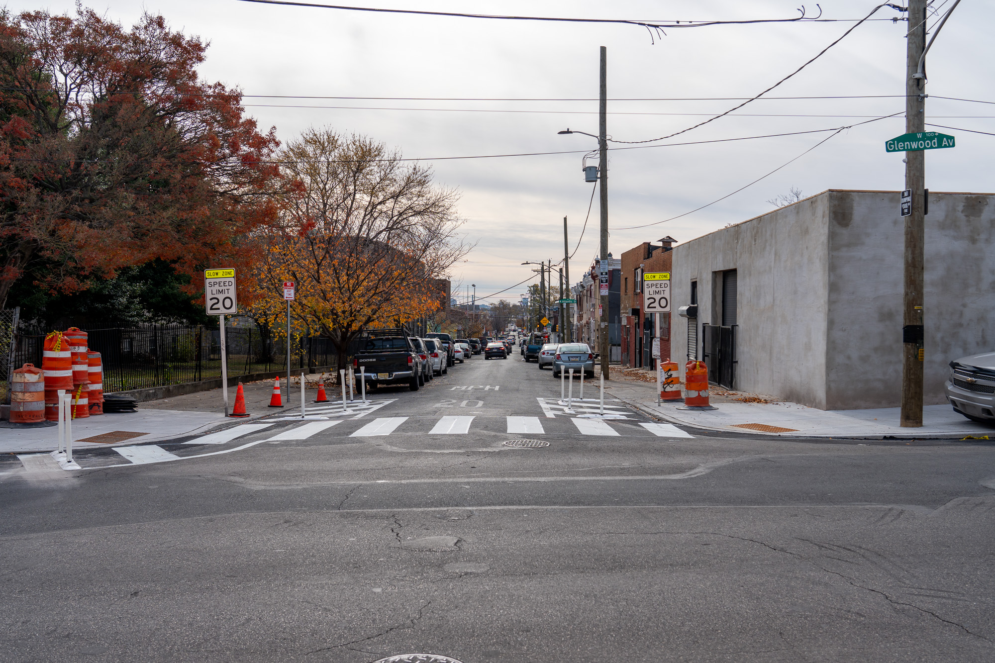
What are Slow Zones?
A program to create safer, more livable neighborhoods by reducing the speed of traffic on residential streets where people live, work, and play.
Cramp Elementary School, 2024

Slide 17
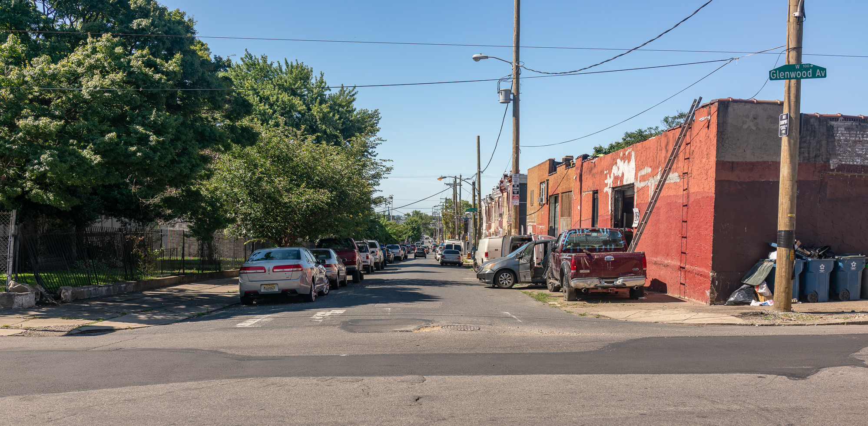
Glenwood Ave & Mascher St, 2024
Cramp Elementary Slow Zone
Glenwood Ave & Mascher St, 2022

Slide 18
Glenwood Ave & Mascher St, 2024
Cramp Elementary Slow Zone
Glenwood Ave & Mascher St, 2024

Slide 19
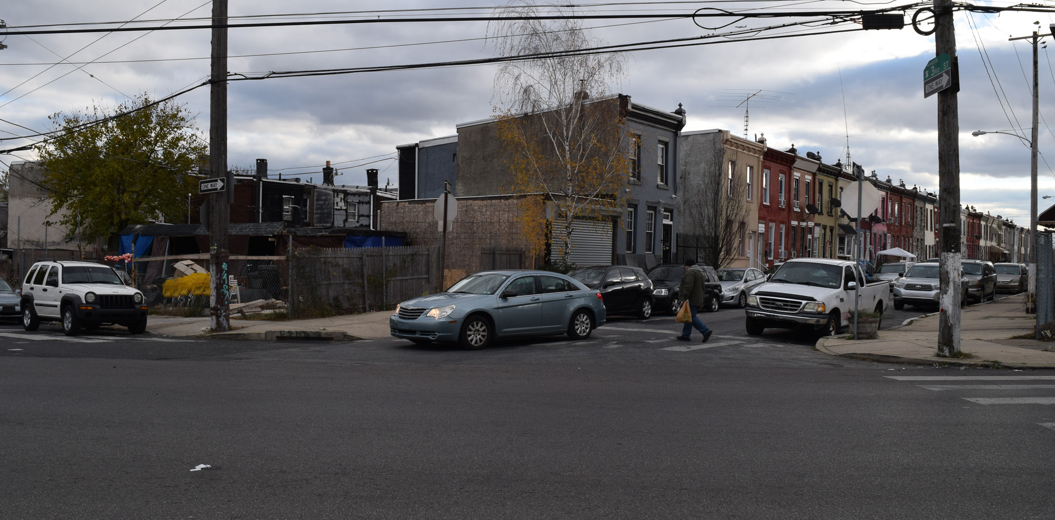
Glenwood Ave & Mascher St, 2024
Fairhill Slow Zone
3rd St and Tioga St, 2021

Slide 20
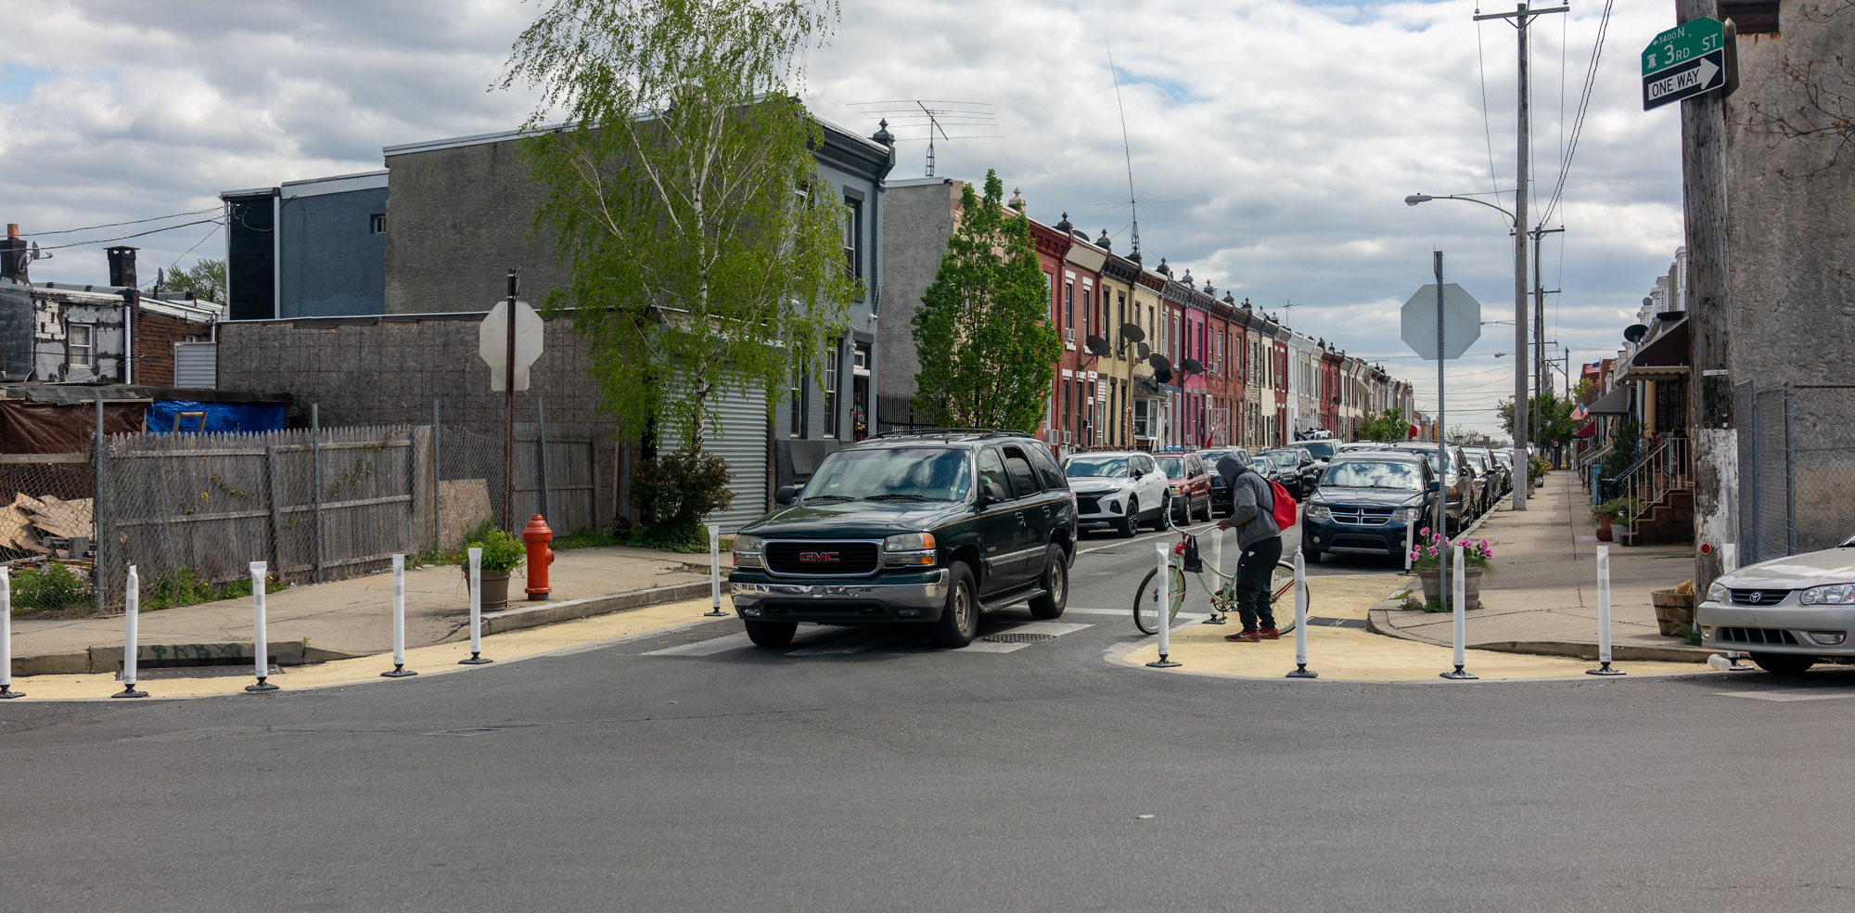
Glenwood Ave & Mascher St, 2024
Fairhill Slow Zone
3rd St and Tioga St, 2022

Slide 21
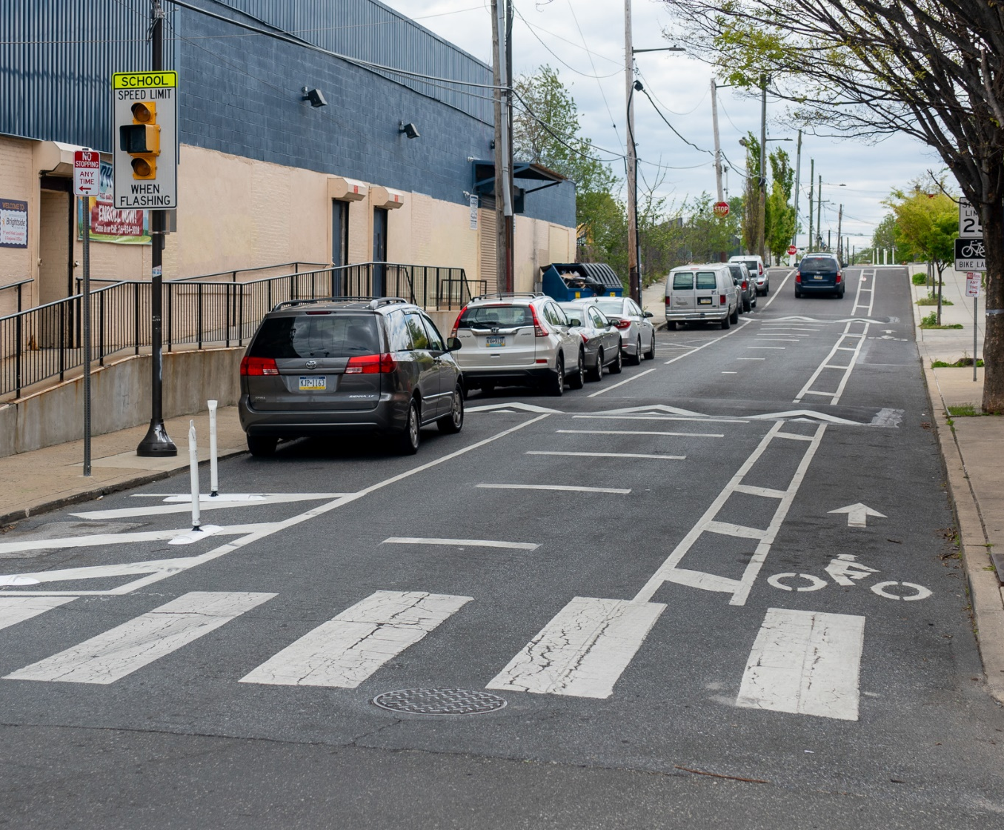
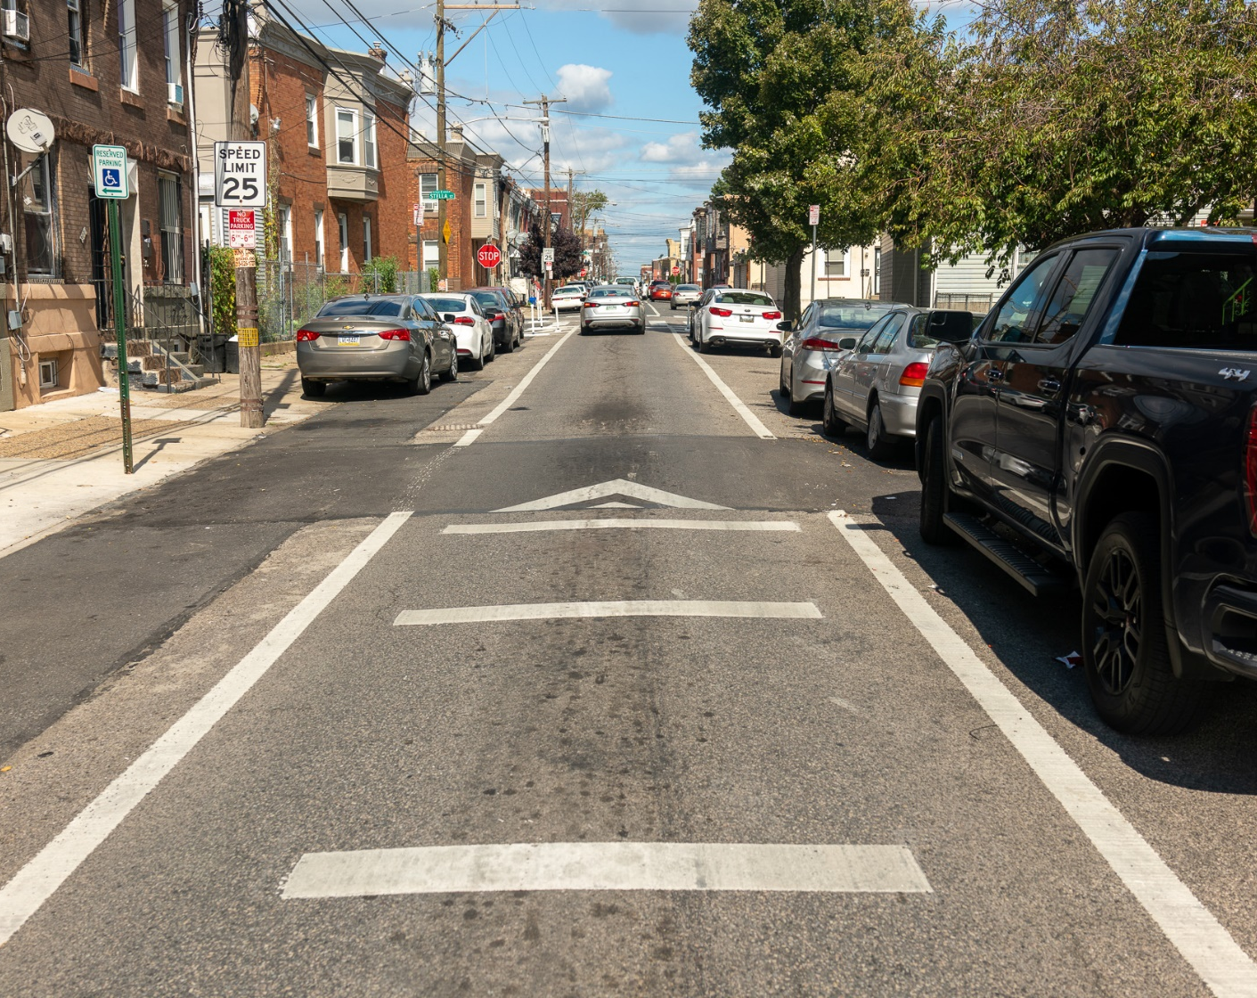
Speed cushions
Westmoreland and 3rd St, Fairhill Slow Zone, 2022
Emerald St & Stella Street, Willard Slow Zone, 2024

Slide 22
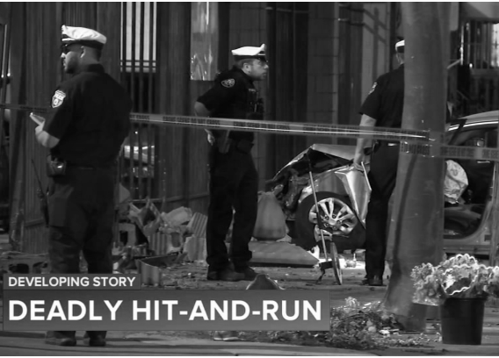
More than a number
A car traveled at high speed on Indiana Ave, hitting a 42-year-old woman crossing 5th St on October 13, 2024.
“She flew up in the air like 10 feet high. And it was really crazy, like some movie stuff I seen. I never seen nothing like this in my life. It hurt my stomach so bad from seeing this kind of situation.” – Anonymous Witness
6abc News

Slide 23




Project Timeline
2024-26
2025-27
2025-27
2027+
Planning and Engagement
Preliminary Engineering
Final Design
Construction
*This project has received Rebuilding American Infrastructure with Sustainability and Equity (RAISE) funding

Slide 24
Project Timeline
Current Phase
2024-26
2025-27
2025-27
2027+
Planning and Engagement
Preliminary Engineering
Final Design
Construction
*This project has received Rebuilding American Infrastructure with Sustainability and Equity (RAISE) funding

Slide 25



Engagement Timeline
Step 1
Winter 2025
Step 2
Spring 2025
Step 3
Summer 2025
Step 4
Fall 2025 +
Define Problem & Get Buy-In
Show (Big) Ideas that Solve the Problems
Develop a Concept
Iterate &
Co-Create
Solidify & Document Support
*This project has received Rebuilding American Infrastructure with Sustainability and Equity (RAISE) funding

Slide 26
Engagement Timeline
We’re Here
Up Next
Step 1
Winter 2025
Step 2
Spring 2025
Step 3
Summer 2025
Step 4
Fall 2025 +
Define Problem & Get Buy-In
Meetings with schools and RCOs
General survey
Show (Big) Ideas that Solve the Problems
In-person interactive activity
Develop a Concept
Iterate &
Co-Create
Solidify & Document Support
*This project has received Rebuilding American Infrastructure with Sustainability and Equity (RAISE) funding

Slide 27
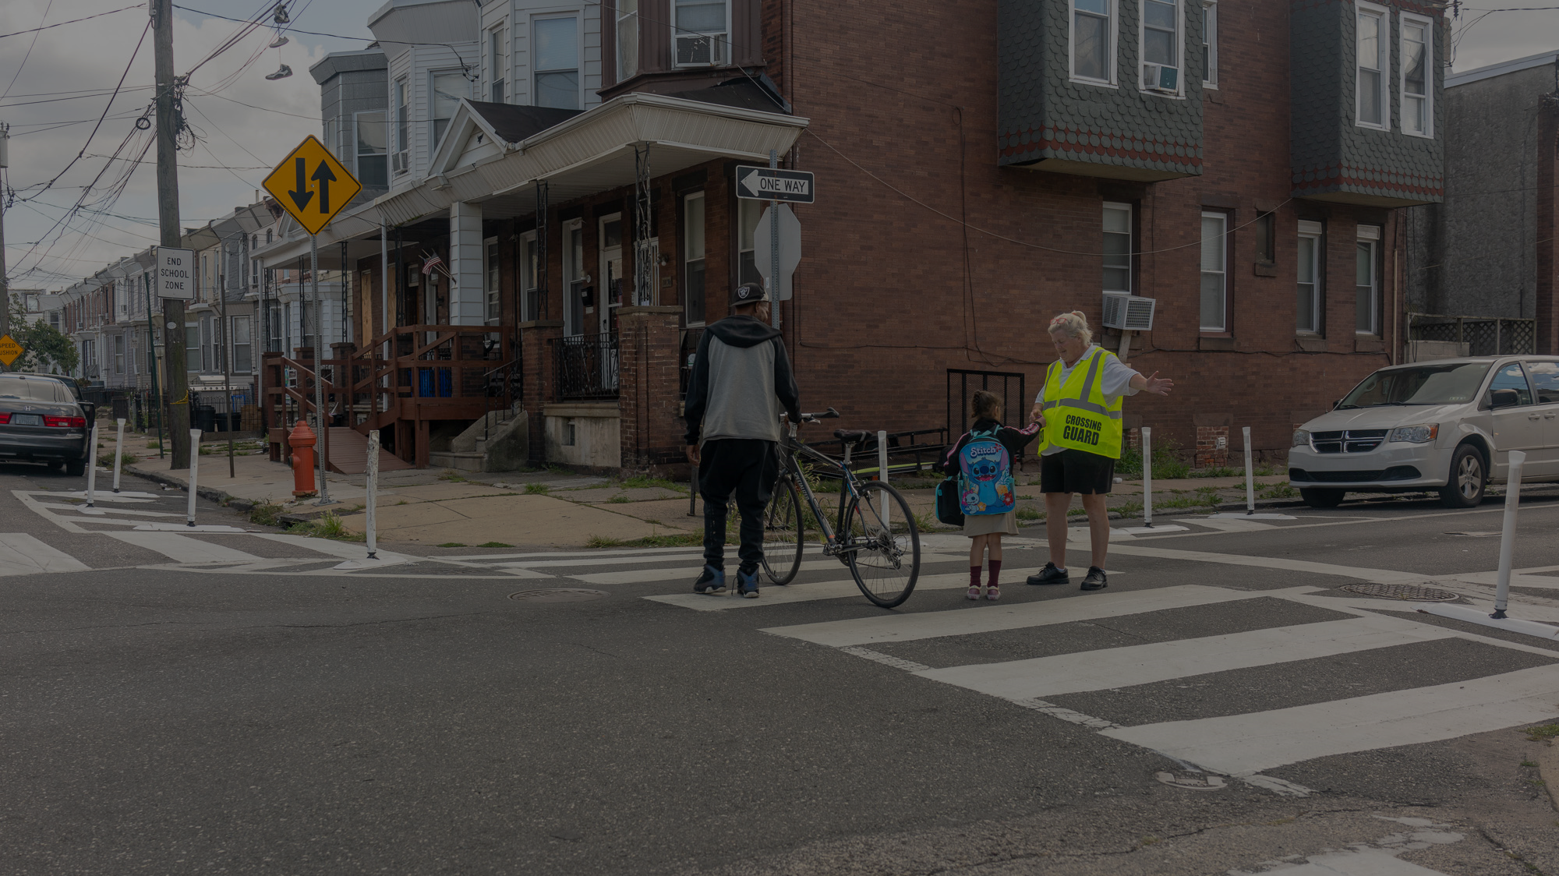
Your Involvement

Slide 28
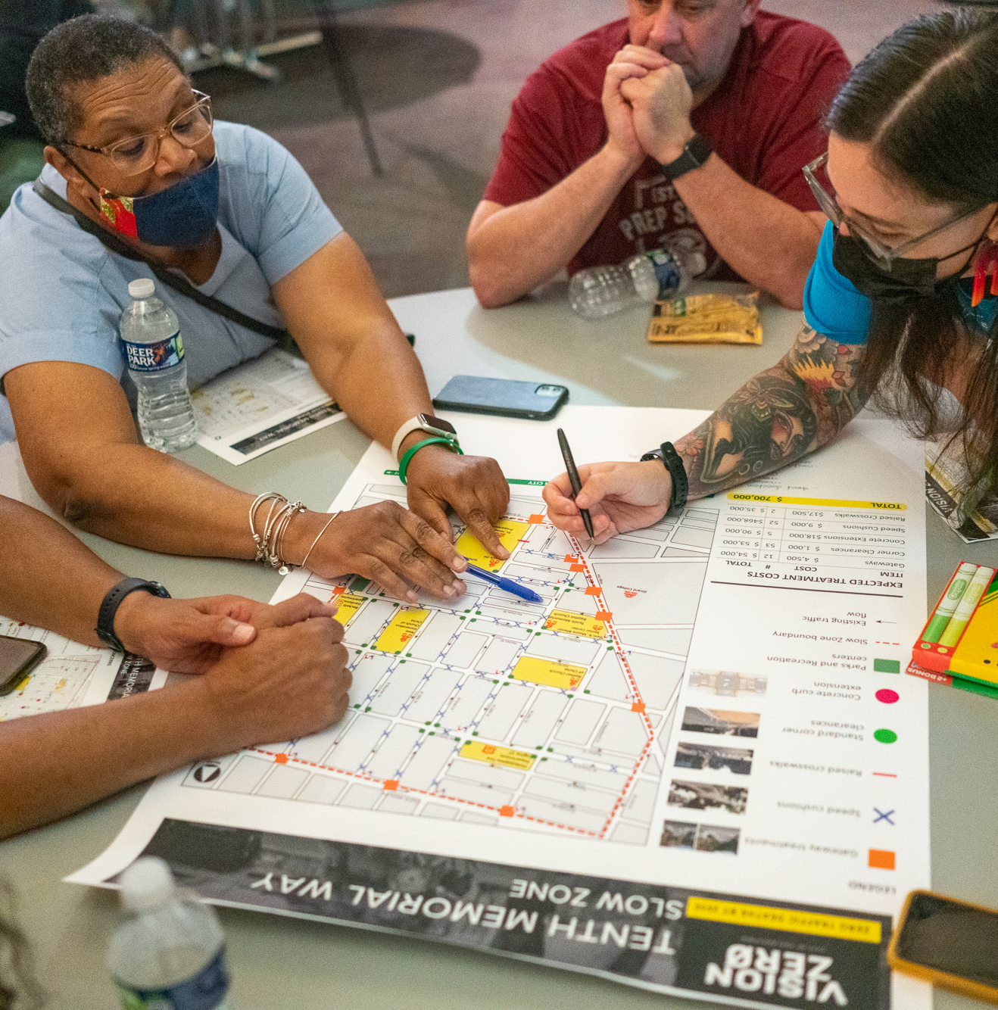
We want your help
How do you connect with your community
Would you be willing to host a community meeting at your school in April
Opportunities for traffic education
10th Memorial Slow Zone Engagement, 2023

Slide 29
Any Questions?
otis@phila.gov

