Slide 1
Philadelphia Fair Housing Commission

Slide 2
Philadelphia Fair Housing Ordinance
City Council enacted FHO in 1962
Philadelphia Code § 9-800
FHO established Fair Housing Commission
Since amended multiple times as housing needs have involved.
Examples: Good Cause and COVID-19 Protections
Notes:
Detail of the law

Slide 3
Fair Housing Commission Key Points
Agency where Tenants file complaints to exercise their legal rights.
Free, do not need a lawyer, not a court, no judgments.
Cases end with positive outcomes for tenants, landlords and neighborhoods .
Notes:
Repairs completed – more habitable properties, Landlords obtain proper licenses and certificates to rent, More stable neighborhoods and communities

Slide 4
Fair Housing Commission Overview
Composed of 5 members appointed by the Mayor.
Has the power to hold hearings and conduct investigations in connection with any unfair rental practice.
Has the authority to compel the attendance of witnesses and production of documents.
Notes:
Investigate – by complaint or FHC can initiate

Slide 5
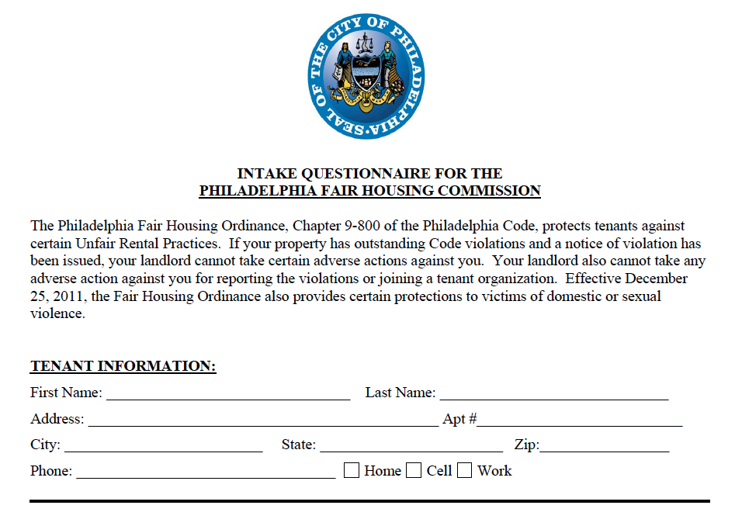
Intake Process
Intake Form Submission.
Intake Interview with Supporting Documentation.
Lease, rent receipts, letters, etc.
Intake Investigation.
Licensing, CRS, Lead, and Code violations.
Complaint Signed and Docketed.
Complaint Served.
Hearing Scheduled.
Document Submission.
Hearing and Order.
Notes:
FHO and other laws

Slide 6
FHC Hearings
Trial structure.
Zoom Hearings with video and audio recording.
Testimony and evidence.
Commissioners weigh facts presented and render decision.
Issue formal orders .
30 days to appeal to Court of Common Pleas.
Notes:
FHO and other laws

Slide 7
Landlord-Tenant Relationship
Governed entirely by lease.
Contract for possession of a property in exchange for money.
Can be Oral or Written.
Governs relationship between parties.
Illegal lease provisions are unenforceable, but do not generally invalidate an entire lease.

Slide 8
Landlord Obligations Prior to Renting
Landlord must have a license to collect rent.
Landlord must have a Certificate of Rental Suitability (“CRS”).
Landlord must deliver the CRS and the “City of Philadelphia Partners for Good Housing Handbook” to Tenant to collect rent.
Landlord must have the property tested for lead and obtain a lead certificate from the City.
Landlord must have a Managing Agent located in Philadelphia.

Slide 9
Rental License Sections 9-3902 and 9-3901
Prior to renting a property a landlord must get a rental license from the City of Philadelphia.
Different from an occupancy permit, use permit, or work permit.
Must list the proper number of rental units in the property.
If a landlord fails to comply, they cannot recover possession or collect rent during time of default.

Slide 10
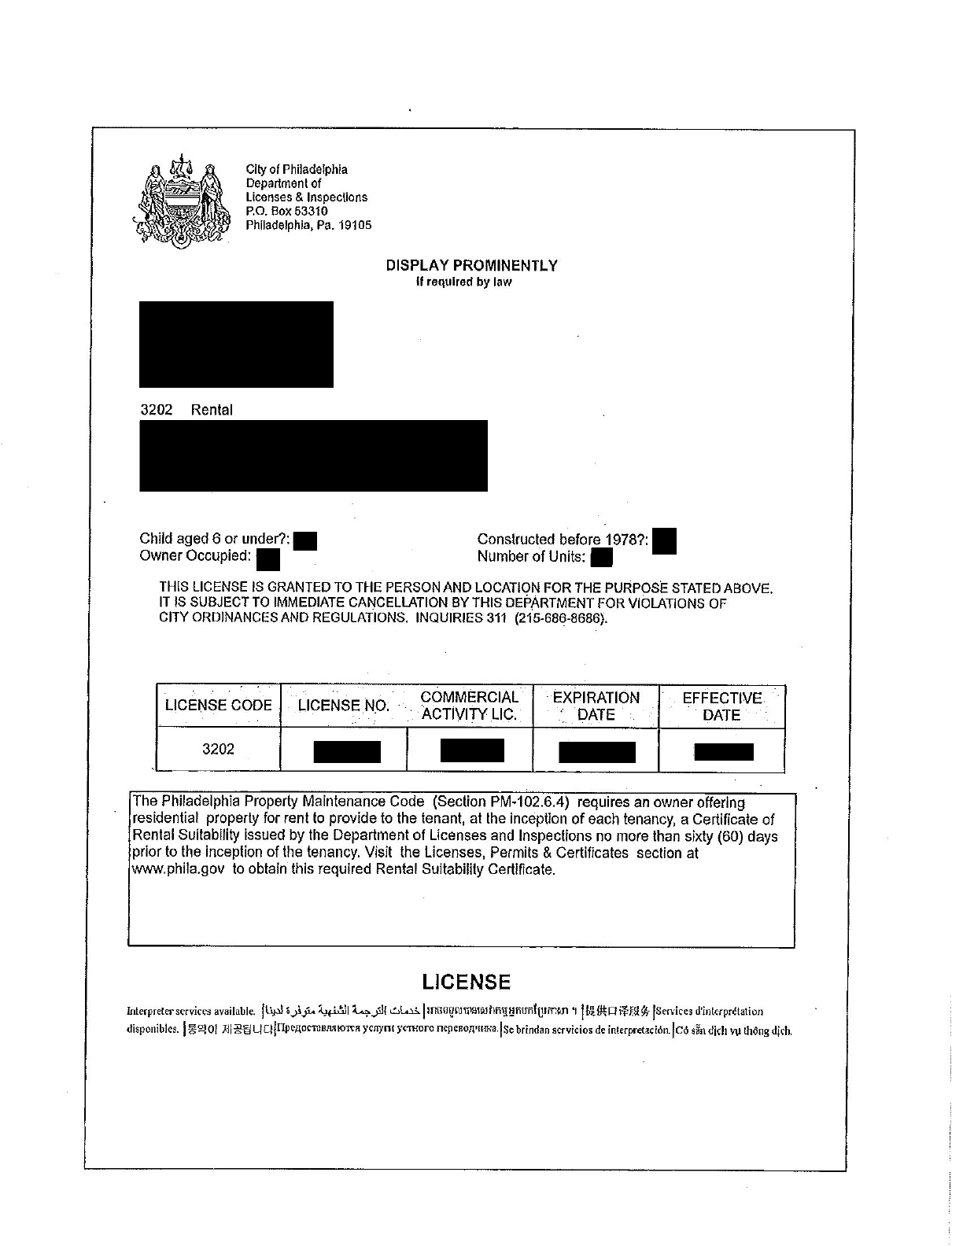

Slide 11
Certificate of Rental Suitability –Sections 9-3903 and 9-3901
Prior to renting a property, landlord must provide certificate to tenant issued by L&I no more than 60 days before tenancy:
Owner has obtained all licenses
Property has no code violations
Landlord must attest to fire and smoke system in working order.
Landlord must attest to habitability of premises and will continue to maintain property in future, give copy of Partners in Good Housing.
Failure to comply, Landlord cannot recover possession or collect rent during time in default.

Slide 12
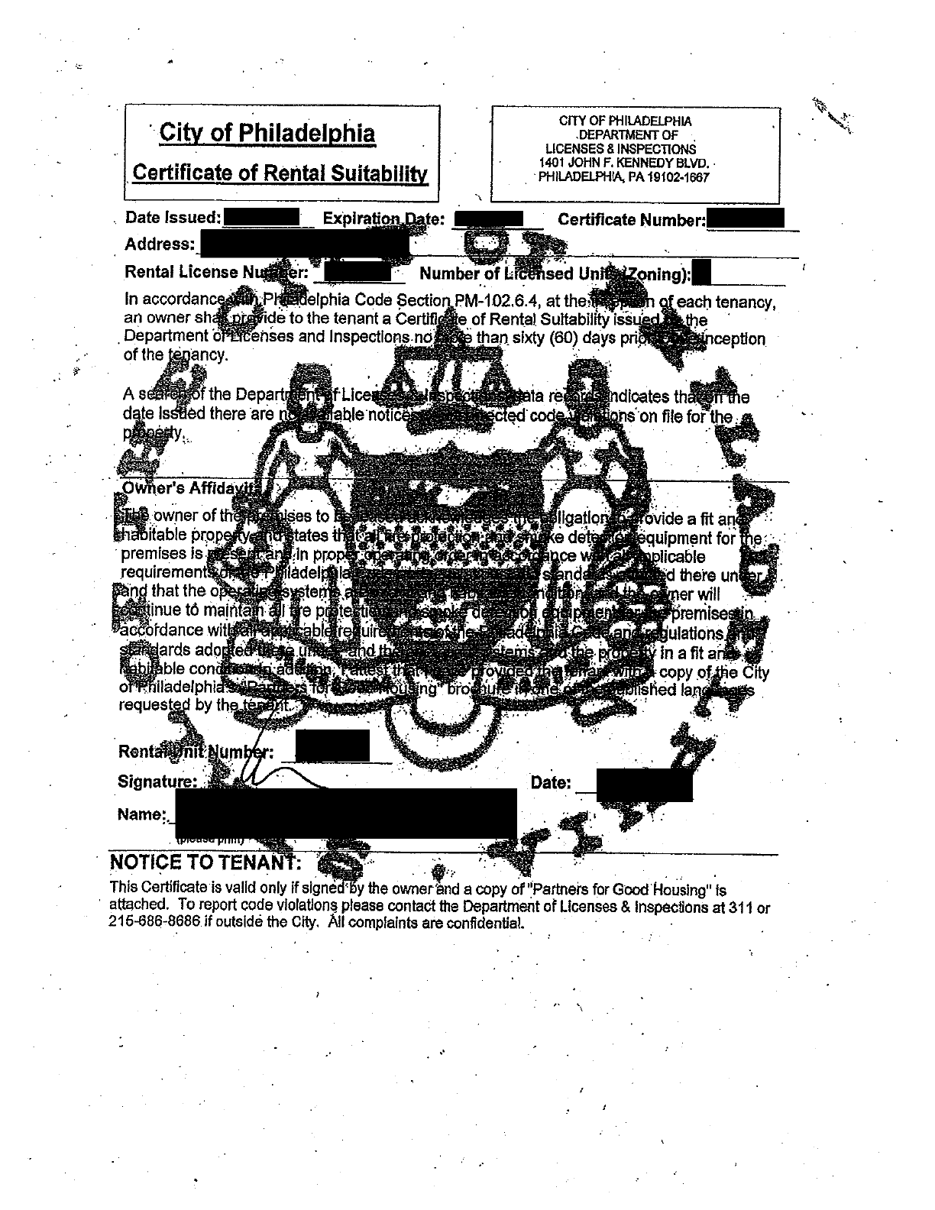

Slide 13
Lead Certification Section 6-800
Landlords must have all properties tested for lead by a certified lead inspector.
The lead results then must be submitted to the City of Philadelphia who issues a Lead-Safe or Lead-Free Certificate.
Lead-Safe or Lead-Free Certificate must be provided to tenants at the inception of the lease.
Failure to comply, Landlord cannot recover possession or collect rent during time in default.
Notes:
Previous law was testing only for properties of a certain age and who had children under six.

Slide 14
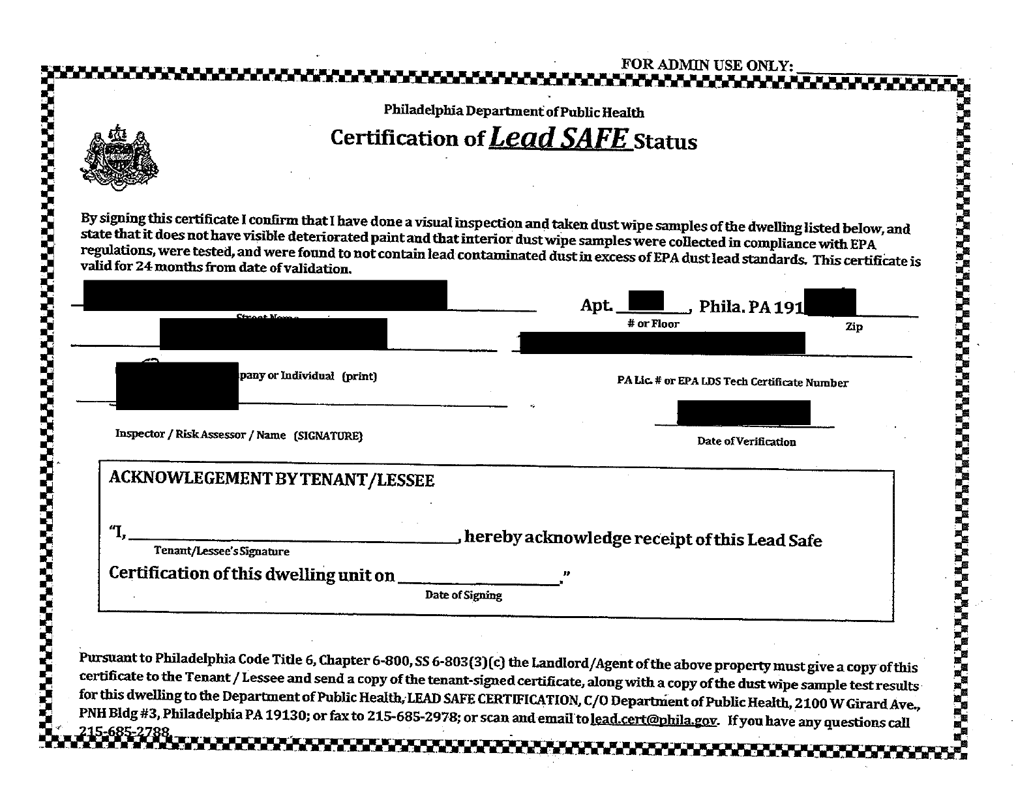

Slide 15
Tenant Obligations
Pay rent on time and get receipts.
Report problems to landlord in writing, sign, date – keep a copy!
Inform landlord of intent to withhold rent in writing.
Allow landlord access to the property make repairs.
Remove all belongings from the property at move-out.

Slide 16
Landlord Obligations
Provide receipts for payments.
Act on repair issues quickly.
Communicate, in writing, often with tenants.
Schedule repairs for specific times and dates with written notice.
Document conditions, repairs and access.

Slide 17
Tenant Remedies for Repairs
Pugh v. Holmes, 384 A.2d 1234 (1978 PA Supreme Court)
Each lease has an “implied warranty of habitability.”
Landlord’s breach of the implied warranty of habitability reduces Tenant’s rental obligation while the conditions exist.
The amount of rent reduction is called an abatement and is based on the “percentage reduction in use” method.

Slide 18
Tenant Remedies for Repairs (Continued)
Withhold
Tenant may withhold all or portion of the rent until Landlord makes repairs with notice to Landlord.
Does not have to be in an official escrow account. (Examples: bank account, money order receipts, cashier’s check).
Repair and Deduct
With notice to Landlord, Tenants can make repairs and deduct costs from rent

Slide 19
§ 9-804 (1): “Unfair Rental Practices”
Whenever a premises is found in violation of any provision of The Philadelphia Code and a violation notice is issued, it shall be illegal for a landlord to:
(a) Terminate the lease
(b) Transfer possession of the property
(c) Modify any term or condition of the lease
(d) Modify the lease to collect cost of making repairs and/or if violations remain uncorrected for 1 year or more
Notes:
Notice has been issued by any department or agency; Landlord = owner, landlord or agent; (unless the tenant has failed to pay rent, committed a nuisance or caused the Code violations); Until the violation has been corrected; Burden is on the Landlord to show that the violation has not existed uncorrected for 1 year or more prior to the date of correction

Slide 20
§ 9-804 (2): Retaliation
An owner or landlord cannot terminate or modify any terms of a lease with a tenant in retaliation for:
Violations found against the premises
Filing of a complaint alleging a violation
Joining of any lawful organization
Any other exercise of a legal right
An incident of domestic violence or sexual assault
Notes:
Burden of Proof on the Landlord to prove that the notice was not given in retaliation for the tenant exercising their legal rights.; DV = In which the tenant was a victim, or a tenant’s status as a victim

Slide 21
Additional DV and SA Protections § 9-804 (6)
Landlord must allow a tenant, who is a victim of DV or sexual assault, to terminate the lease early without penalty provided the tenant follows certain procedures.
Landlord may allow the tenant, to bifurcate the lease.
Notes:
Request is made, in writing, within 90 days of (i) the reporting of an incident of DV or SA, (ii) the issuance of a protection from abuse order; or (iii) the approval of a consent agreement, and at least thirty (30) days before the requested termination date; (b) the victim vacates the premises by the early termination date; and (c)at the time the early termination request is made, the tenant provides: (i) a court order or approved PFA Order; (ii) an police incident report stating that a DV or SA complaint was filed by the tenant; or (iii) written certification from a health care professional, licensed guidance counselor, or victim’s services organization stating that the tenant sought assistance as a victim of DV or SA

Slide 22
Good Cause FHO § 9-804 (12)
Applies to leases less than one year.
Includes leases that convert to shorter time frames, such as month to month.
Landlords must include a Good Cause reason to terminate the lease.

Slide 23
Examples of Good Cause
Habitual non-payment or late-payment of rent (does not apply if the tenant is legally withholding rent).
Breach or non-compliance with a “material term” of the lease.
Nuisance Activity engaged in by the tenant that interferes with others’ use and enjoyment of the property.

Slide 24
Good Cause Examples (Con’t)
Tenant does not allow landlord access to the property, after the landlord has provided written notice.
Tenant refuses to sign an extension of the lease for generally the same lease terms.
Owner, or an immediate family member of the owner, is going to move into the unit.
Notes:
#3 – OWNER, not LL

Slide 25
Good Cause Examples (con’t)
Tenant refuses to agree to a change in the lease
Must provide at least 30 days written notice to tenant with opportunity to accept
If accepted, tenant must respond in writing within 15 days (or terms agreeable to landlord)
If rejected, landlord must prove that the proposed rent change or increase will be applied to next tenant
Owner wants to make renovations with an empty unit
Must provide at least 60 days notice and options to tenant, including return of security deposit

Slide 26
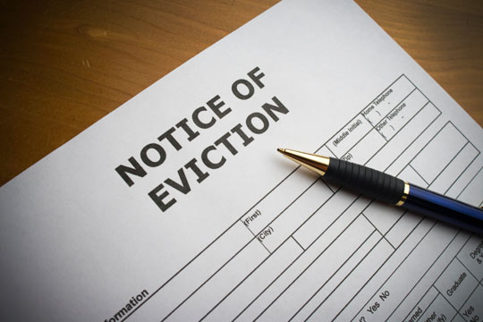
Landlord’s Notice of Good Cause
Landlords must provide at least 30 days written notice with Good Cause reasons to terminate or not renew the lease.
Notice must be sent by hand delivery or first-class mail with proof of mailing.
If the landlord does not issue the notice, lease automatically renews month to month.

Slide 27
Tenant’s Challenge to Notice of Good Cause
Tenants can challenge a Good Cause notice with the Fair Housing Commission or in court.
Tenants must file a complaint within 15 business days of receiving the notice and notify the landlord.

Slide 28
Section 9-804(13): Self-Help Eviction
Gives FHC jurisdiction to take cases where a tenant has been illegally locked out of the rental property
Changes locks
Board windows
Cut utilities
Allows tenants a private right of action against landlords who perform illegal lock-outs to file suit in court.

Slide 29
Section 9-811: Eviction Diversion Program
City has established an Eviction Diversion Program: https://phlevictiondiversion.org/
Mediation program where tenant is assigned a housing counselor and a mediator attempts to help tenants and landlords reach amicable resolutions prior to landlords filing for eviction.
Program mandatory through December 31, 2022.

Slide 30
Section 9-807: Enforcement and Penalties
If FHC finds an unfair rental practice has been committed, can issue an order appropriate under the circumstances.
Violations of the FHO are subject to fines of $2,000.00 per incident and cost of prosecution.

Slide 31
Thank You!
Kia Ghee, Esq. Alison deMedeiros, Esq.
Executive Director FHC Attorney
PCHR/FHC Alison.deMederios@phila.gov
Kia. Ghee @phila.gov
601 Walnut St, Ste 300 South
Philadelphia, PA 19106
Phone 215-686-4670
www.phila.gov/fairhousingcommission

