Slide 1
Landlord Gateway

Slide 2
Agenda
Program Overview
Intake and Construction Process
Slides will be shared afterwards by email
Loan Forgiveness or Repayment
Loan Closing and Draws

Slide 3
Program Overview
Program Objectives
Commonly Used Terms
Eligibility
Loan Terms

Slide 4
Program Objectives
The Rental Improvement Fund (RIF) is a PHDC program
We offer loans to small landlords to fund rental property repairs
RIF goals:
Improve long-term housing quality
Lower tenant energy costs
Improve tenant health
Help small landlords maintain compliance with building code and rental regulations

Slide 5
Loan Terms
Loan Option 1
$25K/10Y
Loan Option 2
$50K/15Y
Both Loan Products
Funds must be drawn down within 12 months
If program requirements are not met, interest rate will be 4%
Cap $100,000 per person
No Mix Loan product per property
Forgivable loan
Minimum: $10,000
Maximum: $24,999
Term: 10 years
Cap: $24,999 per property
Interest rate: 0% if requirements are met
Early repayment penalty:
Year 1: $5,000
Year 2: $2,000
Year 3: $1,000
Loan for repayment
Minimum: $25,000
Maximum: $50,000
Term: 15 years
Cap: $50,000/unit
Interest rate: 0% if requirements are met
Repayment deferred for 1 year
No early repayment penalty

Slide 6
Eligibility
Small landlords (15 units or less, at 5 properties or less)
Tenant-occupied units + eligible vacant units
$25K/10Y: unoccupied properties must have an active rental license
$50K/15Y: unoccupied properties must have an active rental license OR one that expired within the last 2 years
$50K/15Y:units must be rented by a tenant with income below 60% AMI
Meet building code or will meet code after repairs are complete
Meet affordable rent guidelines or rent to a tenant with a voucher
Maximum Monthly Rent by Number of Bedrooms | 0%
0 (Studio) | 1 | 2 | 3 | 4 | 5 | 6
$1,081 | $1,218 | $1,470 | $1,741 | $1,942 | $2,143 | $2,343

Slide 7
Eligibility
25K/10Y Example

Slide 8
Eligible Repairs
Examples
Asbestos abatement
Electrical and plumbing
Fire alarms and sprinklers
Heating and cooling
Lead abatement
Mold remediation
Pest control
Roof repair or replacement
Structural repairs
Insulation, windows, doors
Address habitability issues
Improve energy or water efficiency
Make units accessible to people with disabilities
Both improvements to specific units and improvements to the building are allowed
Adding a Unit - No
Finish Basement- No
Basement Repair - Yes

Slide 9
Loan Forgiveness or Repayment
Overview
Requirements for Loan Forgiveness

Slide 10
$25K/10Y Loan Forgiveness
Forgiveness Schedule
$25K/10Y Loan
After the first year, you will apply for continued deferment annually
If you meet the program requirements, payments will continue to be deferred and a portion of the loan will be forgiven each year until the loan is completely forgiven
If you do not meet forgiveness requirements or the property is sold, the unforgiven portion of the loan must be repaid at 4% interest.
Year 1 | 0%
Year 2 | 0%
Year 3 | 0%
Year 4 | 0%
Year 5 | 0%
Year 6 | 20%
Year 7 | 20%
Year 8 | 20%
Year 9 | 20%
Year 10 | 20%

Slide 11
$50K/15Y Loan Repayment
Loan repayment is deferred for the first year
Repayment will begin in year 2
0% interest rate if program requirements are met
If program requirements are not met, the balance of the loan must be repaid at 4% interest.
Repayment Schedule
$50K/15Y Loan

Slide 12
Requirements for Loan Forgiveness and Repayment
Comply with the Fair Housing Ordinance and landlord obligations
Apply for loan forgiveness annually
Submit copy of current lease and property insurance
PHDC will review City records for L&I violation history, rental license, and property ownership
These documents must verify:
Any annual rent increase must be no more than 3% or units rented to HCV tenants for any units benefitting from repairs
Any new L&I violations have been corrected within 6 months during loan term
Active rental license maintained during loan term
No transfer of property ownership
If you do not apply for or meet the requirements for loan forgiveness each year, you will have to repay the outstanding loan principal at 4% interest

Slide 13
Intake and Construction Process
Documents
Contractor Selection
Scope of Work
Notice to Tenant
PHDC Initial Home Inspection
Building Permits
Notice to Tenant

Slide 14
Documents Needed to Submit Application
Scope of work with itemized estimates for repairs from licensed contractor(s)
Notice to Tenant signed by you and the tenant(s) living in the unit(s) to be repaired
Current lease for unit(s) to be repaired
Bank statement as proof of funds if your loan will have a reimbursement draw schedule
Submit all required documents online with your application.

Slide 15
Timeline
1st Level Review - 10 Business Days
Tax Clearance OK + Eligible + Lease Acceptable + Proposal Acceptable + Tenant Documents Acceptable = Additional 20 Business Days
Additional Documents Review – 30-60 days

Slide 16
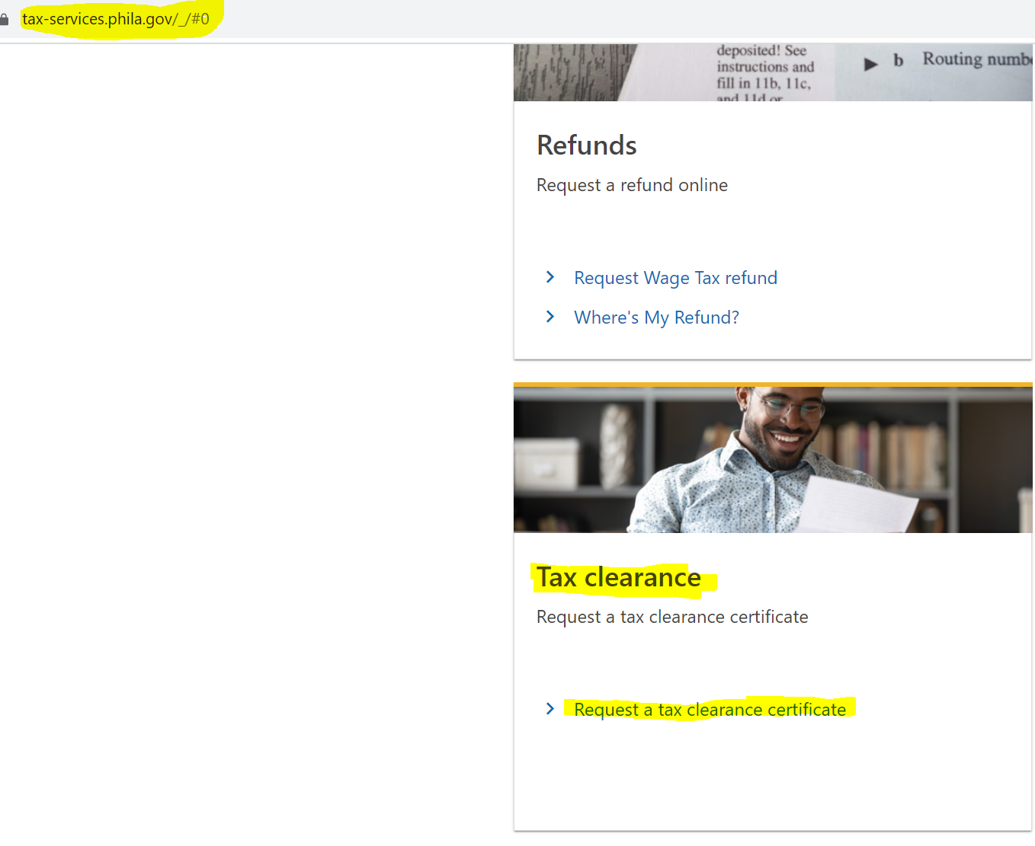
Before you apply: Check your Tax Clearance by yourself
Revenue Department Website: https://tax-services.phila.gov/_/#0

Slide 17
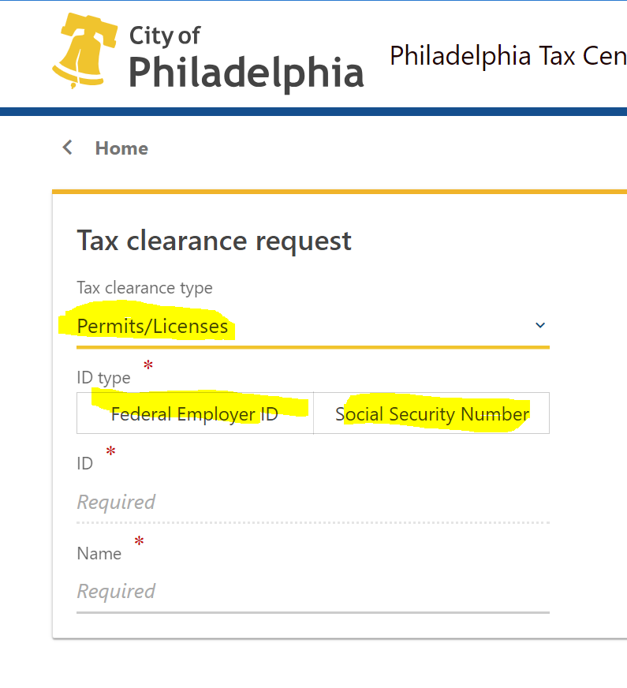
Tax Clearance Continue
If you unable to get your tax clearance, contact Revenue Department please

Slide 18
PHDC Initial Home Inspection
In-person repair assessment conducted by trained PHDC inspector
Ensures roof is in a good condition
Verifies repairs on contractor estimate(s) address health and habitability
May request additional proposal to address safety concerns
Documented with photos and detailed descriptions of repair needs
Includes prioritized summary of repairs based on PHDC guidelines
The loan will be approved if all intake requirements are met and the home inspection verifies the construction activities and estimated cost on the submitted scope of work
If your property does not pass an inspection, a $200 reinspection fee will be deducted from your loan draw
PHDC employees cannot accept tips or cash of any kind
If repairs were started before loan closing, they cannot be included in the loan amount

Slide 19
Loan Closing and Draws
Loan Closing Process
Lease Amendment
Loan Draws
Requirements for Final Loan Draw

Slide 20
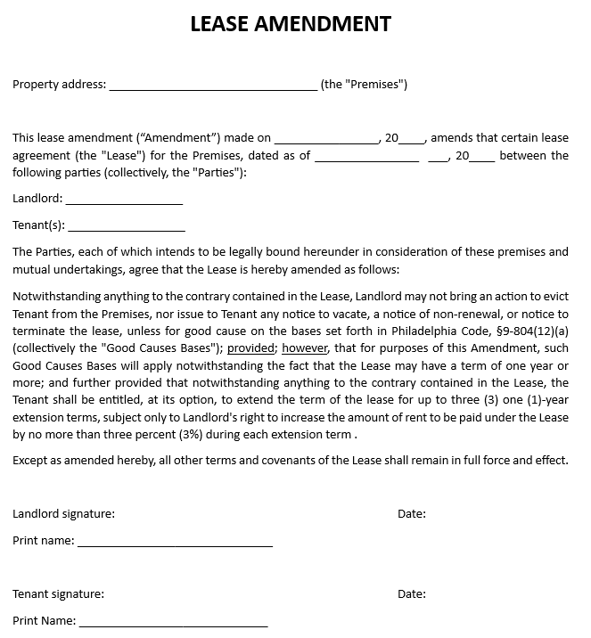
Lease Amendment
3-year good cause eviction protection
Offer tenant option to extend lease for up to 3 one-year terms (doesn't apply if lease provisions are violated by tenant)
Rent increase limited to 3% annually

Slide 21
Loan Closing Process
Photo ID
Certificate of property insurance with PHDC as additional insured
Signed lease amendment
Signatures from all parties named on the deed
Certificate of organization or articles of incorporation
Employer identification number (EIN) for LLCs
Disbursement authorization
Corporate resolution
Required Documents
Additional Documents
for Companies
Upload required documents to RIF Portal within 10 business days of approval
Sign loan documents with a notary public and mail originals to PHDC
Or close loan with a notary at the PHDC office
$244.75 will be deducted from the loan (2022 recording fee)
Closing Process
Recording Fee

Slide 22
FAQ
Email: rentalimprove@phila.gov
Hotline: 215-448-3006
9am-5pm
Monday - Friday

