Slide 1
March 2024
Public

Slide 2
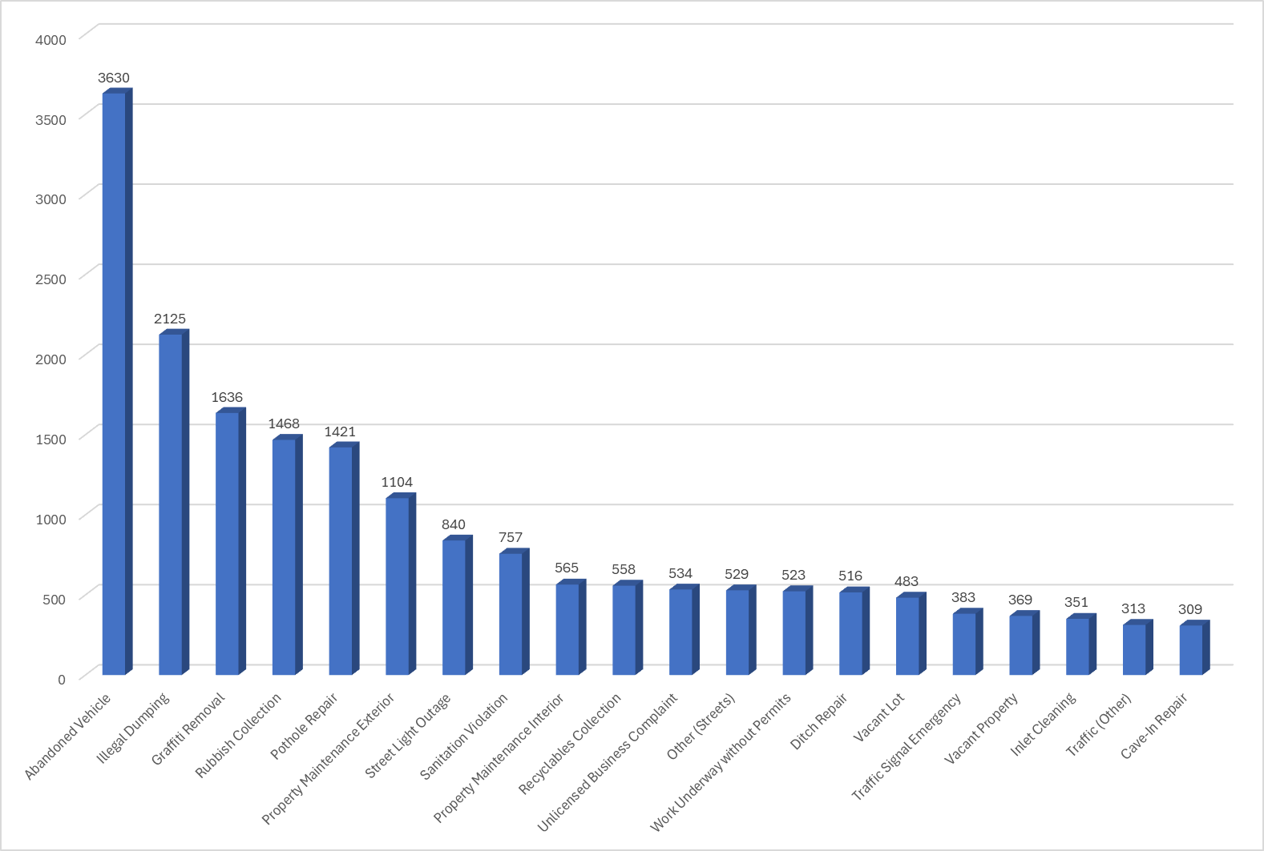
Top 20 Service Requests of the 22,838 Total Cases Submitted

Slide 3
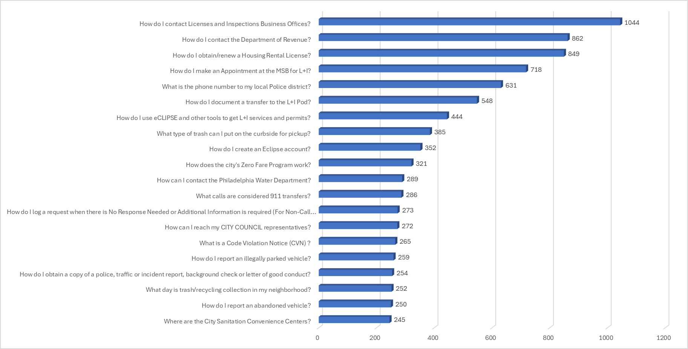
Top 20 Information Requests of the 23,745 Total Cases Submitted

Slide 4
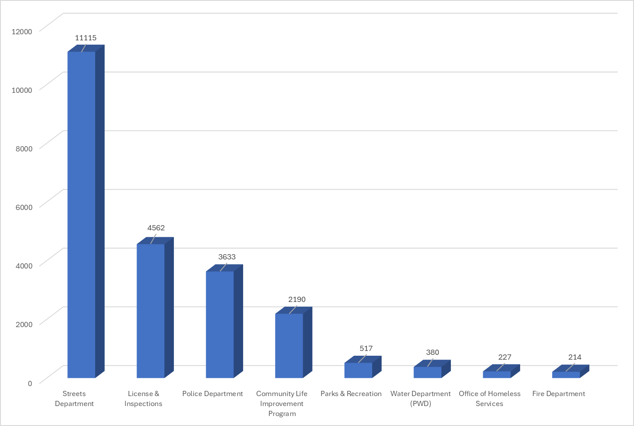
Service Requests by Department of the 22,838 Total Cases Submitted

Slide 5
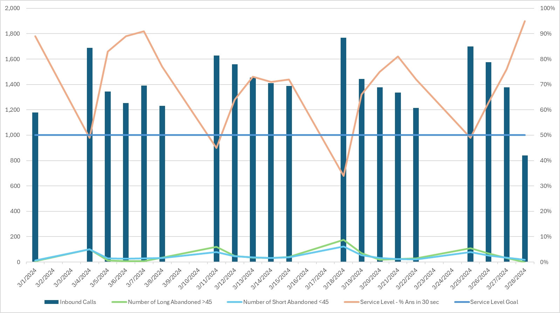
Philly311 Call Volumes, Abandons and Service Level by Day
March 2024 | Week 1 (3/1-3/2) | Week 2 (3/3-3/9) | Week 3 (3/10-3/16) | Week 4 (3/17-3/23) | Week 5 (3/24-3/30)
Calls Handled | 1,178 | 6,907 | 7,438 | 7,140 | 5,490
Service Level (Goal 50%) | 89% | 78% | 65% | 66% | 71%
Average Speed of Answer (Goal <30s) | 4:26 | 4:28 | 4:39 | 4:42 | 4:25
Average Talk Time | 4:01 | 4:04 | 4:14 | 4:18 | 4:01
“Service Level” is the percentage of calls answered in less than 30 seconds. Our goal is 50%.
“Average Speed of Answer” is the average wait time the call experiences in queue.

