Slide 1
Community Health Improvement Plan
Philadelphia Department of Public Health
Drexel University Dornsife School of Public Health
July 2022

Slide 2
CHIP Overview
The Community health Improvement plan is a required part of every health departments accreditation to use data and gather community input to guide the priorities of the health department for the next several years
This Community Health Improvement Plan (CHIP) was developed in partnership between the Philadelphia Department of Public Health (PDPH) and Drexel University’s Dornsife School of Public Health (Drexel)
There were three areas of focus for the CHIP, based on prior CHIP priorities and current areas of need and emphasis in Philadelphia:
  The social determinants of community violence
  Public health preparedness
  Access to care/community-clinical linkages

Slide 3
CHIP Partners & roles
Drexel partnered with the Injury Prevention Program, the Office of Bioterrorism and Public Health Preparedness, and the Division of Ambulatory Care at PDPH to plan, recruit, and host the stakeholder conversations relevant to their office/division
The PDPH units assisted in identifying and recruiting stakeholders, developed a short presentation to frame the topic for the conversations, and co-hosted each of the conversations with Drexel
The Drexel team coordinated the planning process, the logistics of the conversations, facilitated the discussion during each of the conversations, and analyzed the qualitative and quantitative results from the conversation
The final report and presentations was developed in partnership between Drexel and PDPH

Slide 4
CHIP Process
A series of three stakeholder conversations were held for each of the three areas of focus to gather feedback and ideas around key issues and possible solutions in the topic area
These were either in person at a neutral location or via Zoom, depending on the preference or needs of the specific stakeholders
While past CHIP processes have focused on more traditional healthcare stakeholders, this CHIP purposefully focused on engaging more residents and community-based organizations to ensure the findings capture the experience of everyday Philadelphians
Conversations were facilitated like a focus group and recorded in order to generate a transcription for thematic coding and analysis

Slide 5
CHIP Process: Timeline
Planning began in March 2022 when the Drexel team met with each of the PDPH relevant divisions to identify target audiences and develop a basic agenda for each of the three conversations
Recruitment for these events began in May 2022 and the 9 conversations were held between May and June 2022
In July 2022 results were analyzed and a report on findings developed. Recommendations based on the findings were developed in August 2022

Slide 6
CHIP Process: Stakeholders & recruitment
Stakeholders were identified and recruited in partnership between Drexel and the PDPH unit focusing primarily on Philadelphia residents and representatives from community organizations
The stakeholders included
  Philadelphia residents and patients
  representatives of community-based organizations
  social service agencies
  health care providers
  additional groups
Community residents who participated outside of any professional roles were eligible for a gift card to compensate them for their time.

Slide 7
CHIP Process: Conversations
The conversations began with a short presentation on Philadelphia data related to each topic to help ground and inform the discussion
Then transitioned a discussion was facilitated by two Drexel staff and including one trained community researcher.
The discussion solicited reactions, feedback on current solutions, and ideas for new ways to address the issues presented on
Following stakeholder conversations, a link to a survey was sent to all participants via Qualtrics asking participants to rank order a list of concerns and potential solutions discussed during the conversation

Slide 8
CHIP Process: Data & Analysis
All conversations were recorded, transcribed, and imported into NVivo qualitative data analysis software
A coding scheme was created through an iterative, consensus-creation process. A priori codes were developed based on the discussion guide to begin the qualitative coding. We also applied a grounded theory approach to identify and apply emergent codes
We employed an explanatory mixed methods design, where discussion was the primary form of data collection, and survey results provided additional information about the ways participants prioritize the themes (concerns and solutions) discussed

Slide 9
Violence Prevention Qualitative Themes:
Key Solutions
Youth Programming
Participants wanted to see increases in the number of youth programs, better access to free programs and more paid or employment programs for youth to address violence
Collaborations
Participants saw better collaboration as key to better address violence. In particular, participants wanted more engagement with community groups in the form of funding and capacity building
Access to Resources
Participants wanted both access to more specific programs, such as mental health and neighborhood-based programming, as well as asset maps so residents could easier access existing programs
Other Solutions
Additional solutions participants brought up included addressing issues with the built environment, focusing more on anti-racism and historical trauma, and better budget and funding transparency
“There are over 300 spaces owned by Parks and Rec or managed by Parks and Rec that, to me, I see opportunity for job creation [for youth].”
“I feel like resources are really fundamental to progressing the work that we're trying to do. And there are small organizations, folks who are really passionate, folks who are from the community, dedicated, interested in in their community. I live there, I want to stay there, and who cannot compete with folks who may have higher educational attainment, may be more connected to institutions. I think this capacity building for these small organization is critical because they are the organizations that will make the difference.”
“I think focusing on bringing funds to these neighborhoods and bringing the programs to them, sometimes having to travel to get the services that they need, can be a barrier to receiving services. So looking at what we have locally, what we have in our areas that are more needed, and if we don't have that, putting the funds to make sure that's that it's available to them”
“And that is to say if the health department is not including historical trauma into the way in which they are onboarding or … creating programs, if they're not including historical trauma, intergenerational trauma in those programs, you're really missing the point because we're not getting to the bottom of things.”
Notes:
Youth Programming
Increase in programming
Access to free programming
Paid programming/employment opportunities for youth
Collaborations
Community Organization Connections
Connections between departments
Philanthropy
Access to Resources
Resource connections
Mental health
Neighborhood based programming
Other Solutions
Built Environment
Anti-racism focus
Budget Transparency

Slide 10
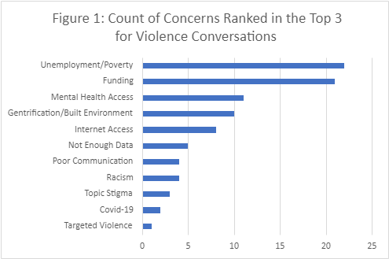
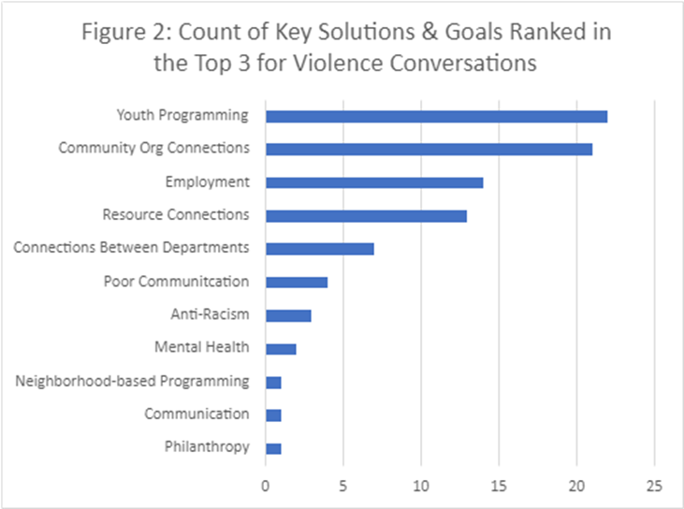
Violence Prevention: Prioritization
At the end of each of the three meetings, participants ranked the topics discussed. Below is a summary of ranking for concerns and for solutions. Not all rankings aligned with the themes from the discussions. For example, unemployment was only briefly discussed in the meetings; however, it was ranked highly. These tables can help provide additional context, but the themes are the key findings of this process.

Slide 11
Next Steps – Social Determinants of Community Violence
Collaborate with neighborhood partners to identify more helpful communication strategies to expand community awareness of current PDPH youth violence prevention programming, such as the Youth Health Corps.
Engage community and agency partners to assess current service levels being offered to families of victims of gun violence to improve where appropriate and to strengthen community linkages where necessary.
Expressly acknowledge the generative mechanism of historical and contemporary racism of violence to ensure prevention programming explicitly addresses its current impacts.
11

Slide 12
Public Health Preparedness Qualitative Themes: Key Solutions
Connections & Collaborations
Participants wanted to see more sustained connections internally and externally to reach the preparedness goals, particularly with well established and trusted community groups
Information Accessibility
Participants discussed ways to make information about risks or services more accessible by using variety of medias and making online information more accessible
Neighborhood specific resources and services
Participants saw providing services directly in communities as crucial to being able to be prepared and respond to emergencies. They pointed to successful examples such as the vaccination clinics
Education & programming
Participants felt that better educational programming for adults and youth were important to inform residents about what public health preparedness is to ensure they are prepared
“But all of us are very well connected with those communities so I think it's just a matter of keeping-- keeping the organizations that already are in touch with those people readily available to you so that when you need announcements to get out, we can pass that along.”
“But also working with local ethnic media as well. And then also working with local newsrooms and not just relying on the Inquirer, so. … like Kensington Voice, Germantown Info Hub, and more niche-serving news outlets across different media. Because they recognize variances in literacy rates across all communities not just English language publishing communities as well.”
“We know that people want to do things close to where they live and what's comfortable for them. Coming into center city may or may not work for people, transportation issues or whatever, but when you're in the neighborhoods where people live, it is much easier for them to react to that.”
“I like the idea that maybe if we get to the youth and just have workshops. Let them come in over the summer and have workshops [about] disasters and communicable diseases and stuff. Kind of educate them on what to do in case there's a disaster.”
Notes:
Connections sub themes
Community organizations & groups
Between departments
Quality of collaborations
Other:
Low barrier solutions
Structural changes to PH (age friendly system)

Slide 13
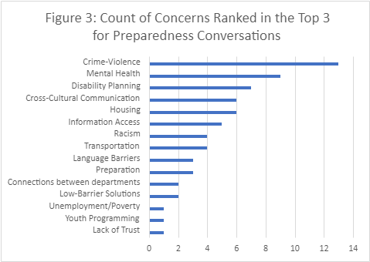
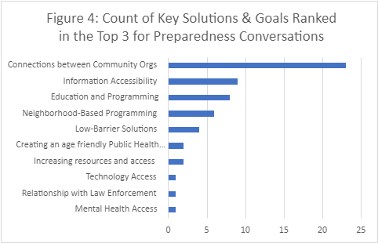
Public Health Preparedness: Prioritization
At the end of each of the three meetings, participants ranked the topics discussed. Below is a summary of ranking for concerns and for solutions. Not all rankings aligned with the themes from the discussions. These tables can help provide additional context, but the themes are the key findings of this process.

Slide 14
Next Steps – Public Health Preparedness
PDPH will expand public health preparedness communication strategies to more effectively engage and reach vulnerable populations such as communities that are linguistically diverse, experience limited literacy, live with disabilities, or have limited access to communications technologies.
PDPH will continue to advance the engagement infrastructures established with community organizations during the COVID-19 pandemic to utilize this network as a pipeline for preparedness-related information and solutions.
Where appropriate, PDPH will adapt/adopt emergency response structures within PDPH and consult with relevant city partners to address potential coordination gaps that can impact response readiness for the agency and affected persons.
14

Slide 15
Access to Care Qualitative Themes:
Key Solutions
Linking to Services
Participants wanted to see PDPH take a more leadership role in coordinating resources. More specifically, participants wanted housing and transportation services to be a priority
Healthcare Delivery
Participants wanted to see changes in staffing in healthcare with focus on more diversity and cultural competency as well as reducing wait time and increasing primary care and social service delivery
Collaborations
Participants saw community engagement, in particular with trusted community leaders, as both a solution and a prerequisite for other solutions. Additionally, participants saw solutions in their own efforts to increase advocacy for these issues.
“I think it is none of each of these institution's jobs to figure out collaboration and figure-- and then it's a full-time job to sort of be able to get everybody together and really-- and I think the recognition of that, and owning that, and having the health department really take that role.”
“before we go trying to set up a lot of primary care, we have to work in the community to help people understand what that is and how that could potentially open doors for both medical as well as some social assistance.”
“just for a faith leader to say, ‘Hey, here's some fresh produce. Take some if you need it or want it.’ I think the idea of not having that stigma or whatever might be-- or concerns around sharing that with a lesser-known healthcare provider I think is also kind of there.”
Notes:
Linking to Services sub themes
Resource Coordination
PH focus
Housing
Transportation
Healthcare Delivery:
Staff Accountability
Health Center Capacity
Collaborations
Community Engagement
Advocacy
Universal Healthcare

Slide 16
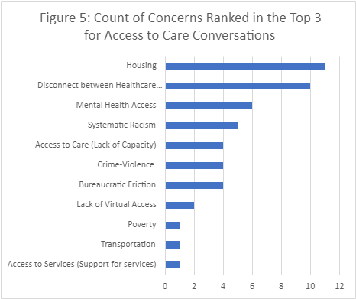
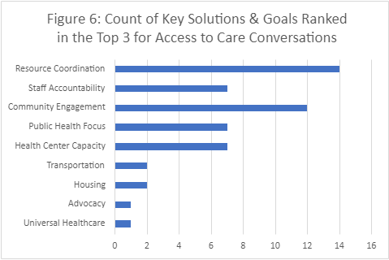
Access to Care: Prioritization
At the end of each of the three meetings, participants ranked the topics discussed. Below is a summary of ranking for concerns and for solutions. Not all rankings aligned with the themes from the discussions. These tables can help provide additional context, but the themes are the key findings of this process.

Slide 17
Next Steps - Community-Clinical Linkages
Consult with community providers to assess the scope of the latest available services and develop coordination strategies to avoid referrals to either limited or expired services.
Address long waiting times for appointments by strengthening information access regarding existing and expanded primary care safety net resources.
Identify and implement approaches to develop the health center workforce to become demographically reflective of the populations served.
17

Slide 18
Cross Cutting Themes
Topical
Violence
COVID-19
Racism & cultural responsiveness
Process
Need for multiple approaches
Ongoing Engagement
Conversations lacking action & follow up
“I would think maybe coming out periodically and getting in touch with the community leaders and saying, "We'd like to come out, and what can we share informationally in your community?" and then let them respond to that and let's pull a meeting together and get people out.”

