Slide 2
Who is a Census Champion and why are they important?
A Census Champion is a trusted messenger
who has the knowledge to educate their community
about the census and its impact on our city.
As a Census Champion,
you will be a part of an elite
team with great responsibility.

Slide 3
Message from Mayor Kenney

Slide 4
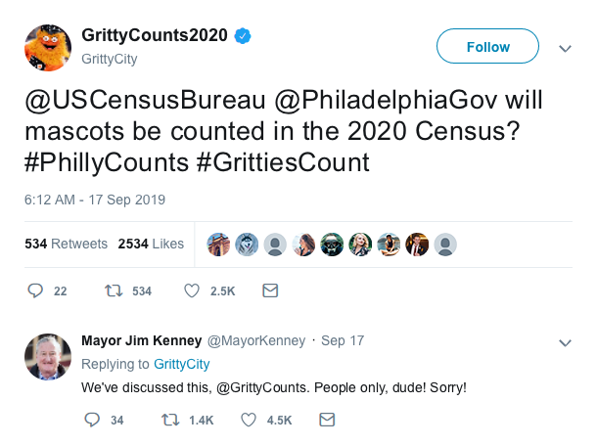
@USCensusBureau
@PhiladelphiaGov
#PhillyCounts

Slide 5
Welcome to your
Census Champion
Training!
Here is what you will learn:
Section I – Census 101.
Section II – Data Security,
Privacy and Confidentiality.
Section III – How Everybody
Gets Counted.
Section IV – Digital Literacy.
Section V – Get Involved.
Section VI – Keys to Success.

Slide 6
Section I
Census 101
What you need to know

Slide 7
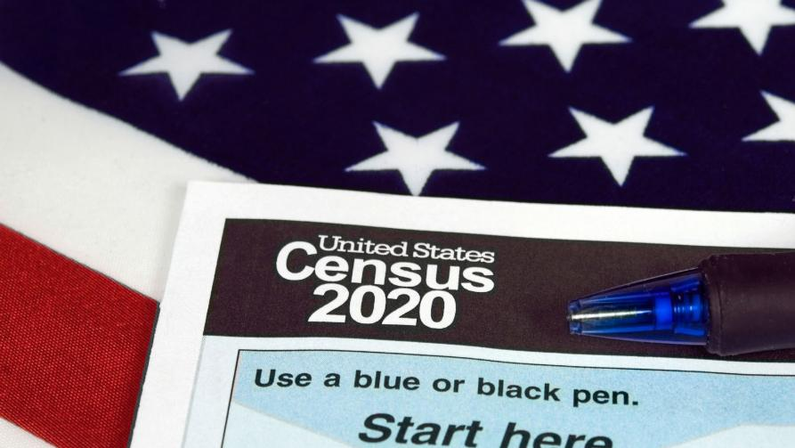
What is the census?
The United States Census is a national survey conducted by the U.S. Census Bureau every ten years to count the population..
Between 1970 and 2000, the U.S. Census Bureau used two questionnaires, a short form and a long-form.
Forget about the past! The 2020 Census will be a short-form questionnaire only consisting of nine questions.
The U.S. Census Bureau is responsible for conducting the decennial census.
Philly Counts is not in charge of conducting the census nor the hiring process for census jobs.
Completing the census is required by law.

Slide 8
Why is the census important?
The census is so much more than just a head count. Its results will impact Philadelphia for the next ten years.
Census data is used to determine representation
in Congress.
Philadelphia receives more than $3 billion in federal funds every year, for health, housing, schools and infrastructure.
Census data is also used for research and to analyze and predict trends.

Slide 9
What is an undercount?
An undercount is when fewer than the actual number of people are recorded in the final Census count.
An undercount means federal programs and representation are allocated for a smaller number of people than actually live in our City.

Slide 10
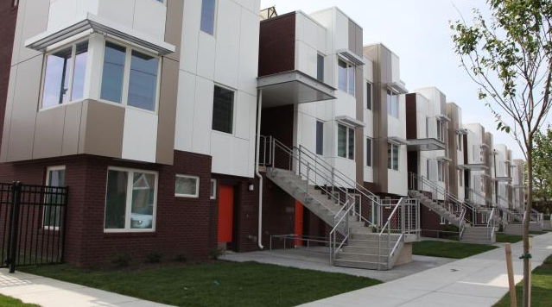
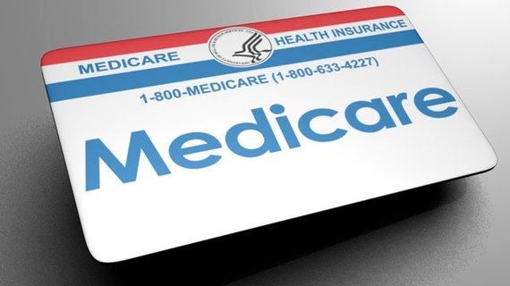
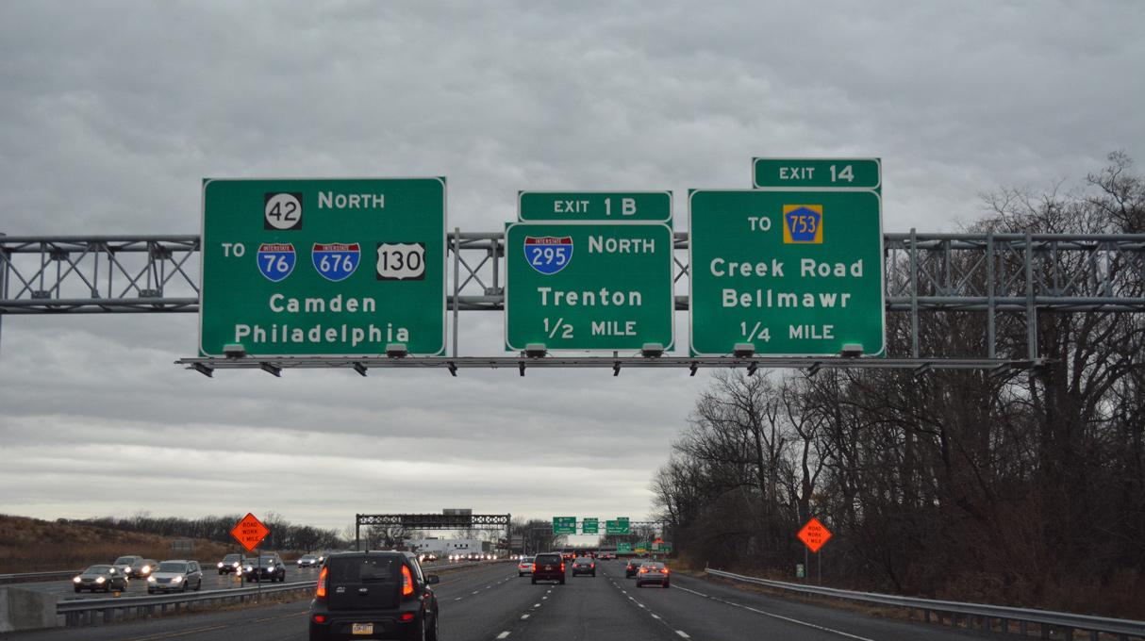
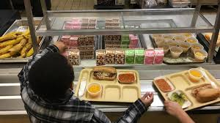
How about Philadelphia?
An undercount would affect the following programs:
Medicaid
and Medicare Part B
Funding for highway planning and construction
Special education grants
School lunch programs
Section 8 Housing
Federal Pell Grants

Slide 11
How does
the census
benefit my community?
Census data helps us see how the country is changing.
Federal programs disperse grants that support communities based on population totals and breakdowns by sex, age, and race.
Businesses use Census Bureau data to decide where to open new stores, factories, and offices, creating jobs for the community.
Local governments use census data to ensure public safety and plan new schools and hospitals, and draw city council districts.
Nonprofits use census data to learn where and how to best serve their constituencies.

Slide 12
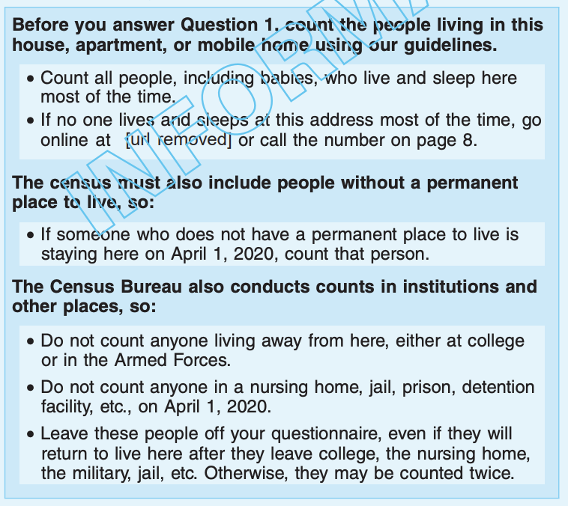
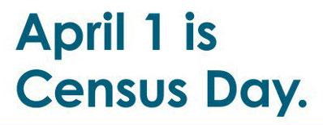
When does the 2020 Census
officially start?
In-Field Address Canvassing
August – October 2019
Group Quarters
February 2020 – July 2020
Census Day
April 1, 2020
Internet Self Response
March 2020 – July 2020
April 1 is the reference date for responses to the 2020 Census.
Invitations to participate will begin going out in mid-March.
Nonresponse
Follow-up
April 2020 – July 2020
December 31, 2020 Deliver apportionment counts to President

Slide 13
How can I respond to the 2020 Census?
By April 1, 2020, households will receive an invitation via U.S. Mail to participate on the census.
For the first time in history, people can respond to the census online.
Paper Form
(via U.S Mail if you have not
completed online)
Census Takers will visit households if they have not completed the census online, by mail, or by phone.
Phone Call

Slide 14
In how many languages will the census
be available?
In addition to English, people can respond to the census
online or by phone in 12 different languages:
Spanish
Chinese
Vietnamese
Korean
Russian
Arabic
Tagalog
Polish
French
Haitian Creole
Portuguese
Japanese
The paper form will be available in English and bilingual English-Spanish.

Slide 15
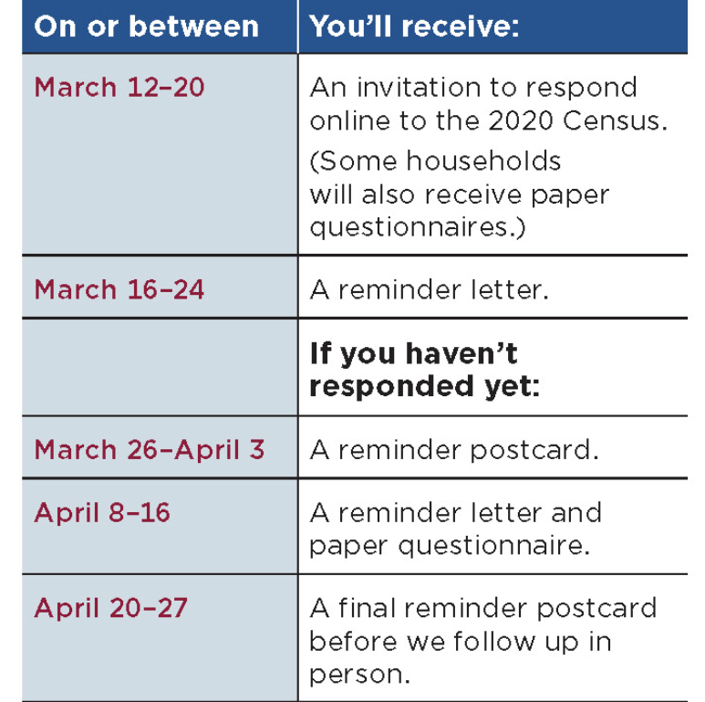
What will you receive in the mail?

Slide 16
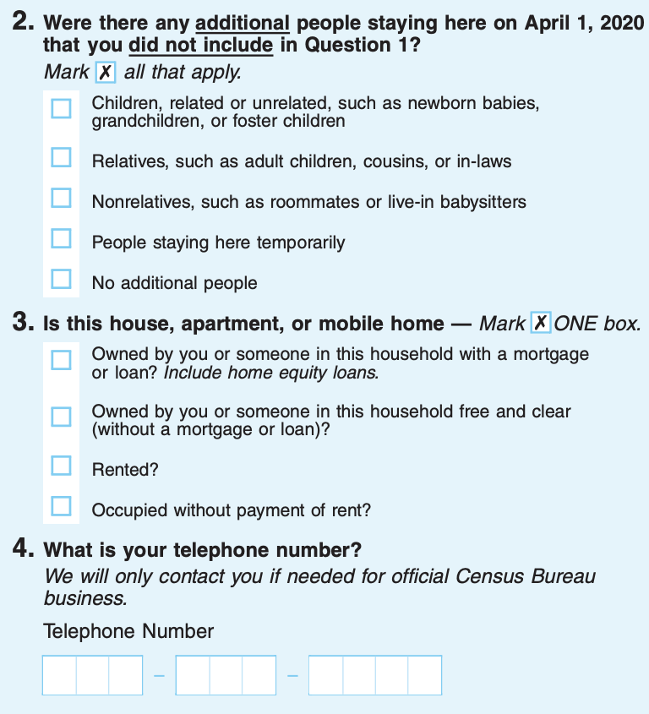
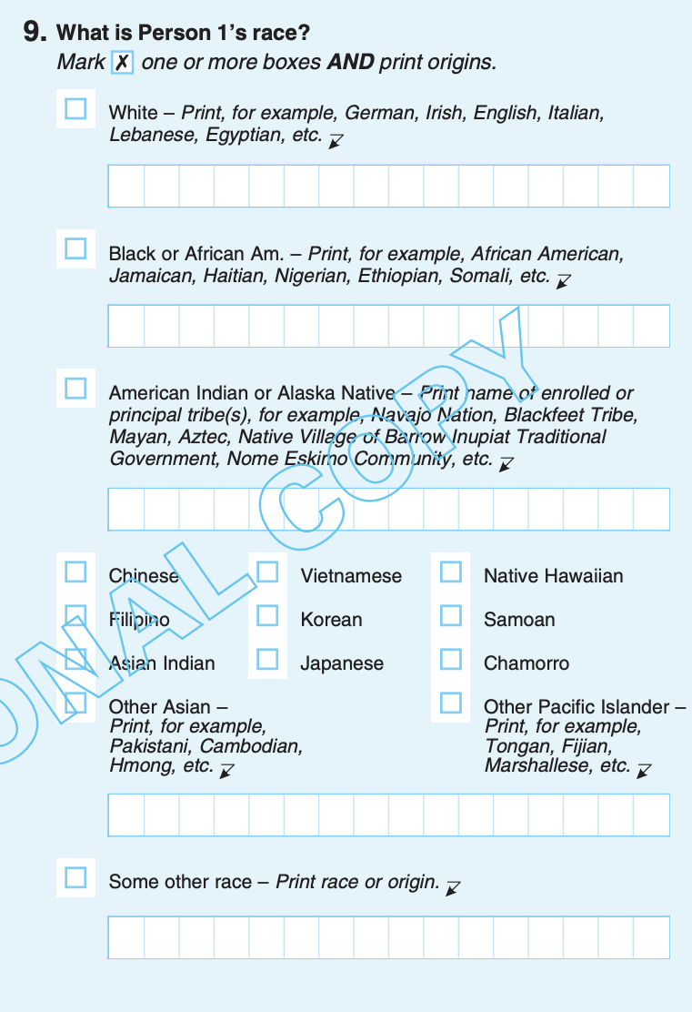
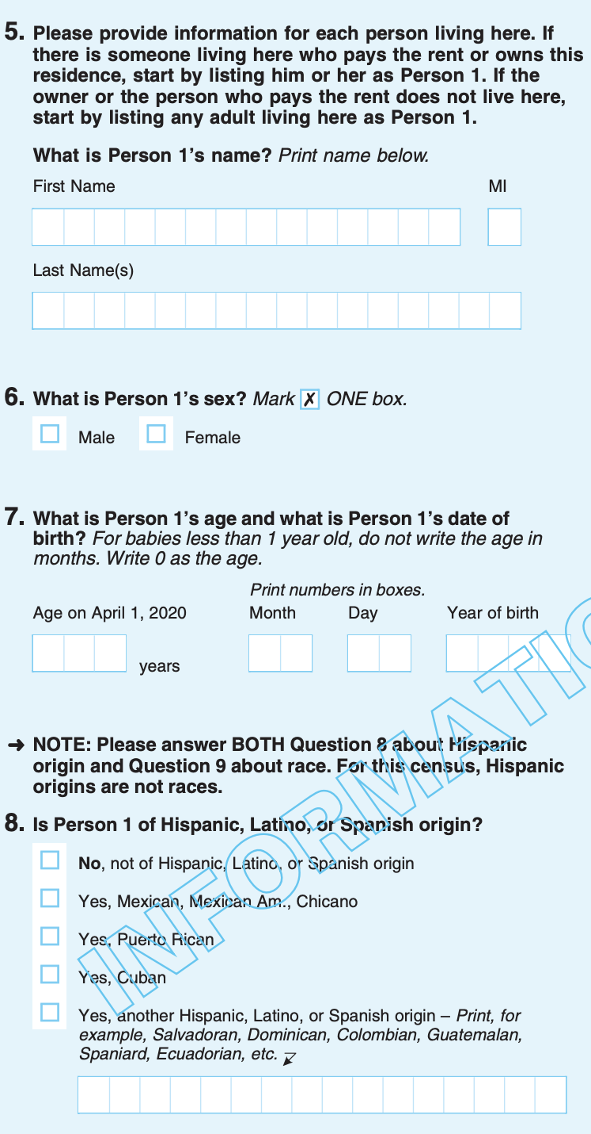
How many questions will
be on the census?
The 2020 Census questionnaire has nine questions.

Slide 17
Do I have to answer all the census questions?
Everyone is encouraged to fill out the census completely.
If you do not answer all the questions, your form can still be submitted.
An enumerator may come by to your house to collect the missing information (if you fill out the form incompletely)

Slide 18
Will there be a question about citizenship status on the 2020 Census?
NO
A question related to citizenship status
will not be added to the 2020 Census.

Slide 19
Section II
Data security, privacy and confidentiality

Slide 20
Is my information secure?
YES!
Your data is secure.
Responses to the census are confidential.
Your information is legally protected by the United States Constitution.

Slide 21
How does the U.S. Census Bureau
use the data collected?
The census data is used only for statistical
purposes.
The census data is protected by federal law.
It cannot be used against any person by any government agency or court.
No one can access individual responses.
No law enforcement agency (not the DHS, ICE, FBI, or CIA) can access or use the information collected at any time.

Slide 22
Can the U.S. Census Bureau
release my information?
The U.S. Census Bureau is required to keep your information confidential for 72 years.
72-Year Rule: the U.S. government will not release identifiable information about an individual to any other individual or agency until 72 years after it was collected for the decennial census.
1940 Census records were released on April 2, 2012.

Slide 23
Do you know who has access to census data?
All U.S. Census Bureau workers take a life-time oath
of non-disclosure that protects your information
because it is confidential.

Slide 24
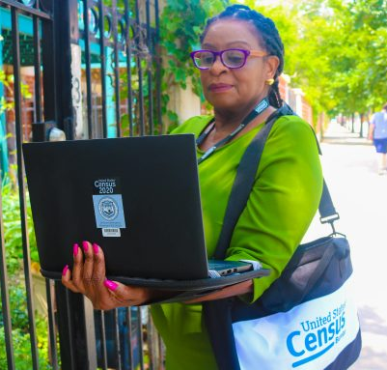
How can I recognize a census worker?
The U.S. Census Bureau workers will have badges and briefcases indicating their affiliation with the U.S. Census Bureau.
Employees will introduce themselves as a Census Bureau employee and show their official government ID badge.
The U.S. Census Bureau will never ask you to step out of your home.
Census takers will be equipped with an iPhone 8s. They will use the phone to record census responses.
Photo: 2019 Address Canvassing Operation

Slide 25
You can use this link to verify the identity of a U.S. Census Bureau worker: https://www.census.gov/cgi-bin/main/email.cgi

Slide 26
Beware of SCAMS!
The U.S. Census Bureau will never:
Ask for your social security number, money, donations, or bank and credit card numbers.
Send an invitation via email to complete the census.
As a general rule of thumb, never provide personal financial information to someone claiming to be a Census worker, online, in person, or over the phone.
To report a scam:
Call 215-717-1800 or 1-800-262-4236
Write to Philadelphia.Regional.Office@census.gov.
Call 311.

Slide 27
Section III
How Everybody Gets Counted

Slide 28
Institutional
Non-Institutional
Group Quarters
Correctional Facilities
College dormitories
The Census Bureau classifies all people not living in housing units (house, apartment, mobile home, rented rooms) as living in group quarters.
Group quarters counting will begin in February 2020.
Nursing homes
Military barracks
Mental hospitals
Group homes
Missions or shelters

Slide 29
Should college students be counted at home or school?
Your student will be
counted at their college
address.

Slide 30
If someone is incarcerated, where
and how are they counted?
Do not count anyone in a detention facility on April 1, 2020. They will be counted at the facility where they are in on Census Day.

Slide 31
Do babies under five-years-old count?
Don’t forget the baby! Include your newborn baby in your census form, even if they are still in the hospital on April 1.
Babies and children under five-years-old must be counted.
You have to count children who live and sleep at your home most of the time, even if the living arrangement is temporary or the parents of the child do not live there.
If the baby will be born after April 1, 2020 should not be included as part of your household.

Slide 32
Should I respond to the 2020 Census if
I am not an American citizen?
YES. The census counts people: citizens, non-citizen legal residents,
non-citizen long-term visitors, and undocumented immigrants.

Slide 33
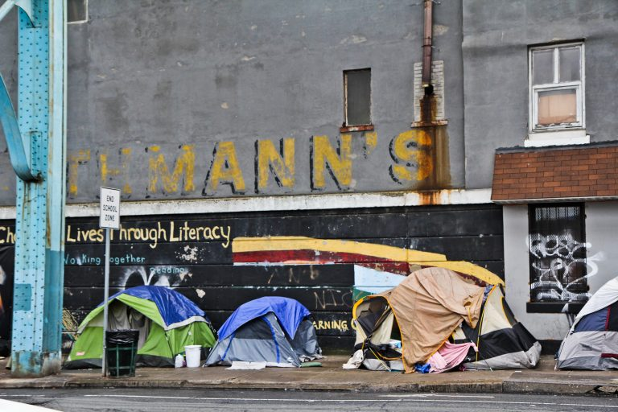
Counting people experiencing
homelessness
Service-Based Enumeration: people experiencing homelessness will be counted at places where they receive services, such shelters and meal centers.
Transitory Location Enumeration: people who do not have a stable home or are experiencing homelessness, can be counted at transitory locations (hotels, motels, campgrounds) using a paper form.

Slide 34
What communities are most likely
to be missed in the count?
Immigrants, people of color, children under five years old, low-income households, rural households, people experiencing homelessness.
In Philadelphia, approximately a third of the people living in the city fall in a hard to count demographic.
Every person not counted in the census is a loss of $2,100 per year over ten years. That’s $21,000 of missing funding for Philadelphia, per person missed.

Slide 35
Section IV
Digital Literacy

Slide 36
My neighbor told me that the 2020 census will be online. Is this the only
way to participate?
No. You can complete the census over the phone or via paper form.
In 2020, for the first time, the U.S. Census Bureau will offer an internet response option as their preferred method of self-response.

Slide 37
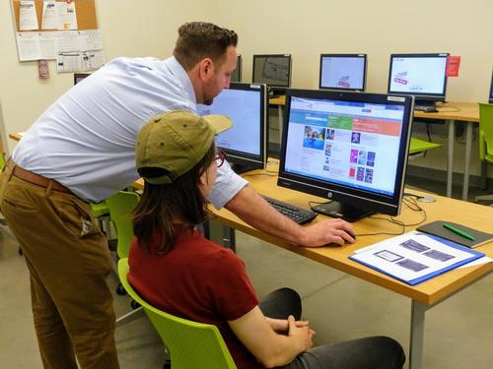
If I do not have internet at home, how can I respond? Can I use a public computer?
You can respond to the Census using any computer.
Philly Counts is working with community organizations to open digital census throughout the city in March and April. Stay tuned!

Slide 38
Can I respond the census using a smartphone or tablet?
Yes, you can submit your answer using your smartphone or tablet.
The 2020 Census questionnaire is mobile friendly.

Slide 39
What to do if you have trouble completing the census
Contact the U.S. Census Bureau.
The U.S. Census Bureau will provide language guides in 59 non-English languages. Please note that language guides are not census forms.
Language guides will also be available in American Sign Language (Braille) and large print.
Call 311 for support.

Slide 40
Section V
Get Involved!

Slide 41
How can I get more involved?
1.
Follow
@PhiladelphiaGov and #PhillyCounts on Social Media
2.
Invite
three friends (or more!) to become Census Champions, online or in person
3.
Celebrate Census Day
Join us in Love Park
on April 1
from 12pm-2pm
4.
Volunteer for our Census Action Days: Mar 21, Mar 28 and April 4
bit.ly/CensusActionDays

Slide 42
2020 Census Jobs
2020census.gov/jobs
In Philadelphia, the U.S. Census Bureau will be hiring more than 3,000 temporary workers. You could make $25 an hour as an Enumerator!
People must apply to jobs online, and if they are selected, they are invited to do online training. The online training must be completed using a computer (not a tablet or smartphone), with a working speaker and headphones.
To be eligible, you must be at least 18 years old and have a valid Social Security number.
Census takers are assigned depending on the zip code where they live.

Slide 43
Where I can go to find more
Information about the census?
Contact Philly311
Visit Philly Counts website: https://www.phila.gov/census
Visit the U.S. Census Bureau website: https://2020census.gov

Slide 44
Section VI
Keys to successful community participation

Slide 45
How do people prefer to receive census information?
In-person
Printed
Digital
Phone
Face-to-face conversations are crucial to educate and engage community members.

Slide 46
What are the preferred response methods?
1
2
3
Online
Paper Form
Phone
Seniors may prefer to wait to submit a paper form via U.S. Mail.
The paper form is considered a secure way to respond.
Young people feel more comfortable filling out the census online.
Completing the census online is convenient.

Slide 47
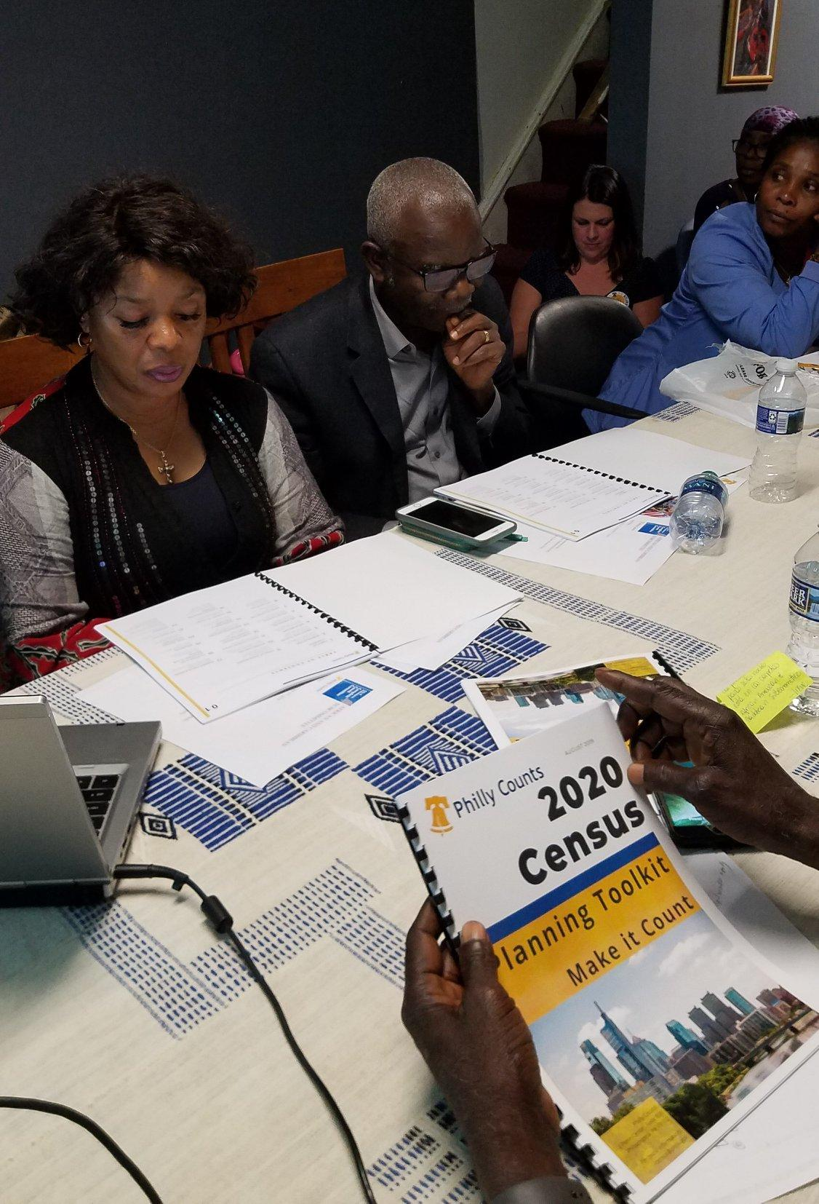
Talking about the Census
We need to count every person in Philadelphia:
To get funding for our community’s needs.
To let decision makers know where we are. It is about equity!
To make our voices heard.
Because the census is our civic responsibility.

Slide 48
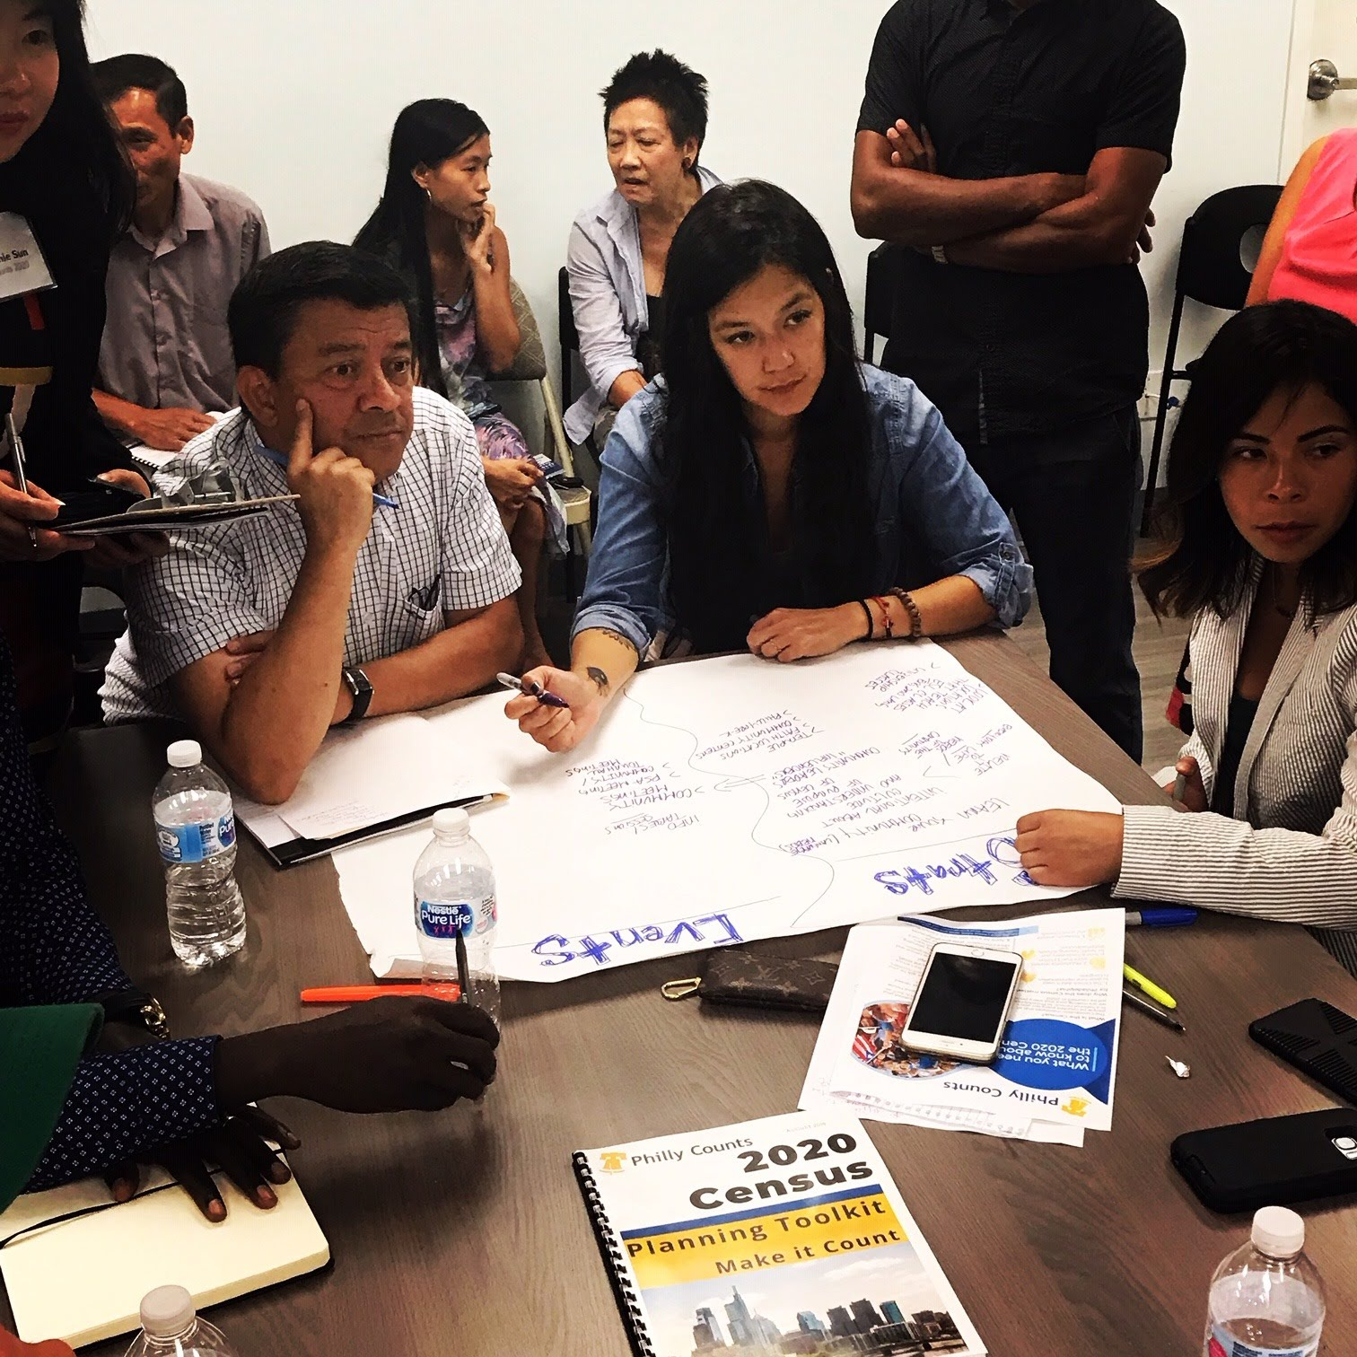
Talking about the Census
We need to count every person in Philadelphia because:
Every person not counted in the census is a loss of $21,000 over ten years.
Communities in need should get the resources they deserve.
Being counted in the census enables us to have political representation.
We must hold on to the representation we currently have.

Slide 49
Talking about the Census
We need to count every person in Philadelphia because:
Completing the census form is a way to ensure a brighter future for our
children and community.
It is up to ALL of us to create a better tomorrow for Philadelphia!

Slide 50
Let’s Practice!

Slide 51
Your Next Step
What action will you take this week to promote Census participation in Philadelphia?
Follow @uscensusbureau and #PhillyCounts on Social Media
Invite
three friends (or more!) to become Census Champions
Canvass
Sign up to volunteer on a Census Action Day
bit.ly/CensusActionDays
Celebrate
Census Day in Love Park
April 1, 12pm-2pm

Slide 52
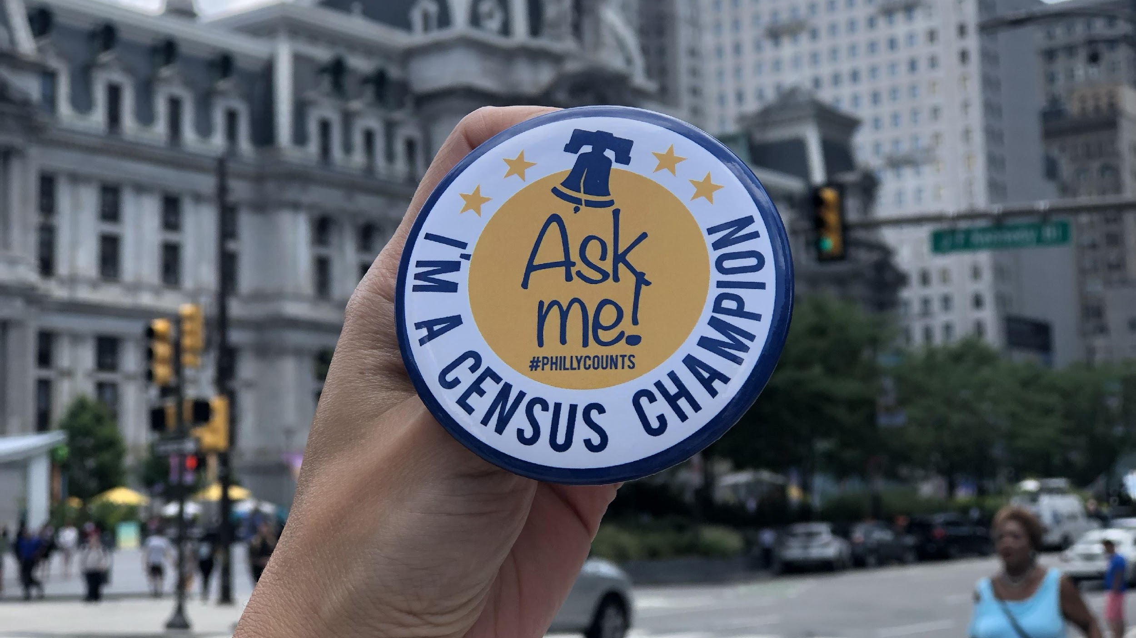
Congratulations Census Champions!

