Slide 1
_ COVID-19 _
_ Community Response Captain Training _
_ Updated May 20, 2020 _

Slide 2
AGENDA
COVID-19: WHAT YOU NEED TO KNOW
What is coronavirus?
City of Philadelphia - Daily Update
The spread and prevention of COVID-19
Treatment and testing options
Your role as a COVID Community-Response-Captain
Volunteer Opportunities
Community Resources

Slide 3
WHAT DOES A COVID-19 COMMUNITY RESPONSE CAPTAIN DO?
Share updated information about the COVID-19 pandemic
Check in on your neighbors
Encourage your peers to follow CDC guidelines
Provide informational support and help peers find services
Provide support to people who need translation services / language access

Slide 4
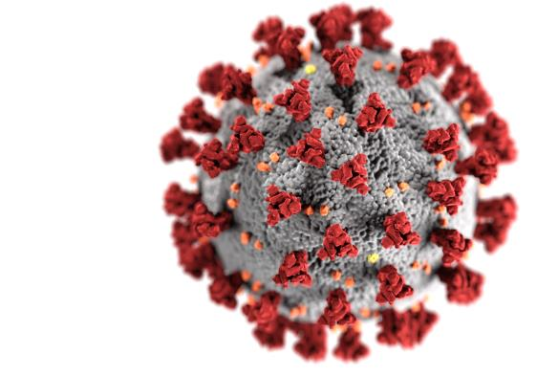
WHAT IS CORONAVIRUS / COVID-19?
COVID-19, also known as the coronavirus, is considered a novel (new) virus whose discovery has been traced back to late October of 2019.

Slide 5
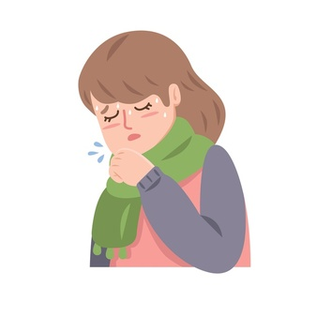
WHAT IS CORONAVIRUS / COVID-19?
There is still a lot we do not know about the coronavirus.
We do know that it looks a lot like other respiratory viruses, like the common cold or the flu.

Slide 6
DAILY COVID-19 UPDATE
https://www.phila.gov/covid-19/

Slide 7
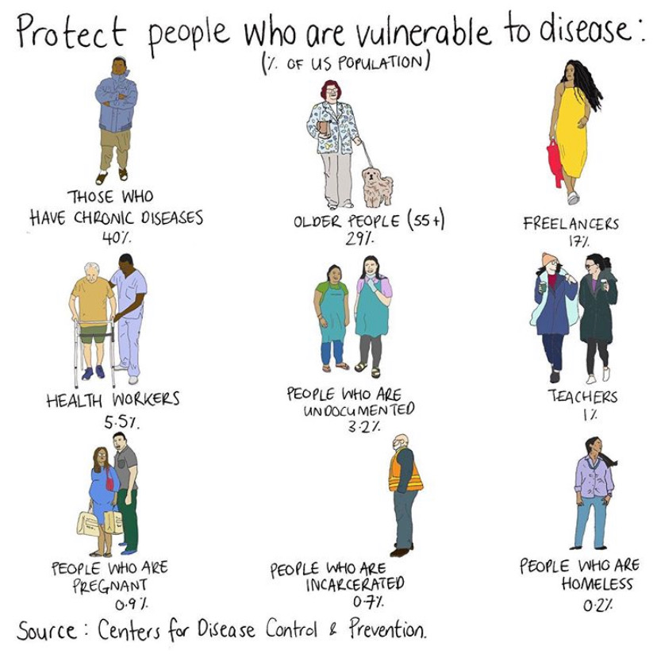
WHO IS AT RISK OF SEVERE ILLNESS?
Older Adults and the elderly (ages 60+)
Those who are immunocompromised
Those with serious underlying health conditions
It is important to understand young and healthy people are NOT immune from contracting the COVID-19!
Image credit: Mona Chalabi

Slide 8
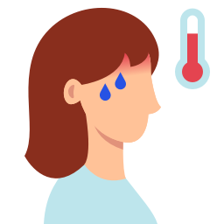
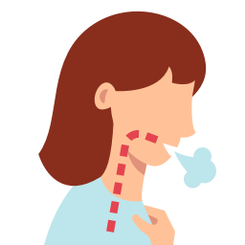
SYMPTOMS OF COVID-19
The most common symptoms:
A COUGH
A FEVER
DIFFICULTY BREATHING
Less common symptoms:
Fatigue
Muscle or joint pain
Headache
Chills
Vomiting
Diarrhea
Loss of sense of smell or taste

Slide 9
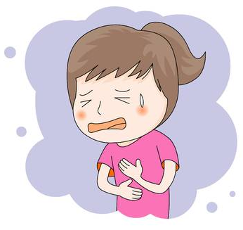
SEVERE SYMPTOMS TO MONITOR
If you have trouble breathing, worsening cough, chest pain or other severe symptoms, call your healthcare provider, go to an urgent care clinic, or go to an emergency department.

Slide 10
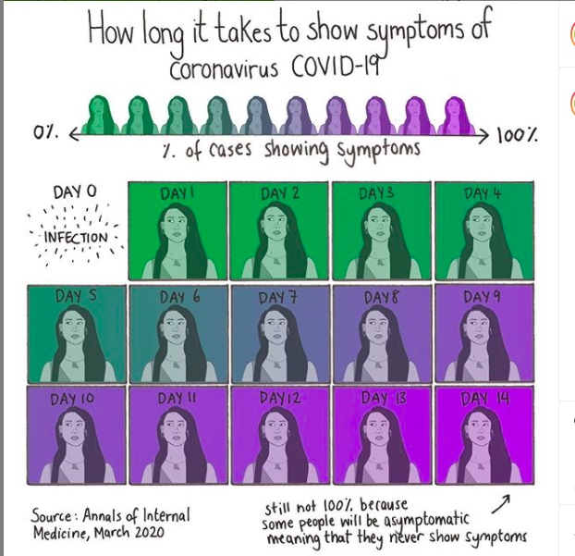
SYMPTOMS OF COVID-19
Most people who get sick from COVID-19 coronavirus will start to feel symptoms between 2 and 14 days after they catch it.
Image credit: Mona Chalabi

Slide 11
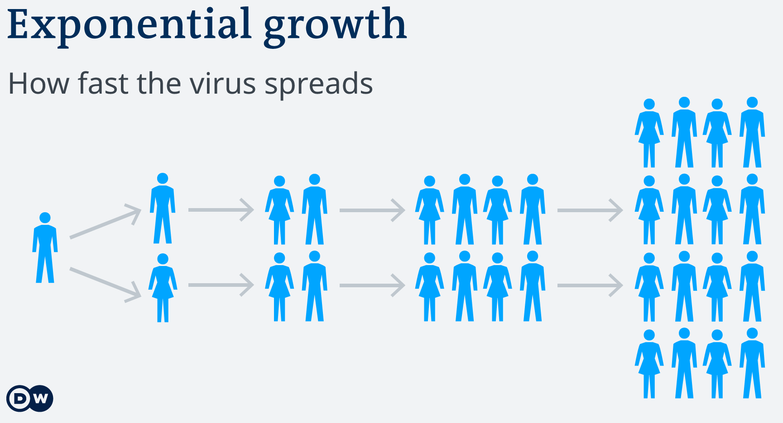
SYMPTOMS OF COVID-19
You can be a carrier of the virus without showing any signs of being sick.
Source: https://www.dw.com/

Slide 12
HOW IS COVID-19 SPREAD?
Through the air when an infected person coughs, sneezes, or talks.
Through close personal contact, like:
touching, shaking hands, or sharing objects.

Slide 13
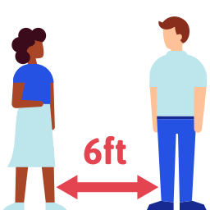
PREVENT THE SPREAD OF COVID-19:
Wash your hands often with soap and water for 20 seconds
Practice physical distancing
Stay home for the duration of the outbreak

Slide 14
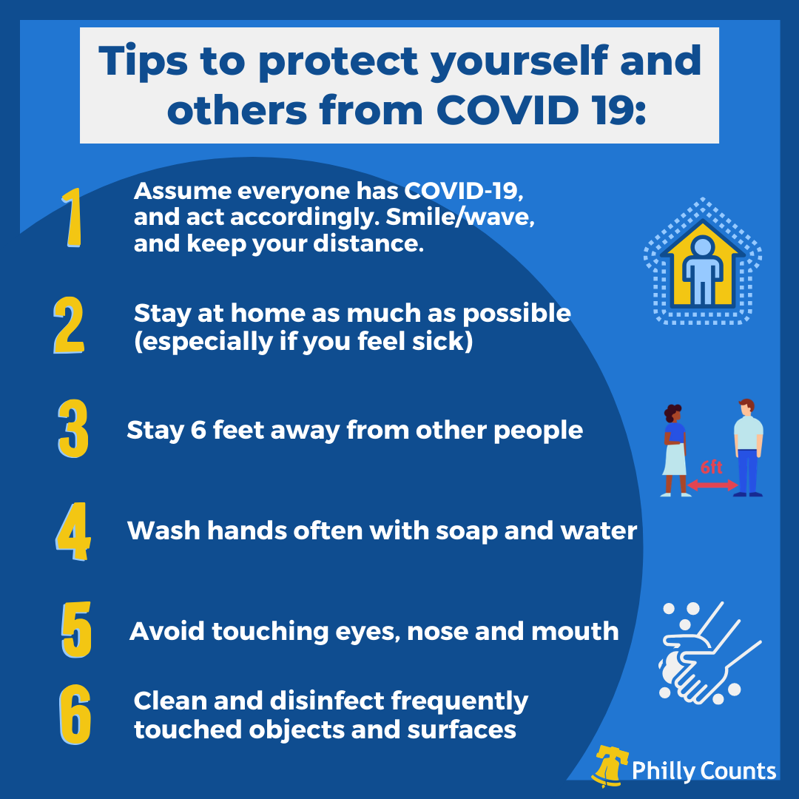

Slide 15
PHYSICAL DISTANCING
Physical Distancing:
avoiding close contact with individuals to prevent catching the virus yourself AND to prevent passing it onto others.

Slide 16
PHYSICAL DISTANCING IS CRUCIAL
Physical Distancing
slows the spread of the virus
protects the healthcare system from becoming overwhelmed
prevents further delays in our day-to-day lives

Slide 17
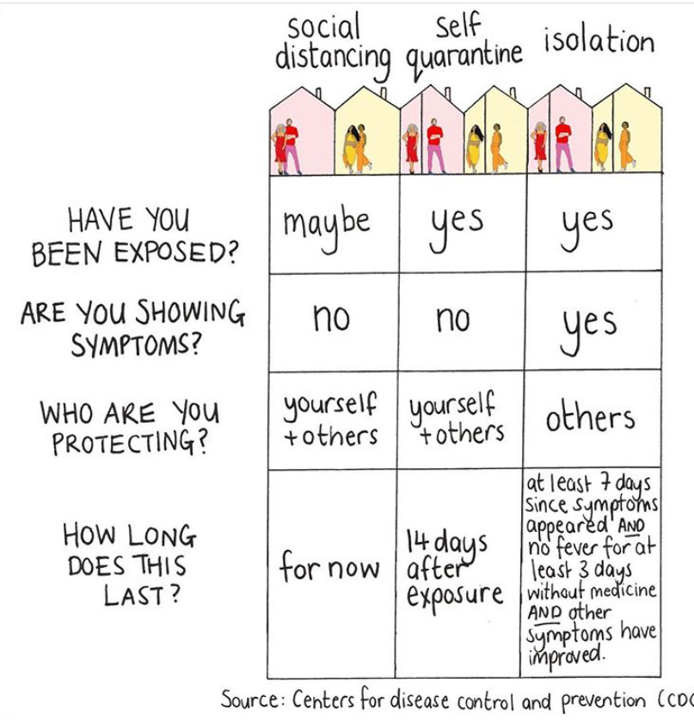
PREVENT THE SPREAD OF COVID-19:
QUARANTINE: staying home and away from others for at least 2 weeks.
SELF-ISOLATION: separation of sick people from other people who are not sick.
Image credit: Mona Chalabi

Slide 18
PREVENT THE SPREAD OF COVID-19:
Even though we have to practice physical distancing to keep ourselves and others safe, maintaining social contact with friends and family is important.
STAY IN TOUCH DIGITALLY!
-text messaging
-phone calls
-face time / video chat
-social media
Remember, we are all experiencing this crisis in different ways.
This is a good time to check in on loved ones.

Slide 19
PREVENT THE SPREAD OF COVID-19:
If you must leave your home, wear a homemade mask.
Wear a mask if you are:
🛒 shopping at essential business, like grocery store
👩‍⚕️ visiting health care provider
🚍 using public transportation
👨🏽‍💼 interacting with customers at essential businesses
🤒 feeling sick, coughing or sneezing

Slide 20
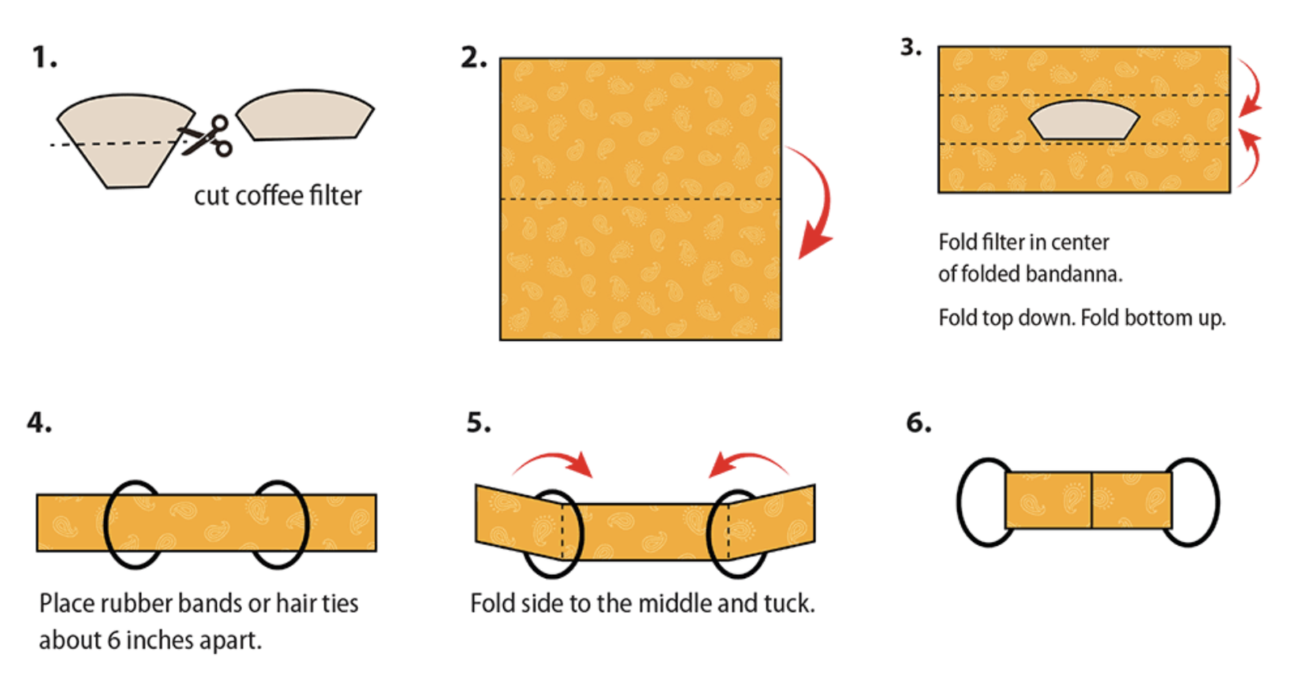
NO-SEW EASY FACE MASK:
bit.ly/FoldedFaceMask
Notes:
Suggested language for script:
If you have a bandana or spare fabric and a few hair ties or rubber bands at home, try this easy DIY face mask.
Simply place a piece of paper towel or coffee filter in the middle of the fabric, and then fold each side of the of the bandana horizontally over the filter.
Loop fabric through two hair ties or rubber bands. Place hair ties or rubber bands 6 inches apart on the fabric.
Fold the sides of the fabric to the middle vertically and tuck to hold in place
Place hair ties or rubber bands behind your ears so the fabric mask covers your face
Source: https://www.countryliving.com/diy-crafts/a32110323/how-to-make-no-sew-bandana-face-mask/

Slide 21
PREVENT THE SPREAD OF COVID-19:
Your mask protects me; my mask protects you
Don’t leave home without it!
Find out how to make a protective mask at home by visiting bit.ly/CDCFaceCover

Slide 22
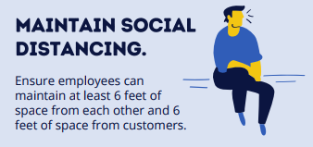
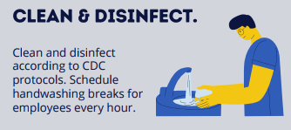
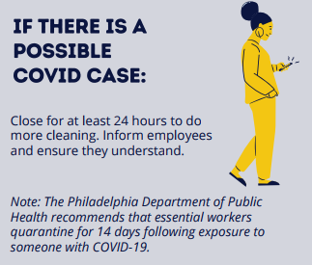
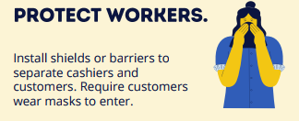
ESSENTIAL WORKERS’ RIGHTS:
Your employer is required to:
To report a business that is not following these guidelines, call 311.

Slide 23
FINES & PENALTIES
Penalties for violation of the City’s COVID-19 orders include:
For businesses: The penalty for a violation of the business operation orders or any other regulation concerning those orders is now $2,000 per violation.
For individuals: The penalty for a violation of the orders is a fine of $500 per violation.
Enforcement officers also have the discretion to to allow payment of lesser amounts for violations of the orders to avoid being taken to court.

Slide 24
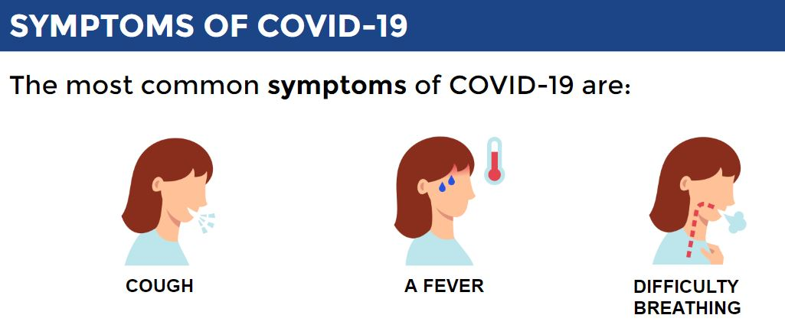
WHAT TO DO IF YOU THINK YOU’RE SICK:
Call your healthcare provider if you:
Have any of the common symptoms,
Have had contact with someone who has tested positive for COVID-19

Slide 25
WHAT TO DO IF YOU THINK YOU’RE SICK:
Call your healthcare provider first.
Only visit an urgent care or emergency center if you are experiencing severe symptoms.
Call 1-800-722-7112
to speak to a healthcare professional.

Slide 26
TREATMENT OF COVID-19
There is no medicine or cure specifically for COVID-19.
STAY HOME
REST
HYDRATE
MILD CASES:
Resting, drinking fluids, and
taking over the counter cold/fever medicine.
Mild cases appear to recover within 1-2 weeks.

Slide 27
TREATMENT OF COVID-19
SEVERE CASES:
there is no specific medicine for COVID-19, so severe cases are treated with oxygen and other supports while they recover.

Slide 28
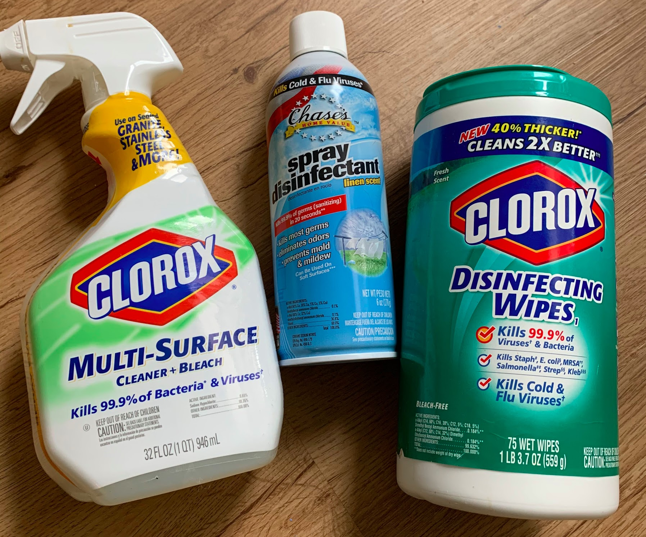
COVID-19 TREATMENT MYTHS
DO NOT CONSUME DISINFECTANTS.
X
Injection or ingestion of household cleaners and disinfectants by any means can cause serious bodily harm or death.
ONLY FOLLOW THE TREATMENT ADVICE OF CERTIFIED MEDICAL PROFESSIONALS

Slide 29
WHERE TO FIND COVID-19 INFO:
cdc.gov/coronavirus
pa.gov/covid-19
phila.gov/covid-19
Please be mindful that misinformation at this time can make it more difficult for people to access accurate information.
Check your sources and facts before sharing new information.

Slide 30
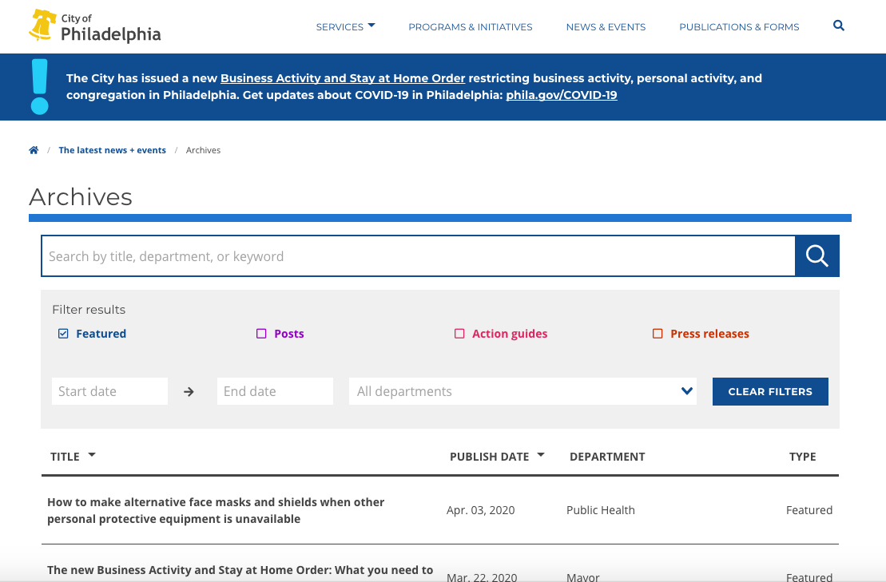
WHERE TO FIND COVID-19 INFO:
For updates on how to stay healthy during the pandemic, text COVIDPHL
to 888-777.

Slide 31
CITIZENSHIP STATUS & MEDICAL ACCESS
COVID-19 impacts all Philadelphians.
The virus does not distinguish between race, nationality, or immigration status.
Everyone should seek medical care when they need it.
Find a Community Health Center with free or low cost care: bit.ly/PhilaHealthCenters
Notes:
https://www.google.com/url?sa=i&url=https%3A%2F%2Fwww.freepik.com%2Ffree-vector%2Fcultural-diversity_4589959.htm&psig=AOvVaw2z6QTCJlO6xzcw2LwNZY5i&ust=1586295004917000&source=images&cd=vfe&ved=0CAIQjRxqFwoTCMj5pMjf1OgCFQAAAAAdAAAAABAD

Slide 32
WHAT TO DO IF YOU SEE OR EXPERIENCE A HATE CRIME
It is ILLEGAL to verbally or physically attack someone based on their ethnicity or assumption of COVID-19 infection.
There have been recent acts of hate and bias against individuals based on the assumption that they are carriers of the COVID-19 virus.
Now is the time for all Philadelphians to keep each other safe, so we can get through this pandemic together! If you see something, say something.
If you witness or are a victim of any crime, you should call 911.
To report hate crimes and bias incidents, contact the
Philadelphia Commission on Human Relations at:
215-686-4670 or pchr@phila.gov.
Find more information at www.phila.gov/humanrelations
Make anonymous reports to the PCHR hotline at 215-686-2856.

Slide 33
RESOURCES FOR THE LGBTQ+ COMMUNITY
EVERYONE should feel safe when seeking support or medical care.
Find LGBTQ+ friendly resources to stay safe and healthy during the pandemic:
Visit bit.ly/COVIDLGBTQ
Notes:
https://www.google.com/url?sa=i&url=https%3A%2F%2Fwww.freepik.com%2Ffree-vector%2Fcultural-diversity_4589959.htm&psig=AOvVaw2z6QTCJlO6xzcw2LwNZY5i&ust=1586295004917000&source=images&cd=vfe&ved=0CAIQjRxqFwoTCMj5pMjf1OgCFQAAAAAdAAAAABAD

Slide 34
ARE YOU IN AN UNSAFE HOME?
If you or your loved one is in immediate danger, please contact the police at 911.
If you think that your relationship is abusive or if you know someone who you think is being abused, call the 24-hour Philadelphia domestic violence hotline at (866) 723-3014.
The National Domestic Violence Hotline: 1-800-799-SAFE (7233)
For more information and additional resources, visit:
bit.ly/HealthyMinds-SurvivorResources

Slide 35
WHAT TO DO IF YOU SUSPECT CHILD ABUSE
High stress, loss of jobs and financial pressures, and long hours together have increased instances of violence in the home, and women and children are often the main victims.
Since the stay at home order, reports of child abuse have gone down. Many more cases go unreported now that children do not have safe spaces to talk to adults or ask for help.
FIND SUPPORT:
Philadelphia Hotline (24/7)
(215) 683-6100
Pennsylvania Hotline (24/7):
(800) 932-0313 or email safe2saypa.org
Children Crisis Treatment Center:
215-496-0707
Philadelphia Children’s Alliance:
215-387-9500
CHOP (CARE) Clinic:
215-590-4923

Slide 36
HOUSING SUPPORT
The Philadelphia courts are closed and there will be no evictions though May 31, 2020.
If you are being evicted without a court order, call the Philly Tenant hotline at 267-444-2500.
Do you need help finding housing?
Contact the Hub of Hope at hubofhope@projecthome.org or call (215) 309-5225
Hours of operation : 9 AM to 5 PM
SEE SOMEONE IN NEED OF SHELTER? Call (215) 232-1984 to request outreach.

Slide 37
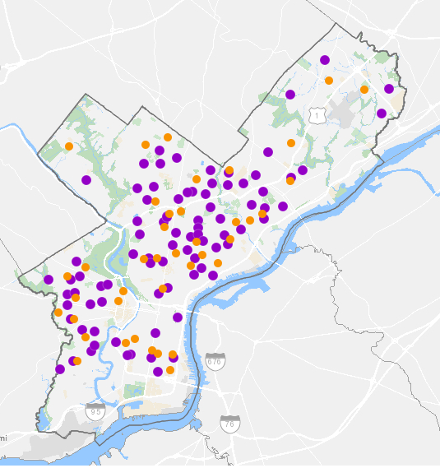
FOOD SUPPORT
Meal distribution sites (orange dots) are open Mondays & Thursdays from 10 a.m. – 12 p.m.
Student meal sites (purple dots) are open Thursdays, 9 a.m. - 12 p.m.
Residents do not need to present an ID
or proof of income for eligibility.
Food sites are supported by the City,
Share Food Program, and Philabundance.
LEARN MORE AT: phila.gov/food
Text your zip code to 1-800-548-6479 to find a list of food pantries

Slide 38
`
PANDEMIC EBT FOR STUDENTS
The Pandemic Electronic Benefit Transfer (P-EBT) will provide students who would have received free or reduced price meals at school with $365 added to their EBT card.
Families who do not have an active EBT card will receive the funds at their address as indicated on School District records.
Notes:
Icons made by <a href="https://www.flaticon.com/authors/freepik" title="Freepik">Freepik</a> from <a href="https://www.flaticon.com/" title="Flaticon"> www.flaticon.com</a>

Slide 39
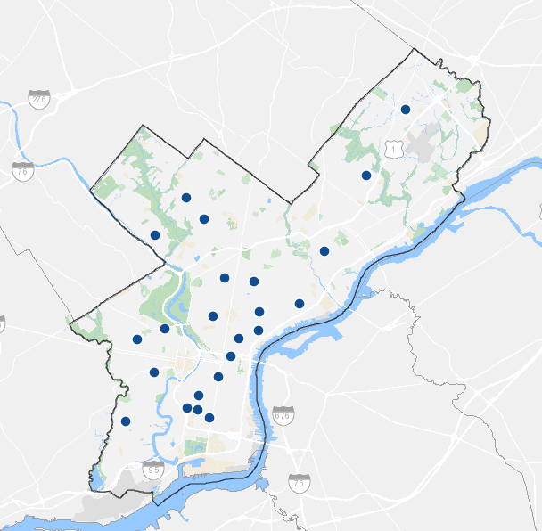
FOOD SUPPORT FOR SENIORS
Seniors (60+) should call ahead to reserve a meal.
To find the phone number of a site near you, visit bit.ly/PhillySeniorMeals
If you need to reserve a meal,
call the PCA helpline: 215-765-9040.
(Services available in English and Spanish.)
Notes:
Icons made by <a href="https://www.flaticon.com/authors/freepik" title="Freepik">Freepik</a> from <a href="https://www.flaticon.com/" title="Flaticon"> www.flaticon.com</a>

Slide 40
`
SUPPORT FOR INDIVIDUALS WITH DISABILITIES
Medicaid Recipients:
You may be eligible to receive home delivered meals as a part of your benefits. Contact your support coordinator or call the CHC Helpline at 1-844-824-3655
If you need food and can’t leave your home due to a disability, call Liberty Resources to set up a free, weekly food delivery in May.
Call or text 215-709-9619
Email food@libertyresources.org
Notes:
Icons made by <a href="https://www.flaticon.com/authors/freepik" title="Freepik">Freepik</a> from <a href="https://www.flaticon.com/" title="Flaticon"> www.flaticon.com</a>

Slide 41
SUPPORT FOR CARETAKERS
Residents can pick up free food and baby supplies.
Many sites require appointments - make sure to call ahead.
Download the Pacify app to access free virtual breastfeeding support
Use access code PHILLY
for free 24/7 access
To find a site near you, and for other resources for caretakers,
visit bit.ly/PhillyBabyCare
Or call (267) 432-5844
Notes:
Icons made by <a href="https://www.flaticon.com/authors/freepik" title="Freepik">Freepik</a> from <a href="https://www.flaticon.com/" title="Flaticon"> www.flaticon.com</a>

Slide 42
STEP UP TO THE PLATE MEAL SITES
Local organizations and donors have come together to establish Step Up to the Plate:
two outdoor sites where individuals experiencing homelessness can receive meal service and access resources related to the COVID-19 crisis.
The sites are located at:
North Apron of City Hall (located near Project HOME’s Hub of Hope outdoor medical clinic)
Intersection of East Clearfield and Ruth Streets in Kensington, near Prevention Point
Notes:
https://philanthropynetwork.org/sites/default/files/Step%20Up%20To%20The%20Plate%20One%20Sheet.pdf

Slide 43
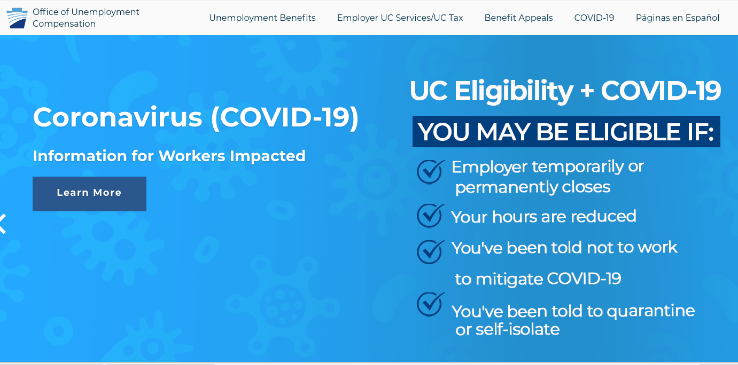
UNEMPLOYMENT SUPPORT
Employees in Pennsylvania who are out of work because of the COVID-19 may be eligible for unemployment and workers’ compensation benefits
VISIT: UC.PA.GOV/COVID-19

Slide 44
Times are tough.
Remember to check in with yourself and your loved ones.
Get help now: call the Crisis Hotline at 215-685-6440

Slide 45
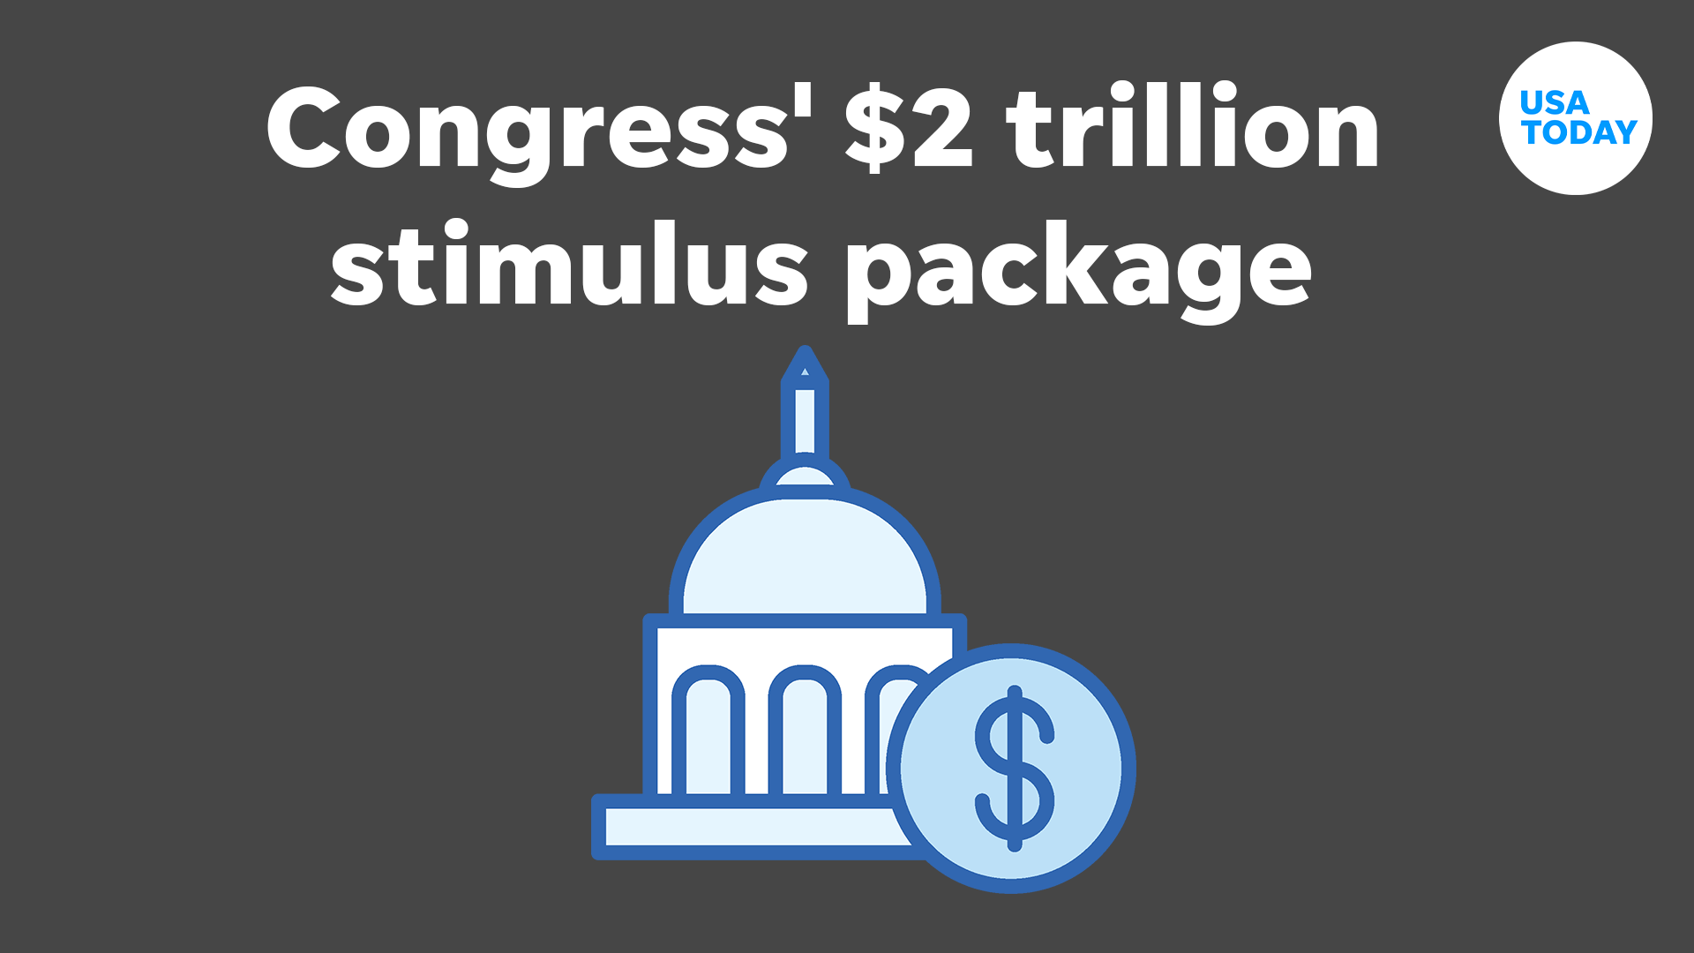
STIMULUS CHECKS FAQ:
Who?
Every documented U.S. resident that is not claimed as a dependent by another person will have received a one-time payment.
What?
Most adults receive one payment of $1,200. For individuals that make $75,000 or more per year, the payments will be less. Households receive an additional $500 per child 17 years old or younger.
How?
If the Internal Revenue Service (IRS) has your bank account information from your 2019 or 2018 tax return, it will transfer the money to you by direct deposit.
To check the status of your payment, visit: www.irs.gov/coronavirus/get-my-payment
Notes:
https://www.cnn.com/2020/04/01/politics/stimulus-money-distribution-individuals/index.html

Slide 46
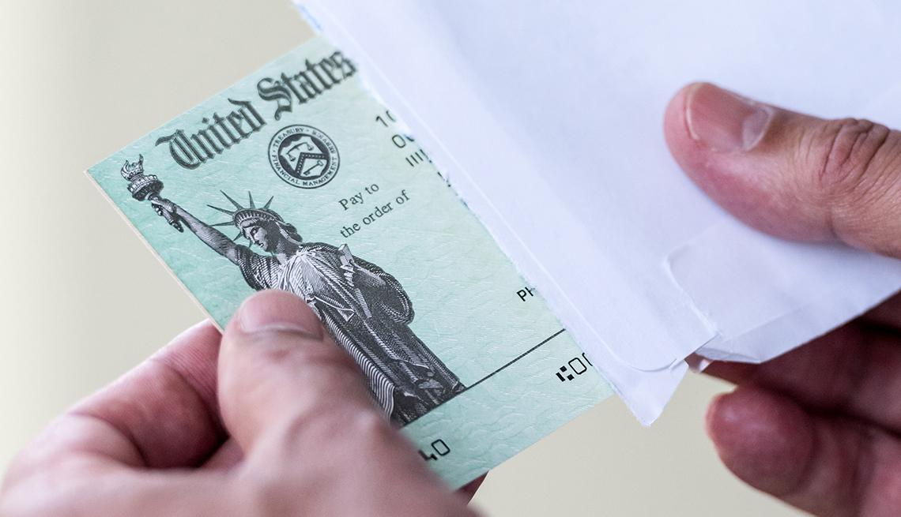
STIMULUS CHECKS FAQ:
When?
Taxpayers that have direct deposit information on file with the IRS should have received their stimulus via direct deposit.
The paper checks have started to go out, and the Treasury expects to be able to send 5 million checks each week, through September.
Notes:
https://www.cnn.com/2020/04/01/politics/stimulus-money-distribution-individuals/index.html

Slide 47
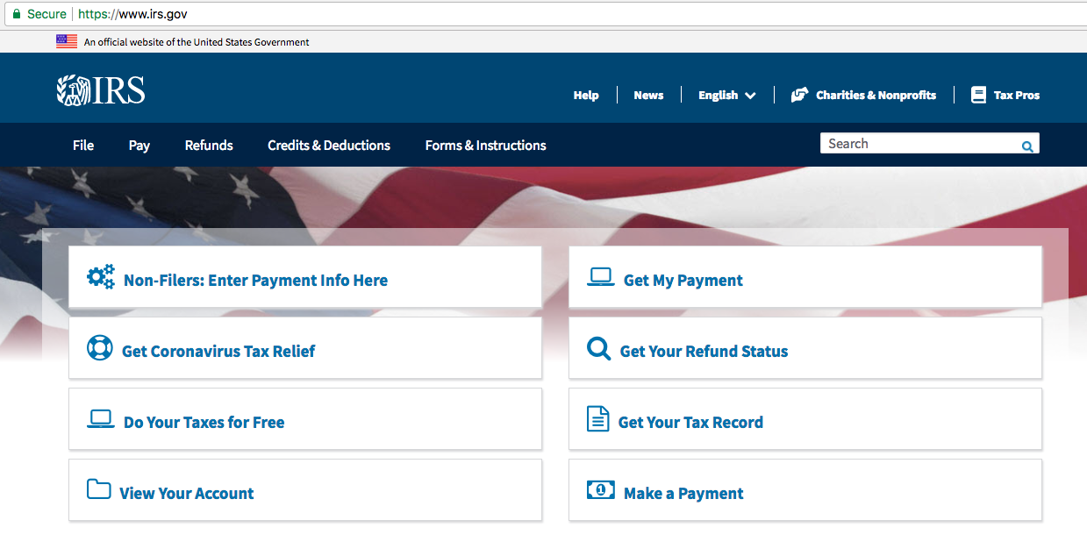
AVOID STIMULUS SCAMS:
You should NEVER provide your direct deposit or other banking information to anyone.
To submit your information,
if you didn’t file a tax return
To check the status of your payment
To report a scam, contact the Fraud Detection and Analysis Unit by emailing PA-PVPITFRAUD@pa.gov.
Notes:
https://www.cnn.com/2020/04/01/politics/stimulus-money-distribution-individuals/index.html

Slide 48
STIMULUS CHECKS FAQ:
Is the stimulus check taxable?
No. The amount an individual receives in federal stimulus does not count as taxable income.
Do I have to repay the stimulus check?
No. You will not have to repay the stimulus check on your tax returns next year.
Notes:
https://www.cnbc.com/2020/04/13/will-you-have-to-pay-back-the-coronavirus-stimulus-check.html

Slide 49
ARTIST SUPPORT
Theatre Philadelphia Emergency Relief:
Micro-grants of $300 to individuals whose income has been impacted by COVID-19. Applications open to ALL individuals who work in the theatre industry. Micro-grants are first-come-first-serve. TO LEARN MORE AND APPLY, VISIT theatrephiladelphia.org/
Emergency Gap Fund for Philly’s Black Working Artists
One-time grants of $500 to help Black working artists residing in Philadelphia stay stable and safe while weathering the impact of the COVID-19 crisis. TO LEARN MORE AND APPLY, VISIT villagearts.org

Slide 50
ARTIST SUPPORT
The COVID-19 Arts Aid PHL program:
Provides up to $500 for working artists and up to $1,000 for small arts and culture organizations.
The program’s focus will be on cultural organizations with budgets of $250,000 or less and working artists for whom support is urgent.
While initial funding is limited, grants will be made on a rolling basis as additional funding is received.
Creative PHL has compiled a list of grant and other funding opportunities.
TO LEARN MORE ABOUT THE ARTS AID PROGRAM AND MORE FINANCIAL SUPPORT, VISIT CREATIVEPHL.ORG/OPPORTUNITIES/

Slide 51
SOLIDARITY FUND FOR COVID-19 ORGANIZING
Bread & Roses Community Fund launched the Solidarity Fund for COVID-19 Community Organizing to support grassroots community organizing groups during the COVID-19 crisis.
Groups doing work directly related to or impacted by the COVID-19 crisis can apply for a grant of up to $10,000 by visiting:
breadrosesfund.org/solidarityfundapply/

Slide 52
INTERNET ESSENTIALS
Internet Essentials is a program for families and other low-income households who currently do not subscribe to Internet at home.
During the COVID-19 crisis, new customers will receive two months of free internet service.
Apply at apply.internetessentials.com

Slide 53
STUDENT CHROMEBOOKS
School District of Philadelphia K-12 families that need a Chromebook for at-home schoolwork can pick one up from one of the Parent & Family Support Centers.
For more info, visit:
philasd.org/chromebooks
Monday, Wednesday, Friday
9am -1pm

Slide 54
DIGITAL LEARNING SUPPORT
SDP Hotline for students and families:
(215)-400-5300
Open Monday - Thursday
9:30 am to 11:30 am
Interpretation available in 10 languages
To find more tips and resources for digital learning while Philly schools are closed, visit https://bit.ly/PhillyDigitalLearning

Slide 55
JUMP START PHILLY SCHOOLS FUND
The Jump-Start Philly Schools Fund, aims to meet the immediate needs of low-income students and families during the school closures caused by COVID-19.
The goals:
Close the device gap
Help transition to virtual learning
Prepare for academic recovery
Every student must have the opportunity to continue their learning, regardless of what part of the city they are from or what kind of school they attend.
Visit philaschoolpartnership.org for more information and to get involved.
Notes:
Philadelphia area donors have come together to launch the Jump-Start Philly Schools Fund, aimed at meeting the immediate needs of low-income students and families across the city during the school closures caused by the COVID-19 pandemic, and providing resources to support schools and teachers when they eventually transition students back to full-time learning environments.
Jump-Start Philly Schools Fund aims to raise $6 million or more to address the needs for students. The first round of grants will help to supply laptop computers to 15,000 students who need them for learning at home.
Students must have the opportunity to continue learning while they are home, regardless of where they live in the city or what kind of school they go to. This program aims to reduce barriers for students to stay on track in school during the COVID-19 crisis.
https://philaschoolpartnership.org/

Slide 56
UPDATES TO WIC OPERATIONS:
Women, Infants, and Children (WIC)
will be issuing benefits via mail.
They are still accepting new participants.
WIC serves the following Pennsylvania residents:
Pregnant women
Breastfeeding women, for up to one year postpartum
Women who are not breastfeeding, up to six months postpartum
Infants and children under 5 years old, including foster children
*Eligibility:
If you receive SNAP, MA, or TANF, you may apply for WIC, regardless of income.
WIC does not require proof of citizenship.

Slide 57
UTILITY UPDATES
Customers will not be shut off for nonpayment through June 1. Drinking water safety is not impacted by the virus.
PGW is suspending non-payment terminations until further notice. PGW also plans to waive new late payment charges.
PECO is suspending service disconnections and waiving new late payment charges through at least July 1, 2020.
Trash and recycling pick-up will occur on a regular schedule.
The Low Income Home Energy Assistance Program (LIHEAP) helps keep families safe and healthy through initiatives that assist families with energy costs, such as:
Home energy bills
Energy crises
Weatherization
Phone Number: (202) 401-9351 https://www.acf.hhs.gov/ocs/programs/liheap

Slide 58
PHILADELPHIA COURTS
The courts in the First Judicial District (Philadelphia Courts) will remain closed for non-essential functions through May 29, 2020.
Those scheduled for Jury Duty during this time should NOT report.
For more information and updates on the services that are available, visit www.courts.phila.gov/covid-19

Slide 59
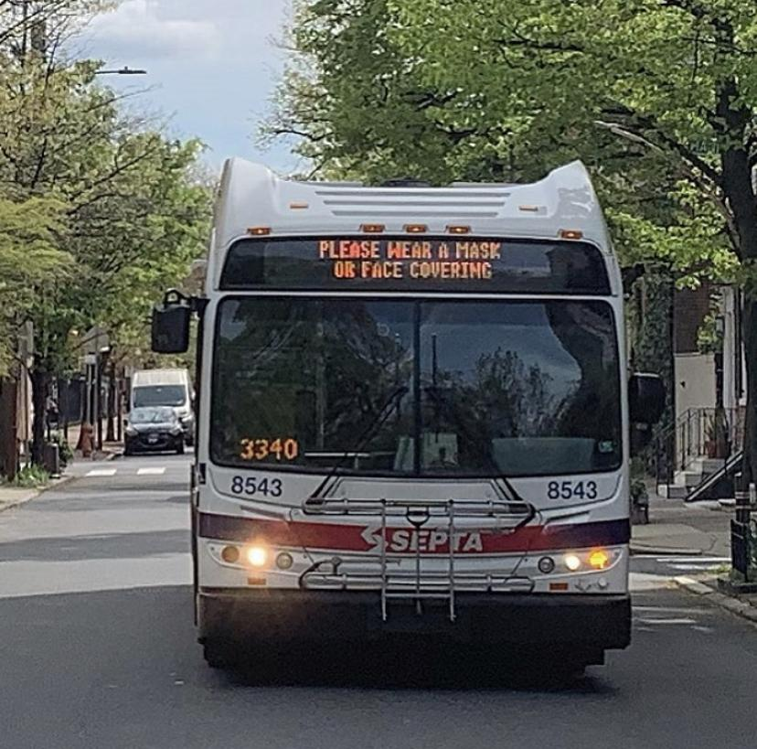
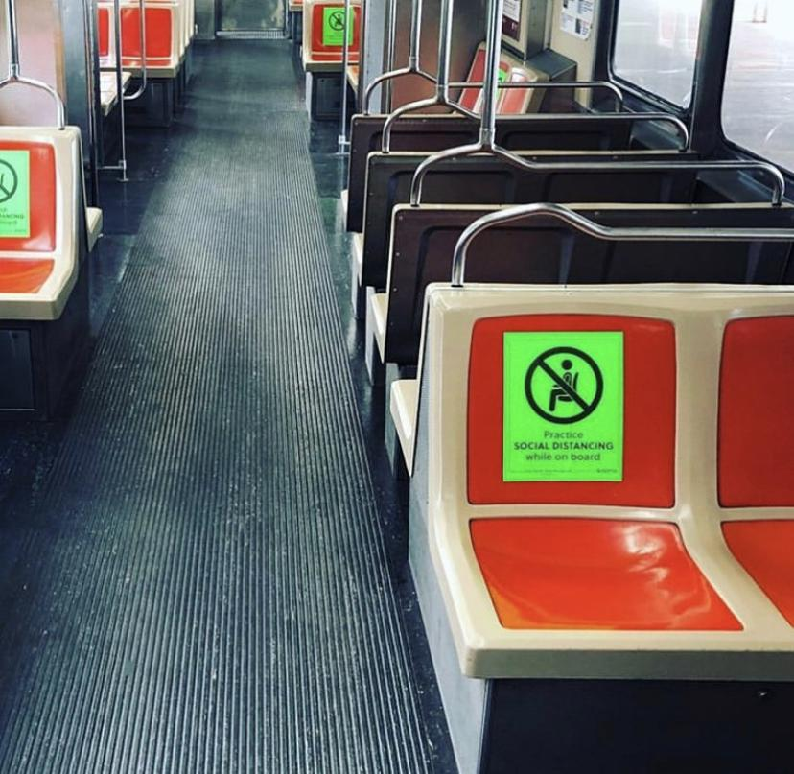
SEPTA OPERATIONS:
SEPTA has resumed operations on a regular schedule.
SEPTA urges riders to:
Follow social distancing guidelines
Limit trips on SEPTA to essential travel
Protect SEPTA employees - wear a mask when riding!
Find routes to essential businesses and hospitals using the map at bit.ly/SeptaEssential

Slide 60
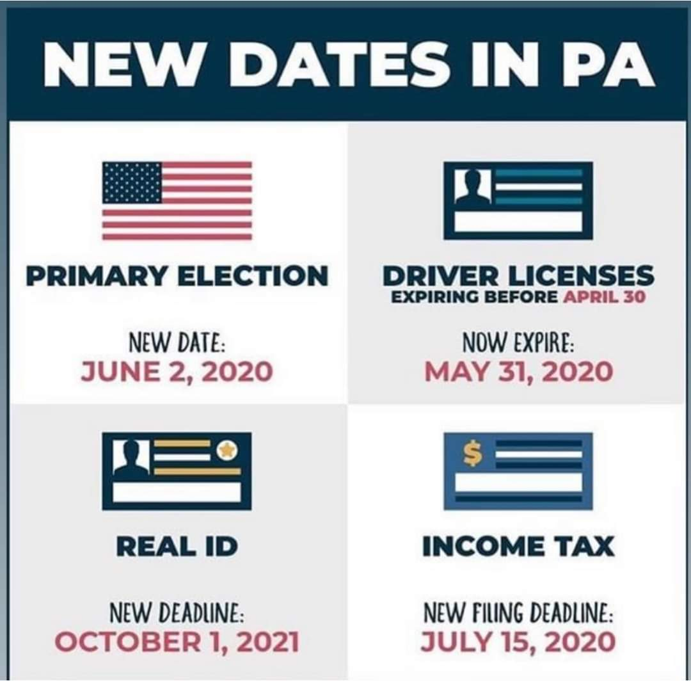
UPDATES TO ESSENTIAL SERVICES:
NEW DEADLINES
Just like the 2020 Census, you can now register to vote online! You can also register by mail.
Not sure if you are registered at your current address?
Check Your Registration Status: www.pavoterservices.pa.gov/

Slide 61
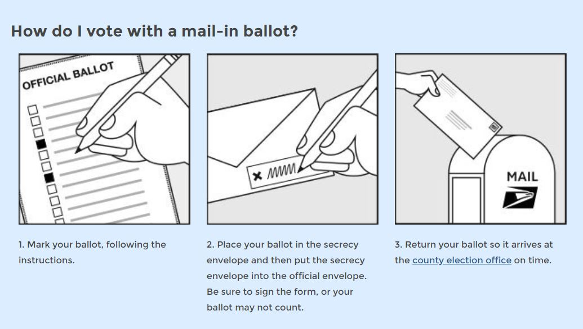
MAIL - IN BALLOT
UPDATES TO ESSENTIAL SERVICES:
Notes:
https://www.pa.gov/guides/voting-and-elections/ #VotingbyMail-InBallot

Slide 62
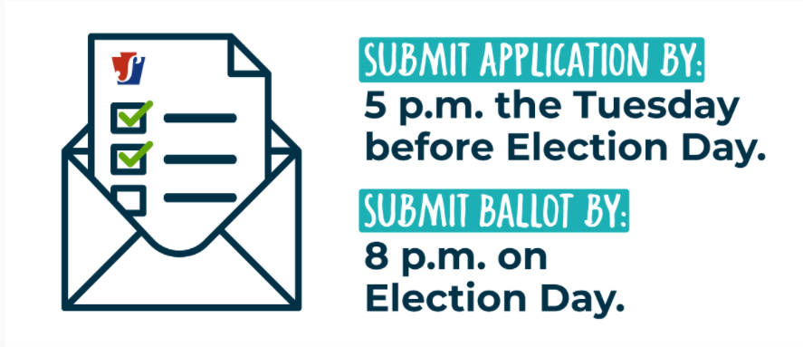
MAIL - IN BALLOT: APPLY TODAY!
UPDATES TO ESSENTIAL SERVICES:
The deadline to register as a Pennsylvania voter was May 18.
Applications for a mail-in-ballot are available until May 26.
Notes:
https://www.pa.gov/guides/voting-and-elections/#VotingbyMail-InBallot

Slide 63
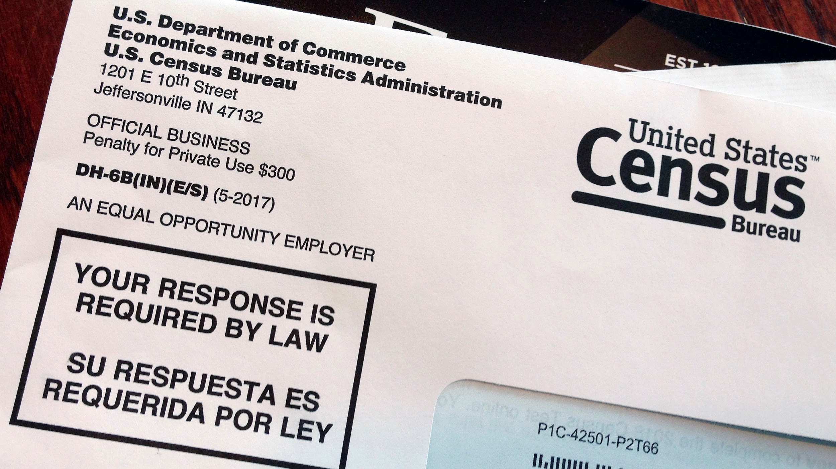
2020 CENSUS - YOU COUNT!
UPDATES TO ESSENTIAL SERVICES:
We need EVERY Philadelphian to count in 2020 to ensure we receive the federal COVID-19 recovery support we need.
Go online to 2020census.gov, call 844-330-2020, or look out for the paper form in your mail
WHY COMPLETE THE CENSUS?
EVERY person counts, regardless of citizenship or immigration status!
(Your response is confidential, too)
Political representation
Demographic
representation
Funding
for communities

Slide 64
PHILLY311
UPDATES TO ESSENTIAL SERVICES:
For more information about COVID-19 and current City guidelines on social gatherings, contact Philly 311.
Phone: 3-1-1 on a cell phone, or 215-686-8686
Email: philly311@phila.gov
Twitter: @philly311
Website: Phila.gov/311
Mobile App: Philly 311 (iOS / Android)
Hours of operation:
Weekdays: 8:00 am - 8:00 pm
Weekends: 8:00 am - 8:00 pm
Language support is available by phone and mobile app.
Notes:
https://www.pa.gov/guides/voting-and-elections/#VotingbyMail-InBallot

Slide 65
YOUR ROLE AS A COMMUNITY RESPONSE CAPTAIN:
Everyday people helping each other.
Here are some ways you can take action to help keep your community safe.
Share on social media about your experience in this training using the #CommunityCaptainPHL
Spread the message
Talk to your family, friends, and neighbors about the information your received in this training
Check on your Neighbors
Call your neighbors
and make sure they have everything they need.
Encourage
everyone you know to follow the CDC’s recommendations

Slide 66
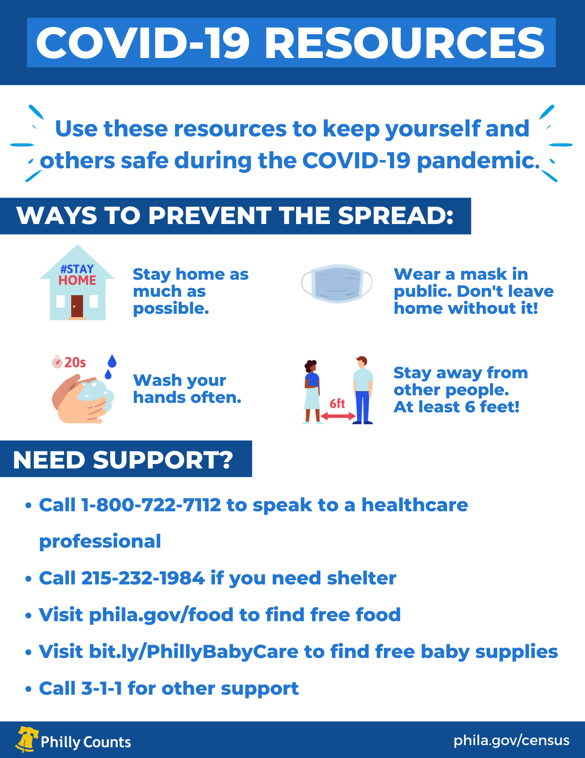
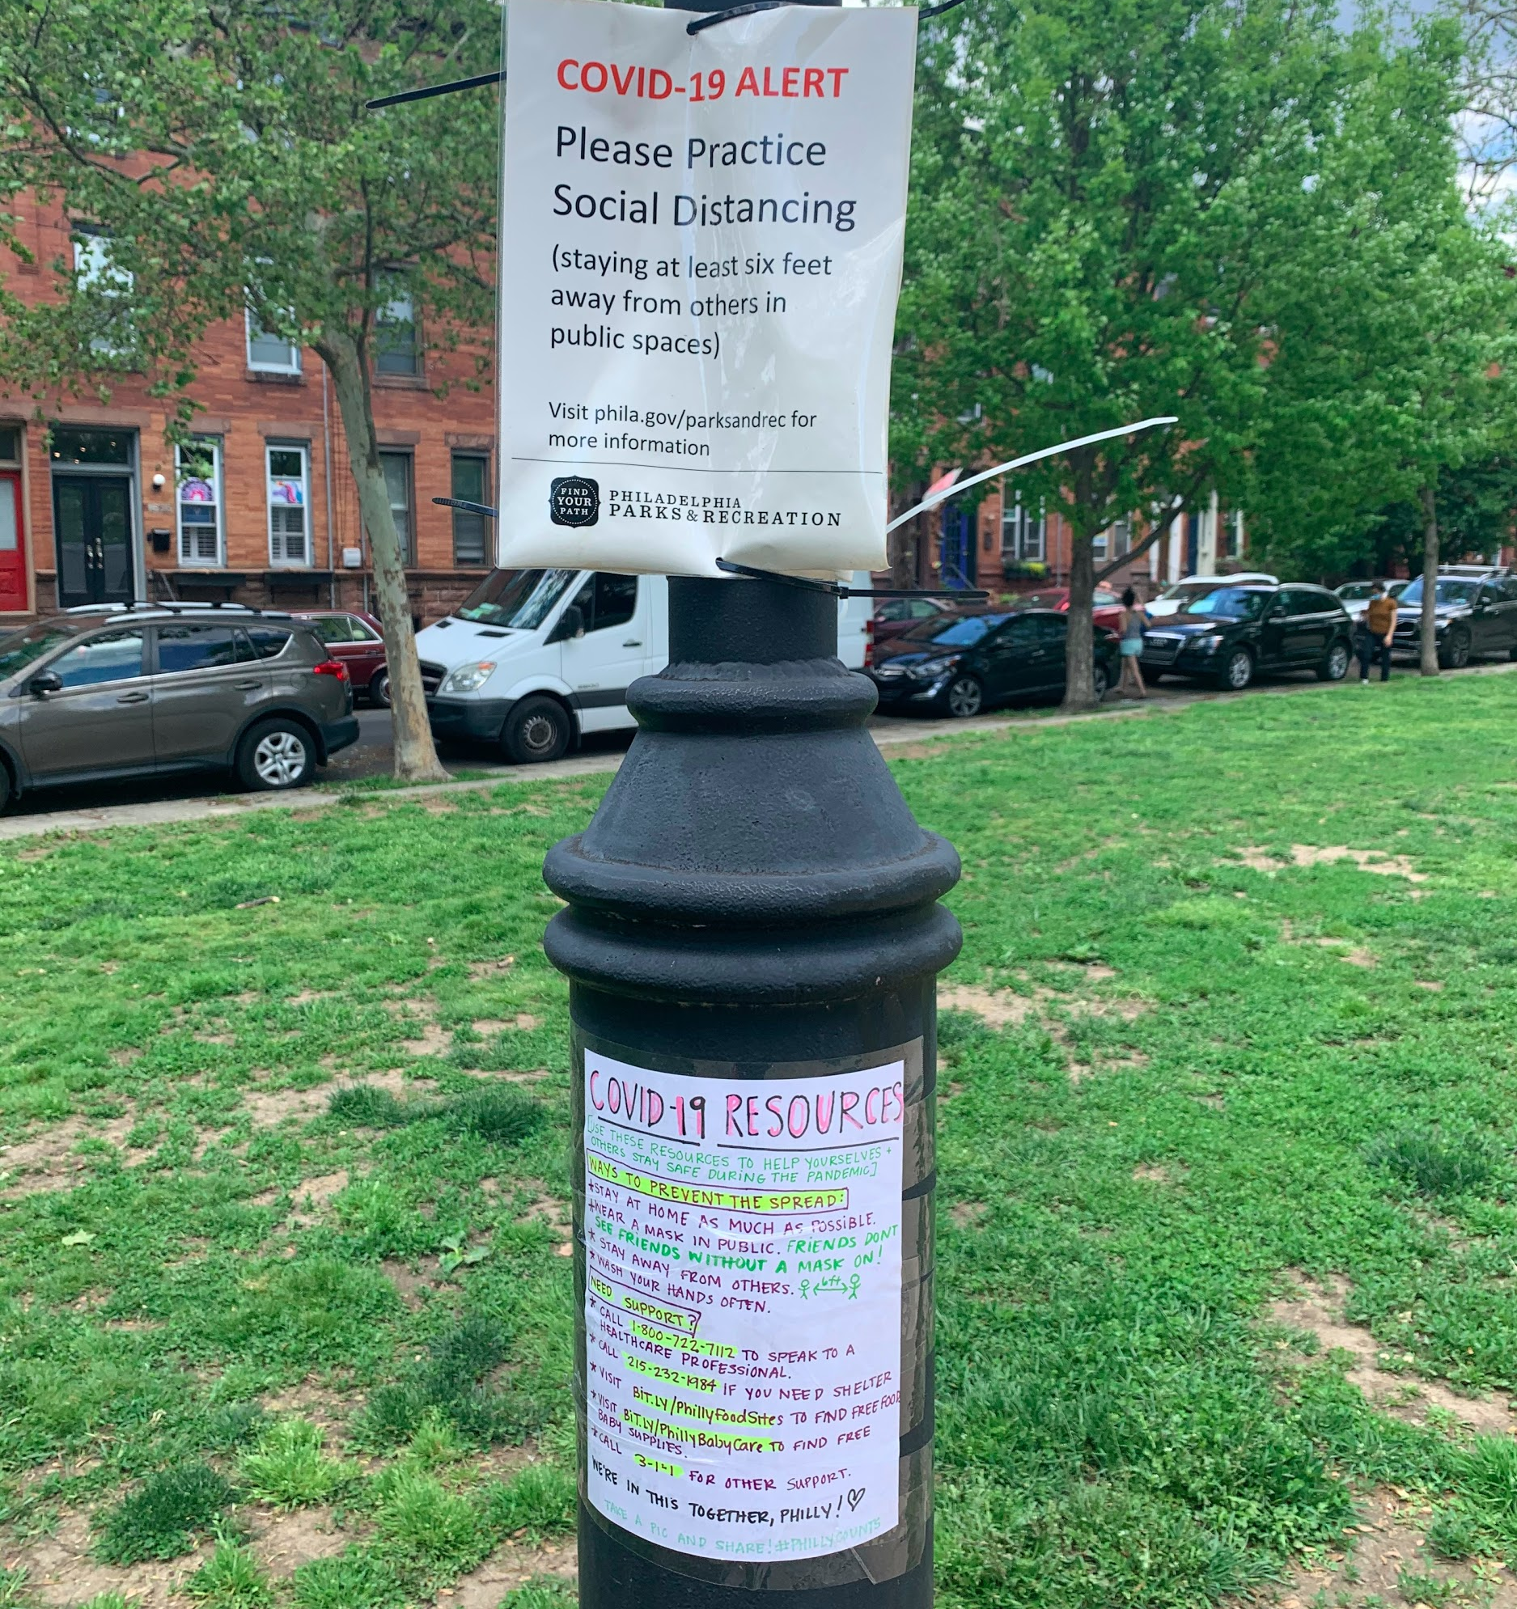
TAKE ACTION!
Share this information with your neighbors!
Print out this resource sheet and hang it up in your area!
No printer? No problem! You can hand-write it too.

Slide 67
ADDITIONAL VOLUNTEER OPPORTUNITIES
Volunteer at a Food Distribution Site: The City of Philadelphia needs help packing and distributing food to those who need it during the COVID-19 pandemic. Visit www.serve.phila.gov for more information and to volunteer.
Join the Philadelphia Medical Reserve Corp: a group of volunteers who serve the City during public health emergencies. Clinical and non-clinical volunteers are needed. You must be at least 18 years old to join. Visit www.serve.phila.gov for more information and to volunteer.
Phone Bank with Philly Counts: We’re reaching out to households across Philadelphia to check in and make sure they have everything they need to stay healthy and safe at home during the pandemic.
Visit https://bit.ly/COVIDPhoneBank to sign up for a phone banking session.

Slide 68
GO FORTH AND SUPPORT YOUR COMMUNITY!
SHARE KNOWLEDGE SHARE RESOURCES SHARE KINDNESS
AND KEEP EACH OTHER SAFE!

