Slide 1
2017 Community Health Assessment (CHA) Philadelphia, PA
Philadelphia Department of Public Health
September 2017

Slide 2
Table of Contents
Section | Slide Number
Summary Health Measures | 11
Tobacco and Alcohol | 25
Obesity | 45
Cardiovascular Disease and Diabetes | 61
HIV | 75
Teen Sexual Health | 91
Maternal and Infant Health | 106
Child Health | 121
Access to Care | 138
Cancer Screening and Prevention | 159
Environmental Health | 174
Violence | 182
Mental Health and Substance Abuse | 192
Built Environment | 205
Social Determinants of Health | 214
Public Health Assets | 248
Data Sources | 254
Data Definitions and Methods | 260

Slide 3
Community Health Assessment (CHA)
The CHA is a systematic assessment of population health in Philadelphia, highlighting key public health challenges and assets and informing local public health programs, policies, and partnerships.
The CHA includes indicators reflecting health behaviors, health conditions, health care factors, and social and environmental determinants of health.

Slide 4
CHA Overview
Published annually since 2014
Combines local, state, and national data sources to provide a snapshot of health indicators and social determinants of health in Philadelphia:
Compared to other large cities or counties
Over time
By race/ethnicity in the most recent available year of data
By planning district in the most recent available year of data
The 2017 annual update includes a number of changes from previous years, which are detailed in the methods slides and in slide notes where applicable.
Interact with the data using the Community Health Explorer

Slide 5
CHA Updates Since 2016
The 2017 CHA added two new indicators: population per primary care physician and population per dentist.
The 2017 CHA uses age-adjusted data for the following:
Homicide Mortality – by race/ethnicity and by planning district
Firearm Homicide Mortality – by race/ethnicity and by planning district
Opioid-Related Mortality - by race/ethnicity and by planning district

Slide 6
How to Use This Report
The CHA can be used to look at progress and remaining challenges for health and health equity across the city.
The document is intended for use by health researchers as well as advocates, making it easier for those interested in health in Philadelphia to access existing data sets.

Slide 7
Key Findings
In general, most health indicators are improving, but some indicators – particularly those related to opioid use and unhealthy behaviors – are troubling. Some key findings include:
Heart disease and other chronic health conditions remain the leading causes of death in Philadelphia. There is a high prevalence of risk factors for cardiovascular disease.
Approximately 22 percent of Philadelphia adults report cigarette smoking -- more than any other major city in the U.S.
The number of children with obesity has slowly declined, particularly among younger children. However, these improvements have not been observed among adults, as obesity rates, affecting approximately one-third of Philadelphians, continue trending upward, particularly among non-Hispanic blacks and Hispanics.
The obesity epidemic is leading to very high rates of diabetes in all racial and ethnic groups, but particularly high rates in non-Hispanic Blacks, in which the prevalence is nearly 20% of adults. Non-Hispanic Blacks also have significantly higher rates of hypertension.

Slide 8
Key Findings
Teen birth rates continue to decline for all racial ethnic groups and are highest among Hispanics.
In 2014, the infant mortality rate was 7.8 per 1,000 live births, a significant reduction from 11.2 per 1,000 live births in 2006. Infant mortality rate in Philadelphia is high compared to the national rate and it remains 2 to 3 times higher in non-Hispanic blacks than other racial and ethnic groups.
Rates of lead exposure in children have declined over the last decade. In 2016, 342 children (0.9% of those tested) had venous blood lead levels above 10 ug/dL and 1,310 children (3.4% of those tested) had venous blood lead levels between 5 and 9 ug/dL. Children in certain low-income neighborhoods, particularly in North Philadelphia and some parts of West and Southwest Philadelphia continued have higher rates of lead exposure than children in other parts of the city.
Non-Hispanic black and Hispanic children have rates of hospitalization for asthma 5 to 7 times that of non-Hispanic white children.

Slide 9
Key Findings
The use of both pharmaceutical opioids and illicit opioids has created a public health crisis. Poisonings, which include unintentional drug overdoses, are now the leading cause of death for individuals ages 25 to 44. In 2016, the number of fatal drug overdoses more than doubled that of previous years, and is 3 times higher than homicides.
The number of new cases of HIV has fallen over the past decade, particularly among heterosexuals and injection drug users. Men who have sex with men continue to have much higher rates of HIV incidence.
In the past 10 years there has been a resurgence of syphilis in men who have sex with men.
The number of days with unhealthy air quality is declining and days with good air quality is increasing in Philadelphia. In 2016, Philadelphians experienced nearly an equal number of days with good and moderate air quality, and only 9 days with unhealthy air quality.

Slide 10
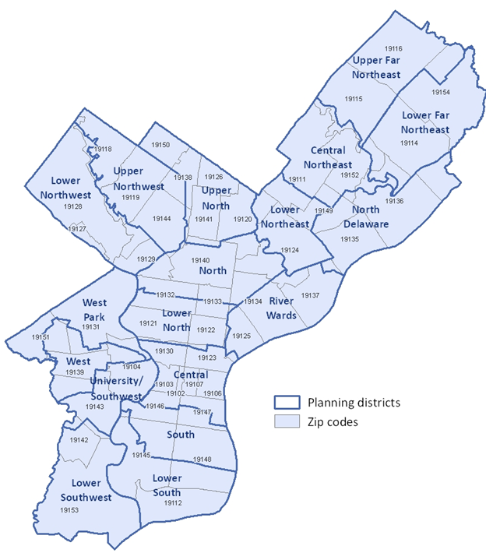
Planning Districts
Philadelphia has 18 Planning Districts, representing distinct economic, geographic, and social units.
Districts plans by the Philadelphia City Planning Commission can be found here.
An online planning district lookup map is available here.

Slide 11
Summary Health Measures
Years of Life Lost Before Age 75
Life Expectancy
Poor or Fair Health

Slide 12
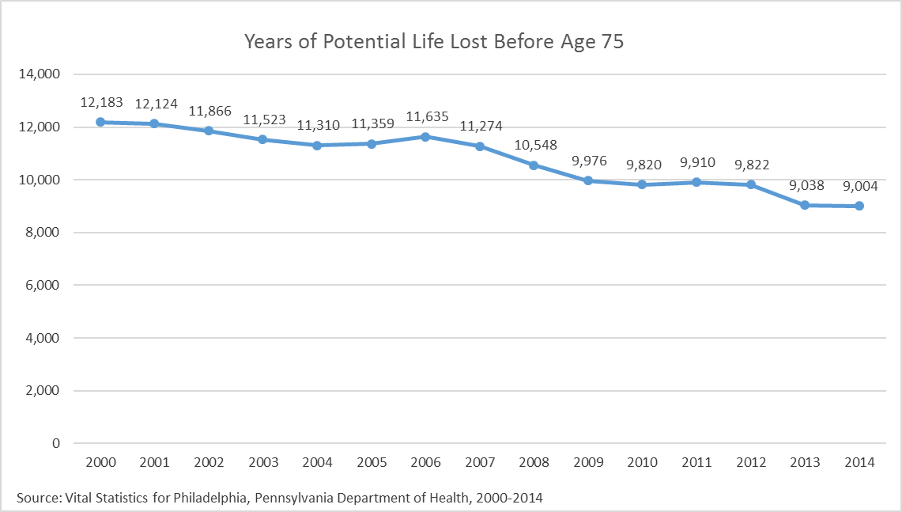
Summary Health Measures
Indicator Definition:
Years of Potential Life Lost Before Age 75 (YPLL-75) is an age-adjusted rate per 100,000 of the population. It is based on the average years a person would have lived if he or she had not died before age 75.

Slide 13
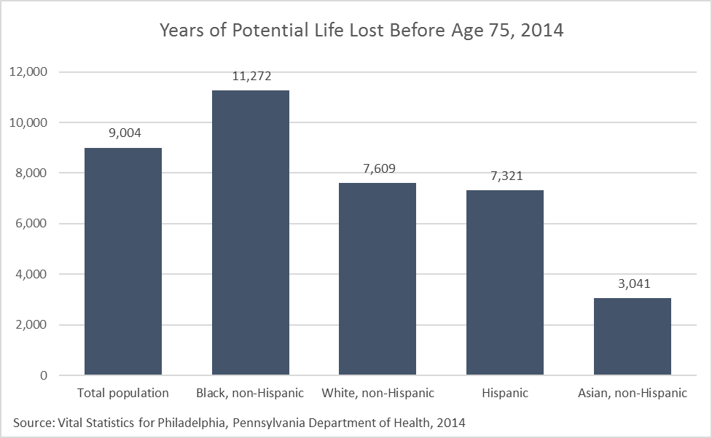
Summary Health Measures
Indicator Definition:
Years of Potential Life Lost Before Age 75 (YPLL-75) is an age-adjusted rate per 100,000 of the population. It is based on the average years a person would have lived if he or she had not died before age 75.

Slide 14
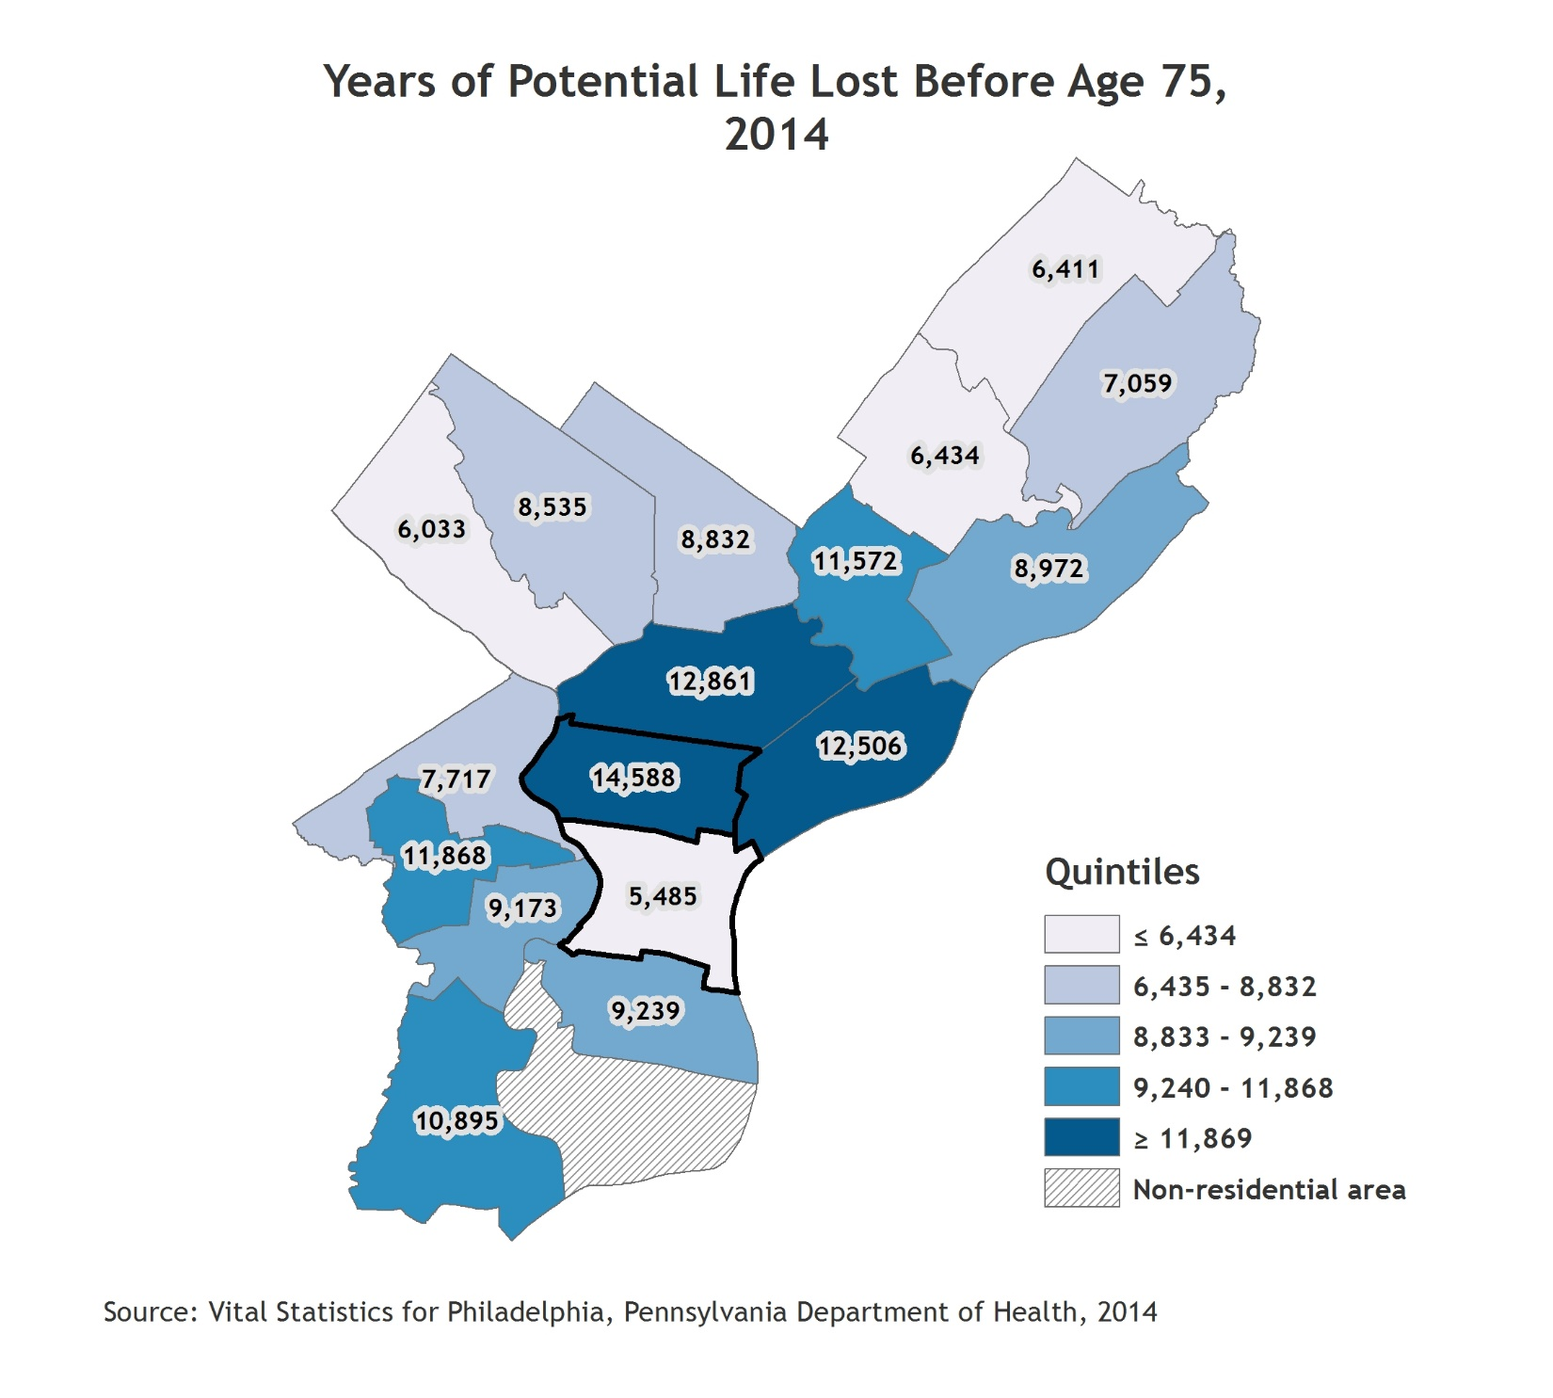
Summary Health Measures
Indicator Definition:
Years of Potential Life Lost Before Age 75 (YPLL-75) is an age-adjusted rate per 100,000 of the population. It is based on the average years a person would have lived if he or she had not died before age 75.
Notes:
Planning districts with the best and poorest outcomes are outlined with a thick black border. For the citywide value, refer to the citywide over time graph.

Slide 15
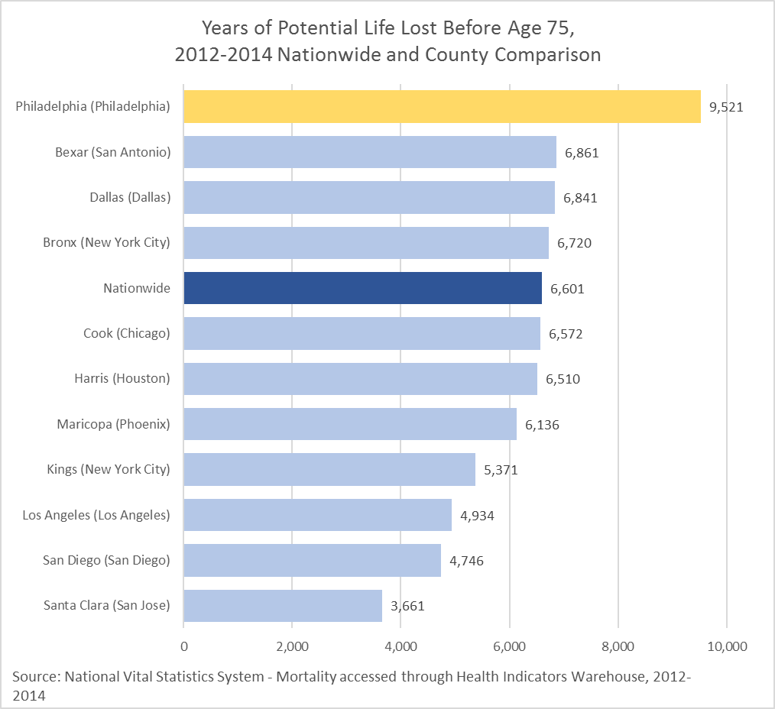
Summary Health Measures
Indicator Definition:
Years of Potential Life Lost Before Age 75 (YPLL-75) is an age-adjusted rate per 100,000 of the population. It is based on the average years a person would have lived if he or she had not died before age 75.

Slide 16
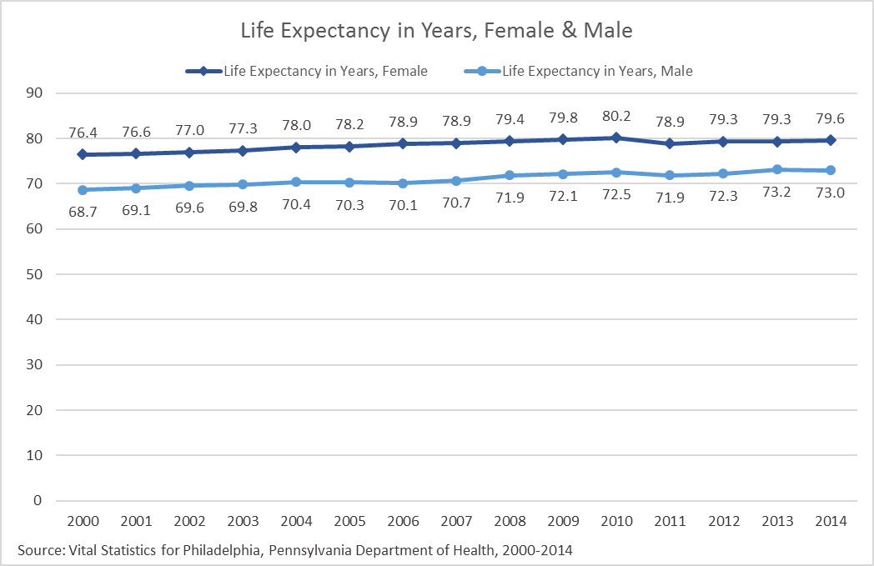
Summary Health Measures
Indicator Definition:
Life expectancy at birth is the expected number of years to be lived by someone born at the time of calculation, if mortality at each age remains constant in the future.

Slide 17
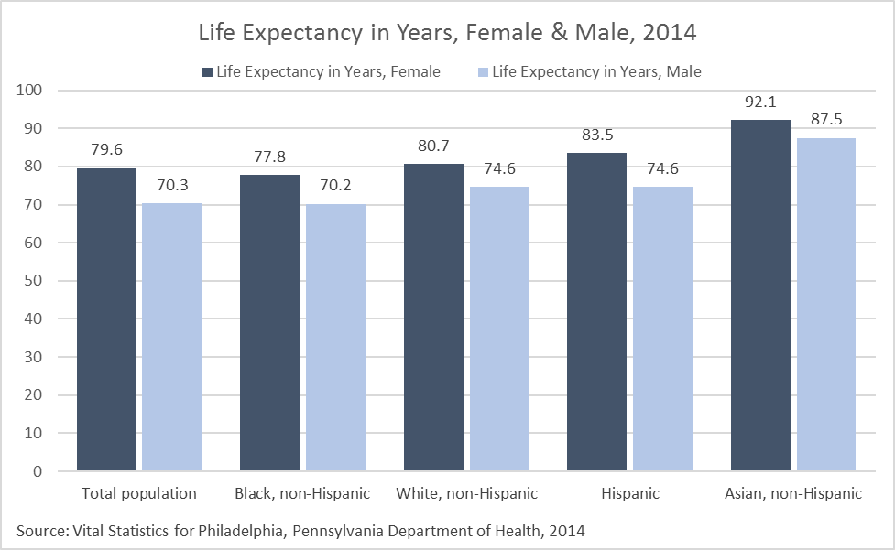
Summary Health Measures
Indicator Definition:
Life expectancy at birth is the expected number of years to be lived by someone born at the time of calculation, if mortality at each age remains constant in the future.
Notes:
Caution low sample size: Asian, non-Hispanic & Hispanic

Slide 18
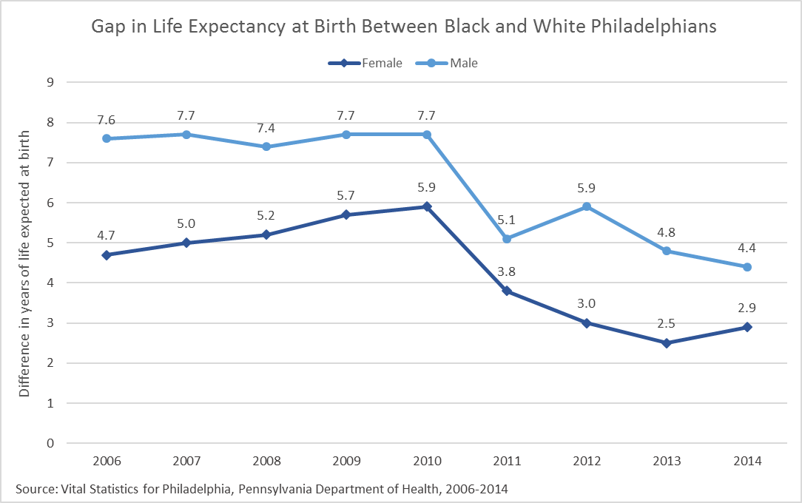
Summary Health Measures
Indicator Definition:
The gap in life expectancy at birth between black, non-Hispanic and white, non-Hispanic Philadelphians. The life expectancy for black is subtracted from the life expectancy for white.

Slide 19
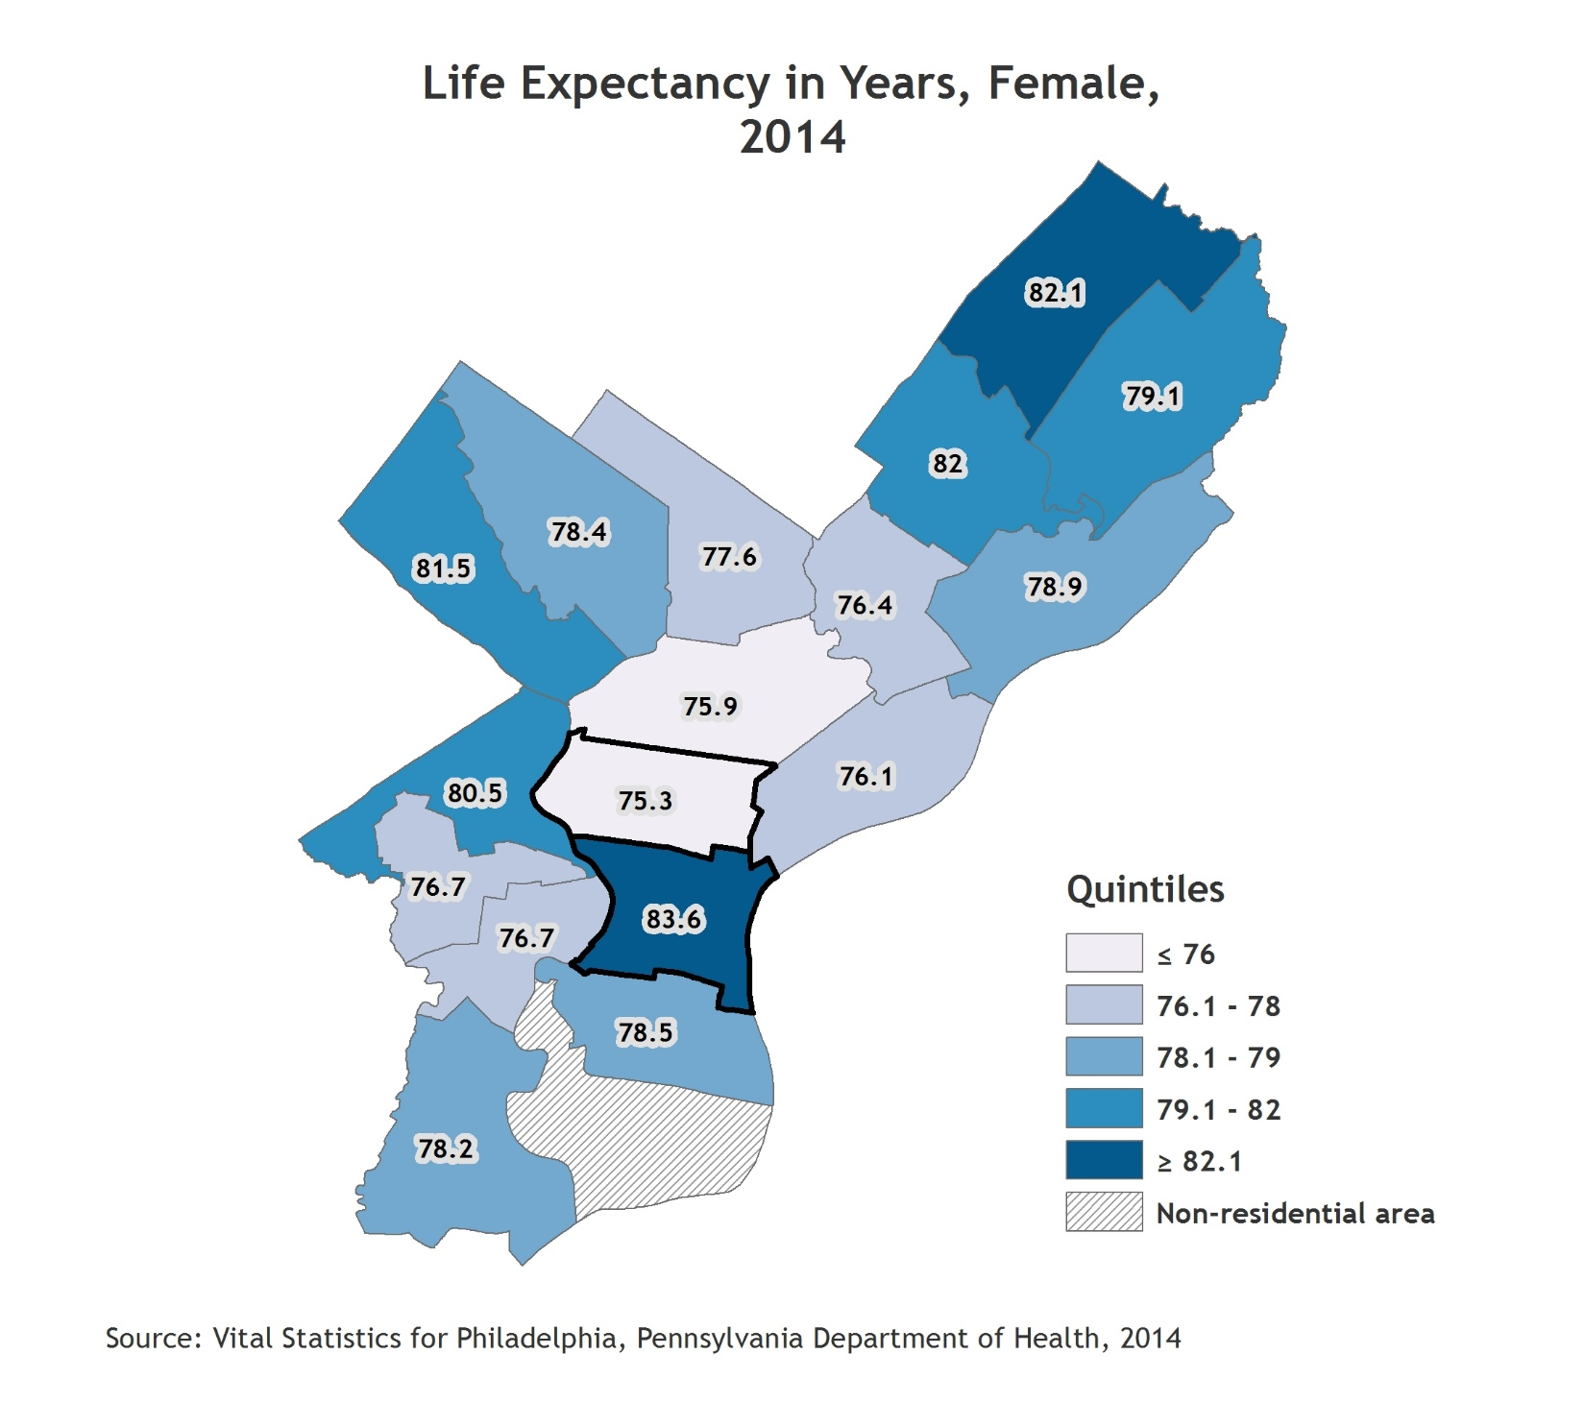
Summary Health Measures
Indicator Definition:
Life expectancy at birth is the expected number of years to be lived by someone born at the time of calculation, if mortality at each age remains constant in the future.
Notes:
Planning districts with the best and poorest outcomes are outlined with a thick black border. For the citywide value, refer to the citywide over time graph.

Slide 20
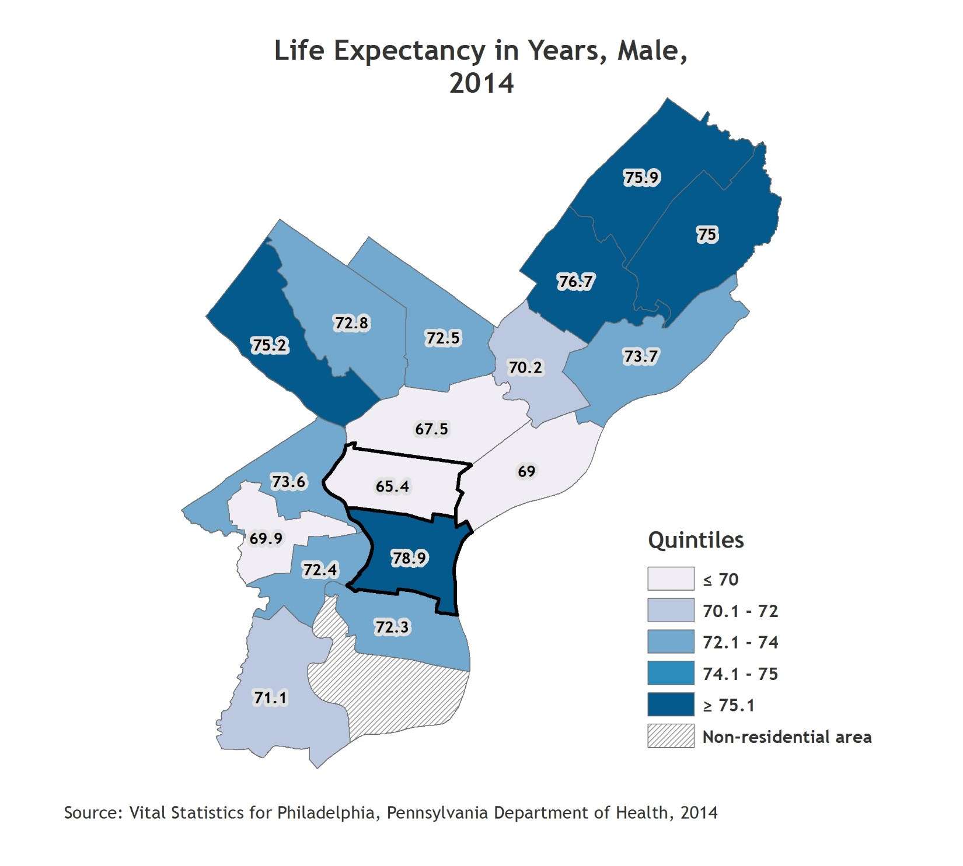
Summary Health Measures
Indicator Definition:
Life expectancy at birth is the expected number of years to be lived by someone born at the time of calculation, if mortality at each age remains constant in the future.
Notes:
Planning districts with the best and poorest outcomes are outlined with a thick black border. For the citywide value, refer to the citywide over time graph.

Slide 21
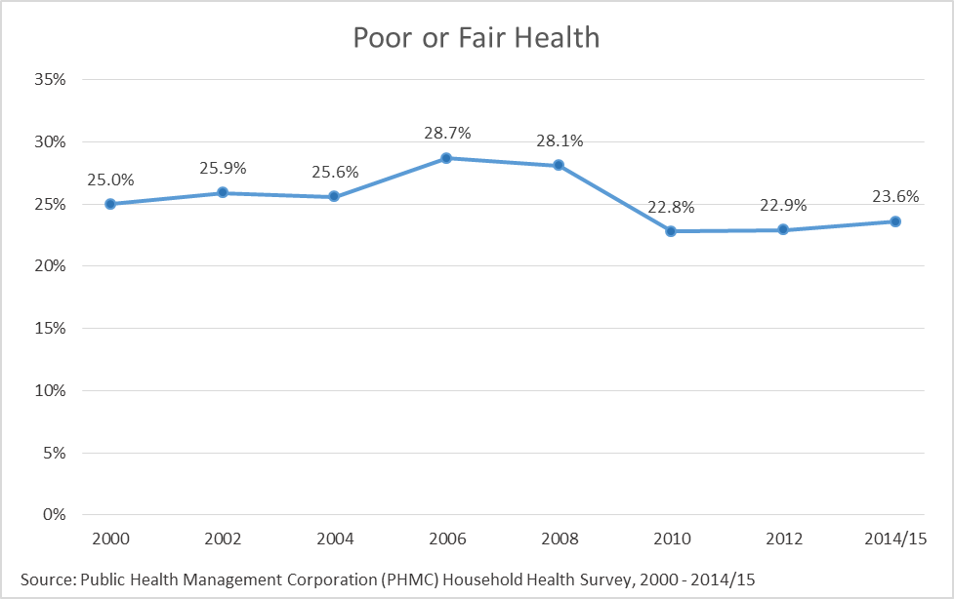
Summary Health Measures
Indicator Definition:
Percentage of adults who rate their health as "fair" or "poor" in response to the question, "In general, would you say that your health is excellent, very good, good, fair, or poor?"

Slide 22
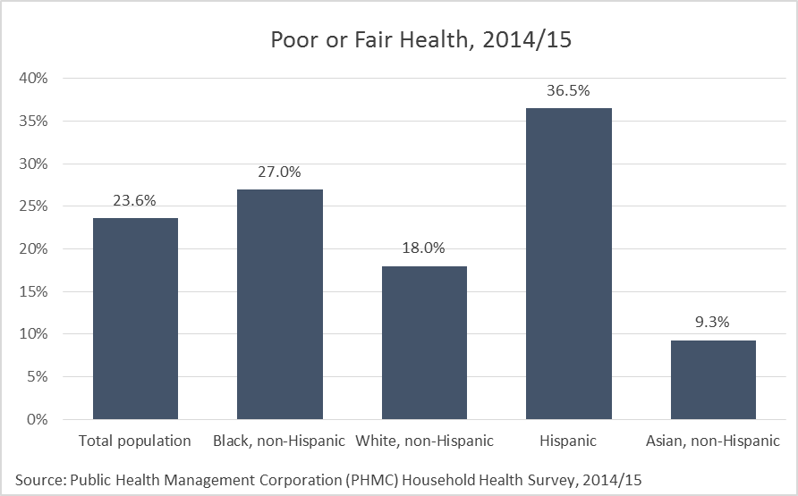
Summary Health Measures
Indicator Definition:
Percentage of adults who rate their health as "fair" or "poor" in response to the question, "In general, would you say that your health is excellent, very good, good, fair, or poor?"
Notes:
Caution low sample size: Asian, non-Hispanic.

Slide 23
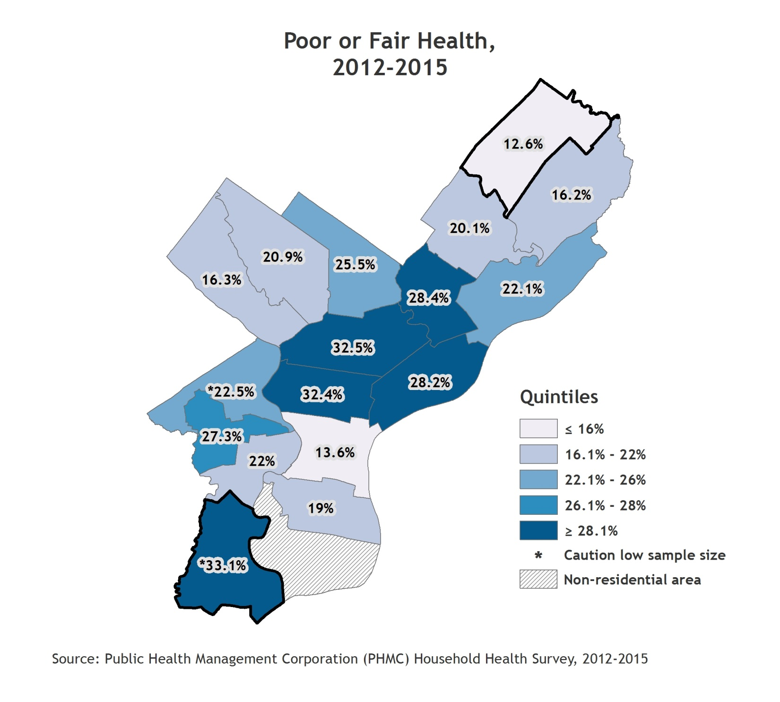
Summary Health Measures
Indicator Definition:
Percentage of adults who rate their health as "fair" or "poor" in response to the question, "In general, would you say that your health is excellent, very good, good, fair, or poor?"
Notes:
Two years of Household Health Survey data (2012 and 2014/15) were combined to provide more reliable estimates by planning district, therefore these numbers are not directly comparable with previous estimates.
Planning districts with the best and poorest outcomes are outlined with a thick black border. For the citywide value, refer to the citywide over time graph.

Slide 24
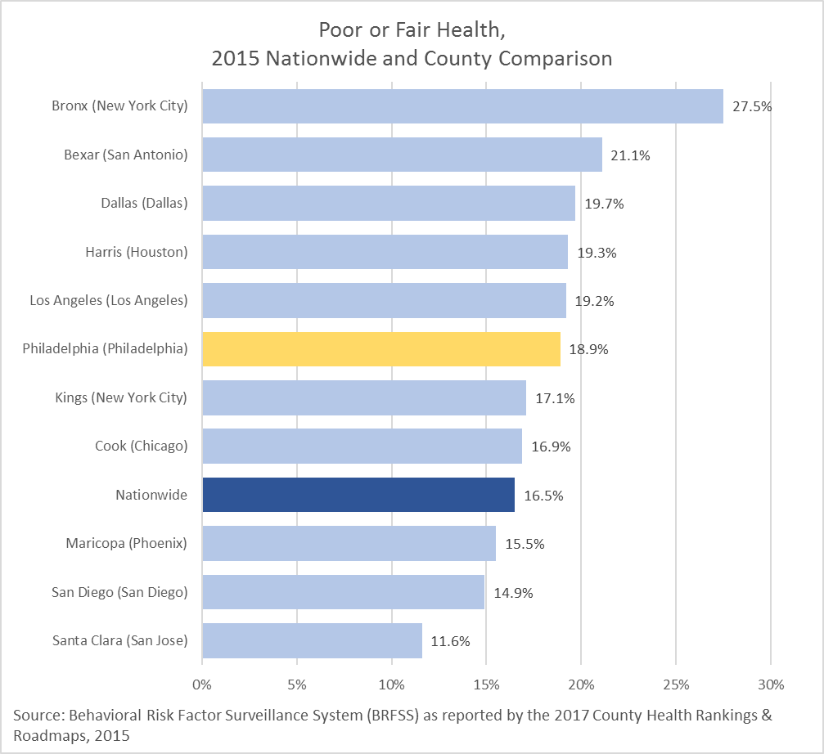
Summary Health Measures
Indicator Definition:
Percentage of adults who rate their health as "fair" or "poor" in response to the question, "In general, would you say that your health is excellent, very good, good, fair, or poor?"

Slide 25
Tobacco and Alcohol
Adult Smoking
Teen Smoking
Smoking-Attributable Mortality
Secondhand Smoke Exposure at Home Among Children
Adult Binge and Excessive Drinking
Teen Binge Drinking

Slide 26
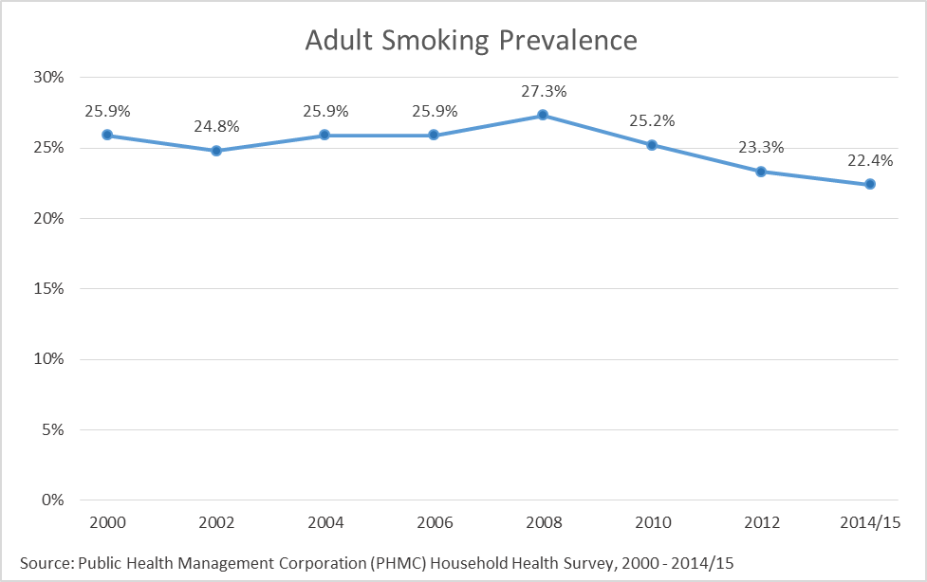
Tobacco and Alcohol
Indicator Definition:
Percentage of adults who have smoked at least 100 cigarettes in their lifetime and currently smoke “every day” or "some days."

Slide 27
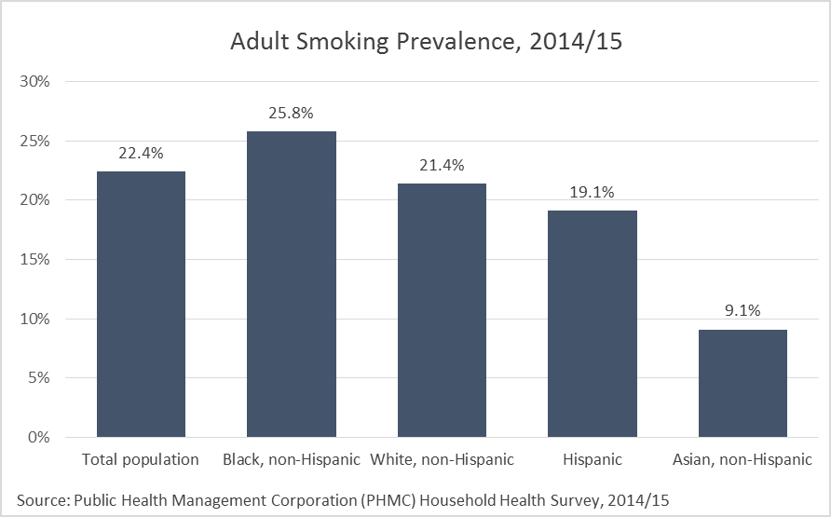
Tobacco and Alcohol
Indicator Definition:
Percentage of adults who have smoked at least 100 cigarettes in their lifetime and currently smoke “every day” or "some days."
Notes:
Caution low sample size: Asian, non-Hispanic.

Slide 28
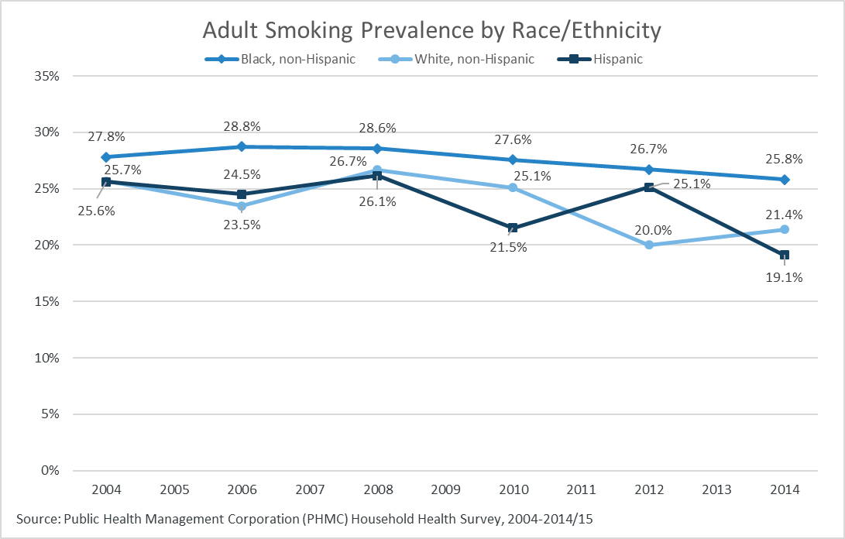
Tobacco and Alcohol
Indicator Definition:
Percentage of adults who have smoked at least 100 cigarettes in their lifetime and currently smoke “every day” or "some days."
Notes:
Caution low sample size: Hispanic and Asian, non-Hispanic. Data missing for some years for some race/ethnic subgroups due to small sample size.

Slide 29
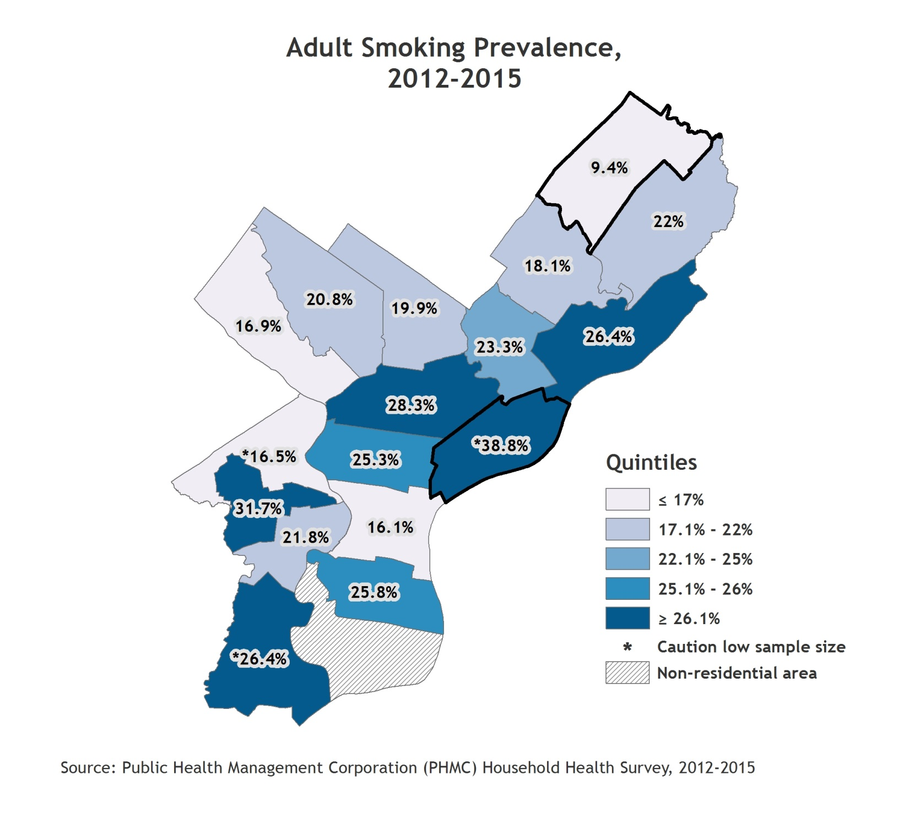
Tobacco and Alcohol
Indicator Definition:
Percentage of adults who have smoked at least 100 cigarettes in their lifetime and currently smoke “every day” or "some days."
Notes:
Two years of Household Health Survey data (2012 and 2014/15) were combined to provide more reliable estimates by planning district, therefore these numbers are not directly comparable with previous estimates.
Planning districts with the best and poorest outcomes are outlined with a thick black border. For the citywide value, refer to the citywide over time graph.

Slide 30
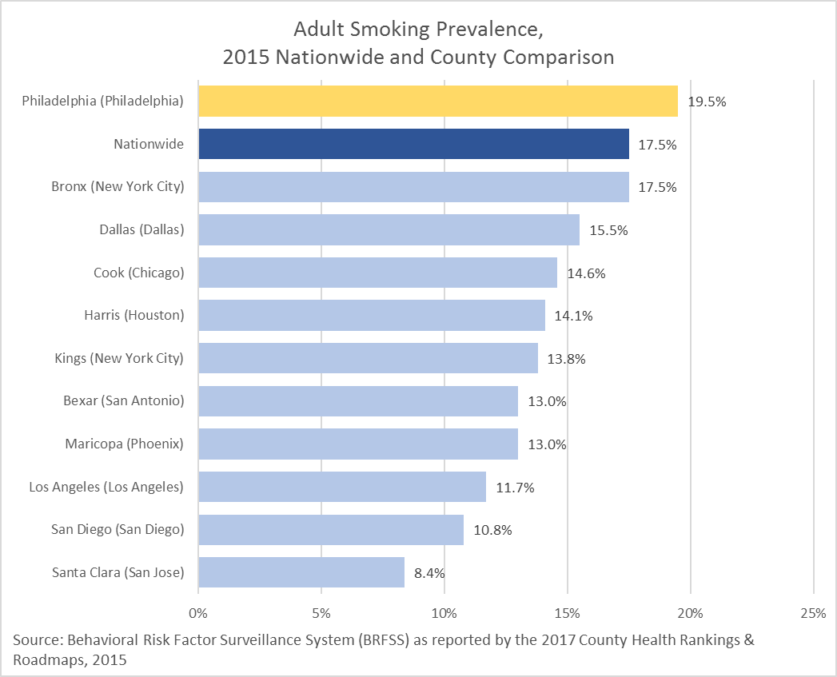
Tobacco and Alcohol
Indicator Definition:
Percentage of adults who have smoked at least 100 cigarettes in their lifetime and currently smoke “every day” or "some days."

Slide 31
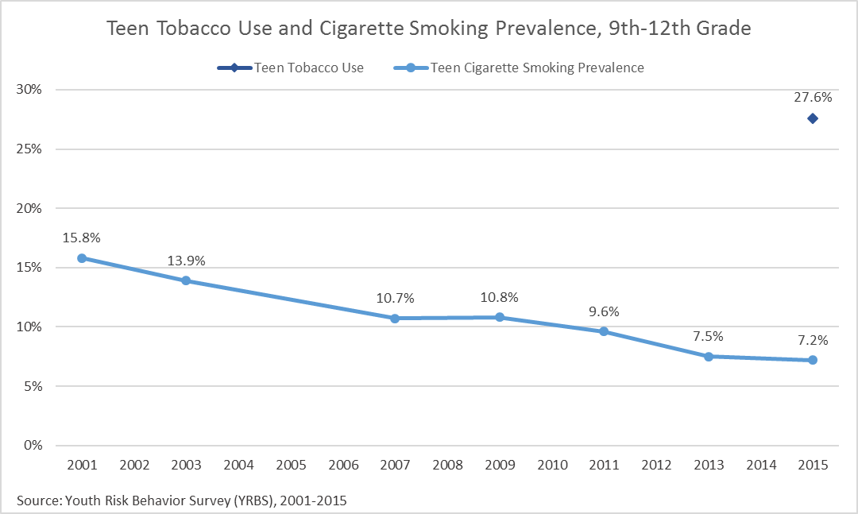
Tobacco and Alcohol
Indicator Definition:
Teen Tobacco Use: Percentage of 9th-12th grade students who used cigarettes, smokeless tobacco, cigars, or electronic vapor products on at least one day in the past 30 days.
Teen Cigarette Smoking Prevalence: Percentage of 9th-12th grade students who smoked cigarettes on at least one day in the past 30 days.
Notes:
2015 is the first year that electronic vapor products were included on the Youth Risk Behavior Survey.

Slide 32
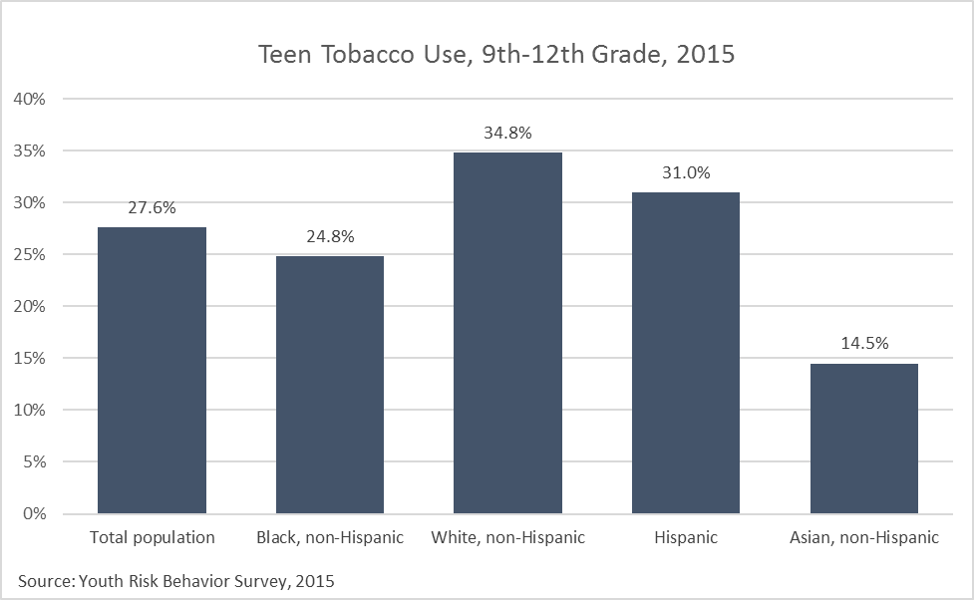
Tobacco and Alcohol
Indicator Definition:
Percentage of 9th-12th grade students who used cigarettes, smokeless tobacco, cigars, or electronic vapor products on at least one day in the past 30 days.
Notes:
2015 is the first year that electronic vapor products were included on the Youth Risk Behavior Survey.

Slide 33
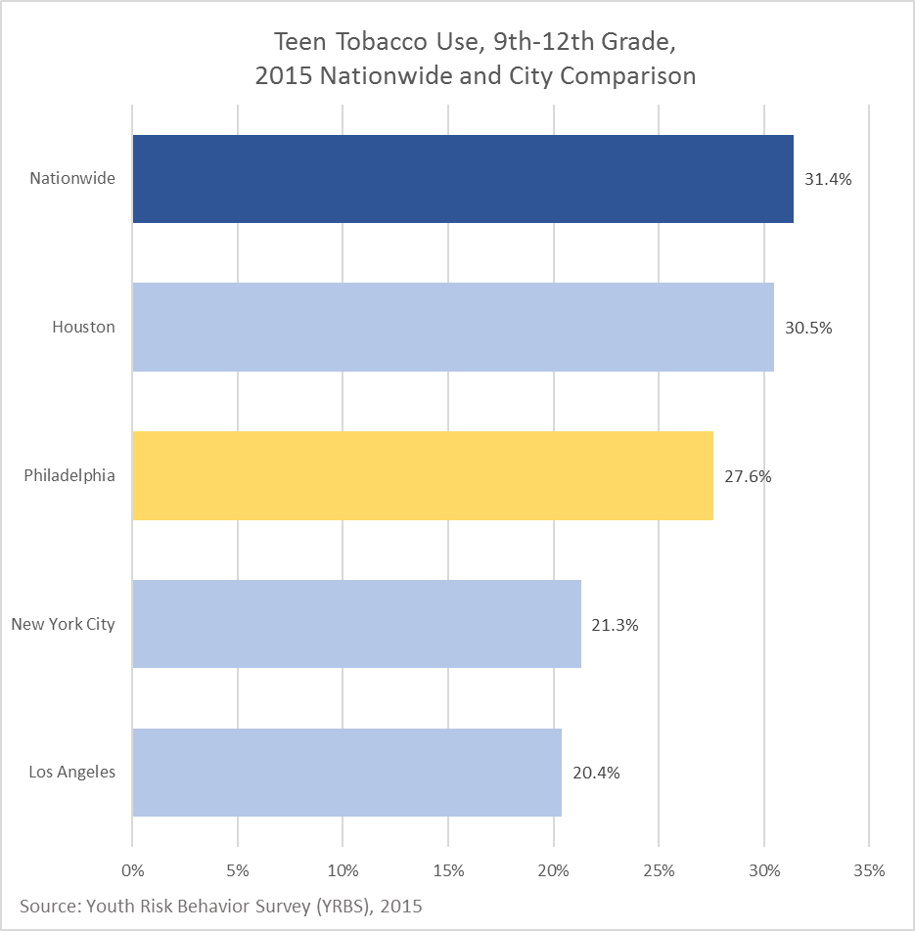
Tobacco and Alcohol
Indicator Definition:
Percentage of 9th-12th grade students who used cigarettes, smokeless tobacco, cigars, or electronic vapor products on at least one day in the past 30 days.
Notes:
2015 is the first year that electronic vapor products were included on the Youth Risk Behavior Survey.

Slide 34
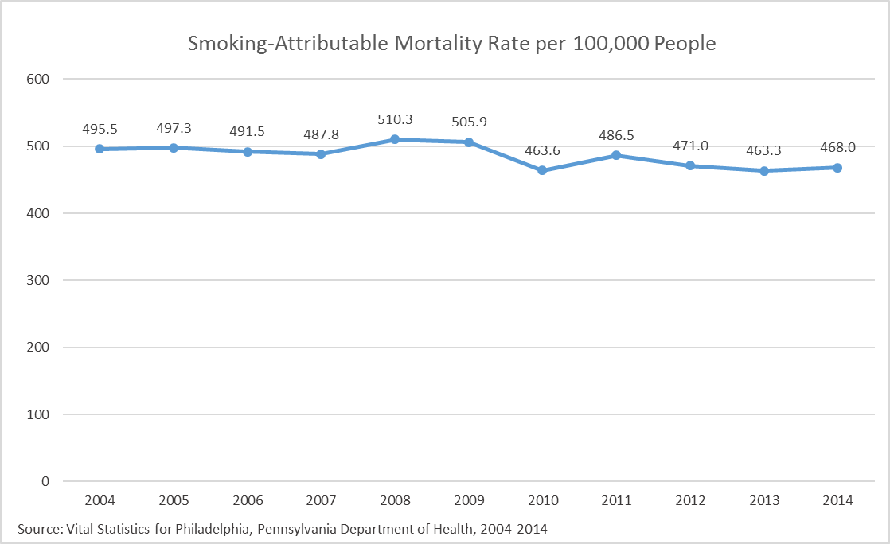
Tobacco and Alcohol
Indicator Definition:
Age-adjusted rate of deaths attributable to smoking per 100,000 adults 35 years and older. This measure is based on CDC's Smoking-Attributable Mortality, Morbidity, and Economic Costs (SAMMEC).

Slide 35
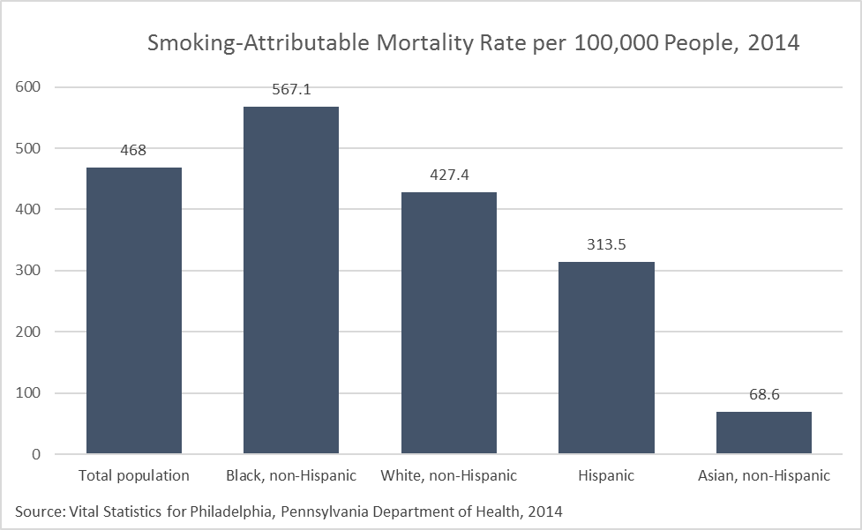
Tobacco and Alcohol
Indicator Definition:
Age-adjusted rate of deaths attributable to smoking per 100,000 adults 35 years and older. This measure is based on CDC's Smoking-Attributable Mortality, Morbidity, and Economic Costs (SAMMEC).
Notes:
Data missing for some race/ethnic subgroups due to small sample size. The methods for calculating smoking-attributable mortality have been updated since prior reports and are not comparable to previous years.

Slide 36
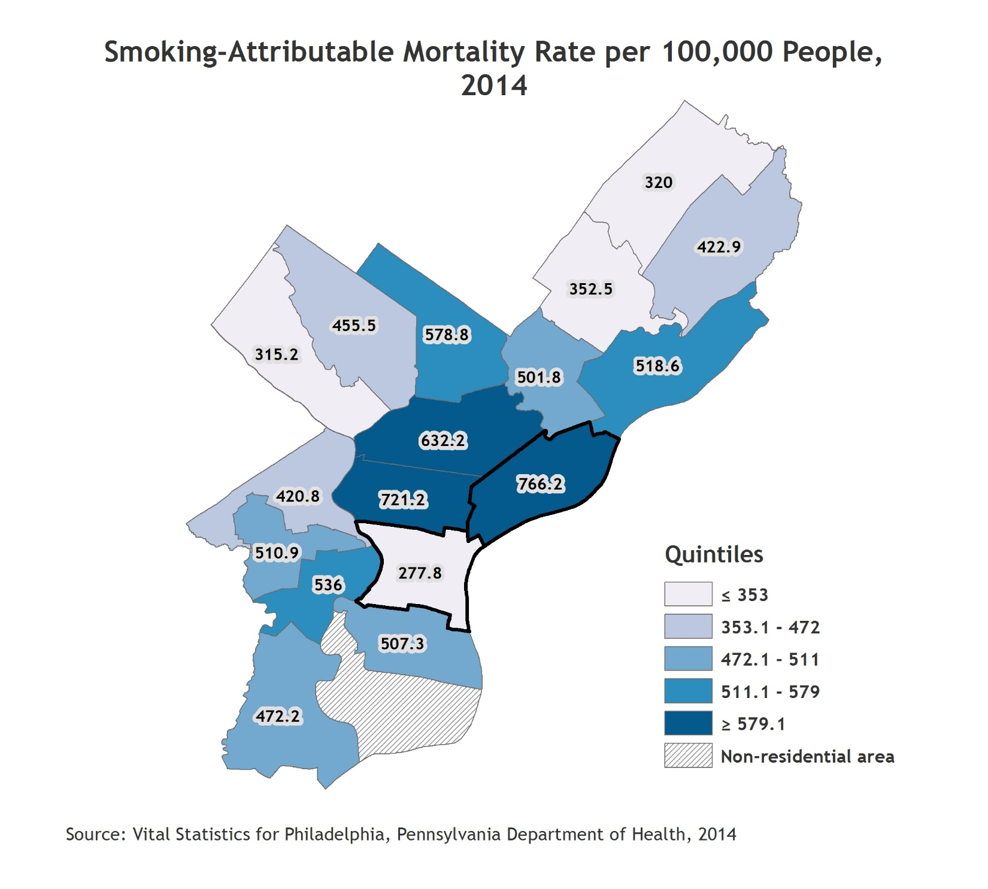
Tobacco and Alcohol
Indicator Definition:
Age-adjusted rate of deaths attributable to smoking per 100,000 adults 35 years and older. This measure is based on CDC's Smoking-Attributable Mortality, Morbidity, and Economic Costs (SAMMEC).
Notes:
Planning districts with the best and poorest outcomes are outlined with a thick black border. For the citywide value, refer to the citywide over time graph.

Slide 37
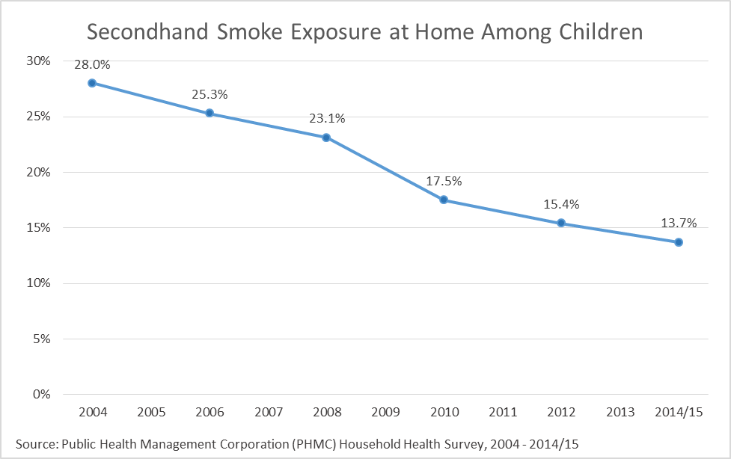
Tobacco and Alcohol
Indicator Definition:
Percentage of children under 18 who live with an adult who smokes in the home.

Slide 38
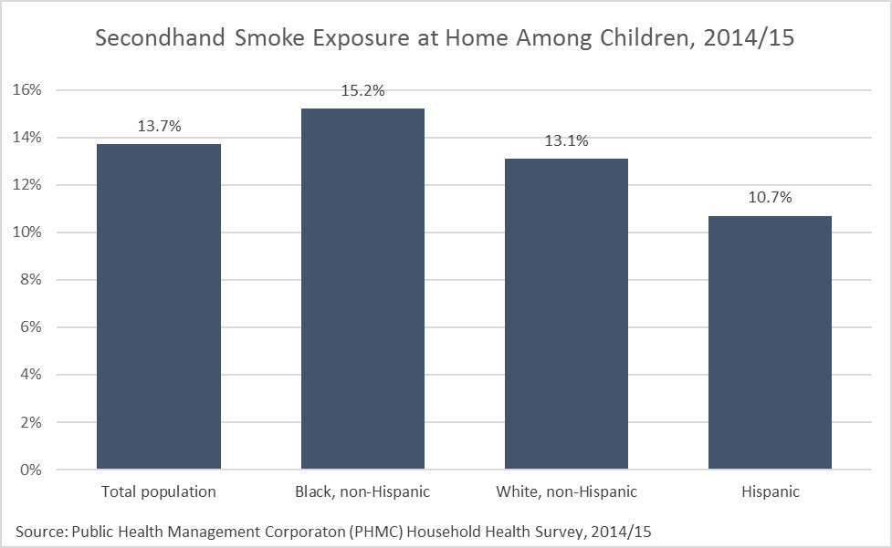
Tobacco and Alcohol
Indicator Definition:
Percentage of children under 18 who live with an adult who smokes in the home.
Notes:
Data not shown for Asian, non-Hispanic.

Slide 39
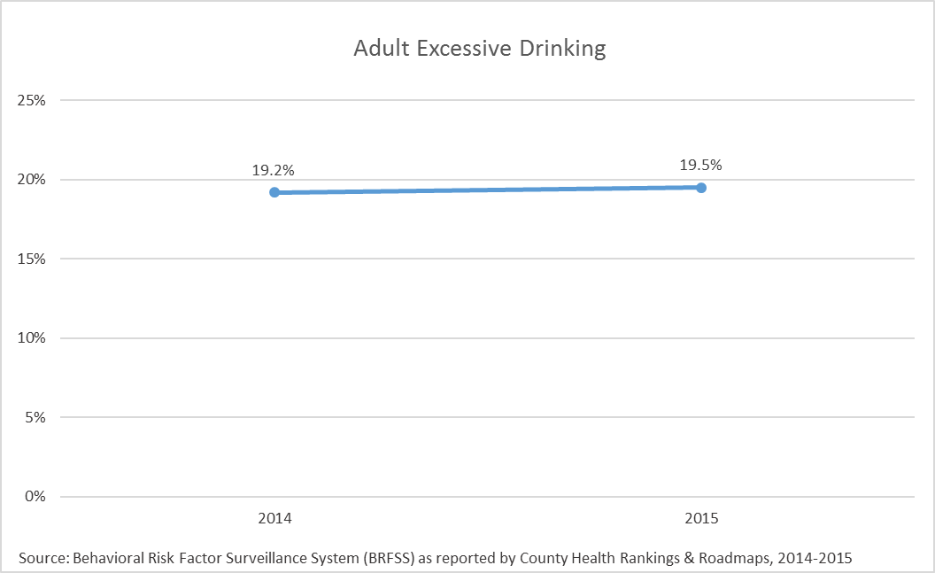
Tobacco and Alcohol
Indicator Definition:
Adult excessive drinking is the percentage of adults reporting binge or heavy drinking.
Notes:
The Centers for Disease Control and Prevention define binge drinking as drinking 5 or more drinks on an occasion for men or 4 or more drinks on an occasion for women and heavy drinking as drinking 15 or more drinks per week for men, or 8 or more drinks per week for women.
Please note that data years differ across dimensions for this indicator.

Slide 40
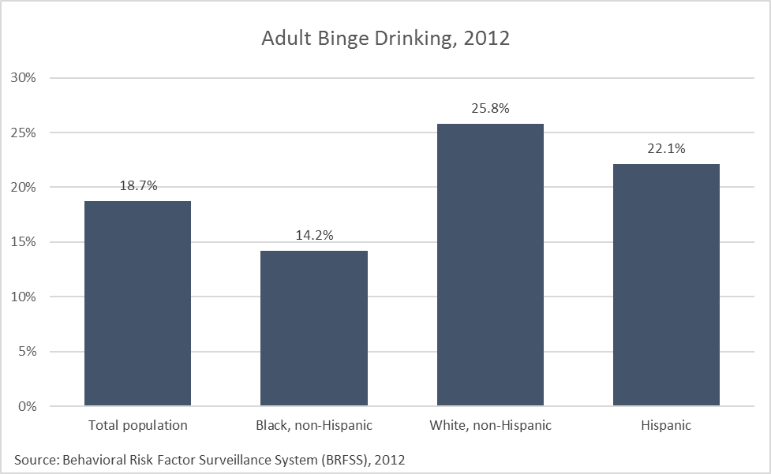
Tobacco and Alcohol
Indicator Definition:
Adult binge drinking is the percentage of adults reporting binge drinking.
Notes:
The Centers for Disease Control and Prevention define binge drinking as drinking 5 or more drinks on an occasion for men or 4 or more drinks on an occasion for women.
Data not shown for Asian, non-Hispanic.
Please note that data years differ across dimensions for this indicator.

Slide 41
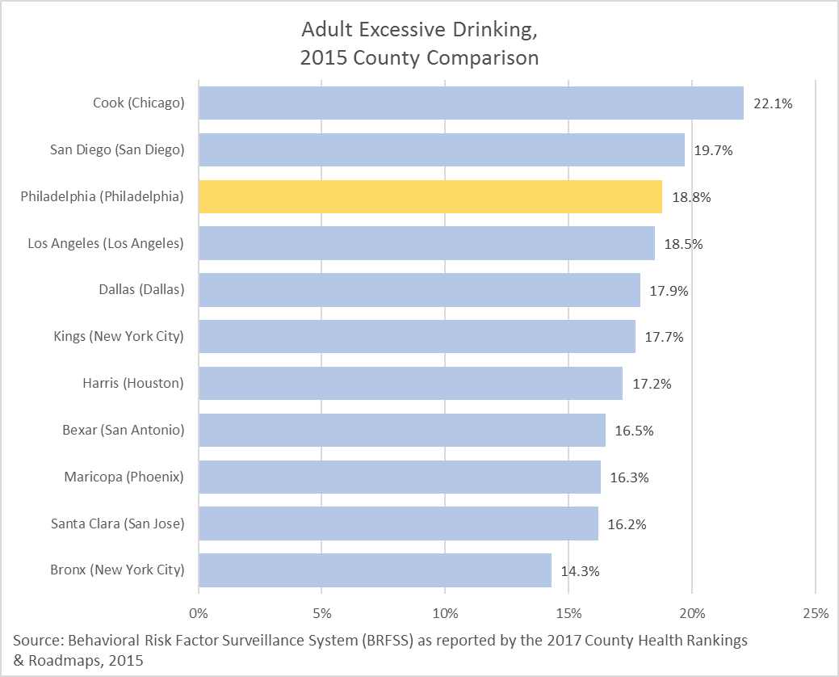
Tobacco and Alcohol
Indicator Definition:
Adult excessive drinking is the percentage of adults reporting binge or heavy drinking.
Notes:
The Centers for Disease Control and Prevention define binge drinking as drinking 5 or more drinks on an occasion for men or 4 or more drinks on an occasion for women and heavy drinking as drinking 15 or more drinks per week for men, or 8 or more drinks per week for women.
Please note that data years differ across dimensions for this indicator.

Slide 42
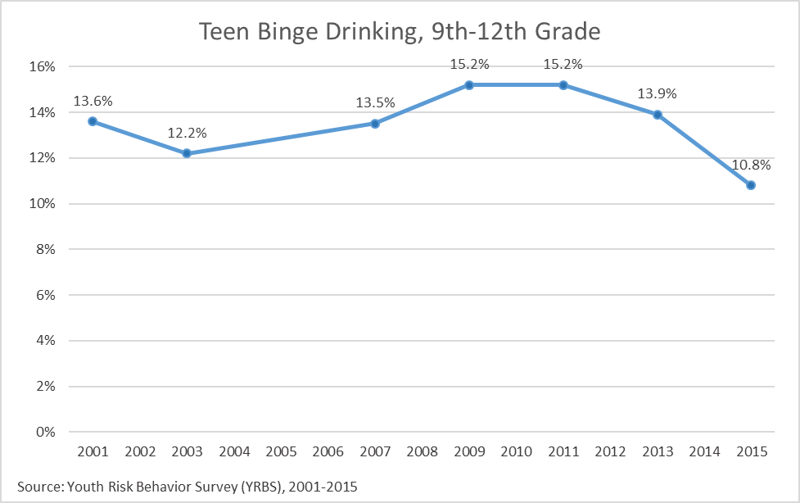
Tobacco and Alcohol
Indicator Definition:
Percentage of 9th-12th grade students who had 5 or more alcoholic drinks in a row within a couple hours on at least one day in past 30 days.
Notes:
Data are not available for 2005.
Please note that data years differ across dimensions for this indicator.

Slide 43
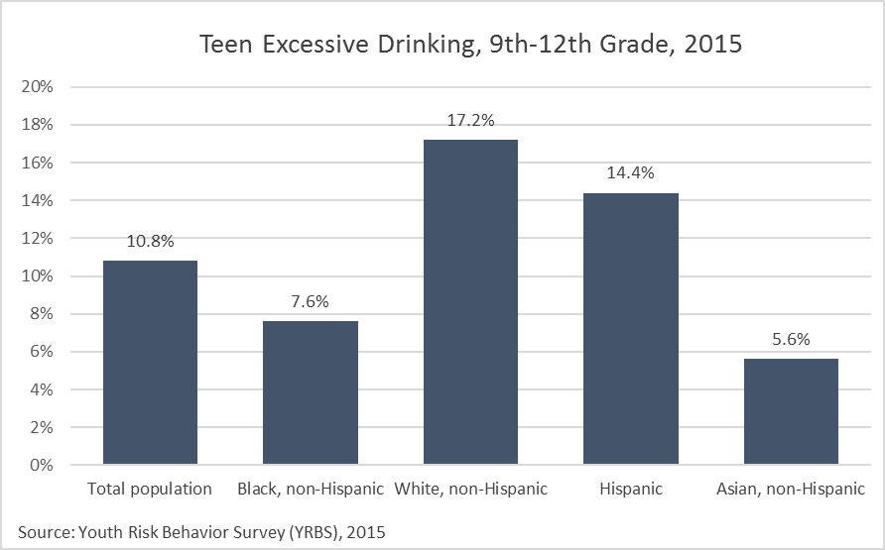
Tobacco and Alcohol
Indicator Definition:
Percentage of 9th-12th grade students who had 5 or more alcoholic drinks in a row within a couple hours on at least one day in past 30 days.

Slide 44
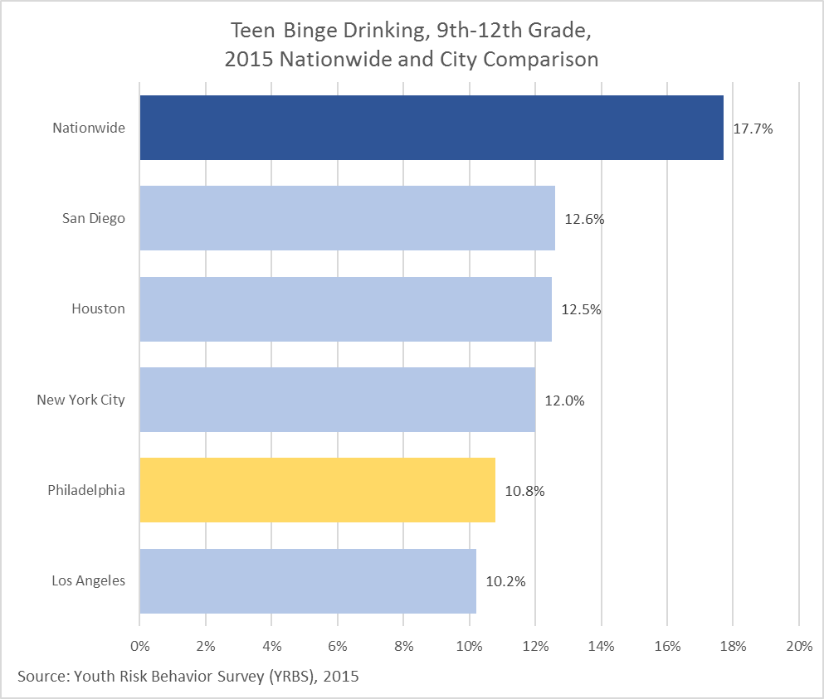
Tobacco and Alcohol
Indicator Definition:
Percentage of 9th-12th grade students who had 5 or more alcoholic drinks in a row within a couple hours on at least one day in the past 30 days.

Slide 45
Obesity
Child Obesity
Adult Obesity
Adults Drinking ≥ 1 Sugary Drink Daily
Teens Drinking ≥ 1 Soda Daily

Slide 46
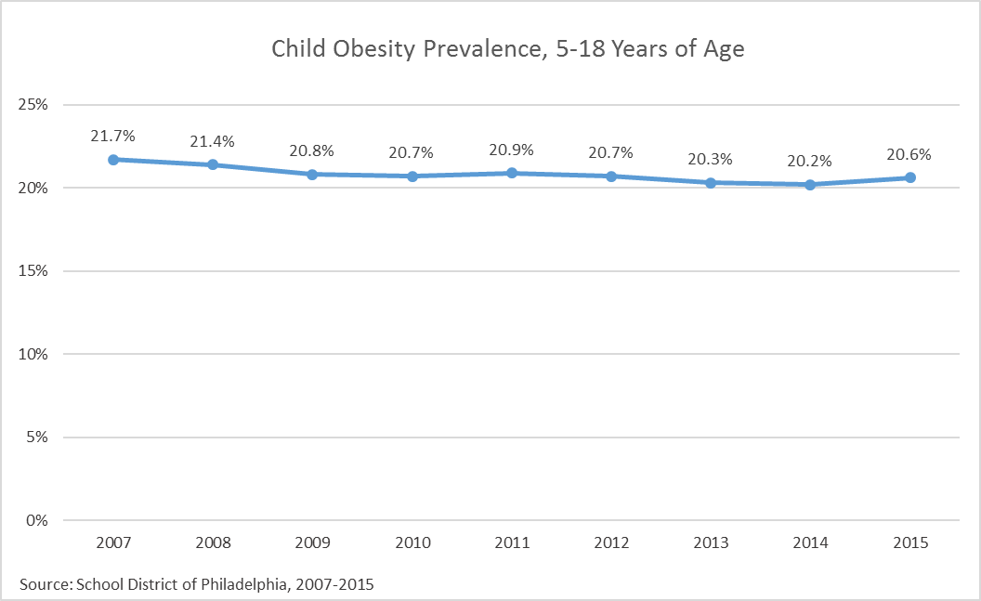
Obesity
Indicator Definition:
Percentage of children, age 5 to 18 years, enrolled in the School District of Philadelphia (SDP) with a body mass index (BMI) greater than or equal to the 95th percentile for their age and gender group based on 2000 Centers for Disease Control growth charts. BMI data are based on nurse-measured heights and weights.
Notes:
Data are by school year. For example, 2005 refers to the school year spanning fall 2004 and spring 2005.

Slide 47
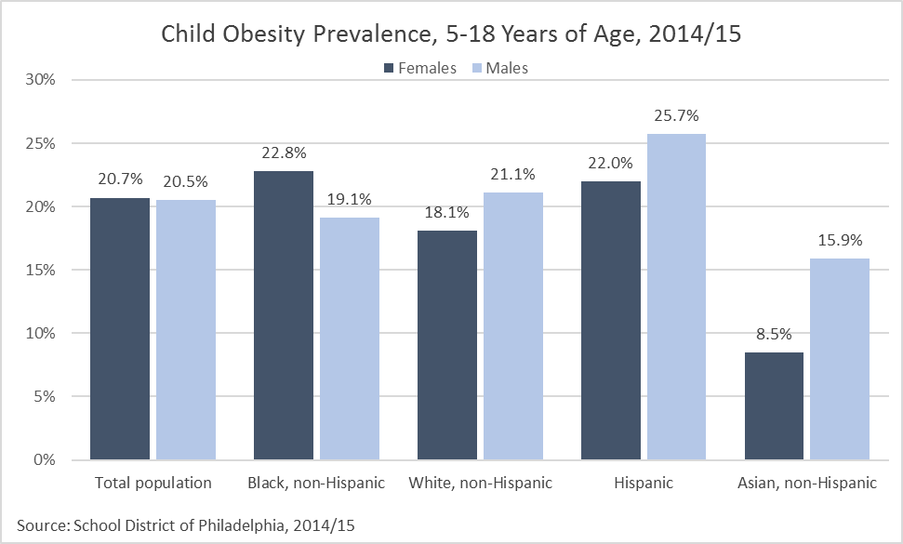
Obesity
Indicator Definition:
Percentage of children, age 5 to 18 years, enrolled in the School District of Philadelphia (SDP) with a body mass index (BMI) greater than or equal to the 95th percentile for their age and gender group based on 2000 Centers for Disease Control growth charts. BMI data are based on nurse-measured heights and weights.
Notes:
Data are by school year.

Slide 48
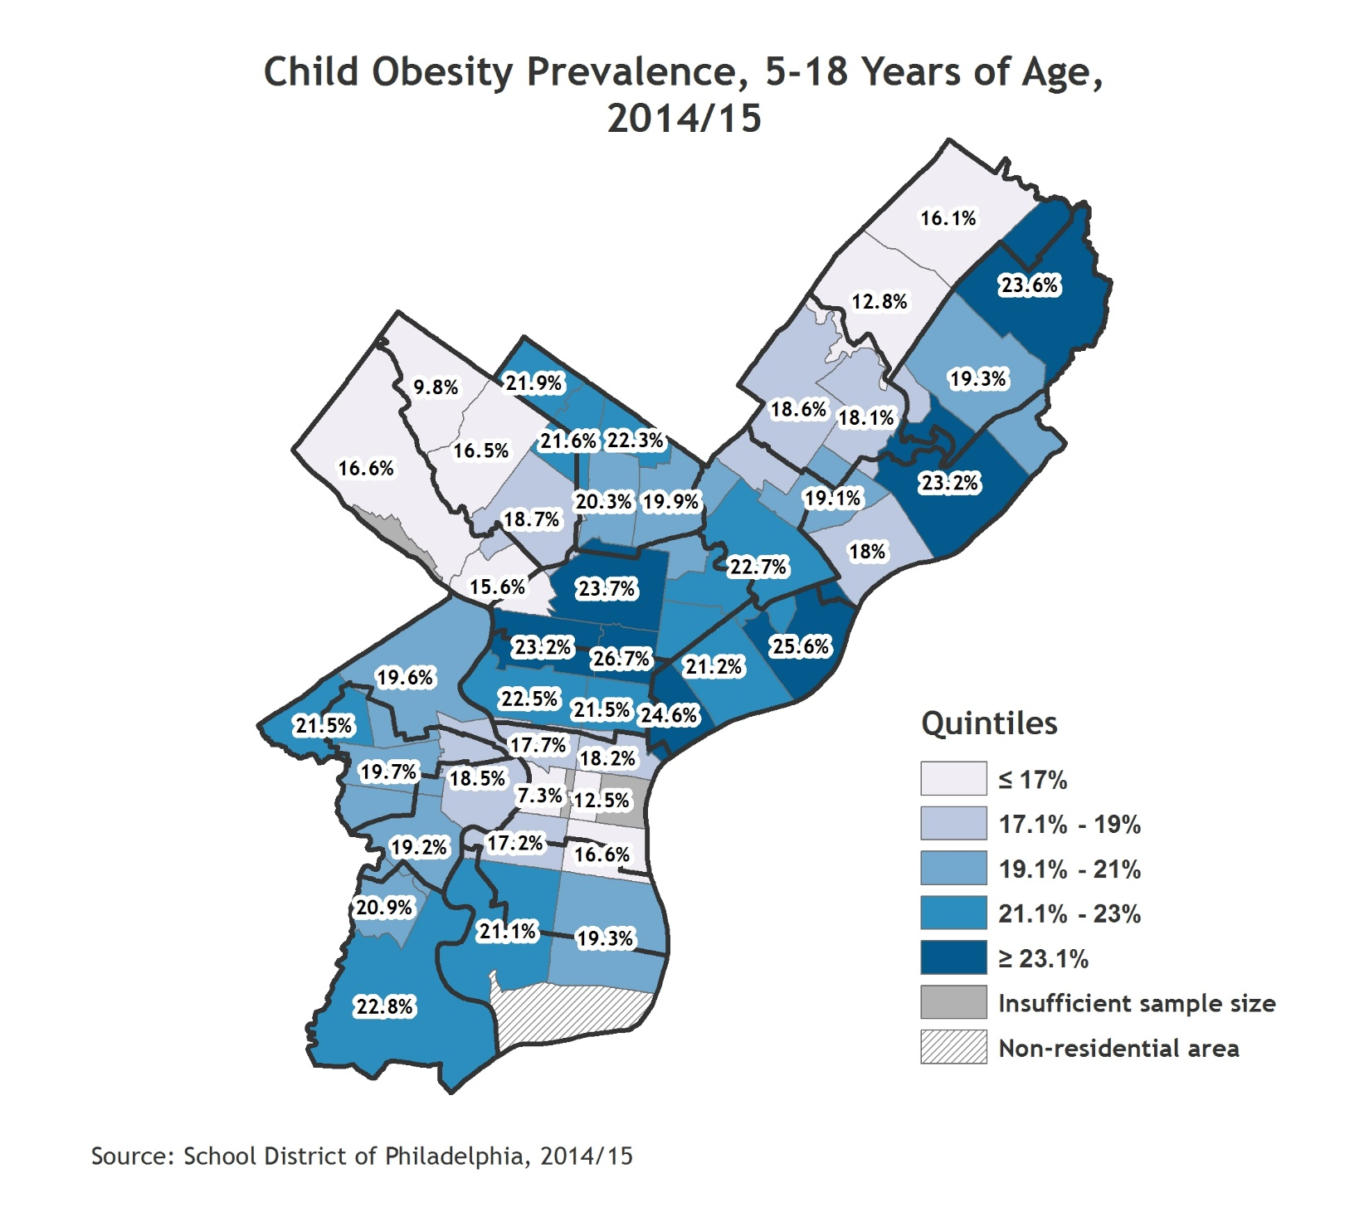
Obesity
Indicator Definition:
Percentage of children, age 5 to 18 years, enrolled in the School District of Philadelphia (SDP) with a body mass index (BMI) greater than or equal to the 95th percentile for their age and gender group based on 2000 Centers for Disease Control growth charts. BMI data are based on nurse-measured heights and weights.
Notes:
Data are by school year and displayed by zip code. Planning District boundaries are overlaid. For the citywide value, refer to the citywide over time graph.

Slide 49
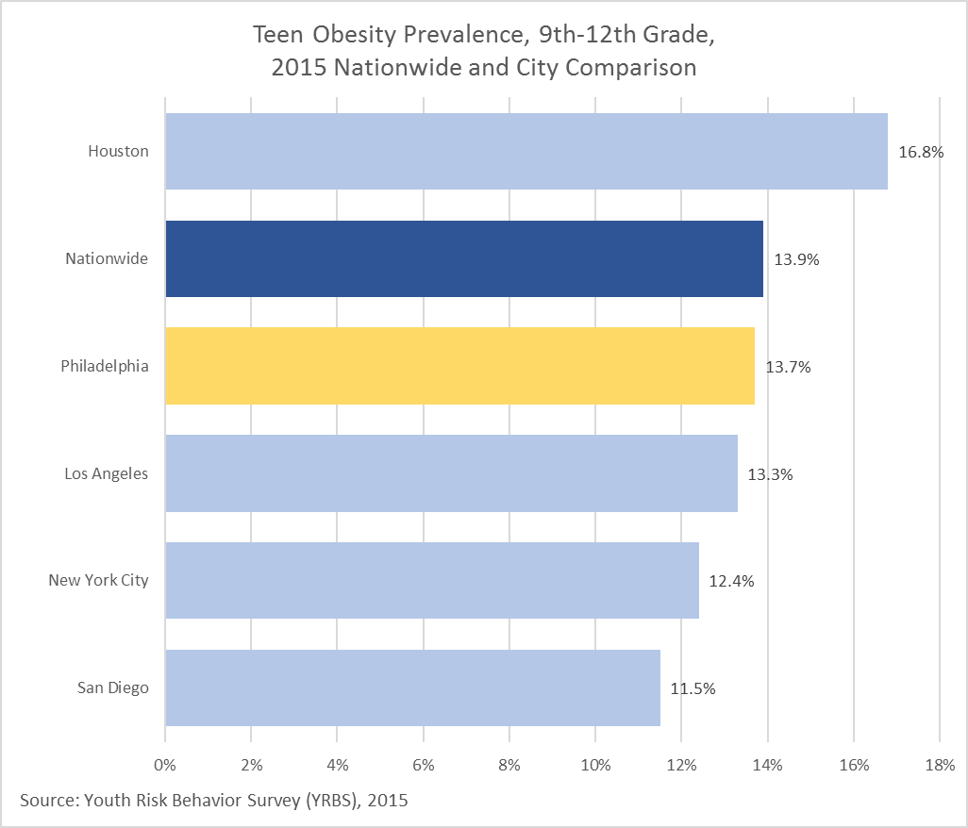
Obesity
Indicator Definition:
Percentage of 9th-12th grade students with BMI greater than or equal to 95th percentile for their sex and age group.

Slide 50
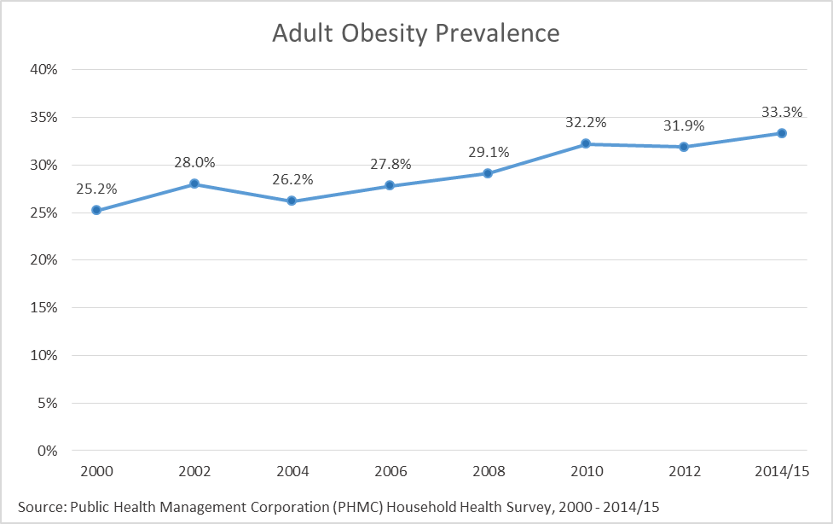
Obesity
Indicator Definition:
Percentage of adults with BMI greater than or equal to 30kg/m2, based on self-reported height and weight.
Notes:
Please note that data years differ across dimensions for this indicator.

Slide 51
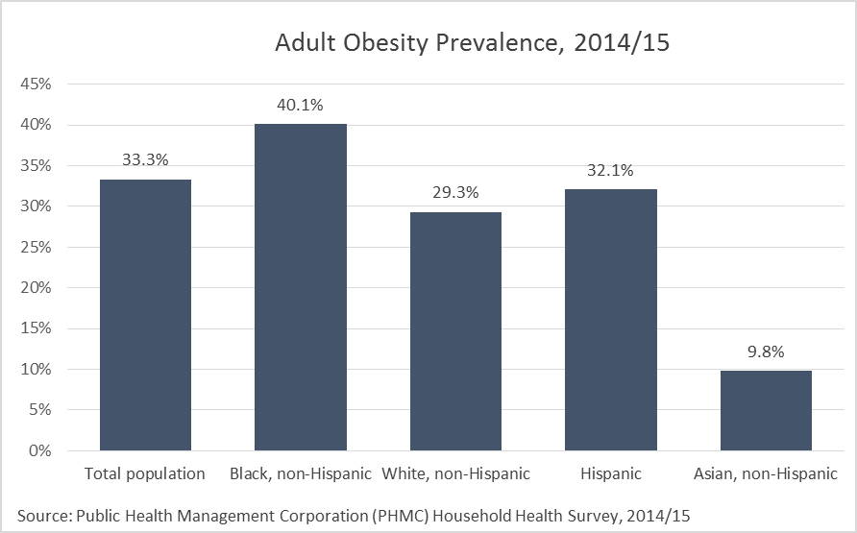
Obesity
Indicator Definition:
Percentage of adults with BMI greater than or equal to 30kg/m2, based on self-reported height and weight.
Notes:
Please note that data years differ across dimensions for this indicator.

Slide 52
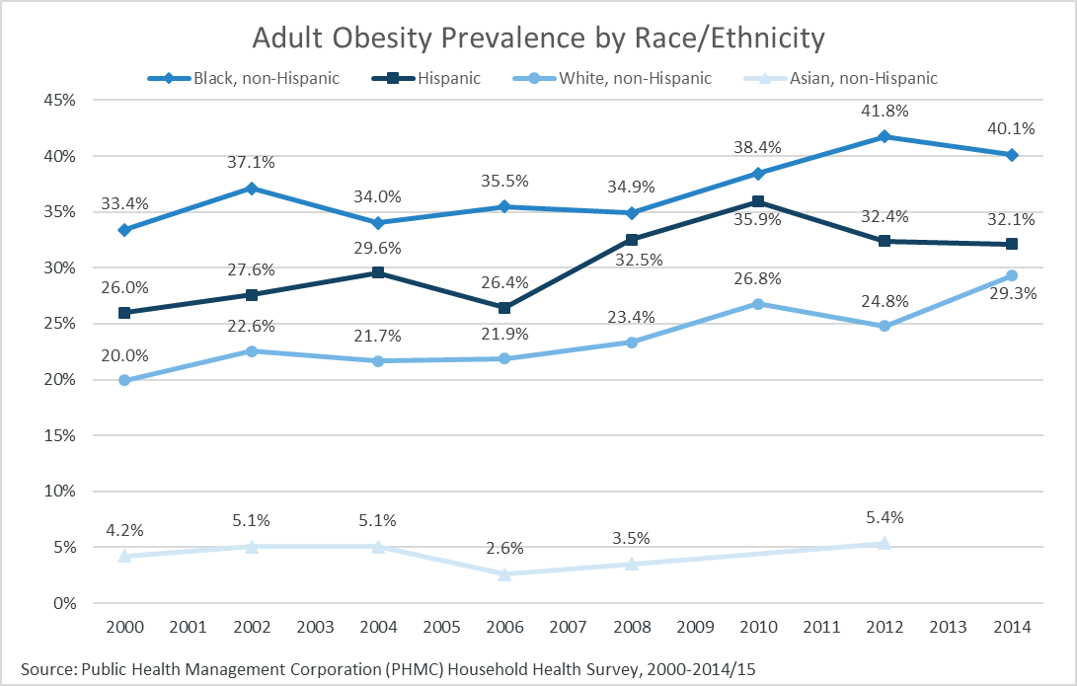
Obesity
Indicator Definition:
Percentage of adults with BMI greater than or equal to 30kg/m2, based on self-reported height and weight.
Notes:
Caution low sample size: Hispanic and Asian, non-Hispanic. Data missing for some years for some race/ethnic subgroups due to small sample size.

Slide 53
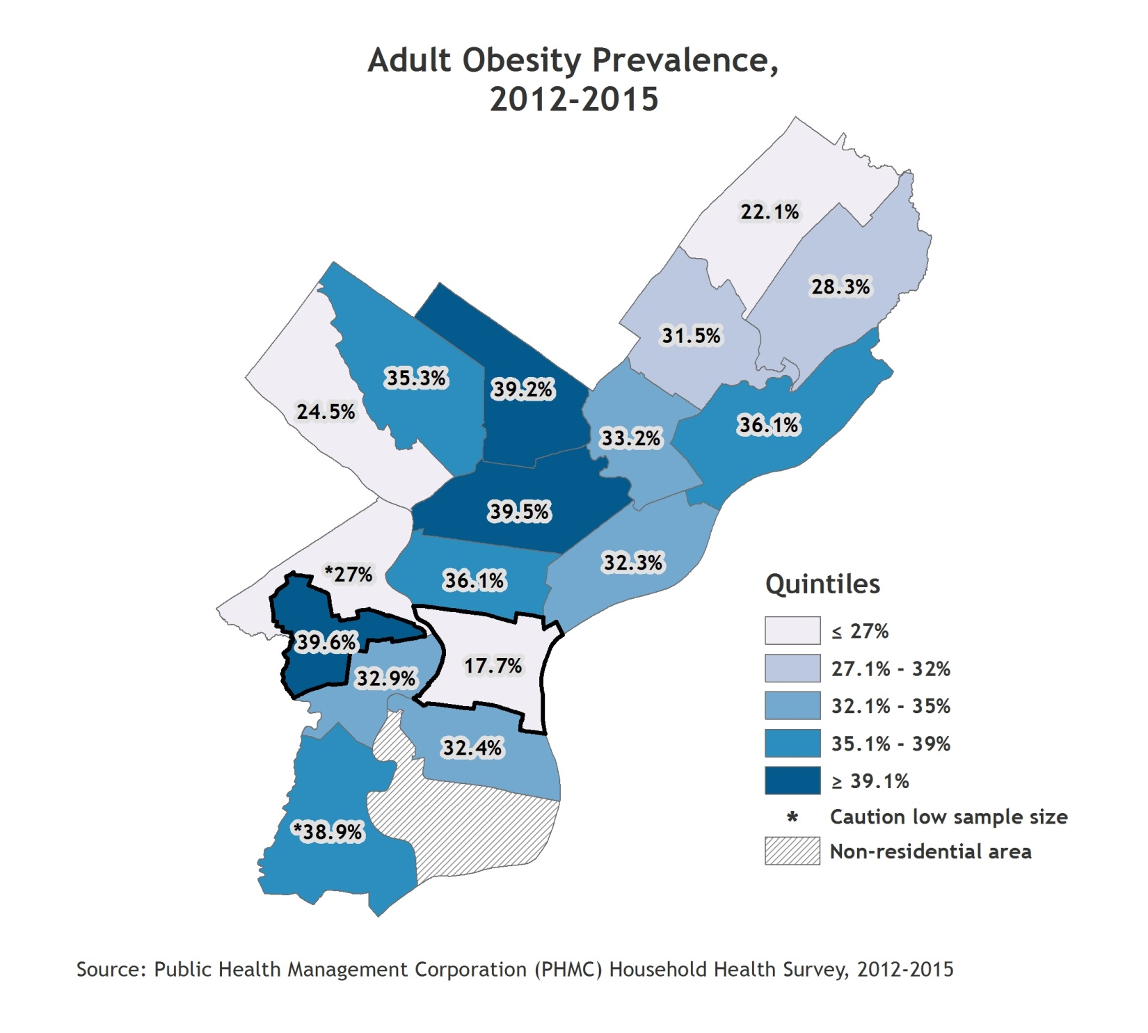
Obesity
Indicator Definition:
Percentage of adults with BMI greater than or equal to 30kg/m2, based on self-reported height and weight.
Notes:
Two years of Household Health Survey data (2012 and 2014/15) were combined to provide more reliable estimates by planning district, therefore these numbers are not directly comparable with previous estimates.
Planning districts with the best and poorest outcomes are outlined with a thick black border. For the citywide value, refer to the citywide over time graph.
Please note that data years differ across dimensions for this indicator.

Slide 54
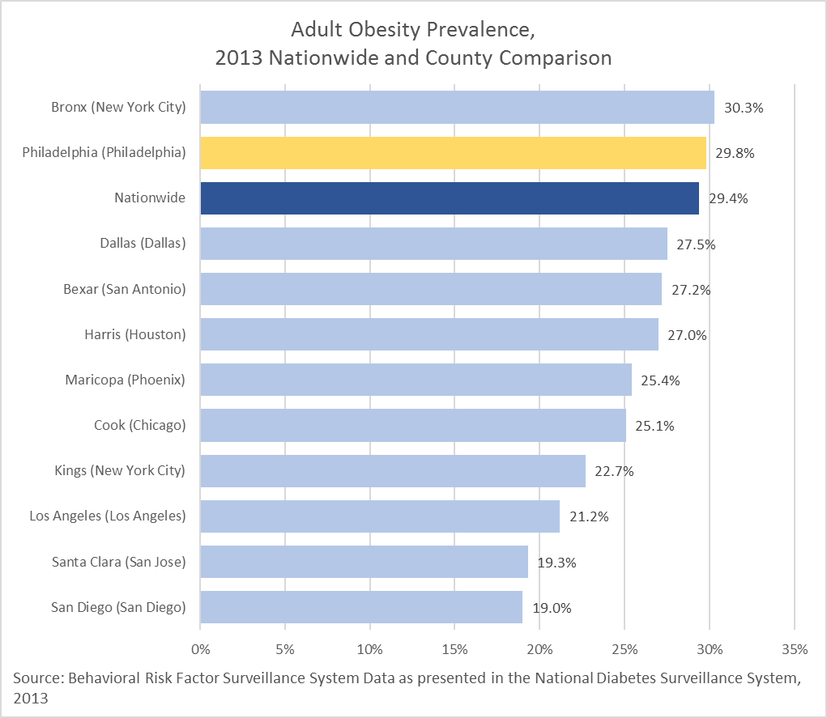
Obesity
Indicator Definition:
Percentage of adults with BMI greater than or equal to 30kg/m2, based on self-reported height and weight.
Notes:
Please note that data years differ across dimensions for this indicator.

Slide 55
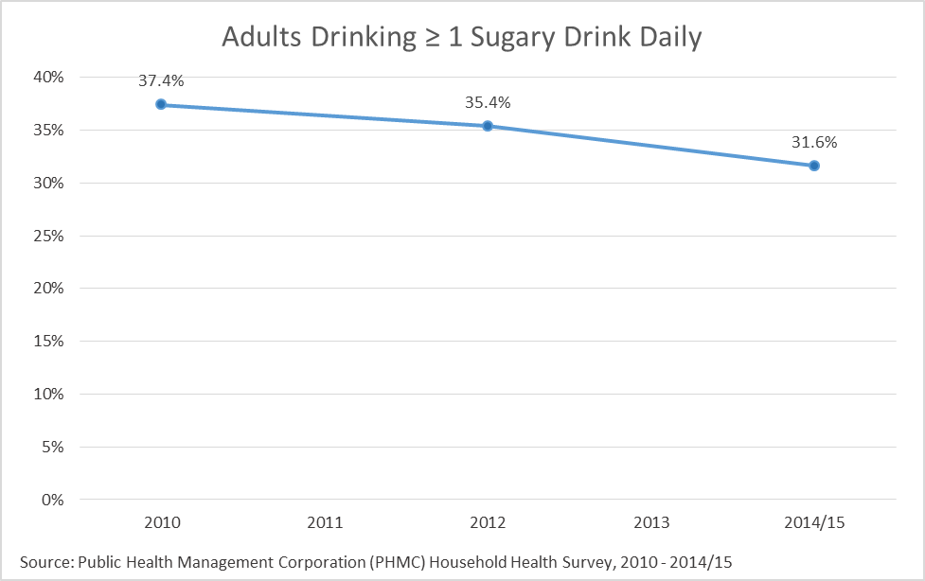
Obesity
Indicator Definition:
Percentage of adults who reported that they drank soda, sweetened fruit drinks, and/or bottled teas at least once a day for past 30 days. Respondents were instructed “do not include diet soda/drinks.”
Notes:
Examples provided to respondents included Coke, 7-Up, Snapple, Hugs, lemonade, and Kool-Aid.

Slide 56
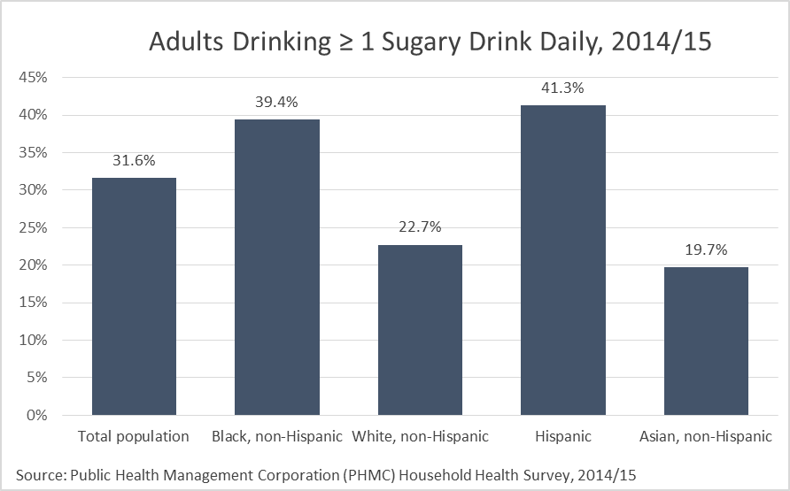
Obesity
Indicator Definition:
Percentage of adults who reported that they drank soda, sweetened fruit drinks, and/or bottled teas at least once a day for past 30 days. Respondents were instructed “do not include diet soda/drinks.”
Notes:
Examples provided to respondents included Coke, 7-Up, Snapple, Hugs, lemonade, and Kool-Aid.
Caution low sample size: Asian, non-Hispanic.

Slide 57
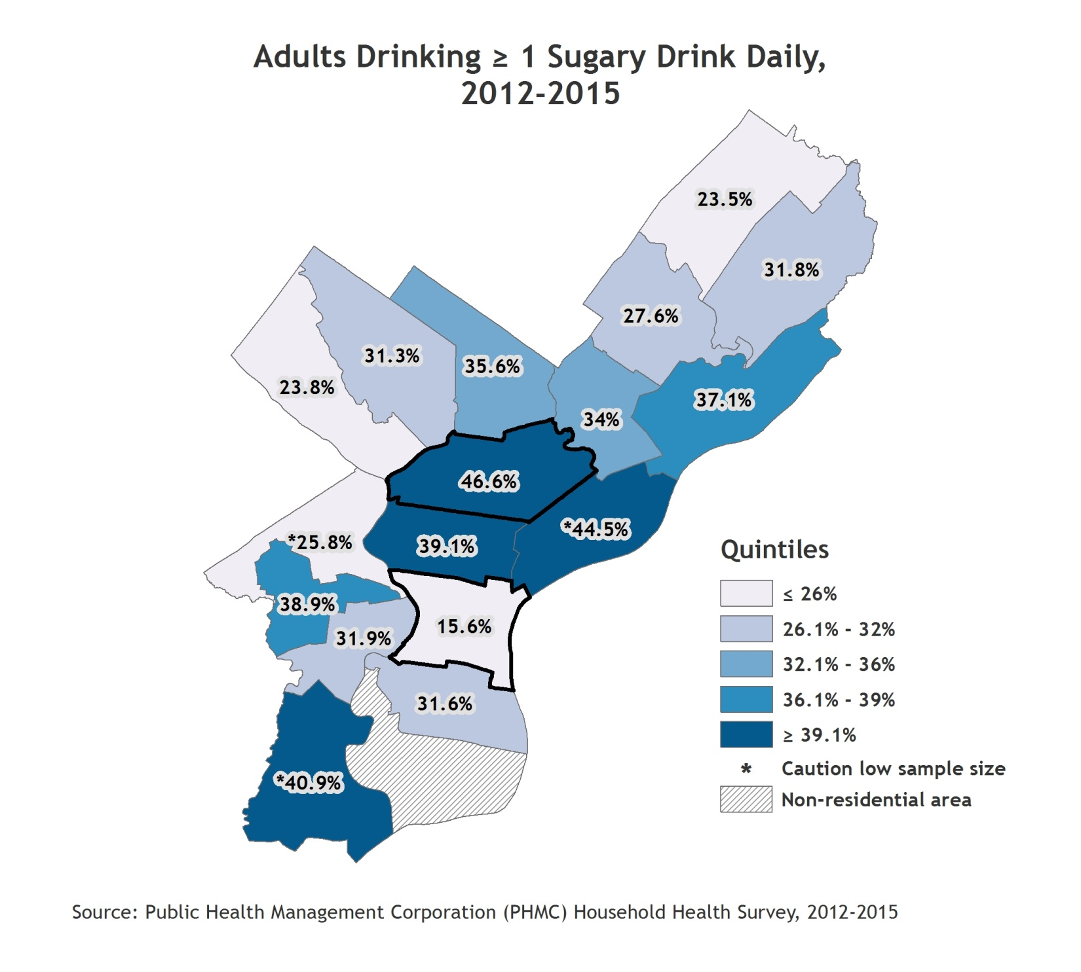
Obesity
Indicator Definition:
Percentage of adults who reported that they drank soda, sweetened fruit drinks, and/or bottled teas at least once a day for past 30 days. Respondents were instructed “do not include diet soda/drinks.”
Notes:
Examples provided to respondents included Coke, 7-Up, Snapple, Hugs, lemonade, and Kool-Aid.
Planning districts with the best and poorest outcomes are outlined with a thick black border. For the citywide value, refer to the citywide over time graph.

Slide 58
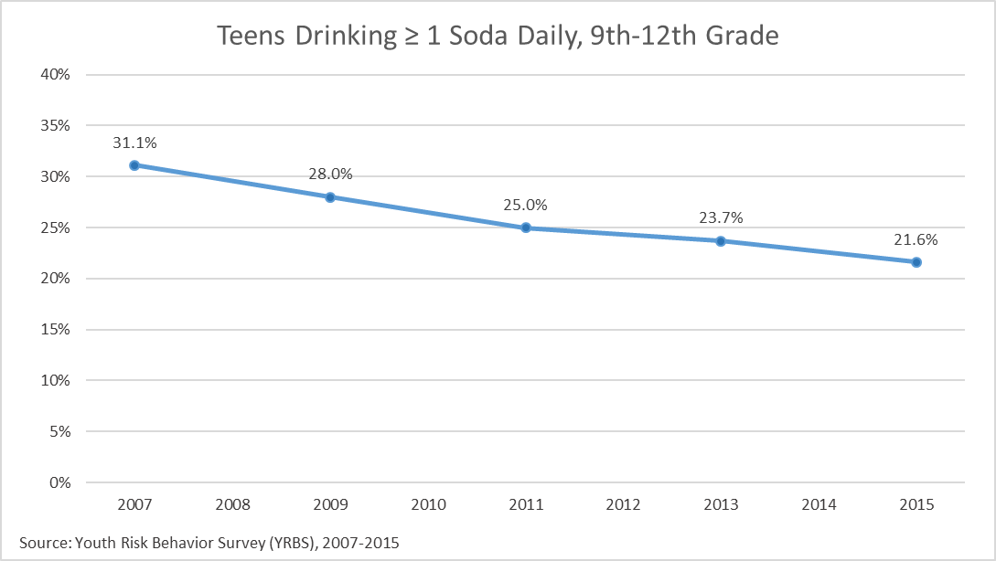
Obesity
Indicator Definition:
Percentage of 9th-12th grade students who reported that they drank soda at least once a day for past 30 days. Respondents were instructed “Do not count diet soda or diet pop.”
Notes:
Examples provided to respondents included Coke, Pepsi, and Sprite.

Slide 59
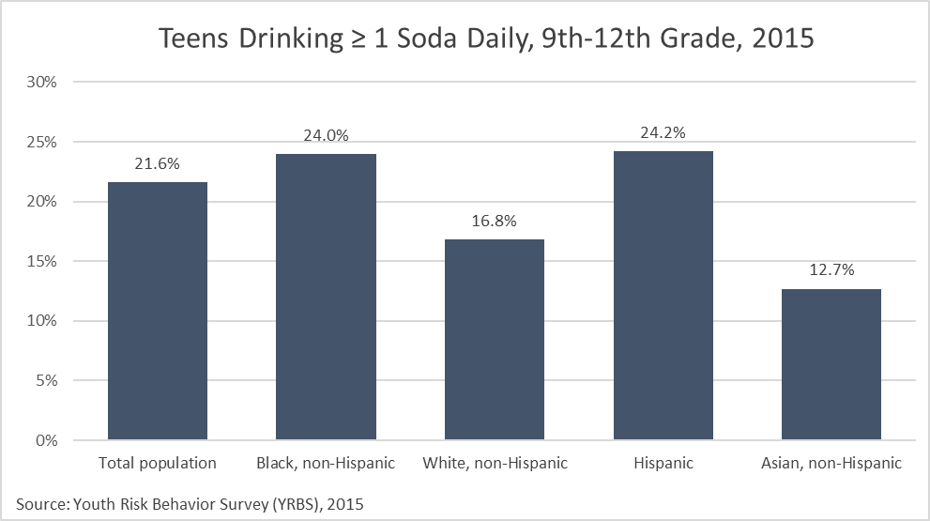
Obesity
Indicator Definition:
Percentage of 9th-12th grade students who reported that they drank soda at least once a day for past 30 days. Respondents were instructed “Do not count diet soda or diet pop.”
Notes:
Examples provided to respondents included Coke, Pepsi, and Sprite.

Slide 60
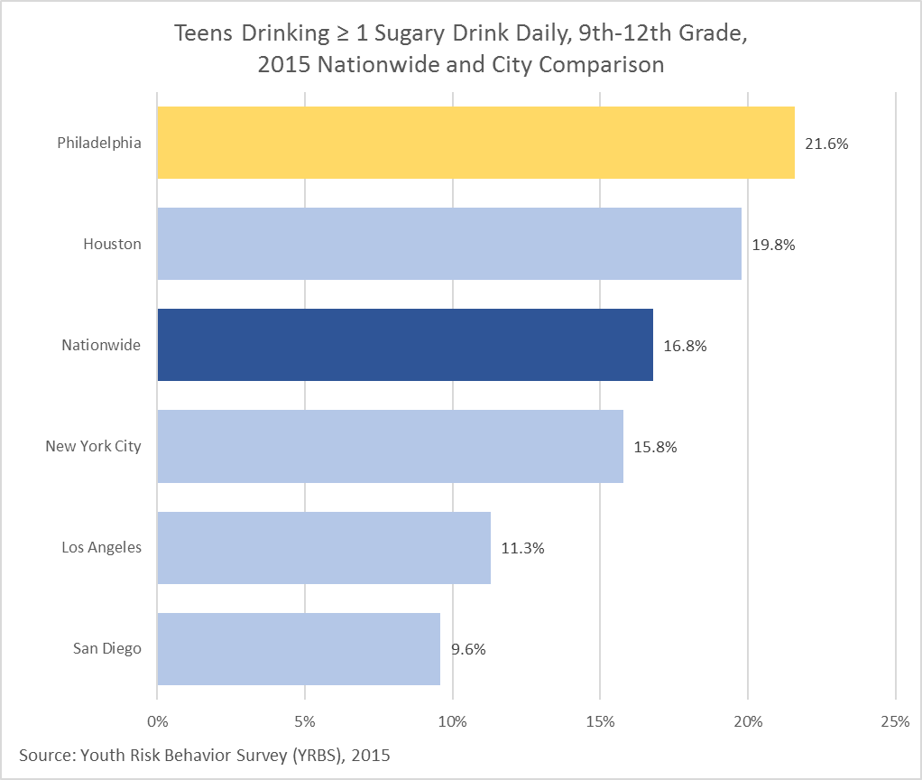
Obesity
Indicator Definition:
Percentage of 9th-12th grade students who reported that they drank soda at least once a day for past 30 days. Respondents were instructed “Do not count diet soda or diet pop.”
Notes:
Examples provided to respondents included Coke, Pepsi, and Sprite.

Slide 61
Cardiovascular Disease and Diabetes
Premature Cardiovascular (CVD) Mortality
Adult Hypertension
Adult Diabetes

Slide 62
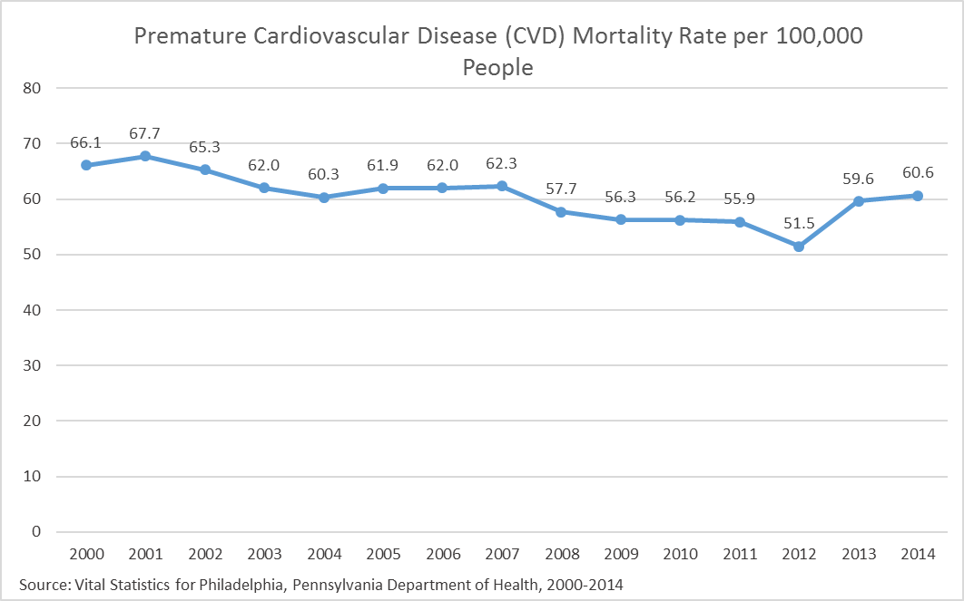
Cardiovascular Disease
Indicator Definition:
Age-adjusted rate per 100,000 persons of CVD deaths to persons under 65 years of age.

Slide 63
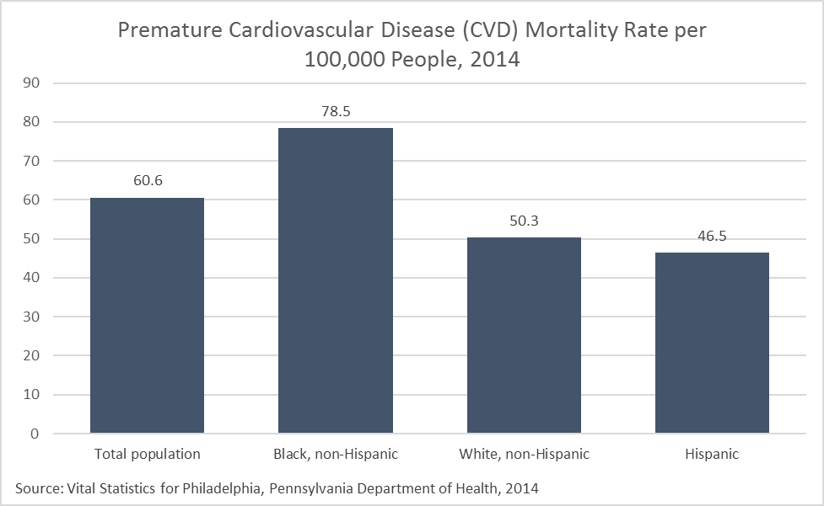
Cardiovascular Disease
Indicator Definition:
Age-adjusted rate per 100,000 persons of CVD deaths to persons under 65 years of age.

Slide 64
Cardiovascular Disease
Indicator Definition:
Age-adjusted rate per 100,000 persons of CVD deaths to persons under 65 years of age.
Notes:
Planning districts with the best and poorest outcomes are outlined with a thick black border. For the citywide value, refer to the citywide over time graph.

Slide 65
Cardiovascular Disease
Indicator Definition:
Age-adjusted rate per 100,000 persons of CVD deaths (all heart disease) to persons under 75 years of age.
Notes:
See the overtime graph for the most recent data for Philadelphia.

Slide 66
Cardiovascular Disease
Indicator Definition:
Percentage of adults who have been told by a doctor or other health professional that they have high blood pressure or hypertension. Excludes respondents with a history of gestational hypertension only.

Slide 67
Cardiovascular Disease
Indicator Definition:
Percentage of adults who have been told by a doctor or other health professional that they have high blood pressure or hypertension. Excludes respondents with a history of gestational hypertension only.
Notes:
Caution low sample size: Asian, non-Hispanic.

Slide 68
Cardiovascular Disease
Indicator Definition:
Percentage of adults who have been told by a doctor or other health professional that they have high blood pressure or hypertension. Excludes respondents with a history of gestational hypertension only.
Notes:
Two years of Household Health Survey data (2012 and 2014/15) were combined to provide more reliable estimates by planning district, therefore these numbers are not directly comparable with previous estimates.
Planning districts with the best and poorest outcomes are outlined with a thick black border. For the citywide value, refer to the citywide over time graph.

Slide 69
Cardiovascular Disease
Indicator Definition:
Percentage of adults who have been told by a doctor or other health professional that they have high blood pressure or hypertension. Excludes respondents with a history of gestational hypertension only.
Notes:
See the overtime graph for the most recent data for Philadelphia.

Slide 70
Cardiovascular Disease
Indicator Definition:
Percentage of adults who have been told by a doctor or other health professional that they have or have had diabetes. Excludes respondents with a history of gestational diabetes only.

Slide 71
Cardiovascular Disease
Indicator Definition:
Percentage of adults who have been told by a doctor or other health professional that they have or have had diabetes. Excludes respondents with a history of gestational diabetes only.
Notes:
Caution low sample size: Asian, non-Hispanic.

Slide 72
Cardiovascular Disease
Indicator Definition:
Percentage of adults who have been told by a doctor or other health professional that they have or have had diabetes. Excludes respondents with a history of gestational diabetes only.
Notes:
Caution low sample size: Hispanic and Asian, non-Hispanic. Data missing for some years for some race/ethnic subgroups due to small sample size.

Slide 73
Cardiovascular Disease
Indicator Definition:
Percentage of adults who have been told by a doctor or other health professional that they have or have had diabetes. Excludes respondents with a history of gestational diabetes only.
Notes:
Two years of Household Health Survey data (2012 and 2014/15) were combined to provide more reliable estimates by planning district, therefore these numbers are not directly comparable with previous estimates.
Planning districts with the best and poorest outcomes are outlined with a thick black border. For the citywide value, refer to the citywide over time graph.

Slide 74
Cardiovascular Disease
Indicator Definition:
Percentage of adults who have been told by a doctor or other health professional that they have or have had diabetes. Excludes respondents with a history of gestational diabetes only.
Notes:
See the overtime graph for the most recent data for Philadelphia. The nationwide estimate provided by BRFSS is a median of the state and DC estimates.

Slide 75
HIV
New HIV Diagnoses
New HIV Diagnoses Transmission Route
Retention in HIV/AIDS Care
Viral Suppression
Adults Never Tested for HIV

Slide 76
HIV
Indicator Definition:
Rate of new HIV diagnoses per 100,000 of the population.

Slide 77
HIV
Indicator Definition:
Rate of new HIV diagnoses per 100,000 of the population.

Slide 78
HIV
Indicator Definition:
Rate of new HIV diagnoses per 100,000 of the population.
Notes:
Planning districts with the best and poorest outcomes are outlined with a thick black border. For the citywide value, refer to the citywide over time graph.

Slide 79
HIV
Indicator Definition:
Rate of new HIV diagnoses per 100,000 of the population.
Notes:
See the overtime graph for the most recent data for Philadelphia.

Slide 80
HIV
Indicator Definition:
Count of new HIV diagnoses from male-to-male sexual contact, heterosexual contact, and injection drug use.
Notes:
Data not available for Heterosexual Contact for 2009. Annual data do not sum to the total new HIV diagnoses for the year due to “other” transmissions not shown.

Slide 81
HIV
Indicator Definition:
Percentage of new HIV diagnoses from male-to-male sexual contact, heterosexual contact, and injection drug use.
Notes:
Race/ethnicity data categories do not sum to 100 due to “other” transmissions not shown.

Slide 82
HIV
Indicator Definition:
Percentage of new HIV diagnoses by transmission category, including: male-to-male sexual contact, heterosexual contact, injection drug use, and other.
Notes:
For the citywide value, refer to the citywide over time graph.

Slide 83
HIV
Indicator Definition:
Percentage of persons living with diagnosed HIV having had 2 or more CD4 or viral load test results, at least 3 months apart, during a 12 month period.

Slide 84
HIV
Indicator Definition:
Percentage of persons living with diagnosed HIV having had 2 or more CD4 or viral load test results, at least 3 months apart, during a 12 month period.

Slide 85
HIV
Indicator Definition:
Percentage of persons living with diagnosed HIV having had 2 or more CD4 or viral load test results, at least 3 months apart, during a 12 month period.
Notes:
The data displayed for the North Delaware planning district includes persons who were diagnosed or received treatment in the Philadelphia Prison System. Inclusion of these individuals may artificially inflate HIV prevalence resulting in artificially lowered HIV retention rates.
Planning districts with the best and poorest outcomes are outlined with a thick black border. For the citywide value, refer to the citywide over time graph.

Slide 86
HIV
Indicator Definition:
Percentage of persons diagnosed living with HIV, who were alive at year end and had a viral load < 200 at most recent test. Persons diagnosed living with HIV whose viral load was not assessed were considered unsuppressed.

Slide 87
HIV
Indicator Definition:
Percentage of persons diagnosed living with HIV, who were alive at year end and had a viral load < 200 at most recent test. Persons diagnosed living with HIV whose viral load was not assessed were considered unsuppressed.

Slide 88
HIV
Indicator Definition:
Percentage of persons diagnosed living with HIV, who were alive at year end and had a viral load < 200 at most recent test. Persons diagnosed living with HIV whose viral load was not assessed were considered unsuppressed.
Notes:
The data displayed for the North Delaware planning district includes persons who were diagnosed or received treatment in the Philadelphia Prison System. Inclusion of these individuals may artificially inflate HIV prevalence resulting in artificially lowered HIV viral suppression rates.
Planning districts with the best and poorest outcomes are outlined with a thick black border. For the citywide value, refer to the citywide over time graph.

Slide 89
HIV
Indicator Definition:
Percentage of adults, age 18-39 years old, reporting "never" to the question, "The next question is about the test for HIV, the virus that causes AIDS. About how long has it been since you last had a test for HIV? Would you say one year or less, more than one year, up to two years, more than 2 years, or never?"

Slide 90
HIV
Indicator Definition:
Percentage of adults, age 18-39 years old, reporting "never" to the question, "The next question is about the test for HIV, the virus that causes AIDS. About how long has it been since you last had a test for HIV? Would you say one year or less, more than one year, up to two years, more than 2 years, or never?"
Notes:
Caution low sample size: Asian, non-Hispanic.

Slide 91
Teen Sexual Health
Teens Who Are Sexually Active
Condom Use
Birth Control Use
Teen Births
Chlamydia
Gonorrhea

Slide 92
Teen Sexual Health
Indicator Definition:
Percentage of 9th-12th grade students who reported having had sexual intercourse during the past 3 months.
Notes:
Data are not available for 2005.

Slide 93
Teen Sexual Health
Indicator Definition:
Percentage of 9th-12th grade students who reported having had sexual intercourse during the past 3 months.

Slide 94
Teen Sexual Health
Indicator Definition:
Percentage of sexually active 9th-12th grade students who reported using a condom during their most recent sexual intercourse. Respondents are considered sexually active if they report intercourse with at least one person in the three months preceding the survey.
Notes:
Data are not available for 2005.

Slide 95
Teen Sexual Health
Indicator Definition:
Percentage of sexually active 9th-12th grade students who reported using a condom during their most recent sexual intercourse. Respondents are considered sexually active if they report intercourse with at least one person in the three months preceding the survey.

Slide 96
Teen Sexual Health
Indicator Definition:
Percentage of sexually active 9th-12th grade students who used some form of birth control during their most recent sexual intercourse. Respondents are considered sexually active if they report intercourse with at least one person in the three months preceding the survey.
Notes:
Data are not available for 2005.

Slide 97
Teen Sexual Health
Indicator Definition:
Percentage of sexually active 9th-12th grade students who used some form of birth control during their most recent sexual intercourse. Respondents are considered sexually active if they report intercourse with at least one person in the three months preceding the survey.

Slide 98
Teen Sexual Health
Indicator Definition:
Birth rate per 1,000 teen girls age 15-19 years.

Slide 99
Teen Sexual Health
Indicator Definition:
Birth rate per 1,000 teen girls age 15-19 years.

Slide 100
Teen Sexual Health
Indicator Definition:
Birth rate per 1,000 teen girls age 15-19 years.
Notes:
Planning districts with the best and poorest outcomes are outlined with a thick black border. For the citywide value, refer to the citywide over time graph.

Slide 101
Teen Sexual Health
Indicator Definition:
Birth rate per 1,000 teen girls age 15-19 years.

Slide 102
Teen Sexual Health
Indicator Definition:
Diagnosed chlamydia infection rate per 100,000 teens age 15-19 years.

Slide 103
Teen Sexual Health
Indicator Definition:
Diagnosed chlamydia infection rate per 100,000 teens age 15-19 years.
Notes:
Planning districts with the best and poorest outcomes are outlined with a thick black border. For the citywide value, refer to the citywide over time graph.

Slide 104
Teen Sexual Health
Indicator Definition:
Diagnosed gonorrhea infection rate per 100,000 teens age 15-19 years.

Slide 105
Teen Sexual Health
Indicator Definition:
Diagnosed gonorrhea infection rate per 100,000 teens age 15-19 years.
Notes:
Planning districts with the best and poorest outcomes are outlined with a thick black border. For the citywide value, refer to the citywide over time graph.

Slide 106
Maternal and Infant Health
Infant Mortality
Low Birth Weight
Prenatal Care
Breastfeeding Initiation

Slide 107
Maternal and Infant Health
Indicator Definition:
Mortality rate per 1,000 live-born infants under one year of age.

Slide 108
Maternal and Infant Health
Indicator Definition:
Mortality rate per 1,000 live-born infants under one year of age.
Notes:
Three years of data were combined to provide more reliable estimates by race/ethnicity, therefore these numbers are not directly comparable with previous estimates. Data missing for some race/ethnic subgroups due to small sample size.

Slide 109
Maternal and Infant Health
Indicator Definition:
Mortality rate per 1,000 live-born infants under one year of age.
Notes:
Planning districts with the best and poorest outcomes are outlined with a thick black border. For the citywide value, refer to the citywide over time graph.

Slide 110
Maternal and Infant Health
Indicator Definition:
Mortality rate per 1,000 live-born infants under one year of age.

Slide 111
Maternal and Infant Health
Indicator Definition:
Percentage of live-born infants weighing less than 2,500 grams - or 5 pounds 8 ounces - at birth.

Slide 112
Maternal and Infant Health
Indicator Definition:
Percentage of live-born infants weighing less than 2,500 grams - or 5 pounds 8 ounces - at birth.
Notes:
The methods for calculating low birth weights have been updated since prior reports.

Slide 113
Maternal and Infant Health
Indicator Definition:
Percentage of live-born infants weighing less than 2,500 grams - or 5 pounds 8 ounces - at birth.
Notes:
Planning districts with the best and poorest outcomes are outlined with a thick black border. For the citywide value, refer to the citywide over time graph.
The methods for calculating low birth weights have been updated since prior reports.

Slide 114
Maternal and Infant Health
Indicator Definition:
Percentage of live-born infants weighing less than 2,500 grams - or 5 pounds 8 ounces - at birth.

Slide 115
Maternal and Infant Health
Indicator Definition:
Percentage of women who received prenatal care either in the third trimester or not at all, out of all women giving birth within the year, for whom the timing of prenatal care is known.

Slide 116
Maternal and Infant Health
Indicator Definition:
Percentage of women who received prenatal care either in the third trimester or not at all, out of all women giving birth within the year, for whom the timing of prenatal care is known.

Slide 117
Maternal and Infant Health
Indicator Definition:
Percentage of women who received prenatal care either in the third trimester or not at all, out of all women giving birth within the year, for whom the timing of prenatal care is known.
Notes:
Planning districts with the best and poorest outcomes are outlined with a thick black border. For the citywide value, refer to the citywide over time graph.

Slide 118
Maternal and Infant Health
Indicator Definition:
Percentage of women initiating breastfeeding before hospital discharge, out of all women for whom breastfeeding status is known.
Notes:
The methods for calculating breastfeeding initiation have been updated since prior reports, and all data years have been recalculated.

Slide 119
Maternal and Infant Health
Indicator Definition:
Percentage of women initiating breastfeeding before hospital discharge, out of all women for whom breastfeeding status is known.
Notes:
The methods for calculating breastfeeding initiation have been updated since prior reports.

Slide 120
Maternal and Infant Health
Indicator Definition:
Percentage of women initiating breastfeeding before hospital discharge, out of all women for whom breastfeeding status is known.
Notes:
Planning districts with the best and poorest outcomes are outlined with a thick black border. For the citywide value, refer to the citywide over time graph.
The methods for calculating breastfeeding initiation have been updated since prior reports.

Slide 121
Child Health
Children Up to Date on Immunizations
Asthma Hospitalization
Elevated Blood Lead Levels
Pedestrian and Bicycle Crashes
Child Mortality

Slide 122
Child Health
Indicator Definition:
Percentage of children, age 19-35 months, who have completed the recommended vaccination schedule 4:3:1:3 (DTaP : IPV : MMR : Hib).

Slide 123
Child Health
Indicator Definition:
Percentage of children, age 19-35 months, who have completed the recommended vaccination schedule 4:3:1:3 (DTaP : IPV : MMR : Hib).

Slide 124
Child Health
Indicator Definition:
Percentage of children, age 19-35 months, who have completed the recommended vaccination schedule 4:3:1:3 (DTaP : IPV : MMR : Hib).
Notes:
Planning districts with the best and poorest outcomes are outlined with a thick black border. For the citywide value, refer to the citywide over time graph.

Slide 125
Child Health
Indicator Definition:
Percentage of children, age 19-35 months, who have completed the recommended vaccination schedule 4:3:1:3 (DTaP : IPV : MMR : Hib).

Slide 126
Child Health
Indicator Definition:
Age-adjusted rate of hospital discharges with a primary diagnosis of asthma per 10,000 children under 18.
Notes:
The methods for calculating asthma hospitalization have been updated in 2014, and all data years have been recalculated.

Slide 127
Child Health
Indicator Definition:
Age-adjusted rate of hospital discharges with a primary diagnosis of asthma per 10,000 children under age 18.
Notes:
The methods for calculating asthma hospitalization were updated in 2014 and are not comparable to previous years.

Slide 128
Child Health
Indicator Definition:
Age-adjusted rate of hospital discharges with a primary diagnosis of asthma per 10,000 children under 18.
Notes:
Data are displayed by zip code. Planning District boundaries are overlaid. For the citywide value, refer to the citywide over time graph.
The methods for calculating asthma hospitalization have been updated since prior reports and are not comparable to previous years.

Slide 129
Child Health
Indicator Definition:
Percentage of children, 0-5 years old, with newly identified blood lead levels (BLLs) from 5-9 mcg/dL and 10+ mcg/dL using any blood specimens for screening.

Slide 130
Child Health
Indicator Definition:
Percentage of children, 0-5 years old, with newly identified blood lead levels (BLLs) from 5-9 mcg/dL using any blood specimens for screening.
Notes:
Planning districts with the best and poorest outcomes are outlined with a thick black border. For the citywide value, refer to the citywide over time graph.

Slide 131
Child Health
Indicator Definition:
Percentage of children, 0-5 years old, with newly identified blood lead levels (BLLs) at or above 10 mcg/dL using any blood specimens for screening.
Notes:
Planning districts with the best and poorest outcomes are outlined with a thick black border. For the citywide value, refer to the citywide over time graph.

Slide 132
Child Health
Indicator Definition:
Rate of child-involved pedestrian and bicyclist crashes involving motor vehicles per 100,000 children under 18.
Notes:
The methods for calculating pedestrian and bicycle crashes per 100,000 children have been updated since prior reports and are not comparable to previous years.

Slide 133
Child Health
Indicator Definition:
Rate of child-involved pedestrian and bicyclist crashes involving motor vehicles per 100,000 children under 18.
Notes:
The methods for calculating pedestrian and bicycle crashes per 100,000 children have been updated since prior reports and are not comparable to previous years.
Planning districts with the best and poorest outcomes are outlined with a thick black border. For the citywide value, refer to the citywide over time graph.

Slide 134
Child Health
Indicator Definition:
Age-adjusted mortality rate per 100,000 children under 18 years of age.
Notes:
See PDPH Vital Statistics Reports for causes of death by age: http://www.phila.gov/health/commissioner/VitalStatistics.html

Slide 135
Child Health
Indicator Definition:
Age-adjusted mortality rate per 100,000 children under 18 years of age.
Notes:
See PDPH Vital Statistics Reports for causes of death by age: http://www.phila.gov/health/commissioner/VitalStatistics.html

Slide 136
Child Health
Indicator Definition:
Age-adjusted mortality rate per 100,000 children under 18 years of age.
Notes:
See PDPH Vital Statistics Reports for causes of death by age: http://www.phila.gov/health/commissioner/VitalStatistics.html
Planning districts with the best and poorest outcomes are outlined with a thick black border. For the citywide value, refer to the citywide over time graph.

Slide 137
Child Health
Indicator Definition:
Age-adjusted mortality rate per 100,000 children under 18 years of age.

Slide 138
Access to Care
Adults Without Health Insurance
Children Without Health Insurance
Adults Covered by Medicaid
Adults Forgoing Care Due to Cost
Ambulatory Care Sensitive Hospitalization
Children Receiving Dental Care
Population per Primary Care Physician
Population per Dentist

Slide 139
Access to Care
Indicator Definition:
Percentage of adults, age 18-64 years old, reporting no source of insurance.

Slide 140
Access to Care
Indicator Definition:
Percentage of adults, age 18-64 years old, reporting no source of insurance.
Notes:
Caution low sample size: Asian, non-Hispanic.

Slide 141
Access to Care
Indicator Definition:
Percentage of adults, age 18-64 years, reporting no source of insurance.
Notes:
Planning districts with the best and poorest outcomes are outlined with a thick black border. For the citywide value, refer to the citywide over time graph.

Slide 142
Access to Care
Indicator Definition:
Percentage of adults, age 18-64 years old, reporting no source of insurance.

Slide 143
Access to Care
Indicator Definition:
Percentage of children under 18 for whom no source of insurance is reported by adult proxy.

Slide 144
Access to Care
Indicator Definition:
Percentage of children under 18 for whom no source of insurance is reported by adult proxy.
Notes:
Caution low sample size: Asian, non-Hispanic.

Slide 145
Access to Care
Indicator Definition:
Percentage of children under 18 without health insurance.
Notes:
Small Area Health Insurance Estimates (SAHIE) for counties are based on data from a variety of sources and may not be based on survey data.

Slide 146
Access to Care
Indicator Definition:
Percentage of adults, age 18-64 years, reporting insurance coverage through Medicaid, Medical Assistance (M.A.), HealthChoices, or Access Card.

Slide 147
Access to Care
Indicator Definition:
Percentage of adults, age 18-64 years, reporting insurance coverage through Medicaid, Medical Assistance (M.A.), HealthChoices, or Access Card.
Notes:
Caution low sample size: Asian, non-Hispanic.

Slide 148
Access to Care
Indicator Definition:
Percentage of adults, age 18-64 years, reporting insurance coverage through Medicaid, Medical Assistance (M.A.), HealthChoices, or Access Card.
Notes:
Planning districts with the best and poorest outcomes are outlined with a thick black border. For the citywide value, refer to the citywide over time graph.

Slide 149
Access to Care
Indicator Definition:
Percentage of adults, age 18-64 years, answering "yes" to the question, "In the past year, has there been any time when you were sick or injured AND did not seek health care because of the cost?"

Slide 150
Access to Care
Indicator Definition:
Percentage of adults, age 18-64 years, answering "yes" to the question, "In the past year, has there been any time when you were sick or injured AND did not seek health care because of the cost?"
Notes:
Caution low sample size: Asian, non-Hispanic.

Slide 151
Access to Care
Indicator Definition:
Percentage of adults, age 18-64 years, answering "yes" to the question, "In the past year, has there been any time when you were sick or injured AND did not seek health care because of the cost?"
Notes:
Two years of Household Health Survey data (2012 and 2014/15) were combined to provide more reliable estimates by planning district, therefore these numbers are not directly comparable with previous estimates.
Planning districts with the best and poorest outcomes are outlined with a thick black border. For the citywide value, refer to the citywide over time graph.

Slide 152
Access to Care
Indicator Definition:
Age-adjusted rate per 100,000 persons for conditions where appropriate ambulatory care prevents or reduces the need for admission to the hospital, for population under 75 years of age.
Notes:
The methods for calculating ambulatory care sensitive hospitalizations have been updated since prior reports, and all data years have been recalculated.

Slide 153
Access to Care
Indicator Definition:
Age-adjusted rate per 100,000 persons for conditions where appropriate ambulatory care prevents or reduces the need for admission to the hospital, for population under 75 years of age.
Notes:
The methods for calculating ambulatory care sensitive hospitalizations have been updated since prior reports.

Slide 154
Access to Care
Indicator Definition:
Age-adjusted rate per 100,000 persons for conditions where appropriate ambulatory care prevents or reduces the need for admission to the hospital, for population under 75 years of age.
Notes:
The methods for calculating ambulatory care sensitive hospitalizations have been updated since prior reports.
Data are displayed by zip code. Planning District boundaries are overlaid. For the citywide value, refer to the citywide over time graph.

Slide 155
Access to Care
Indicator Definition:
Percentage of children, age 3-17 years, for whom adult proxy reported dental visit in past 12 months.

Slide 156
Access to Care
Indicator Definition:
Percentage of children, age 3-17 years, for whom adult proxy reported dental visit in past 12 months.
Notes:
Caution low sample size: Asian, non-Hispanic.

Slide 157
Access to Care
Indicator Definition:
Number of people per primary care physician.
Notes:
Planning districts with the best and poorest outcomes are outlined with a thick black border.

Slide 158
Access to Care
Indicator Definition:
Number of people per dentist.
Notes:
Planning districts with the best and poorest outcomes are outlined with a thick black border.

Slide 159
Cancer Screening and Prevention
Cancer Mortality
Colon Cancer Screening
Breast Cancer Screening
HPV Vaccination

Slide 160
Cancer Screening and Prevention
Indicator Definition:
Age-adjusted rate of cancer deaths per 100,000 persons.

Slide 161
Cancer Screening and Prevention
Indicator Definition:
Age-adjusted rate of cancer deaths per 100,000 persons.
Notes:
Data missing for some race/ethnic subgroups due to small sample size.

Slide 162
Cancer Screening and Prevention
Indicator Definition:
Age-adjusted rate of cancer deaths per 100,000 persons.
Notes:
Planning districts with the best and poorest outcomes are outlined with a thick black border. For the citywide value, refer to the citywide over time graph.

Slide 163
Cancer Screening and Prevention
Indicator Definition:
Percentage of adults, age 50-74 years, reporting ever having had a colonoscopy or sigmoidoscopy.

Slide 164
Cancer Screening and Prevention
Indicator Definition:
Percentage of adults, age 50-74 years, reporting ever having had a colonoscopy or sigmoidoscopy.
Notes:
Caution low sample size: Asian, non-Hispanic.

Slide 165
Cancer Screening and Prevention
Indicator Definition:
Percentage of adults, age 50 years and older, reporting ever having had a colonoscopy or sigmoidoscopy.
Notes:
Philadelphia (local source) data reflect adults 50-74 years of age.

Slide 166
Cancer Screening and Prevention
Indicator Definition:
Percentage of women, age 50-74 years, reporting having had a mammogram in the past 2 years.

Slide 167
Cancer Screening and Prevention
Indicator Definition:
Percentage of women, age 50-74 years, reporting having had a mammogram in the past 2 years.
Notes:
Caution low sample size: Asian, non-Hispanic.

Slide 168
Cancer Screening and Prevention
Indicator Definition:
Percentage of women, age 50 years and older, reporting having had a mammogram in the past 2 years.
Notes:
Philadelphia (local source) data reflect women 50-74 years of age.

Slide 169
Cancer Screening and Prevention
Indicator Definition:
Percentage of girls, age 13-17 years, who received 3 doses of HPV vaccine out of all girls 13-17 years in the population.
Notes:
Data are based on local reporting of immunizations provided by clinicians, and some underreporting for adolescents may occur.
Estimates for 2014 and 2015 were reviewed and updated – numbers may not match those previously reported.

Slide 170
Cancer Screening and Prevention
Indicator Definition:
Percentage of girls, age 13-17 years, who received 3 doses of HPV vaccine out of all girls 13-17 years in the population.
Notes:
Data are based on local reporting of immunizations provided by clinicians, and some underreporting for adolescents may occur.

Slide 171
Cancer Screening and Prevention
Indicator Definition:
Percentage of girls, age 13-17 years, who received 3 doses of HPV vaccine out of all girls 13-17 years in the population.
Notes:
Data are based on local reporting of immunizations provided by clinicians, and some underreporting for adolescents may occur.
Planning districts with the best and poorest outcomes are outlined with a thick black border. For the citywide value, refer to the citywide over time graph.

Slide 172
Cancer Screening and Prevention
Indicator Definition:
Percentage of girls and boys, age 13-17 years, who received 3 doses of HPV vaccine out of all girls and boys, age 13-17 years, in the respective population.

Slide 173
Cancer Screening and Prevention
Indicator Definition:
Percentage of girls and boys, age 13-17 years, who received 3 doses of HPV vaccine out of all girls and boys, age 13-17 years, in the respective population.

Slide 174
Environmental Health
Food Safety Compliance
Rat Complaints
Air Quality
Housing Code Violations

Slide 175
Environmental Health
Indicator Definition:
Percentage of food establishments in compliance with food safety regulations upon initial annual inspection by the Philadelphia Department of Public Health.
Notes:
Data are by fiscal year.

Slide 176
Environmental Health
Indicator Definition:
Percentage of food establishments in compliance with food safety regulations upon initial annual inspection by the Philadelphia Department of Public Health.
Notes:
Planning districts with the best and poorest outcomes are outlined with a thick black border. For the citywide value, refer to the citywide over time graph.
Some establishments included in the overall compliance rate are not included in the planning district dimension due to non-permanent locations.

Slide 177
Environmental Health
Indicator Definition:
Rate of rat complaint calls to the Philadelphia Department of Public Health per 10,000 residents.
Notes:
The methods for calculating rat complaints per 10,000 people have been updated slightly since prior reports, and all data years have been recalculated.

Slide 178
Environmental Health
Indicator Definition:
Rate of rat complaint calls to the Philadelphia Department of Public Health per 10,000 residents.
Notes:
Planning districts with the best and poorest outcomes are outlined with a thick black border. For the citywide value, refer to the citywide over time graph.

Slide 179
Environmental Health
Indicator Definition:
Count of days that are Good, Moderate, and Unhealthy based on the Air Quality Index (AQI). Please see the Data Definitions for more detail.
Notes:
Data for year 2016 reflect preliminary data analysis.
The definition for moderate and unhealthy air quality has been corrected from previous reports.
The reporting is based on 2015 Environmental Protection Agency standards.

Slide 180
Environmental Health
Indicator Definition:
Rate of Philadelphia Building Construction and Occupancy Code violations per 1,000 occupied housing units. Violations are based on follow-up inspections to complaints filed through Philly 311.

Slide 181
Environmental Health
Indicator Definition:
Rate of Philadelphia Building Construction and Occupancy Code violations per 1,000 occupied housing units. Violations are based on follow-up inspections to complaints filed through Philly 311.
Notes:
Planning districts with the best and poorest outcomes are outlined with a thick black border. For the citywide value, refer to the citywide over time graph.

Slide 182
Violence
Violent Crime
Homicide Mortality
Firearm Homicide Mortality

Slide 183
Violence
Indicator Definition:
Rate per 100,000 persons of reported violent crimes, including murders and non-negligent manslaughters, forcible rapes, robberies, and aggravated assaults.

Slide 184
Violence
Indicator Definition:
Rate per 100,000 persons of reported violent crimes, including murders and non-negligent manslaughters, forcible rapes, robberies, and aggravated assaults.

Slide 185
Violence
Indicator Definition:
Rate of homicide deaths per 100,000 persons (not age-adjusted).
Notes:
Data do include deaths of residents who died outside of Philadelphia.

Slide 186
Violence
Indicator Definition:
Age-adjusted rate of homicide deaths per 100,000 persons.
Notes:
Data do include deaths of residents who died outside of Philadelphia.

Slide 187
Violence
Indicator Definition:
Age-adjusted rate of homicide deaths per 100,000 persons.
Notes:
Data do include deaths of residents who died outside of Philadelphia.
Planning districts with the best and poorest outcomes are outlined with a thick black border. For the citywide value, refer to the citywide over time graph.

Slide 188
Violence
Indicator Definition:
Rate of homicide deaths per 100,000 persons.

Slide 189
Violence
Indicator Definition:
Rate of intentional deaths by discharge of firearm per 100,000 persons (not age-adjusted).
Notes:
Data do include deaths of residents who died outside of Philadelphia.

Slide 190
Violence
Indicator Definition:
Age-adjusted rate of intentional deaths by discharge of firearm per 100,000 persons.
Notes:
Data do include deaths of residents who died outside of Philadelphia.

Slide 191
Violence
Indicator Definition:
Age-adjusted rate of intentional deaths by discharge of firearm per 100,000 persons.
Notes:
Data do include deaths of residents who died outside of Philadelphia.
Planning districts with the best and poorest outcomes are outlined with a thick black border. For the citywide value, refer to the citywide over time graph.

Slide 192
Mental Health and Substance Abuse
Suicide Mortality
Teens Considering Suicide
Adults with Mental Health Conditions
Opioid-Related Mortality

Slide 193
Mental Health and Substance Abuse
Indicator Definition:
Rate of deaths by intentional self-harm per 100,000 persons.
Notes:
Data do include deaths of residents who died outside of Philadelphia.

Slide 194
Mental Health and Substance Abuse
Indicator Definition:
Age-adjusted rate of deaths by intentional self-harm per 100,000 persons.
Notes:
Data do include deaths of residents who died outside of Philadelphia.

Slide 195
Mental Health and Substance Abuse
Indicator Definition:
Age-adjusted rate of deaths by intentional self-harm per 100,000 persons.
Notes:
Data do include deaths of residents who died outside of Philadelphia.
Planning districts with the best and poorest outcomes are outlined with a thick black border. For the citywide value, refer to the citywide over time graph.

Slide 196
Mental Health and Substance Abuse
Indicator Definition:
Percentage of 9th-12th grade students who seriously considered attempting suicide in the past 12 months.

Slide 197
Mental Health and Substance Abuse
Indicator Definition:
Percentage of 9th-12th grade students who seriously considered attempting suicide in the past 12 months.

Slide 198
Mental Health and Substance Abuse
Indicator Definition:
Percentage of 9th-12th grade students who seriously considered attempting suicide in the past 12 months.

Slide 199
Mental Health and Substance Abuse
Indicator Definition:
Percentage of adults answering "yes" to the question, "Have you ever been diagnosed with any mental health condition, including clinical depression, anxiety disorder or bipolar disorder?"

Slide 200
Mental Health and Substance Abuse
Indicator Definition:
Percentage of adults answering "yes" to the question, "Have you ever been diagnosed with any mental health condition, including clinical depression, anxiety disorder or bipolar disorder?"
Notes:
Caution low sample size: Asian, non-Hispanic.

Slide 201
Mental Health and Substance Abuse
Indicator Definition:
Percentage of adults answering "yes" to the question, "Have you ever been diagnosed with any mental health condition, including clinical depression, anxiety disorder or bipolar disorder?"
Notes:
Two years of Household Health Survey data (2012 and 2014/15) were combined to provide more reliable estimates by planning district, therefore these numbers are not directly comparable with previous estimates.
Planning districts with the best and poorest outcomes are outlined with a thick black border. For the citywide value, refer to the citywide over time graph.

Slide 202
Mental Health and Substance Abuse
Indicator Definition:
Rate of deaths per 100,000 persons that were determined by the medical examiner to be caused by drug/medication overdose and for which a toxicology test was positive for an opioid (not age-adjusted).
Notes:
Opioids include heroin, morphine, methadone, fentanyl, and all pharmaceutical opioids such as codeine, hydrocodone, and oxycodone.
Data do include deaths of residents who died outside of Philadelphia.

Slide 203
Mental Health and Substance Abuse
Indicator Definition:
Age-adjusted rate of deaths per 100,000 persons that were determined by the medical examiner to be caused by drug/medication overdose and for which a toxicology test was positive for an opioid.
Notes:
Opioids include heroin, morphine, methadone, fentanyl, and all pharmaceutical opioids such as codeine, hydrocodone, and oxycodone.
Data do include deaths of residents who died outside of Philadelphia.

Slide 204
Mental Health and Substance Abuse
Indicator Definition:
Age-adjusted rate of deaths per 100,000 persons that were determined by the medical examiner to be caused by drug/medication overdose and for which a toxicology test was positive for an opioid.
Notes:
Opioids include heroin, morphine, methadone, fentanyl, and all pharmaceutical opioids such as codeine, hydrocodone, and oxycodone.
Data do include deaths of residents who died outside of Philadelphia.
Planning Districts with the best and poorest outcomes are outlined with a thick black border. For the citywide value, refer to the citywide over time graph.

Slide 205
Built Environment
Food Access
Access to Nearby Parks or Outdoor Space
Pedestrian and Bicycle Crashes

Slide 206
Built Environment
Indicator Definition:
Percentage of population living in high-poverty areas with low-to-no walkable access to healthy foods as assessed in PDPH’s Food Access Report.
Notes:
Please note that data definitions and sources differ across dimensions for this indicator.

Slide 207
Built Environment
Indicator Definition:
Percentage of adults reporting that it is “difficult” or “very difficult” to find fruit and vegetables in their neighborhood.
Notes:
Caution low sample size: Asian, non-Hispanic.
Please note that data definitions and sources differ across dimensions for this indicator.

Slide 208
Built Environment
Indicator Definition:
Percentage of population living in high-poverty areas with low-to-no walkable access to healthy foods as assessed in PDPH’s Food Access Report.
Notes:
Planning Districts with the best and poorest outcomes are outlined with a thick black border. For the citywide value, refer to the citywide over time graph.
Please note that data definitions and sources differ across dimensions for this indicator.

Slide 209
Built Environment
Indicator Definition:
Percentage of adults responding yes to the question, “Is there a park or other outdoor space in your neighborhood that you’re comfortable visiting during the day?”

Slide 210
Built Environment
Indicator Definition:
Percentage of adults responding yes to the question, “Is there a park or other outdoor space in your neighborhood that you’re comfortable visiting during the day?”
Notes:
Caution low sample size: Asian, non-Hispanic.

Slide 211
Built Environment
Indicator Definition:
Percentage of adults responding yes to the question, “Is there a park or other outdoor space in your neighborhood that you’re comfortable visiting during the day?”
Notes:
Two years of Household Health Survey data (2012 and 2014/15) were combined to provide more reliable estimates by planning district, therefore these numbers are not directly comparable with previous estimates.
Planning Districts with the best and poorest outcomes are outlined with a thick black border. For the citywide value, refer to the citywide over time graph.

Slide 212
Built Environment
Indicator Definition:
Rate of pedestrian and bicyclist crashes involving motor vehicles per 100,000 persons.

Slide 213
Built Environment
Indicator Definition:
Rate of pedestrian and bicyclist crashes involving motor vehicles per 100,000 persons.
Notes:
Planning Districts with the best and poorest outcomes are outlined with a thick black border. For the citywide value, refer to the citywide over time graph.

Slide 214
Social Determinants of Health
English Language Arts (ELA) Achievement in 4th Grade
On-Time High School Graduation
Adults Completing Some College
Unemployment
Poverty
Children Living in Poverty
Children in Single-Parent Households
Social Capital
Housing-Cost Burden for Renters

Slide 215
Social Determinants of Health
Indicator Definition:
Percentage of 4th graders who score at the advanced or proficient levels of Reading Skills and English Language Arts (ELA) as assessed by the Pennsylvania System of School Assessment (PSSA) standardized test.
Notes:
Data are by school year. For example, 2005 refers to the school year spanning fall 2004 and spring 2005. The PSSA exam changed, beginning in 2015, so data from prior years is not comparable.

Slide 216
Social Determinants of Health
Indicator Definition:
Percentage of 4th graders who score at the advanced or proficient levels of English Language Arts (ELA) as assessed by the Pennsylvania System of School Assessment (PSSA) standardized test.
Notes:
Data are by school year. Results were presented for 3rd graders in previous years.

Slide 217
Social Determinants of Health
Indicator Definition:
Percentage of students in 4th grade scoring at the proficient or advanced level on the 4th grade reading assessment.
Notes:
National and county data are not available for 3rd grade: using 4th grade as a substitute. City data are from the urban school districts program of NAEP, called Trial Urban District Assessment (TUDA).

Slide 218
Social Determinants of Health
Indicator Definition:
Percentage of all public school students who graduate from high school within four years after starting 9th grade.
Notes:
Data are by school year. For example, 2005 refers to the school year spanning fall 2004 and spring 2005.

Slide 219
Social Determinants of Health
Indicator Definition:
Percentage of all students who graduate from high school within four years after starting 9th grade.
Notes:
Data are by school year.

Slide 220
Social Determinants of Health
Indicator Definition:
Percentage of all students who graduate from high school within four years after starting 9th grade.

Slide 221
Social Determinants of Health
Indicator Definition:
Percentage of adults, 25 years or older, who completed at least some college.

Slide 222
Social Determinants of Health
Indicator Definition:
Percentage of adults, 25 years or older, who completed at least some college.

Slide 223
Social Determinants of Health
Indicator Definition:
Percentage of adults, 25 years or older, who completed at least some college.
Notes:
Planning districts with the best and poorest outcomes are outlined with a thick black border. For the citywide value, refer to the citywide over time graph.

Slide 224
Social Determinants of Health
Indicator Definition:
Percentage of adults, 25 years or older, who completed at least some college.

Slide 225
Social Determinants of Health
Indicator Definition:
Percentage of population, 16 years or older, who are unemployed but seeking work.
Notes:
Please note that data sources and years differ across dimensions for this indicator.

Slide 226
Social Determinants of Health
Indicator Definition:
Percentage of population, 16 years or older, who are unemployed but seeking work.
Notes:
Please note that data sources and years differ across dimensions for this indicator.

Slide 227
Social Determinants of Health
Indicator Definition:
Percentage of population, 16 years or older, who are unemployed but seeking work.
Notes:
Planning districts with the best and poorest outcomes are outlined with a thick black border. For the citywide value, refer to the citywide over time graph.
Please note that data sources and years differ across dimensions for this indicator.

Slide 228
Social Determinants of Health
Indicator Definition:
Percentage of population, 16 years or older, who are unemployed but seeking work.
Notes:
Please note that data sources and years differ across dimensions for this indicator.

Slide 229
Social Determinants of Health
Indicator Definition:
Percentage of population, including all ages, living in a household with an income below 100% of the federal poverty level (FPL).
Notes:
In 2015, the FPL was equivalent to a yearly income of no more than $11,770 for an individual, or $24,250 for a family of 4.

Slide 230
Social Determinants of Health
Indicator Definition:
Percentage of population, including all ages, living in a household with an income below 100% of the federal poverty level (FPL).
Notes:
In 2015, the FPL was equivalent to a yearly income of no more than $11,770 for an individual, or $24,250 for a family of 4.

Slide 231
Social Determinants of Health
Indicator Definition:
Percentage of population, including all ages, living in a household with an income below 100% of the federal poverty level (FPL).
Notes:
In 2015, the FPL was equivalent to a yearly income of no more than $11,770 for an individual, or $24,250 for a family of 4.
Planning districts with the best and poorest outcomes are outlined with a thick black border. For the citywide value, refer to the citywide over time graph.

Slide 232
Social Determinants of Health
Indicator Definition:
Percentage of population, including all ages, living in a household with an income below 100% of the federal poverty level (FPL).
Notes:
In 2015, the FPL was equivalent to a yearly income of no more than $11,770 for an individual, or $24,250 for a family of 4.

Slide 233
Social Determinants of Health
Indicator Definition:
Percentage of children under 18 with a family income below 100% of the federal poverty level (FPL).
Notes:
In 2015, the FPL was equivalent to a yearly income of no more than $11,770 for an individual, or $24,250 for a family of 4.

Slide 234
Social Determinants of Health
Indicator Definition:
Percentage of children under 18 with a family income below 100% of the federal poverty level (FPL).
Notes:
In 2015, the FPL was equivalent to a yearly income of no more than $11,770 for an individual, or $24,250 for a family of 4.

Slide 235
Social Determinants of Health
Indicator Definition:
Percentage of children under 18 with a family income below 100% of the federal poverty level (FPL).
Notes:
In 2015, the FPL was equivalent to a yearly income of no more than $11,770 for an individual, or $24,250 for a family of 4.
Planning districts with the best and poorest outcomes are outlined with a thick black border. For the citywide value, refer to the citywide over time graph.

Slide 236
Social Determinants of Health
Indicator Definition:
Percentage of children under 18 with a family income below 100% of the federal poverty level (FPL).
Notes:
In 2015, the FPL was equivalent to a yearly income of no more than $11,770 for an individual, or $24,250 for a family of 4.

Slide 237
Social Determinants of Health
Indicator Definition:
Percentage of all children in family households that live in a household headed by a single parent (male or female head of household with no spouse present).

Slide 238
Social Determinants of Health
Indicator Definition:
Percentage of all children in family households that live in a household headed by a single parent (male or female head of household with no spouse present).
Notes:
Planning districts with the best and poorest outcomes are outlined with a thick black border. For the citywide value, refer to the citywide over time graph.

Slide 239
Social Determinants of Health
Indicator Definition:
Percentage of all children in family households that live in a household headed by a single parent (male or female head of household with no spouse present).

Slide 240
Social Determinants of Health
Indicator Definition:
Percentage of adults reporting "yes" to, "Have people in your neighborhood ever worked together to improve the neighborhood? For example, through a neighborhood watch, creating a community garden, building a community playground, or participating in a block party."

Slide 241
Social Determinants of Health
Indicator Definition:
Percentage of adults reporting "yes" to, "Have people in your neighborhood ever worked together to improve the neighborhood? For example, through a neighborhood watch, creating a community garden, building a community playground, or participating in a block party."
Notes:
Caution low sample size: Asian, non-Hispanic.

Slide 242
Social Determinants of Health
Indicator Definition:
Percentage of adults reporting "yes" to, "Have people in your neighborhood ever worked together to improve the neighborhood? For example, through a neighborhood watch, creating a community garden, building a community playground, or participating in a block party."
Notes:
Planning districts with the best and poorest outcomes are outlined with a thick black border. For the citywide value, refer to the citywide over time graph.

Slide 243
Social Determinants of Health
Indicator Definition:
Housing-cost burden for renters is the percentage of the household population who pays 30% or more of their income for rental housing. Severe housing-cost burden for renters is the household population who pays 50% or more of their income for rental housing.
Notes:
According to the US Department of Housing and Urban Development (HUD), families who pay more than 30% of their income for housing are considered cost burdened and may have difficulty affording necessities such as food, clothing, transportation, and medical care.

Slide 244
Social Determinants of Health
Indicator Definition:
Housing-cost burden for renters is the percentage of the household population who pays 30% or more of their income for rental housing.
Notes:
According to the US Department of Housing and Urban Development (HUD), families who pay more than 30% of their income for housing are considered cost burdened and may have difficulty affording necessities such as food, clothing, transportation, and medical care.
Planning districts with the best and poorest outcomes are outlined with a thick black border. For the citywide value, refer to the citywide over time graph.

Slide 245
Social Determinants of Health
Indicator Definition:
Severe housing-cost burden for renters is the household population who pays 50% or more of their income for rental housing.
Notes:
According to the US Department of Housing and Urban Development (HUD), families who pay more than 30% of their income for housing are considered cost burdened and may have difficulty affording necessities such as food, clothing, transportation, and medical care.
Planning districts with the best and poorest outcomes are outlined with a thick black border. For the citywide value, refer to the citywide over time graph.

Slide 246
Social Determinants of Health
Indicator Definition:
Housing-cost burden for renters is the percentage of the household population who pays 30% or more of their income for rental housing.
Notes:
According to the US Department of Housing and Urban Development (HUD), families who pay more than 30% of their income for housing are considered cost burdened and may have difficulty affording necessities such as food, clothing, transportation, and medical care.

Slide 247
Social Determinants of Health
Indicator Definition:
Severe housing-cost burden for renters is the household population who pays 50% or more of their income for rental housing.
Notes:
According to the US Department of Housing and Urban Development (HUD), families who pay more than 30% of their income for housing are considered cost burdened and may have difficulty affording necessities such as food, clothing, transportation, and medical care.

Slide 248
Public Health Assets
Parks and Recreation Centers
Healthy Food Retail Sites
Schools
Hospitals and Health Centers

Slide 249
Public Health Assets
Includes recreation centers, playgrounds, and parks.

Slide 250
Public Health Assets
Includes supermarkets with an annual revenue of $2 million or more, farmers markets, and Get Healthy Philly’s Healthy Chinese Take-Out participating restaurants.

Slide 251
Public Health Assets
Includes School District of Philadelphia schools, charter schools, and private schools.

Slide 252
Public Health Assets
Community schools are public schools where a full-time coordinator works with the entire school community—students, parents, teachers, administrators, service providers, and neighbors—to identify the community’s most pressing needs, such as expanded medical services, after-school programming, and job training. The coordinator then works with service providers and City agencies to bring these resources directly into the school. Community schools become neighborhood centers, improving access to programs and services for students, families, and neighbors.

Slide 253
Public Health Assets
Includes hospitals and primary care health centers. Primary care health centers comprise City health centers operated by the Philadelphia Department of Public Health, and community health centers (also known as Federally Qualified Health Centers).

Slide 254
Data Sources

Slide 255
Data Sources – Departmental
AIDS Activities Coordinating Office (AACO)—The AACO HIV/AIDS Surveillance Unit is responsible for the ongoing and systematic collection, analysis, and dissemination of population-based information on HIV/AIDS for the City of Philadelphia. HIV/AIDS data is based on a combination of passive and active surveillance sources. Passive surveillance sources are health care providers and laboratories who are required to report the following to the Philadelphia Department of Public Health: all positive results used as part of the HIV testing algorithm to establish the presence of HIV, both detectable and undetectable HIV viral loads, all CD4 results regardless of level, and all HIV genotypes containing the nucleotide sequence data. Active surveillance is intended to identify unreported cases of HIV/AIDS and relies on leads from laboratories, death certificates, direct contact with health care providers, and review of medical records, all of which may initiate follow-up investigations. For more information: http://www.phila.gov/health/aaco/index.html
Air Management Services (AMS)—As the local air pollution control agency, AMS monitors air pollutants and enforces city, state, and federal air quality standards. Air quality data included in this report are based on an AMS operated network of air monitoring sites (12 in 2015) located throughout the City that measure criteria pollutants, such as ozone, carbon monoxide, nitrogen dioxide, sulfur dioxide, particulate matter, and lead. Some sites also measure toxics, such as benzene and carbon tetrachloride. For more information: http://www.phila.gov/health/airmanagement/index.html
Division of Disease Control (DDC)—DDC monitors an array of communicable disease-related indicators, including immunization data and sexually transmitted infections. Immunization and vaccination data are from the KIDS Immunization Registry, maintained by the DDC Immunization Program. For more information: http://kids.phila.gov/. Data on teen chlamydia and gonorrhea rates are maintained by the DDC STD Control Program. For more information: http://www.phila.gov/health/diseasecontrol/STDControl.html
Environmental Health Services (EHS)—EHS monitors food safety, rat complaints, and elevated lead levels. Food safety data are based on inspections of food businesses conducted by health sanitarian staff of the EHS Office of Food Protection. Counts of rat complaints are based on calls to the rat complaint line operated by EHS Vector Control. EHS also monitors instances of elevated blood lead levels in children. This data comes from health care providers and laboratories who report all lead test results, by requirement, to the Pennsylvania National Electronic Disease Surveillance System (PA-NEDSS). For more information: http://www.phila.gov/health/environment/index.html
Get Healthy Philly (GHP)—GHP monitors tobacco use, diet, and physical activity behaviors and related chronic conditions. In this report, data prepared by GHP includes the indicator on “Low-to-No Walkable Access to Healthy Foods and High Poverty.” This data comes from a bi-annual report by GHP that utilizes purchased and gathered data on food outlets in the city and poverty data from the US Census Bureau. For more information: http://www.phila.gov/health/pdfs/WalkableAccessHealthyFood20122014.pdf
Medical Examiner’s Office (MEO)—MEO conducts autopsies, including determination of cause and manner of death, and leads fatality review programs. For more information: http://www.phila.gov/health/medicalexaminer/index.html

Slide 256
Data Sources – Local and State
School District of Philadelphia (SDP)
With an enrollment of approximately 2000,000 students, SDP is the eighth largest school district in the nation. It tracks a variety of student indicators, including dropout and graduation rates, reading and math proficiency, and height and weight.
Public Health Management Corporation (PHMC) Southeastern Pennsylvania Household Health Survey (HHS)
Conducted biannually since 1994, the Household Health Survey is a comprehensive local health survey providing information on a broad range of topics, including as health status and chronic health conditions, access to care, health screenings, and risk behaviors. All data are self-reported through a random-digit-dial telephone survey, including 20% of the sample using cell phones, with a representative sample of approximately 5,000 non-institutionalized Philadelphia adults age 18 years and older each cycle. The last cycle of the PHMC HHS survey was conducted in 2014 and, contrary to past cycles, extended to the next year 2015. For more information: http://www.chdbdata.org/
Vital Statistics, Pennsylvania Department of Health
Vital statistics contain comprehensive data about births, deaths, and fetal deaths occurring to Philadelphia residents, as reported on birth and death certificates. For full reports on Philadelphia Vital Statistics: http://www.phila.gov/health/commissioner/VitalStatistics.html
Pennsylvania Health Care Cost Containment Council (PHC4)
The Pennsylvania Health Care Cost Containment Council (PHC4) is an independent state agency responsible for addressing the problem of escalating health costs, ensuring the quality of health care, and increasing access to health care for all citizens regardless of ability to pay. PHC4 has provided data to this entity in an effort to further PHC4’s mission of educating the public and containing health care costs in Pennsylvania. PHC4, its agents, and staff, have made no representation, guarantee, or warranty, express or implied, that the data -- financial, patient, payer, and physician specific information -- provided to this entity, are error free, or that the use of the data will avoid differences of opinion or interpretation. This analysis was not prepared by PHC4. This analysis was done by the Philadelphia Department of Public Health. PHC4, its agents and staff, bear no responsibility or liability for the results of the analysis, which are solely the opinion of this entity. For more information: http://www.phc4.org/
Pennsylvania Department of Transportation (PennDOT)
PennDOT oversees transportation issues in Pennsylvania. Data on motor vehicle crashes, including those involving pedestrians and bicyclists, are monitored by PennDOT using police reports of reportable crashes. Reportable crashes include those which: have occurred on a highway or traffic way that is open to the public and involve at least one motor vehicle in transport. Additionally, they involve injury to or death of any person and/or damage to any vehicle involved to the extent that I cannot be driven under its own power in its customary manner without further damage or hazard to the vehicle, other traffic elements, or the roadway, and therefore requires towing.

Slide 257
Data Sources - Federal
US Census Bureau (Census)
US Census—The decennial US Census provides age and race/ethnicity data of the US population, based on actual counts of persons dwelling in US residential structures, including citizens, non-citizen legal residents, non-citizen long-term visitors, and illegal immigrants.
American Community Survey (ACS)—The ACS is an ongoing national survey that samples a percentage of the population every year. It provides data on demographics, family and relationships, income and benefits, and health insurance. Data from the ACS are available as 1-year, 3-year, or 5-year estimates, which pool 60 months of data.
American Community Survey 1 year estimates were used to provide information for the Top 10 and ethnographic dimensions.
American Community Survey 5 year estimates were used to provide information for the Planning District dimension.
Small Area Health Insurance Estimates (SAHIE)—The SAHIE program produces single-year estimates of health insurance coverage for counties and states by detailed demographic and income groups. Estimates are model-based and consistent with the American Community Survey (ACS).
Small Area Income and Poverty Estimates (SAIPE)—The SAIPE program produces single-year estimates of income and poverty for school districts, counties, and states. These model-based estimates combine data from administrative records, post-censal population estimates, and the decennial census with direct estimates from the American Community Survey (ACS).

Slide 258
Data Sources - Federal
Bureau of Labor Statistics (BLS)
BLS is a unit of the US Department of Labor. It collects, processes, analyzes, and disseminates essential statistical data in the broad field of labor economics and statistics. The Local Area Unemployment Statistics (LAUS) program of the Bureau of Labor Statistics produces monthly and annual employment, unemployment, and labor force data for Census regions and divisions, states, counties, metropolitan areas, and many cities by place of residence. The LAUS estimates are consistent with the national labor force and unemployment measures from the Current Population Survey.
Federal Bureau of Investigation (FBI) Uniform Crime Reports (UCR)
The UCR program collects statistics on violent crime (murder and non-negligent manslaughter, forcible rape, robbery, and aggravated assault) and property crime (burglary, larceny-theft, motor vehicle theft, and arson). Data are voluntarily provided by nearly 18,000 city, university and college, county, state, tribal, and federal law enforcement agencies. All data used in the 2016 CHA were reported by city agency. For more information and full data tables: https://ucr.fbi.gov/crime-in-the-u.s/2014/crime-in-the-u.s.-2014
Centers for Disease Control and Prevention (CDC)
Youth Risk Behavior Surveillance System (YRBSS)—YRBSS monitors health risk behaviors that contribute to the leading causes of death and disability among youth and adults. Data are collected via a national school-based survey conducted by CDC and state, territorial, tribal, and local surveys conducted by state, territorial, and local education and health agencies and tribal governments. The data are self-reported by youth, using anonymous surveys, during school hours. All data used in the 2016 CHA were reported by urban school districts. For more information: http://www.cdc.gov/healthyyouth/data/yrbs/index.htm

Slide 259
Data Sources - Federal
Centers for Disease Control and Prevention (CDC) continued
Behavioral Risk Factor Surveillance System (BRFSS)—BRFSS is a national system of health-related telephone surveys that collect state and county data about adult health risk behaviors, chronic health conditions, and use of preventive services. BRFSS collects data in all 50 states as well as the District of Columbia and three US territories. Data for the 2016 CHA are at the county level and based on reports of BRFSS data by the County Health Rankings and Roadmaps project. For more information: http://www.countyhealthrankings.org/
National Diabetes Surveillance System (NDSS)—NDSS provides national statistics on the prevalence, incidence, and duration of diabetes, as well as complications, health status and disability, and healthcare for people with diabetes. Data included in the 2016 CHA are from the BRFSS questionnaire and presented by NDSS.
National Immunization Survey (NIS)—NIS is a list-assisted random-digit-dialing telephone survey followed by a mailed survey to children’s immunization providers, targeting children between the ages of 19 and 35 months. NIS provides estimates of vaccination coverage rates for all recommended childhood vaccinations.
National Vital Statistics System (NVSS)—NVSS provides official vital statistics data based on the collection and registration of birth and death events at the state and local levels. It provides critical information on teenage births and birth rates, prenatal care and birth weight, risk factors for adverse pregnancy outcomes, infant mortality rates, leading causes of death, and life expectancy.
HIV Surveillance Report—The annual HIV Surveillance Report provides an overview on the current epidemiology of HIV disease in the US and dependent areas. It includes de-identified data on persons diagnosed with HIV infection, by age, race, sex, transmission category, and jurisdiction.
Health Resources and Services Administration (HRSA)
HRSA is an agency of the U.S. Department of Health and Human Services, is the primary Federal agency for improving health care to people who are geographically isolated, economically or medically vulnerable.

Slide 260
Data Definitions and Methods

Slide 261
Summary Health Measures
Years of Potential Life Lost Before Age 75—Years of Potential Life Lost Before Age 75 (YPLL-75) is an age-adjusted rate per 100,000 of the population. It is based on the average years a person would have lived if he or she had not died before age 75. For deaths among people under 75, YPLL is calculated by subtracting age at death from 75; for people aged 75 and over, YPLL is set to 0. Total YPLL represents the sum of these individual YPLL estimates.
Life Expectancy—Life expectancy at birth is the expected number of years to be lived by someone born at the time of calculation, if mortality at each age remains constant in the future. It is reported separately for males and females.
Poor or Fair Health—Percentage of adults who rate their health as "fair" or "poor" in response to the question, "In general, would you say that your health is excellent, very good, good, fair, or poor?"

Slide 262
Tobacco and Alcohol
Adult Smoking Prevalence—Percentage of adults who have smoked at least 100 cigarettes in their lifetime and currently smoke “every day” or "some days.“
Teen Tobacco Use, 9th-12th grade—Percentage of 9th-12th grade students who used cigarettes, smokeless tobacco, cigars, or electronic vapor products on at least one day in past 30 days. In previous editions only Teen Smoking (cigarette) Prevalence was reported.
Smoking-Attributable Mortality Rate per 100,000 People— Age-adjusted rate of deaths attributable to smoking per 100,000 adults 35 years and older. This measure is based on CDC's Smoking-Attributable Mortality, Morbidity, and Economic Costs (SAMMEC) methodology. For more details: https://chronicdata.cdc.gov/Health-Consequences-and-Costs/Smoking-Attributable-Mortality-Morbidity-and-Econo/3kjq-j5dm/data & https://www.ncbi.nlm.nih.gov/books/NBK294316/
Secondhand Smoke Exposure at Home—Percentage of children under 18 who live with an adult who smokes in the home.
Adult Binge Drinking—Percentage of adults reporting binge drinking.
Adult Excessive Drinking—Percentage of adults reporting binge or heavy drinking.
Teen Binge Drinking, 9th-12th grade—Percentage of 9th-12th grade students who had 5 or more alcoholic drinks in a row within a couple hours on at least one day in past 30 days.

Slide 263
Obesity
Child Obesity Prevalence, 5-18 Years of Age—Percentage of children 5 to 18 years enrolled in the School District of Philadelphia (SDP) with a body mass index (BMI) greater than or equal to the 95th percentile for their age and gender group based on 2000 Centers for Disease Control growth charts. BMI data are based on nurse-measured heights and weights.
Adult Obesity Prevalence—Percentage of adults with BMI greater than or equal to 30kg/m2, based on self-reported height and weight.
Adults Drinking ≥1 Sugary Drink Daily—Percentage of adults who drank soda, sweetened fruit drinks, and/or bottled teas at least once a day for past 30 days. Respondents were instructed “do not include diet soda/drinks.”
Teens Drinking ≥1 Soda Daily, 9th-12th Grade—Percentage of 9th-12th grade students who drank soda at least once a day for past 30 days. Respondents were instructed “Do not count diet soda or diet pop.”

Slide 264
Cardiovascular Disease and Diabetes
Premature Cardiovascular Disease (CVD) Mortality Rate per 100,000 People—Age-adjusted rate per 100,000 persons of CVD deaths to persons under 65 years of age.
Adult Hypertension Prevalence—Percentage of adults who have been told by a doctor or other health professional that they have high blood pressure or hypertension. Excludes respondents with a history of gestational hypertension only.
Adult Diabetes Prevalence—Percentage of adults who have been told by a doctor or other health professional that they have or have had diabetes. Excludes respondents with a history of gestational diabetes only.

Slide 265
HIV
New HIV Diagnoses per 100,000 People—Rate of new HIV diagnoses per 100,000 population.
New HIV Diagnoses by Transmission Category—Count or Percentage of new HIV diagnoses in each of the following transmission categories: male-to-male sexual contact, heterosexual contact, injection drug use, and other.
Retention in HIV/AIDS Care—Percentage of persons living with diagnosed HIV having had 2 or more CD4 or viral load test results, at least 3 months apart, during a 12 month period.
Viral Suppression—Percentage of persons diagnosed living with HIV, who were alive at year end and had a viral load < 200 at most recent test. Persons diagnosed living with HIV whose viral load was not assessed were considered unsuppressed.
Adults Never Tested for HIV, 18-39 Years of Age—Percentage of adults, age 18-39 years old, reporting "never" to the question, "The next question is about the test for HIV, the virus that causes AIDS. About how long has it been since you last had a test for HIV? Would you say one year or less, more than one year, up to two years, more than 2 years, or never?"

Slide 266
Teen Sexual Health
Teens Who Are Currently Sexually Active, 9th-12th Grade—Percentage of 9th-12th grade students who reported having had sexual intercourse during the past 3 months.
Teens Who Used a Condom with Last Sexual Encounter, 9th-12th Grade—Percentage of sexually active 9th-12th grade students who reported using a condom during the most recent sexual intercourse. Respondents are considered sexually active if they report intercourse with at least one person in the three months preceding the survey.
Teens Who Used Birth Control with Last Sexual Encounter, 9th-12th Grade—Percentage of sexually active 9th-12th grade students who used some form of birth control during the most recent sexual intercourse. Respondents are considered sexually active if they report intercourse with at least one person in the three months preceding the survey.
Teen Births per 1,000 Teen Girls, 15-19 Years of Age—Birth rate per 1,000 teen girls age 15-19 years.
Teen Chlamydia Rate per 100,000 Teens, 15-19 Years of Age—Diagnosed chlamydia infection rate per 100,000 teens age 15-19 years.
Teen Gonorrhea Rate per 100,000, Teens 15-19 Years of Age—Diagnosed gonorrhea infection rate per 100,000 teens age 15-19 years.

Slide 267
Maternal and Infant Health
Infant Mortality Rate per 1,000 Live Births—Mortality rate per 1,000 live-born infants under one year of age.
Low Birth Weight Births—Percentage of live-born infants weighing less than 2,500 grams - or 5 pounds 8 ounces - at birth.
Late or No Prenatal Care—Percentage of women who received prenatal care either in the third trimester or not at all, out of all women giving birth within the year, for whom the timing of prenatal care is known.
Breastfeeding Initiation—Percentage of women initiating breastfeeding before hospital discharge, out of all women for whom breastfeeding status is known.

Slide 268
Child Health
Children Up to Date on Immunizations, 19-35 months of age—Percentage of children 19-35 months completing recommended vaccination schedule 4:3:1:3 (DTaP : IPV : MMR : Hib).
Asthma Hospitalization Rate per 10,000 Children, <18 years of age—Age-adjusted rate of hospital discharges with a primary diagnosis of asthma per 100,000 children under 18. The methods for calculating asthma hospitalization have been updated since prior reports, and all data years have been recalculated. Prior reports of asthma hospitalization included secondary diagnoses of asthma during hospital visits – these are no longer included in the asthma hospitalization rate. Additionally, the rate is now reported per 10,000 children where in prior years the rate was reported per 100,000 children.
Newly Identified Elevated Blood Lead Levels (5-9 mcg/dL) in Children, < 6 Years of Age—Percentage of children, 0-5 years old, with newly identified blood lead levels (BLLs) from 5-9 mcg/dL using any blood specimens for screening.
Newly Identified Elevated Blood Lead Levels (10+ mcg/dL) in Children, < 6 Years of Age—Percentage of children, 0-5 years old, with newly identified blood lead levels (BLLs) at or above 10 mcg/dL using any blood specimens for screening.
Pedestrian and Bicycle Crashes Involving Children per 100,000 Children, < 18 Years of Age—Rate of child-involved pedestrian and bicyclist crashes involving motor vehicles per 100,000 children under 18.
Child Mortality Rate per 100,000, <18 Years of Age—Age-adjusted mortality rate per 100,000 children under 18.

Slide 269
Access to Care
Adults Without Health Insurance, 18-64 Years of Age—Percentage of adults 18-64 years reporting no source of insurance.
Children Without Health Insurance, <18 Years of Age—Percentage of children under 18 for whom no source of insurance is reported by adult proxy.
Adults Covered by Medicaid, 18-64 Years of Age—Percentage of adults 18-64 years reporting insurance coverage through Medicaid, Medical Assistance (M.A.), HealthChoices, or Access Card.
Adults Forgoing Care Due to Cost, 18-64 Years of Age—Percentage of adults 18-64 years answering "yes" to the question " In the past year, has there been any time when you were sick or injured AND did not seek health care because of the cost? “
Ambulatory Care Sensitive Hospitalization Rate per 100,000 People—Age-adjusted rate per 100,000 persons for conditions where appropriate ambulatory care prevents or reduces the need for admission to the hospital, for population under 75 years of age.
Children with Dental Visit in Past Year, 3-17 Years of Age—Percentage of children 3-17 years for whom adult proxy reported dental visit in past 12 months.
Population per Primary Care Physician—Number of people per primary care physician.
Population per Dentist—Number of people per dentist.

Slide 270
Cancer Screening and Prevention
Cancer Mortality per 100,000 People—Age-adjusted rate of cancer deaths per 100,000 persons.
Adults with Colonoscopy or Sigmoidoscopy in Lifetime, 50-74 Years of Age—Percentage of adults 50-74 years reporting ever having had a colonoscopy or sigmoidoscopy.
Women with Mammography in Past 2 Years, 50-74 Years of Age—Percentage of women 50-74 years reporting having had a mammogram in the past 2 years.
Girls Completing 3-Dose HPV Vaccine, 13-17 Years of Age—Percentage of girls 13-17 years who received 3 doses of HPV vaccine out of all girls 13-17 years in the population.

Slide 271
Environmental Health
Food Establishments in Compliance with Food Safety Regulations Upon Initial Annual Inspection—Percentage of food establishments in compliance with food safety regulations upon initial annual inspection by the Philadelphia Department of Public Health.
Rat Complaints per 10,000 People—Rate of rat complaint calls to the Philadelphia Department of Public Health per 10,000 residents.
Days with Good, Moderate, and Unhealthy Air Quality—The Air Quality Index (AQI) is a scale from 0 to 500, reflecting measures of ground-level ozone, particulate matter, carbon monoxide, sulfur dioxide, and nitrogen dioxide. Days with good air quality reflect AQI levels of 0-50, wherein air quality is considered satisfactory and air pollution poses little or no risk. Days with moderate air quality reflect AQI levels of 51-100, wherein air quality is considered acceptable but for some pollutants there may be a moderate health concern for a very small number of people, and days with unhealthy air quality reflect AQI levels of 151-500, wherein air quality is considered “unhealthy to sensitive people” to “hazardous”, and everyone may begin to experience some adverse health effects. The reporting is based on 2015 Environmental Protection Agency standards.
Philadelphia Building Construction and Occupancy Code Violations per 1,000 Occupied Housing Units—Rate of Philadelphia Building Construction and Occupancy Code violations per 1,000 occupied housing units. Violations are based on follow-up inspections to complaints filed through Philly 311.

Slide 272
Violence
Violent Crime Rate per 100,000 People—Rate per 100,000 persons of reported violent crimes, including murders and non-negligent manslaughters, forcible rapes, robberies, and aggravated assaults.
Homicide Mortality Rate per 100,000 People—Rate of homicide deaths per 100,000 persons. Crude rates are reported over-time and age-adjusted rates are reported by race/ethnicity and planning district.
Firearm Homicide Rates per 100,000 People—Rate of intentional deaths by discharge of firearm per 100,000 persons. Crude rates are reported over-time and age-adjusted rates are reported by race/ethnicity and planning district.

Slide 273
Mental Health and Substance Abuse
Suicide Mortality Rate per 100,000 People—Age-adjusted rate of deaths by intentional self-harm per 100,000 persons.
Teens Considering Suicide in Past Year, 9th-12th Grade—Percentage of 9th-12th grade students who seriously considered attempting suicide in past 12 months.
Adults with Diagnosed Mental Health Condition—Percentage of adults answering "yes" to the question " Have you ever been diagnosed with any mental health condition, including clinical depression, anxiety disorder or bipolar disorder? “
Opioid-Related Deaths—Rate of deaths per 100,000 persons that were determined by the medical examiner to be caused by drug/medication overdose and for which a toxicology test was positive for an opioid. The medical examiner cannot necessarily determine that it was the opioid that caused the death when there are multiple positive toxicology results, so the term “opioid-related” deaths is used. Opioids include heroin, morphine, methadone, fentanyl, and all pharmaceutical opioids such as codeine, hydrocodone, and oxycodone. All “intents” of death were included: accident, suicide, homicide, undetermined. Crude rates are reported over-time and age-adjusted rates are reported by race/ethnicity and planning district.

Slide 274
Built Environment
Low-to-no Walkable Access to Healthy Foods and High Poverty—Percentage of population living in high-poverty areas with low to no walkable access to healthy food as assessed in PDPH's report: http://www.phila.gov/health/pdfs/Walkable%20Access%20to%20Healthy%20Food%202012-2014.pdf.
Limited Access to Healthy Foods—Percentage of adults reporting that it is “difficult” or “very difficult” to find fruit and vegetables in their neighborhood.
Access to Nearby Parks or Outdoor Space—Percentage of adults responding yes to the question, “Is there a park or other outdoor space in your neighborhood that you’re comfortable visiting during the day?”
Pedestrian and Bicycle Crashes per 100,000 People—Rate of pedestrian and bicyclist crashes involving motor vehicles per 100,000 persons.

Slide 275
Social Determinants of Health
Advanced or Proficient English Language Arts (ELA) Achievement in 4th grade—Percentage of 4th graders who score at the advanced or proficient levels of English Language Arts (ELA) as assessed by the Pennsylvania System of School Assessment (PSSA) standardized test. The PSSA test changed, beginning in 2015, to align with the Pennsylvania Core Standards. Reading Skills, which were measured in prior years of the PSSA, are no longer available. For more information on the PSSA: http://www.education.pa.gov/pages/pssa-information.aspx#tab-1
On-Time High School Graduation Rate—Percentage of all public school students who graduate from high school within four years after starting 9th grade. The Pennsylvania Department of Education reports on graduation rates by Local Education Agency (LEA). For this report, LEA Philadelphia City SD was used. Graduation rates are reported by cohort, and the 4-year cohort rate is considered “on-time.” You can access the data on the state site at: http://www.education.pa.gov/Data-and-Statistics/Pages/Cohort-Graduation-Rate-.aspx#tab-1
Adults with Some College, ≥25 Years of Age—Percentage of adults 25 years or older who completed at least some college.
Unemployment, ≥16 Years of Age—Percentage of population 16 years or older unemployed but seeking work.
Poverty—Percentage of population, including all ages, living in a household with an income below 100% of the federal poverty level (FPL).
Children Living in Poverty, <18 Years of Age—Percentage of children under 18 with a family income below 100% of the federal poverty level.
Children in Single-Parent Households, <18 Years of Age—Percentage of all children in family households that live in a household headed by a single parent (male or female head of household with no spouse present).
Social Capital—Percentage of adults reporting "yes" to, " Have people in your neighborhood ever worked together to improve the neighborhood? For example, through a neighborhood watch, creating a community garden, building a community playground, or participating in a block party. "
Housing-Cost Burden for Renters—Percentage of the household population who pays 30% or more of their income for rental housing.
Severe Housing-Cost Burden for Renters—Percentage of the household population who pays 50% or more of their income for rental housing.

